Slide 1


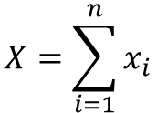


Non-response: $x_{i}=0$
$$X=\sum_{i=1}^{n}{x_{i}}$$
Response: $x_{i}=1$

