Slide 1


Machine Learning and AI Methods
Emily C. Zabor
Department of Quantitative Health Sciences
Ohio Ocular Oncology Symposium
June 7, 2025

Slide 2
Artificial intelligence
Machine learning
Deep learning
Neural networks
Machines that mimic human intelligence and human cognitive functions
Uses algorithms to detect patterns in data
More unstructured and automated form of machine learning
Imitates the function of the human brain to detect relationships

Slide 3
Generative vs predictive AI
Generative AI
Predictive AI
Create something new:
Text
Image
Video
Voice
Unsupervised learning
Predict something based on historical data:
Diagnosis
Prognosis
Supervised or unsupervised

Slide 4
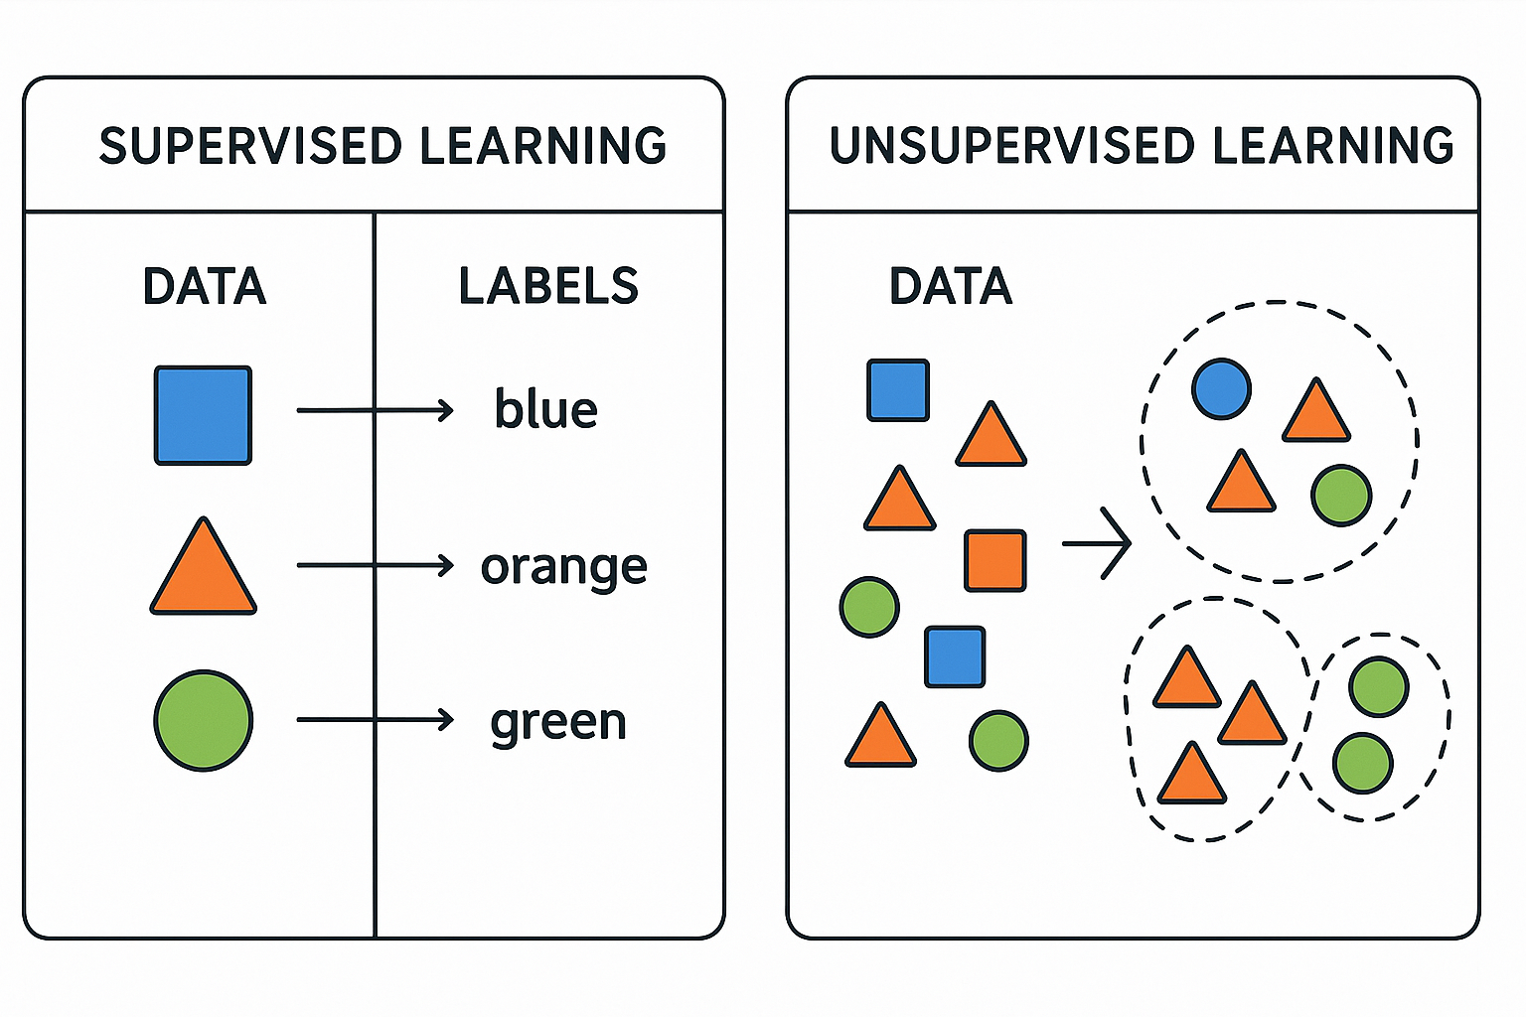
Example of use of generative AI, image created by ChatGPT

Slide 5
Examples of predictive machine learning algorithms
Linear regression
Logistic regression
Decision trees
Random forests
Convoluted neural networks
Support Vector Machines
Gradient Boosting
K-means clustering
Hierarchical clustering
Supervised
Unsupervised

Slide 6
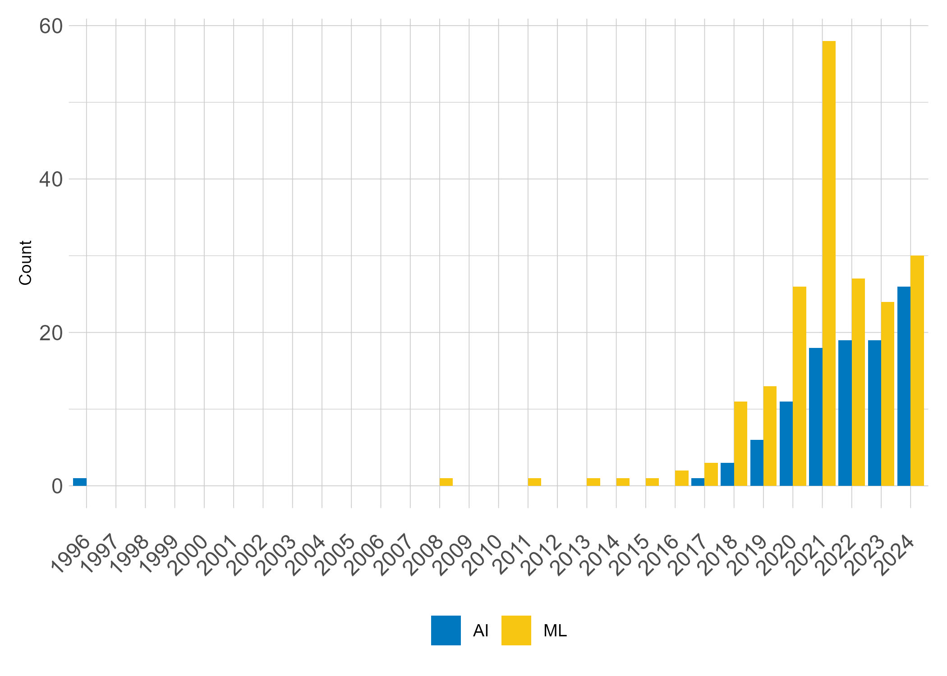
References to AI and ML over time
A (rough) literature review in 3 journals:
Am J Ophthalmology
Br J Ophthalmology
Ophthalmology
Search terms:
Artificial intelligence
AI
Machine learning
ML

Slide 7
Classification = Diagnosis
The majority of these articles are using AI/ML for diagnosis purposes, a classification problem
Commonly used classification methods included:
Neural networks
Deep learning
Random forests
Logistic regression

Slide 8
An early outlier…

Slide 9
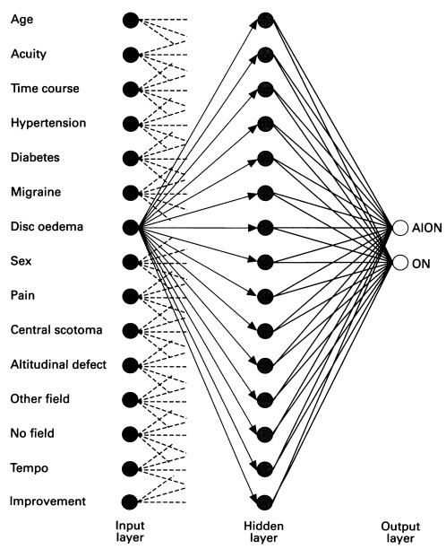
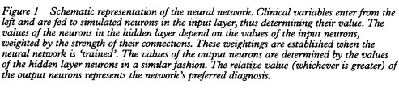
1996: Neural network differentiation of optic neuritis and anterior ischaemic optic neuropathy
Levin LA, Rizzo JF 3rd, Lessell S. Br J Ophthalmol. 1996 Sep;80(9):835-9.

Slide 10
And a big jump in 2021…

Slide 11

Standardization of Uveitis Nomenclature (SUN) Working Group
26 articles
Machine learning using logistic regression
85% training/15% validation for each condition
Goal was classification

Slide 12
Areas for caution
Areas of promise
Only as good as the data they are built on
Black box – e.g. what happens in the hidden layer?
Trade-off of complexity versus interpretation
Ability to handle large quantities of data
Automation of complicated procedures/processes
Better patient care through improved diagnostic and prognostic models

Slide 13

Thank you! Questions?
zabore2@ccf.org

