Slide 1

Software Requirements Specification
KOBA multi-café pre-ordering platform — role dashboards for Super Admin, Branch Admin and Customer
Version 1.0 · November 2026 · Demo build, branch feature/dashboards
Notes:
This deck is the Software Requirements Specification for the KOBA role dashboards. It covers what the system does, how every piece of logic works, and how we verify it. Everything shown runs today on demo data, with no new database tables.

Slide 2
What this specification covers
CONTENTS
01
02
03
Introduction
Overall description
System logic
Purpose, scope and the terms we use
Product, users, environment, constraints
Architecture, access, data, order flow, metrics
04
05
06
Functional requirements
Quality requirements
Verification and roadmap
Screens and what each role can do
Non-functional: security, speed, live, brand
Tests, running the demo, going live
Notes:
Six parts, following the usual SRS structure: introduction, overall description, then the system logic in detail, the functional requirements per role, the quality requirements, and finally verification and the road to production.

Slide 3


Purpose and scope
01 · INTRODUCTION
Purpose
Defines what the KOBA role dashboards must do, how every rule behaves and how it is verified. It is the reference for the demo build and for the move to a production database.
In scope
Three role dashboards behind Jetstream login
Live order handling, kitchen to pickup
KPIs, charts, comparisons and CSV reports
Branch, menu, admin and settings screens
Readers
KOBA management, branch managers, developers and testers.
Out of scope (this release)
Basis
New database tables (demo data only)
Real payment capture and refunds
Changes to the website cart and checkout
SMS and push notifications
The dashboard brief and the Laravel code on branch feature/dashboards.
Notes:
The dashboards sit on top of the existing KOBA website. In scope: the three role dashboards, live order handling, analytics and management screens. Out of scope for this release: a new database, real payments, and any change to the website cart and checkout.

Slide 4
Definitions and abbreviations
01 · INTRODUCTION
Term | Meaning
Pre-order | An order placed ahead and collected at a chosen pickup time
Branch | One KOBA café: Sanford, Bole Atlas or 4 Killo
Super Admin | Platform owner; sees and manages every branch
Branch Admin | Manager of exactly one branch
Prep time | Minutes from placing an order until it is ready
Valid order | Any order that was not cancelled
AOV | Average order value: revenue ÷ valid orders
KPI | Key performance indicator, shown as a card with trend and sparkline
ETB | Ethiopian birr; every price and total
Demo store | Laravel cache that keeps demo changes (file store; array store in tests)
Jetstream / Fortify | Laravel packages for sign-in, registration, profile and two-factor
Notes:
The words used throughout. Note that a valid order means any order that was not cancelled; revenue and averages only count valid orders.

Slide 5






Product perspective
02 · OVERALL DESCRIPTION
Super Admin · /admin
All branches
KOBA website
Jetstream login
Menu, cart and checkout — unchanged
Navbar: Sign in / My account
Fortify sign-in and register
Profile, password, 2FA
/dashboard sends each role home
Branch Admin · /branch
One branch
Customer · /customer
Own orders
Demo data layer
DemoDataService (orders) · DemoCatalog (branches, products, customers) · DemoState (cache) — replaceable by Eloquent queries returning the same shapes
No new tables: only Jetstream's users table is stored in SQLite.
Notes:
The website stays as it is; we only added a Sign in / My account link to its navbar. Jetstream handles login and sends each person to their role dashboard. All three dashboards read from one demo data layer, which is the single seam to replace when real data arrives.

Slide 6



User classes and their reach
02 · OVERALL DESCRIPTION
Super Admin
Branch Admin
Customer
superadmin@test.com
Meron Alemu
branchadmin@test.com
Abel Tesfaye · Bole Atlas
customer@test.com
Selam Tesfaye
Scope: all branches
Scope: one branch
Scope: own orders
Compare branches and trends
Manage branches and their admins
Menu, commission and settings
Payments, revenue, CSV reports
Run the live orders board
Move orders to the next status
Menu availability and pickups
Open, pause or close the branch
Track the active order live
Order history and reorder
Pickups and favourite cafés
Notifications and profile
Notes:
Three roles, each with a demo account. The Super Admin sees everything. A Branch Admin is tied to one branch and can never see another. A Customer sees only their own orders.

Slide 7
Operating environment and constraints
02 · OVERALL DESCRIPTION
Operating environment
Design constraints
SERVER
Laravel 12 · PHP 8.2
C1
No new database design: dashboards run on generated demo data.
DATABASE
SQLite (Jetstream users only)
SIGN-IN
Jetstream 5 (Livewire) + Fortify
C2
Website cart and checkout logic stay unchanged.
INTERFACE
Blade · Tailwind CSS v4 · Alpine.js
C3
New front-end libraries limited to ApexCharts, Alpine and Lucide.
CHARTS
ApexCharts 4, loaded on demand
C4
Demo accounts and seeder work only in local and testing.
ICONS
Lucide
TESTS
PHPUnit 11
C5
Access is enforced on the server, never by hiding links.
LOCALE
Africa/Addis_Ababa time · ETB
C6
Demo payments are labelled; never shown as real money.
Notes:
The stack is the existing KOBA Laravel application. The constraints came from the brief: no new database design, do not touch cart or checkout, only three new front-end libraries, demo logins only on local machines, and access control on the server.

Slide 8

Assumptions and the demo data set
02 · OVERALL DESCRIPTION
3
39
7
Branches
Products
Categories
160
120
4
Customers
Days of history
Payment methods
Going live keeps the order shape: replace DemoDataService calls with Eloquent queries. Views, charts and JSON endpoints do not change.
Notes:
The demo catalogue mirrors the real KOBA menu and branches. The key assumption: the order shape stays the same when real data arrives, so only the data layer changes. Bole Atlas is the busiest branch in the demo, 4 Killo the quietest.

Slide 9
Architecture in five layers
03 · SYSTEM LOGIC
Browser
Blade + Alpine
Blade pages · Alpine.js components · ApexCharts (lazy) · Lucide icons · command palette (Ctrl K) · polls every 15 s while the tab is visible
Routes
auth + role
Jetstream session → role:super_admin | branch_admin | customer · 62 named routes in routes/admin.php, branch.php, customer.php
Controllers
thin
Return the page, or JSON when the request asks for JSON (chart refreshes, tables, live feeds, status changes)
Services
logic
Admin / Branch / Customer DashboardService · OrderPresenter · DateRange · Metrics · TableQuery · Csv · Navigation
Demo data
one seam
DemoDataService (orders) · DemoCatalog (reference data) · DemoState (Laravel cache: file store, array store in tests)
Notes:
A request goes top to bottom. The browser asks for a page or JSON; routes check login and role; thin controllers call a dashboard service; services use the support classes and the presenter; and everything reads from the demo data layer.

Slide 10

Login and role routing
03 · SYSTEM LOGIC
1
2
3
4
5
Sign in
Go home
Find the role
Redirect
Check each request
/login with email and password (Fortify)
/dashboard runs HomeRedirectController
By email in config/dashboard.php; anyone else is a Customer
To /admin, /branch or /customer dashboard
Wrong role → 403; inactive branch admin → 403
Guests are sent to /login. Profile, password and two-factor settings use the Jetstream screens. Sign out sits in the top-right account menu and at the bottom of the sidebar.
Notes:
Everyone signs in on the same Jetstream page. The /dashboard address then looks up the role and redirects. The role comes from config/dashboard.php by email, only in local and testing; any other account is a customer. Every later request is checked again by the role middleware.

Slide 11
Branch isolation is enforced on the server
03 · SYSTEM LOGIC
The branch is read from the signed-in admin — never from the URL or a form.
Abel · Branch Admin, Bole Atlas
GET /branch/orders/ORD-2026-122405
Every lookup is scoped: findOrder(id, branch) cannot see other branches.
Another branch's order → 404. Another role's page → 403.
findOrder(id, 'bole-atlas')
Searches Bole Atlas orders only
Menus hide pages a role can't use, but middleware is what enforces access.
404 Not found
Order 122405 belongs to Sanford, so it does not exist for this admin
Proven by BranchIsolationTest and RoleAccessTest.
Notes:
A branch admin can never reach another branch's data, even by typing an order number into the address bar. The branch always comes from the signed-in user, and every lookup is scoped, so the other branch's order simply does not exist for them.

Slide 12
How the demo orders are generated
03 · SYSTEM LOGIC
STABLE HISTORY
Seed = version | date | branch (Mersenne Twister), so a past day always returns the same orders.
ORDERS PER DAY
Branch volume × weekday factor (Mon 0.90 → Sat 1.30) × seasonal trend × random 0.85–1.15, max 98.
BASKET
1–4 lines (38 / 36 / 18 / 8 %); products weighted by popularity and by time of day.
PREP MINUTES
9 + 1.8 × lines + 4 at rush hours (08, 09, 12, 13) + kitchen offset ± random, kept within 6–34.
MIX
32 % scheduled 1–5 h ahead · 4 % cancelled · 35 % rated · 85 % from the branch's regulars.
Notes:
There is no orders table, so orders are generated. The generator is seeded by date and branch, which means a past day always shows the same orders. Volumes follow the weekday and a slow seasonal swing; baskets and prep times follow simple, realistic rules. The chart shows the hourly demand weights: breakfast and lunch peaks.

Slide 13

Order lifecycle
03 · SYSTEM LOGIC
Customer placed it; waits for the kitchen.
Kitchen accepted it; ETA = pickup − 3 min.
Waiting at the counter.
Collected; a rating may follow.
New
pending
Preparing
preparing
Ready
ready
Picked up
completed
Cancelled
cancelled
Cancel is allowed only while an order is New or Preparing. Its payment then shows Refunded (digital) or Void (cash).
Checked on the server: PATCH /branch/orders/{id}/status accepts only the next status, or "cancelled" before Ready. Anything else is rejected (422) with a clear message.
Notes:
Four steps in a fixed order: New, Preparing, Ready, Picked up. An order can only move one step forward. It can be cancelled only while it is New or Preparing. The server enforces this, not just the buttons.

Slide 14
How today's orders move by themselves
03 · SYSTEM LOGIC
Placed
order appears on the board
Ready
pickup − 3 min
Picked up
pickup + 0–13 min
New
Preparing
Ready
Done
Accepted
max(placed + 4 min, pickup − prep − 4 min)
Pickup time
chosen by the customer
Today's orders appear only after their placement time has passed.
A cancelled order shows as New for 8 minutes, then Cancelled.
An admin's change wins only if it moves the order further on, or cancels it.
Past days are fixed: every order ended Picked up or Cancelled.
Notes:
So the boards feel alive without staff clicking, every one of today's orders moves with the clock. The times come from the order itself: placed time, prep minutes and pickup time. If an admin moves an order, that change wins, but only when it is further along than the clock.

Slide 15
One change, seen by every role
03 · SYSTEM LOGIC
Who changes it
Who sees it
Branch admin
Moves or simulates orders, opens or pauses the branch, switches stock
Branch live board
Feed polls every 15 s; new orders chime
Shared demo store
Customer
Places a demo order, saves favourites, reads notifications
overrides:{date}
extra-orders:{date}
branch-status:{branch}
settings, favourites…
Customer tracker
Polls every 15 s; timeline and ETA move
Super admin
Edits branches, admins, products and settings
Super admin
Overview, alerts and tables refresh
Laravel cache (file)
Polling pauses while the tab is hidden. Every request rebuilds today from the clock plus stored changes.
Notes:
This is what makes the three dashboards feel connected. Any change is written to the shared demo store. Each page polls every 15 seconds and rebuilds today from the clock plus those stored changes, so the kitchen, the customer and the super admin always agree.

Slide 16



Payment status and money rules
03 · SYSTEM LOGIC
Order state | Cash on pickup | Telebirr · CBE Birr · Chapa
Picked up | Paid | Paid
New, Preparing or Ready | Due | Paid
Cancelled | Void | Refunded
Reference: TX- + first 8 characters of md5(order id).
Commission 8 % by default (0–30 %); branch net = gross × (1 − rate).
Every payments page shows a Demo data badge — no real money moves.
Notes:
Payment status is derived, not stored. Cash is due until the order is picked up. Digital payments are paid at once and refunded if the order is cancelled. Every payment page carries a Demo data badge: no real money moves in this release.

Slide 17

Date ranges and fair comparisons
03 · SYSTEM LOGIC
Today
7 days
30 days
This month
Custom
Range | Chart buckets | Compared with
Today | Hourly, 06:00–22:00 | Yesterday, counting only orders placed by this time yesterday
7 days | Daily | The 7 days before
30 days | Daily | The 30 days before
This month | Daily, from the 1st | The same number of days before ("vs last month")
Custom | Daily, up to 60 days, ending today at the latest | The equal period before; invalid dates fall back to 7 days
Charts draw the previous period as a neutral dashed line. KPI arrows turn green or red; for prep time and cancellations, lower counts as better.
Notes:
Every analytics page shares one filter. Each range is compared with the period of equal length just before it. The interesting case is Today: at 10:30 we compare with orders placed by 10:30 yesterday, not the whole of yesterday, otherwise every morning would look like a collapse.

Slide 18
KPI and metric formulas
03 · SYSTEM LOGIC
Revenue
Orders
Avg. order value
Avg. prep time
Σ totals of valid orders
Count of orders in the range
Revenue ÷ valid orders
Mean prep of Ready and Picked up orders
Cancelled orders excluded
Placed by pickup time
In ETB
Lower is better
Cancellation rate
Rating
Change %
Commission
Cancelled ÷ all orders × 100
Mean of the ratings given (1–5)
(current − previous) ÷ previous × 100
Revenue × rate (8 % default)
Lower is better
One decimal
Hidden when previous is 0
Branch net = gross − commission
Notes:
All figures come from one small Metrics class, so every dashboard counts the same way. Cancelled orders never count towards revenue or averages. Change percentages are hidden when the previous period was zero, rather than showing a misleading infinity.

Slide 19

Alerts and stock rules
03 · SYSTEM LOGIC
Late orders
New or Preparing after the pickup time
Danger
Stock and availability
Branch paused or closed
Customers can't pre-order there
Each branch, each day: 3 items low (2–6 left) and 1 sold out, fixed per date.
Branch admin switches items on or off for their branch.
Super admin hides an item on every branch.
Available = active · not switched off · not sold out.
Warning
Slow kitchen
Today's average prep > target + 1 min (target 15)
Warning
Items running low
Any product low or sold out at a branch
Info
Alerts feed the super admin's bell and overview; each one links to that branch's page.
Notes:
The super admin's bell is driven by four simple rules checked across every branch. Stock in the demo is generated per day: three items run low and one sells out at each branch. Availability combines three switches.

Slide 20
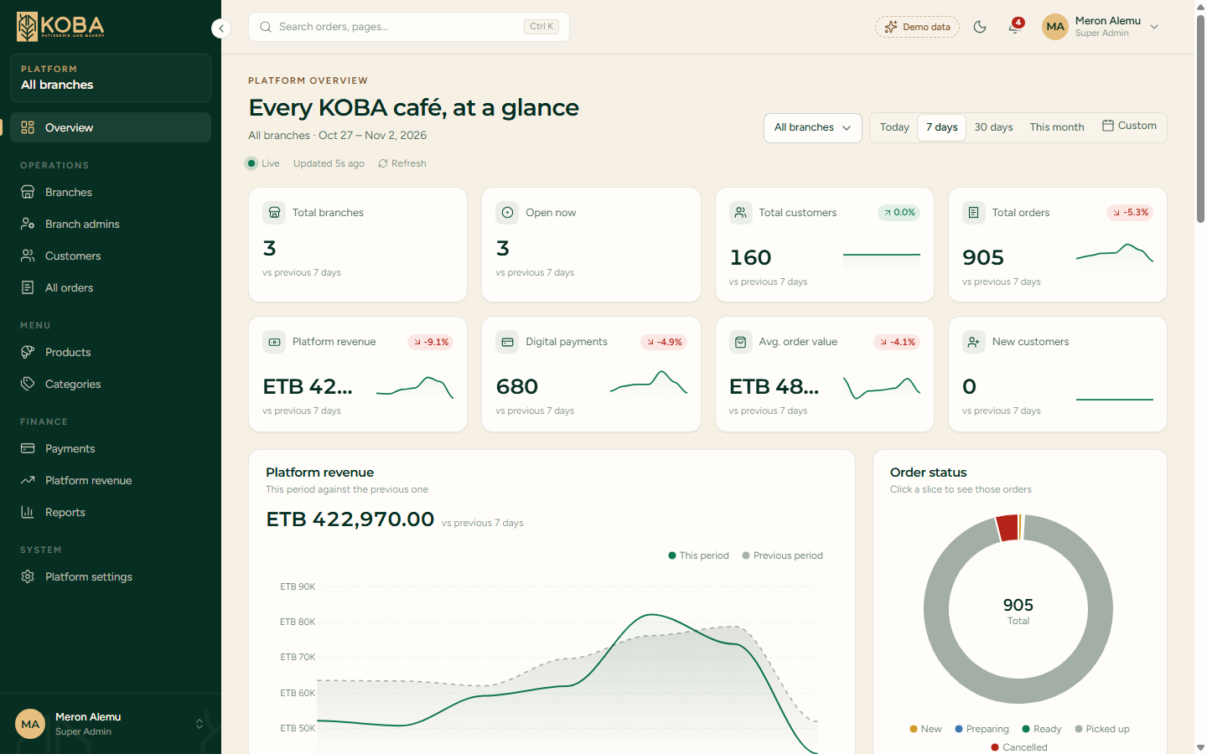
Super Admin: the whole platform at a glance
04 · FUNCTIONAL REQUIREMENTS
1
Filters
1
Today to custom range; all branches or one.
2
2
Eight KPI cards
Change vs previous period, with sparkline.
3
Revenue trend
3
4
This period against the previous one (dashed).
4
Order status
Click a slice to open those orders.
Notes:
The super admin overview. Every number on this page responds to the date and branch filter, and refreshes on its own while the range includes today.

Slide 21
Super Admin requirements
04 · FUNCTIONAL REQUIREMENTS
ID | The system shall… | Page
FR-A01 | Show 8 KPI cards with change vs the previous period and a sparkline | Overview
FR-A02 | Chart revenue, orders by branch, status mix, heatmap, categories, payments | Overview
FR-A03 | Rank branches and list live alerts; a click opens the branch | Overview
FR-A04 | Create branches; edit name, phone, manager; set open, paused, closed | Branches
FR-A05 | Assign branch admins to a branch; activate or deactivate them | Branch admins
FR-A06 | Search, filter and sort every customer and every order | Customers, All orders
FR-A07 | Activate or hide products on all branches; list categories | Products, Categories
FR-A08 | Show payment methods, transactions, commission and branch payouts | Payments, Revenue
FR-A09 | Download CSV reports for any date range | Reports
FR-A10 | Edit platform name, commission, hours, prep target, slot length | Settings
Notes:
Ten requirements for the platform owner, grouped by page. Everything here is wired to the demo store, so changes are visible immediately to the other roles.

Slide 22
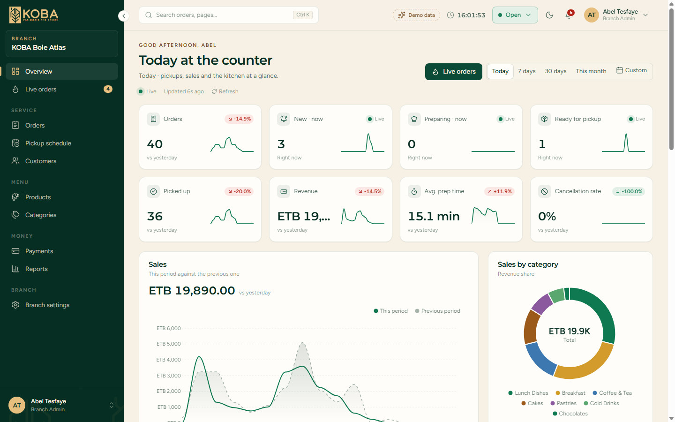
Branch Admin: today at the counter
04 · FUNCTIONAL REQUIREMENTS
1
Open, pause or close
1
Controls whether customers can pre-order here.
2
2
Live counts
New, Preparing and Ready right now.
3
Sales vs yesterday
3
4
Hourly when the range is Today.
4
Sales by category
Revenue share of each menu category.
Notes:
The branch overview for Bole Atlas. The status button in the top bar is the branch's on/off switch for pre-orders. The live cards show what is in the kitchen this minute.

Slide 23
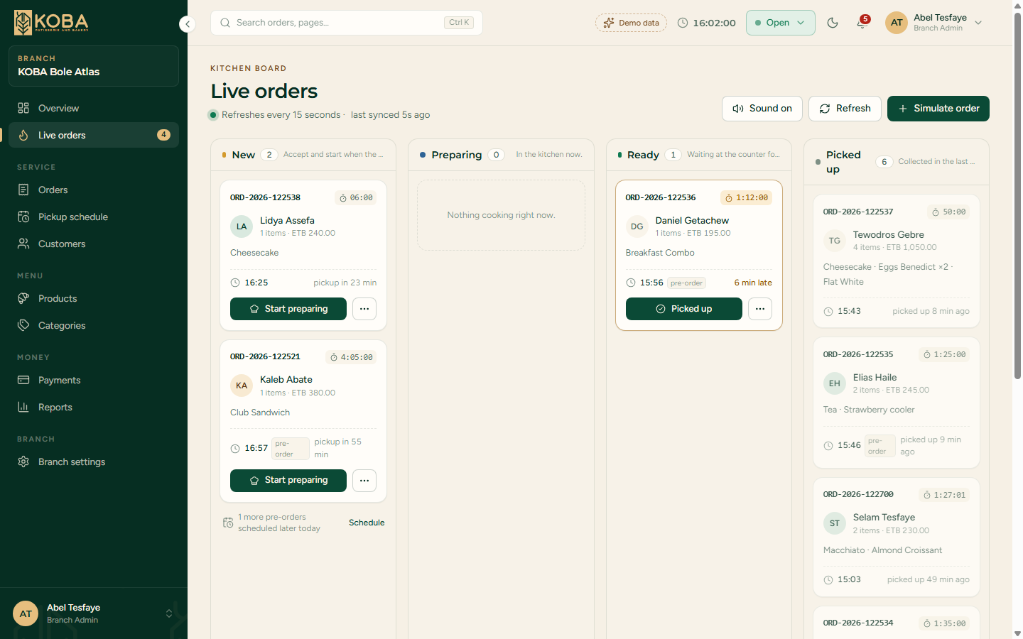
Branch Admin: the live orders board
04 · FUNCTIONAL REQUIREMENTS
1
Four columns
4
New, Preparing, Ready, Picked up.
1
2
One click to the next step
3
"…" opens details or cancels.
2
3
Pickup countdown
Amber 5 min before pickup, red when late.
4
Simulate and sound
Add a demo order; a chime marks new ones.
Notes:
This is the kitchen's main screen. It refreshes every 15 seconds. Moving a card updates immediately on screen and on the server, and the customer's tracker follows on its next refresh.

Slide 24
Branch Admin requirements
04 · FUNCTIONAL REQUIREMENTS
ID | The system shall… | Page
FR-B01 | Show KPIs: orders, live status counts, revenue, prep time, cancellations | Overview
FR-B02 | Chart sales, busy hours, top products, categories, prep vs target | Overview
FR-B03 | Show a live board New → Preparing → Ready → Picked up, refreshed every 15 s | Live orders
FR-B04 | Chime and highlight new orders; amber near pickup, red when late | Live orders
FR-B05 | Move an order one step forward, or cancel it before Ready | Live orders, Orders
FR-B06 | List orders with search, filters, a details drawer and a printable receipt | Orders
FR-B07 | Switch products on or off; reorder menu categories | Products, Categories
FR-B08 | Show the pickup schedule by time slot with the load per slot | Pickup schedule
FR-B09 | List branch customers, payments (cash still due) and CSV reports | Customers, Payments
FR-B10 | Open, pause or close pre-orders from the top bar | Every page
FR-B11 | Edit hours, prep target, slot length, max per slot, auto-accept | Settings
FR-B12 | Add a simulated order to test the flow | Live orders
Notes:
Twelve requirements for the branch manager. All of them work only on the admin's own branch, which the server takes from the signed-in user.

Slide 25
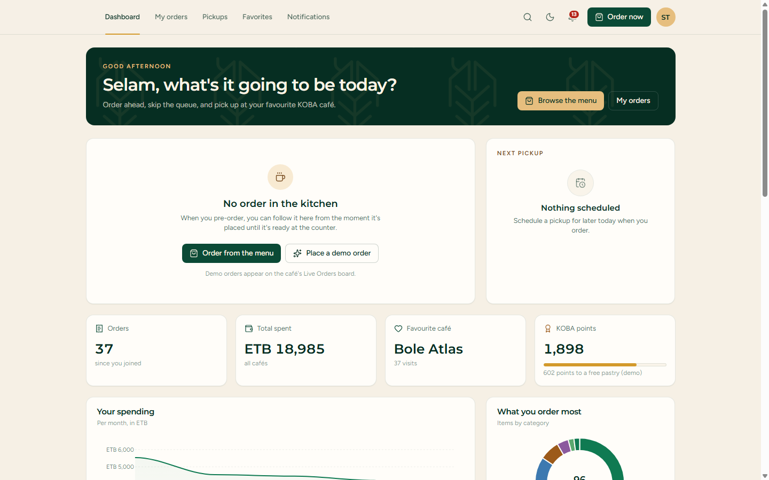
Customer: my orders and pickups
04 · FUNCTIONAL REQUIREMENTS
1
Kitchen tracker
Follows the active order live, or places a demo order.
1
2
2
Next pickup
The next scheduled pickup and its café.
3
Personal stats
3
Orders, spent, favourite café, KOBA points.
4
Spending charts
4
Per month, and what you order most.
Notes:
The customer's home. When an order is in the kitchen, the tracker shows its timeline and ready time and updates every 15 seconds. Points are one per ETB 10 spent, shown as demo only.

Slide 26
Customer requirements
04 · FUNCTIONAL REQUIREMENTS
ID | The system shall… | Page
FR-C01 | Track the active order: timeline, ready time and branch; refresh every 15 s | Dashboard
FR-C02 | Show orders, total spent, favourite café and KOBA points (1 per ETB 10) | Dashboard
FR-C03 | List order history with details; reorder into the website cart | My orders
FR-C04 | List upcoming pickups with branch address and map link | Pickups
FR-C05 | Save favourite cafés and products | Favorites
FR-C06 | Show order notifications; mark all as read | Notifications
FR-C07 | Place a demo order at a favourite open café (one active order at a time) | Dashboard
FR-C08 | Show only the customer's own orders; any other order → 404 | Every page
Notes:
Eight requirements for customers. Reorder writes straight into the website's existing cart, so we did not have to change checkout.

Slide 27







Shared across every dashboard
04 · FUNCTIONAL REQUIREMENTS
Command palette
Dark mode
Smart tables
Clickable charts
Ctrl K jumps to any page or order
Remembered in this browser
Search, filter, sort, paginate, export CSV
Click a bar or slice to filter or drill in
Notifications
Profile
Sign out
Responsive
Bell with live counts and alerts
Name, email and password via Fortify
Top-right account menu and sidebar
Drawer sidebar and phone tab bar
Notes:
These features are built once and appear in all three dashboards, so the experience is consistent whichever role you sign in as.

Slide 28
Input validation rules
04 · FUNCTIONAL REQUIREMENTS
Input | Rule
Order status | Required; only the next status, or "cancelled" while New or Preparing
Branch status | One of open, paused, closed
Opening hours | HH:MM; closing time after opening time (weekday and weekend)
Prep target | Whole minutes, 5–60
Pickup slots | Slot length 10, 15, 20 or 30 min; 1–60 orders per slot
Commission | 0–30 %; currency ETB only; support email must be valid
Product switches | Available / active must be true or false
Category order | Only known category keys
Favourites | Type branch or product; the value must exist
Branch admin | Known admin email, existing branch, active true or false
Profile | Name ≤ 255 characters, unique email; current password to change it
Notes:
Every form and action is validated on the server with Laravel rules. The browser checks are only for convenience.

Slide 29
Pages and routes inventory
04 · FUNCTIONAL REQUIREMENTS
62
29
3
15 s
Named routes
Pages
Roles
Live refresh
Super Admin · 12 pages
Branch Admin · 11 pages
Customer · 5 pages
Overview
Branches
Branch detail
Branch admins
Customers
All orders
Products
Categories
Payments
Revenue
Reports
Settings
Overview
Live orders
Orders
Receipt
Products
Categories
Pickups
Customers
Payments
Reports
Settings
Dashboard
My orders
Pickups
Favorites
Notifications
Profile (all roles)
Notes:
The full map of what was built: 62 routes, 29 pages across three roles, all refreshing live every 15 seconds where it matters.

Slide 30





Quality requirements
05 · NON-FUNCTIONAL REQUIREMENTS
Security
Performance
Live updates
Role middleware on every route, branch scoping, CSRF, server validation, hashed passwords, demo logins local only.
Past days cached once per date; ApexCharts loads only on pages with charts; JSON for refreshes.
15 s polling, paused when the tab is hidden; KPI numbers animate; new-order chime.
Usability
Reliability
Maintainability
Keyboard and screen-reader labels, reduced-motion support, light and dark themes, phone layouts.
Deterministic data: a day always shows the same orders; changes survive page reloads.
Thin controllers, one data seam, shared Blade components and chart options.
Notes:
Beyond features: security first, then speed, live behaviour, usability, reliability and ease of change. Each item here is implemented in the demo, not just planned.

Slide 31
Brand and interface rules
05 · NON-FUNCTIONAL REQUIREMENTS
Brand colours
Type
Montserrat headings and numbers
Figtree body text
Noto Sans Ethiopic Amharic
Forest
#062E22
Green
#006A47
Sand
#E6BE7E
Brown
#7A4E22
Cream
#FFF5E6
Rules
Chart colours · light / dark
KOBA logo, photos and palette on every dashboard
Dark-green sidebar, cream canvas, sand accents
Same components across all three roles
Light and dark themes, both checked for contrast
The previous period is always a neutral dashed series.
Notes:
The brief asked for a professional dashboard that looks like KOBA, not a generic template. So the dashboards use the KOBA logo, photography, palette and fonts. Chart colours were checked for contrast in light and dark mode.

Slide 32

Testing and acceptance
06 · VERIFICATION
86
330
43
7
Tests passed
Assertions
Dashboard tests
Skipped by design
RoleAccessTest
BranchIsolationTest
PagesRenderTest
Each role lands on its own dashboard
New sign-ups are customers
Other roles' pages → 403; guests → login
Deactivated branch admin is locked out
Demo roles ignored outside local/testing
Opens its own branch's orders
Other branch's order → 404, can't update
Status moves one step; super admin sees it
Feeds hold only the admin's branch
Customers see only their own orders
Every admin page renders
Every branch page renders
Every customer page renders
Branch detail and JSON endpoints answer
Notes:
The full suite passes: 86 tests and 330 assertions, 43 of them for the dashboards. The 7 skipped tests belong to Jetstream features this project has switched off, such as API tokens. The three dashboard test files map directly to the riskiest requirements: who can see what.

Slide 33
Running the demo
06 · VERIFICATION
Demo accounts
Set up
Email | Lands on
superadmin@test.com | /admin/dashboard
branchadmin@test.com | /branch/dashboard (Bole Atlas)
customer@test.com | /customer/dashboard
composer install && npm install
php artisan migrate
php artisan db:seed --class=DemoUserSeeder
npm run build # or: npm run dev
php artisan serve
Password: Password123!
Local and testing only. The seeder refuses to run elsewhere, and demo roles are ignored in production.
Then open http://127.0.0.1:8000/login
Notes:
Five commands from a fresh checkout. The demo user seeder only runs in the local environment. All three demo accounts share the same password, which works only on local and testing machines, never in production.

Slide 34
From demo to production
06 · ROADMAP
1
Real tables
2
Roles in the database
Orders, order items, branches and products; Eloquent queries return the same shapes as DemoDataService.
Role and branch columns on users replace the config/dashboard.php email map.
3
Payments
4
Checkout connection
Telebirr, CBE Birr and Chapa with webhooks; real refunds; reconciled payouts.
Website checkout creates real orders for the branch boards.
5
Push instead of polling
6
Notifications and audit
Laravel Reverb (websockets) for instant board and tracker updates.
SMS or push to customers; a log of every status change.
Notes:
The demo was built so that going live is mostly a data-layer swap. The order of work: real tables first, then roles in the database, then payments and checkout integration, and finally push updates and notifications.

Slide 35

Questions and discussion
Three dashboards, one live picture of every KOBA café — ready to connect to real data.
Notes:
To close: the dashboards run end to end on demo data today, all tests pass, and the path to production is mostly swapping the data layer. Happy to take questions or walk through any screen live.

