Slide 1
Application of ML Models for Brain Cancer Predictions
By,
Junaid Imam, Shivani D., Zachary Webel
Notes:
Shivani

Slide 2

Brain Cancer Facts
There are over 120 types of brain cancer
Not all tumors are cancerous but benign ones can be harmful based on their location
Symptoms:
Headaches
Seizures
Memory Loss
Confusion/Disorientation
Vision changes
Our Project Focuses on Glioblastoma, Astrocytoma, Oligodendroglioma
Notes:
Shivani

Slide 3
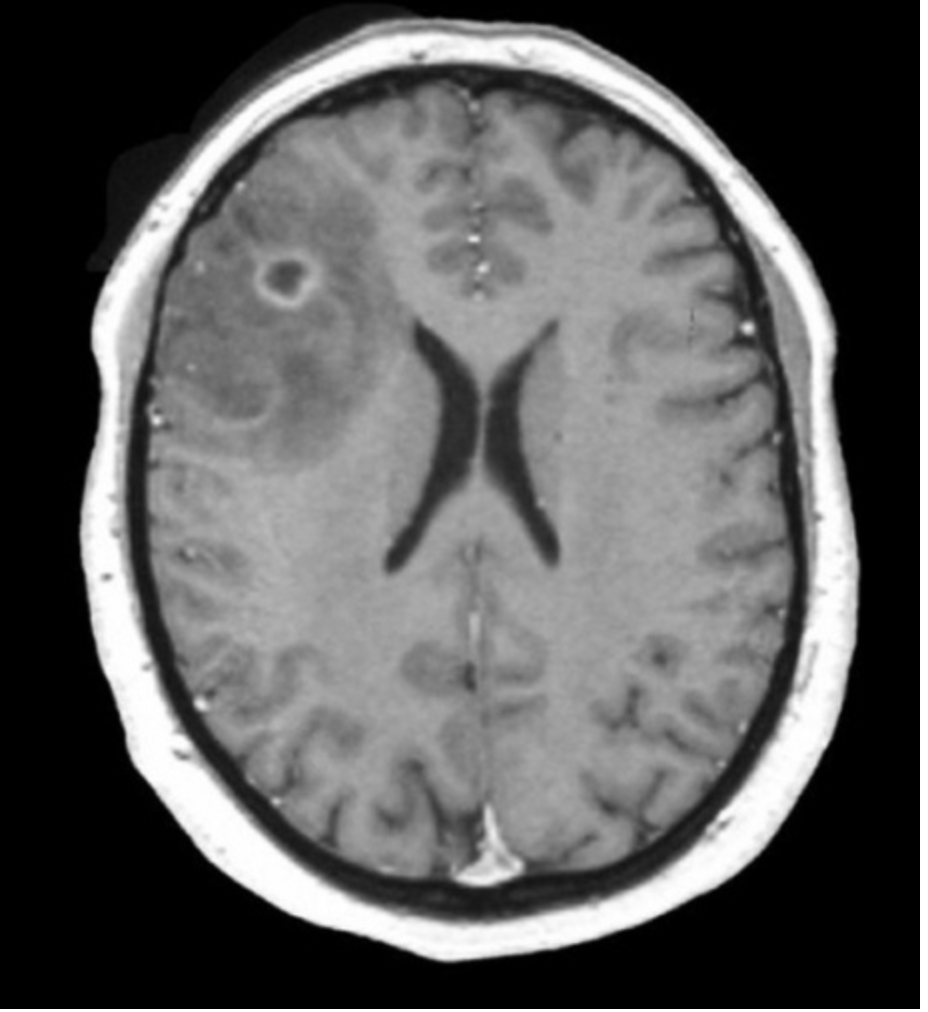
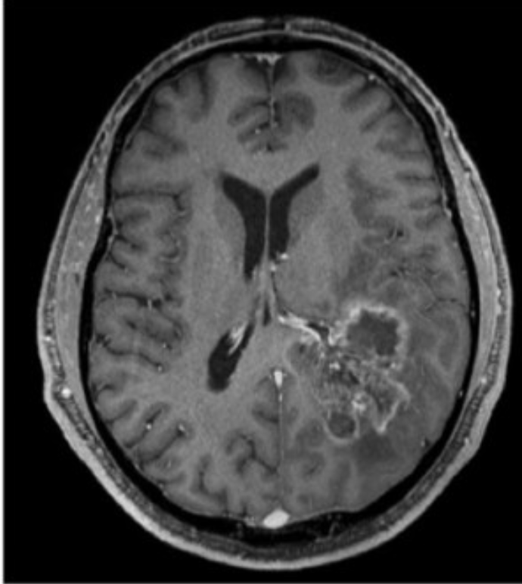
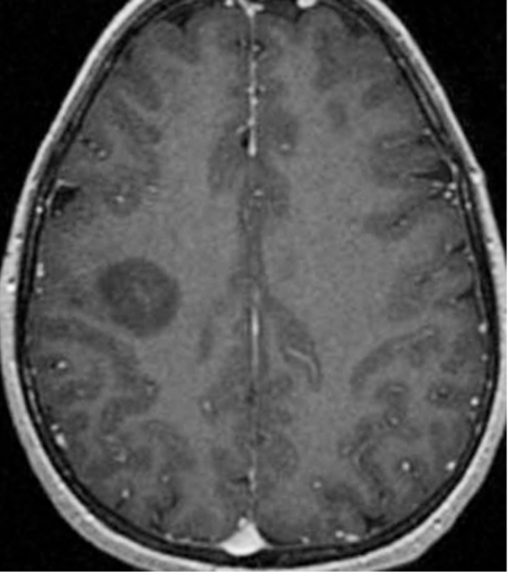
Images of Each type of Cancer
Oligodendroglioma: T1 Modality
Glioblastoma: T1 Modality
Astrocytoma–Diffuse: T1 Modality
Notes:
Shivani

Slide 4
Types of Cancer: Little Biology Explanation
Oligodendroglioma
CNS(Central Nervous System) Tumor → begins in Brainstem or Spinal Cord
On MRI it looks like a single tumor with well defined borders
Grade II is benign while Grade III is malignant
5 year survival rate is 74.1%
Astrocytoma
CNS Tumor which starts from astrocytes that support the nerve cells
Has all 4 grades of tumor classes
A Grade 4 is called GBM
Glioblastoma(GBM)
A CNS tumor that starts out as Astrocytoma and over time turns into this
Can be de novo or start from an Astrocytoma
Survival rate is 40% after 1st year and 17% after 2nd year
Notes:
Shivani

Slide 5
Our Goal and Data We Used
Task 1: Utilized Imaging Data from the REMBRANT collection of 64 patients
Task 2: Used CSV files from TCGA PyRadiomics Data and Clinical Data
Task 3: Took Task 2 Data and applied it to a ML model and used task 1 data as validation for accurate results
Looked for Disease type i.e. types of cancer
Task 4: Used Ground Truth files and predicted how accurate our ML models were in classifying the right type of Cancer for the patient
Notes:
Shivani

Slide 6
Our Process: Task 1
Goal: Extract PyRadiomics Features from REMBRANT Data
Data Given:
All 4 modalities of MRI images and their output labels from GLISTERBOOST
We chose T1 modality for this project
Result
Each of the 64 patients had 129 features that were Extracted
Saved into a CSV file for future use
Notes:
Shivani

Slide 7
Our Process: Task 2
Processing TCGA Brain Cancer MRI dataset
Dropped Metadata Columns
Removed any cases where no cancer outcome was defined
Removed samples with NA rows
Dropped all samples with Oligoastrocytoma as the outcome
Created training and validation sets
Created a label map: {'Astrocytoma': 0, 'GBM': 1, 'Oligoastrocytoma': 2, 'Oligodendroglioma': 3}
Notes:
Junaid will go over this

Slide 8
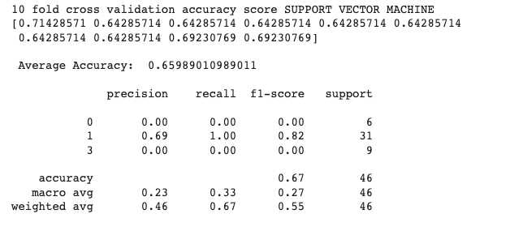
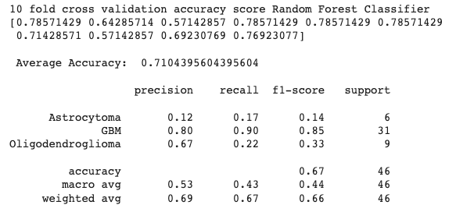
Our Process: Task 2
Notes:
Junaid will go over this

Slide 9

Our Process: Task 2
Notes:
Junaid will go over this

Slide 10
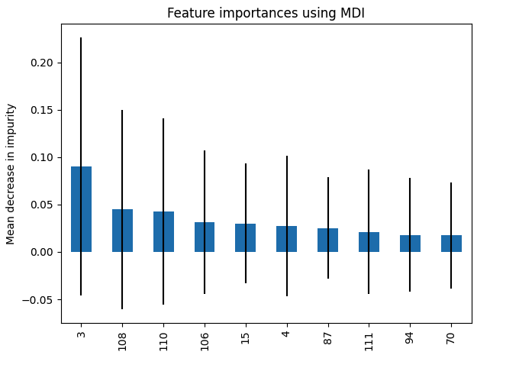
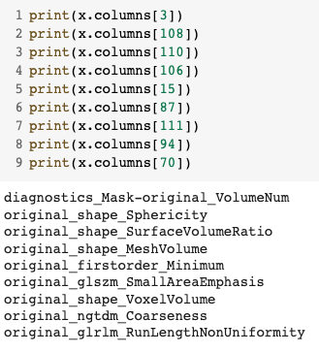
Our Process: Task 2
Notes:
Junaid will go over this

Slide 11
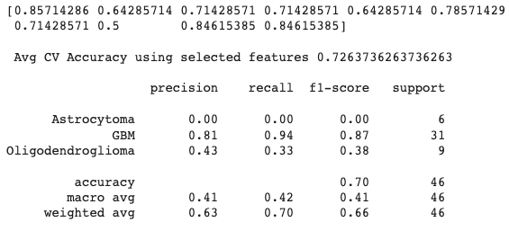
Our Process: Task 2
Slight increase in avg cv accuracy
Notes:
Junaid will go over this

Slide 12
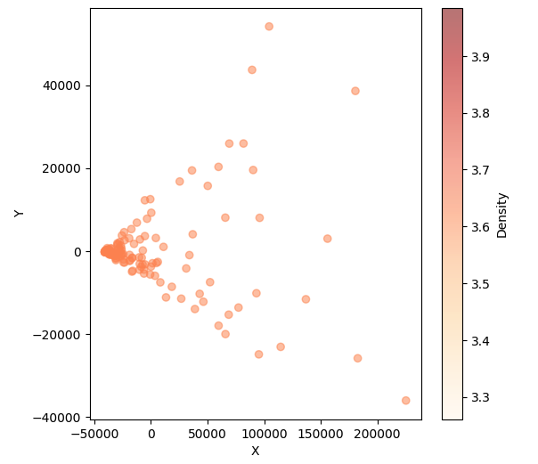
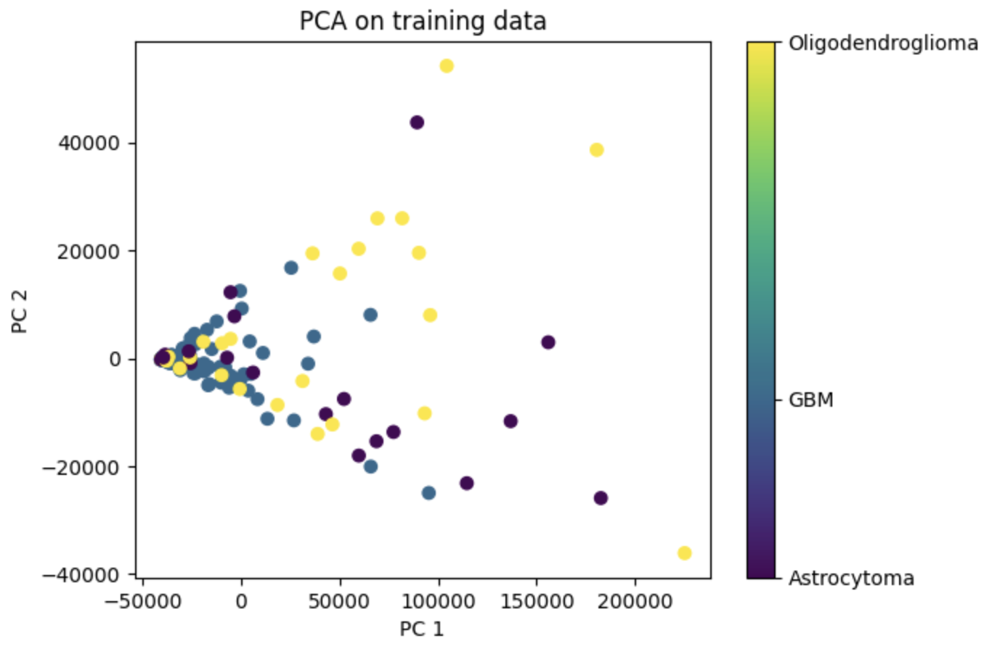
Notes:
Junaid will go over this

Slide 13
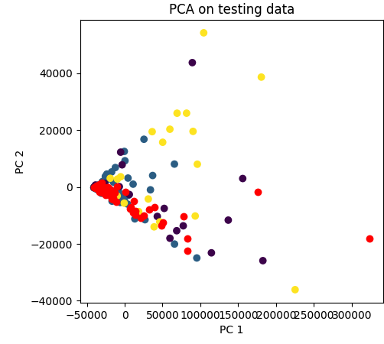
Notes:
Junaid will go over this

Slide 14

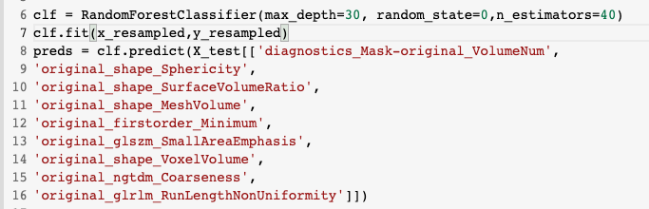
Our Process: Task 3
Notes:
Zac

Slide 15
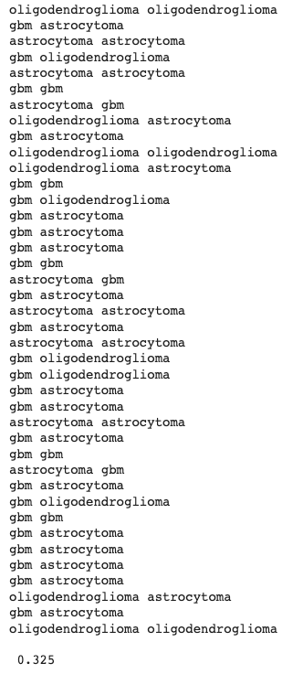
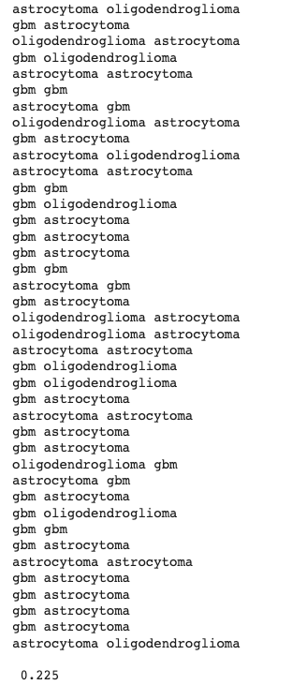
Our Process: Task 4
Procedure:
Load saved models
Dropped and reordered columns in Rembrandt Dataset.
Evaluated against ground truth values
Notes:
Zac

Slide 16
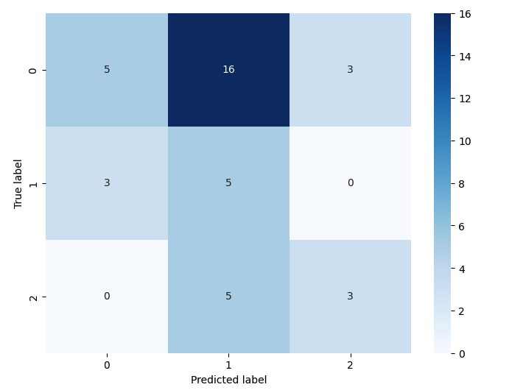
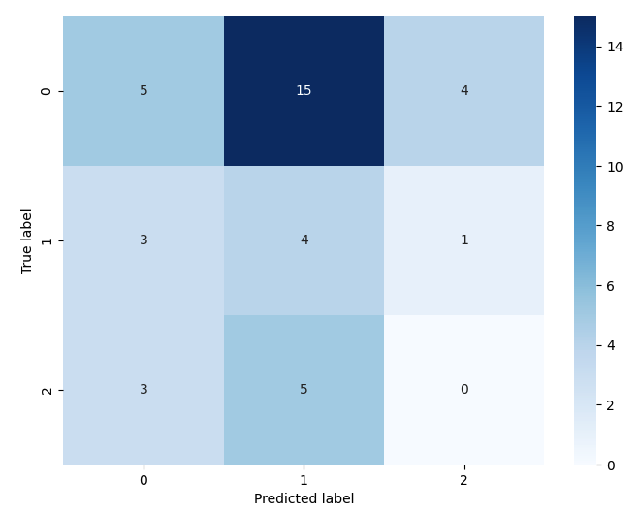
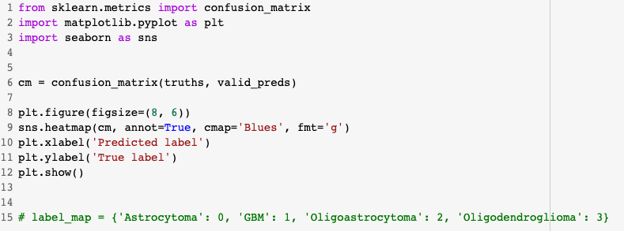
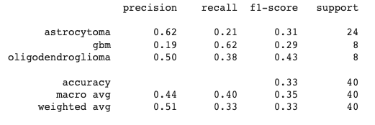
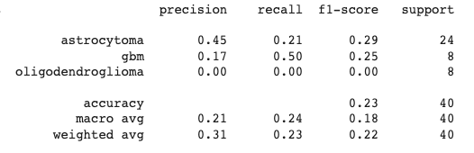
Random Forest: 32.5% Accuracy
SVM: 22.5% Accuracy
Notes:
Zac

Slide 17
Features and Biological Meanings
Features extracted from Radiomics Data are divided into 4 Sub-Categories
Shape
Describes the overall look of the tumor
Gives information like volume, max diameter, and surface area etc.
1st order Statistics
Describes voxels that are extracted independent from any spatial relationship
Has histogram properties
2nd order Statistics
Textural features i.e what the tumor texture would look like
Calculated by the statistical relationship between neighboring voxels
For our purposes anything that says grey-level
Higher Order Statistics
Helps to identify repetitive and non repetitive patterns, suppressing noise or highlighting important features
Obtained after applying filters or transformations to the images
Notes:
Shivani

Slide 18
Features and Biological Meanings
Diagnostics_Mask-original_VolumeNum
Volume of the tumor and any features that are extracted from the tumor itself while passing the image through the ML program
Original_shape_surfacevolumeratio
Shape feature which will interpret the surface area and volume of the tumor based on the voxels present
Orignal_shape_sphericity
3D feature of the tumor that describes the shape of the ROI from a sphere or circle.
Least affected by volume changes in tumor growth however segmentation method changes the value
The Radiomics feature is independent of scale and orientation
Has prognostic value
Notes:
Shivani

Slide 19
Features and Biological Meanings
Original_firstorder_minimum
Represent histogram based distributions, so your regular descriptive statistics
Most reproducible features
Minimum = least amount of space between neighboring voxels
Original_shape_VoxelVolume
Texture feature of Radiomics
Homogenous texture results in flatter voxels
Explains morphology of tumors
Affects the results of feature extraction
Original_gldm_LargeDependenceHighGrayLevelEmphasis
Gradient feature
Most frequently reproducible → shows up a lot during analysis
Represents the heterogeneity and homogeneity of the tumor
Original_ngtdm_coarseness
Independent predictor of the patients survival
Captures spacial changes in gray level intensity
Notes:
Shivani

Slide 20
Features and Biological Meanings
Original_shape_MeshVolume
Volume of the tumor that is calculated using a triangle mesh or filter placed on top of the tumor
The volume of the tumor is important to note because it allows the radiologist to see how big the tumor is
Original_glrlrm_RunLengthNonUniformity
Lower score for this indicate homogeneity in tumors
Associated with intracellular communication which leads to tumors growing and spreading
Original_glszm_SmallAreaEmphasis
This feature is associated with cellular hypoxia and protein metabolism
This will help in analysing how fast the tumor is growing which helps in treatment options
Notes:
Shivani

Slide 21
Analysis
Biologically we saw a lot of shape features extracted
Would’ve liked to see more 1st order stats possible 2nd order stats
Model performance is poor. Reasons could be:
Small sample size
Data is not linearly separable
TCGA and Rembrandt use different data generation mechanism
Imbalanced data
Train
Test

Slide 22
Future Work we would like to Do
Collect more data
Try different models
Use oversampling to balance the dataset.
Explore Generative models to create ‘new’ samples
Identify patterns of difference between TCGA and Rembrandt datasets.

Slide 23
Feature density maps in testing set appear to follow the density map of our training data…. Could suggest that, with as few samples as we had, we should expect the results we saw.
Input features do not seem to explain the cancer type
Notes:
Junaid will go over this

Slide 24
Feature density maps in testing set appear to follow the density map of our training data…. Could suggest that, with as few samples as we had, we should expect the results we saw.
Input features do not seem to explain the cancer type
Notes:
Junaid will go over this

Slide 25
Citations
Brain tumors and brain cancer. Brain Tumors and Brain Cancer | Johns Hopkins Medicine. https://www.hopkinsmedicine.org/health/conditions-and-diseases/brain-tumor. Published 2023. Accessed May 7, 2023.
Aaron Cohen-Gadol MD. Low-grade diffuse astrocytoma. The Neurosurgical Atlas. https://www.neurosurgicalatlas.com/volumes/neuroradiology/cranial-disorders/brain-tumors/low-grade-diffuse-astrocytoma. Published April 27, 2021. Accessed May 7, 2023.
Rizzo S, Botta F, Raimondi S, et al. Radiomics: the facts and the challenges of image analysis. Eur Radiol Exp. 2018;2(1):36. Published 2018 Nov 14. doi:10.1186/s41747-018-0068-z
Oligodendroglioma diagnosis and treatment. National Cancer Institute. July 21, 2021. Accessed May 10, 2023. https://www.cancer.gov/rare-brain-spine-tumor/tumors/oligodendroglioma#:~:text=Oligodendroglioma%20is%20a%20primary%20central,then%20review%20the%20tumor%20tissue.
P Thakkar, MD J, Peruzzi, MD, PhD, FAANS PP, C Prabhu, MD, FAANS V. Glioblastoma multiforme. AANS. 2023. Accessed May 10, 2023. https://www.aans.org/en/Patients/Neurosurgical-Conditions-and-Treatments/Glioblastoma-Multiforme#:~:text=A%20Neurosurgeon%20Explains%3A%20Glioblastoma%20Multiforme&text=Glioblastoma%20(GBM)%2C%20also%20referred,evolve%20from%20lower%2Dgrade%20astrocytoma.
Astrocytoma tumors. AANS. Accessed May 10, 2023. https://www.aans.org/Patients/Neurosurgical-Conditions-and-Treatments/Astrocytoma-Tumors.
Avanzo M, Wei L, Stancanello J, et al. Machine and deep learning methods for radiomics. Med Phys. 2020;47(5):e185-e202. doi:10.1002/mp.13678
Marius E. Mayerhoefer, Andrzej Materka, Georg Langs, Ida Häggström, Piotr Szczypiński, Peter Gibbs, Gary Cook Journal of Nuclear Medicine Apr 2020, 61 (4) 488-495; DOI: 10.2967/jnumed.118.22289
Yip SS, Aerts HJ. Applications and limitations of radiomics. Phys Med Biol. 2016;61(13):R150-R166. doi:10.1088/0031-9155/61/13/R150

Slide 26
Citations
Author links open overlay panelC. McCague a b c d, a, b, et al. Introduction to radiomics for a clinical audience. Clinical Radiology. January 11, 2023. Accessed May 10, 2023. https://www.sciencedirect.com/science/article/pii/S000992602200705X.
Limkin, E.J., Reuzé, S., Carré, A. et al. The complexity of tumor shape, spiculatedness, correlates with tumor radiomic shape features. Sci Rep 9, 4329 (2019). https://doi.org/10.1038/s41598-019-40437-5
Radiomic features¶. Radiomic Features - pyradiomics v3.0.1.post15+g2791e23 documentation. Accessed May 10, 2023. https://pyradiomics.readthedocs.io/en/latest/features.html#:~:text=Sphericity&text=Sphericity%20is%20a%20measure%20of,independent%20of%20scale%20and%20orientation.
Jang J, Ngo LH, Mancio J, et al. Reproducibility of Segmentation-based Myocardial Radiomic Features with Cardiac MRI. Radiol Cardiothorac Imaging. 2020;2(3):e190216. Published 2020 Jun 25. doi:10.1148/ryct.2020190216
Gilles RJ, Kinahan PE, Hricak H. Radiomics: Images are more than pictures, they are data. Radiomics: Images Are More than Pictures, They Are Data. November 18, 2015. Accessed May 10, 2023. https://pubs.rsna.org/doi/full/10.1148/radiol.2015151169.
Cui H, Sun Y, Zhao D, et al. Radiogenomic analysis of prediction HER2 status in breast cancer by linking ultrasound radiomic feature module with Biological Functions - Journal of Translational Medicine. BioMed Central. January 24, 2023. Accessed May 10, 2023. https://translational-medicine.biomedcentral.com/articles/10.1186/s12967-022-03840-7.

