Slide 1

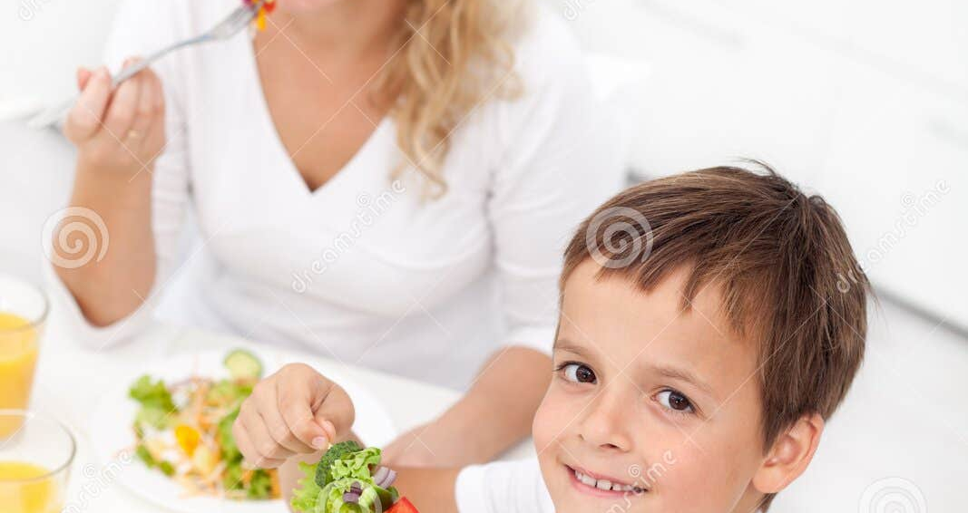

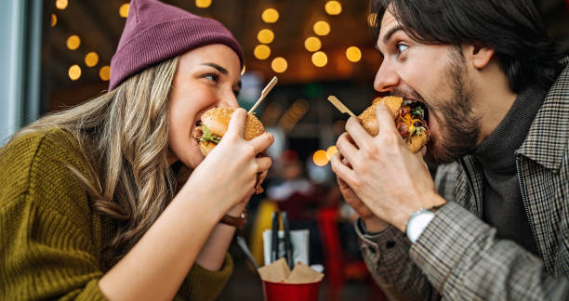

Calorie Tracker
Zac Affinito

Slide 2
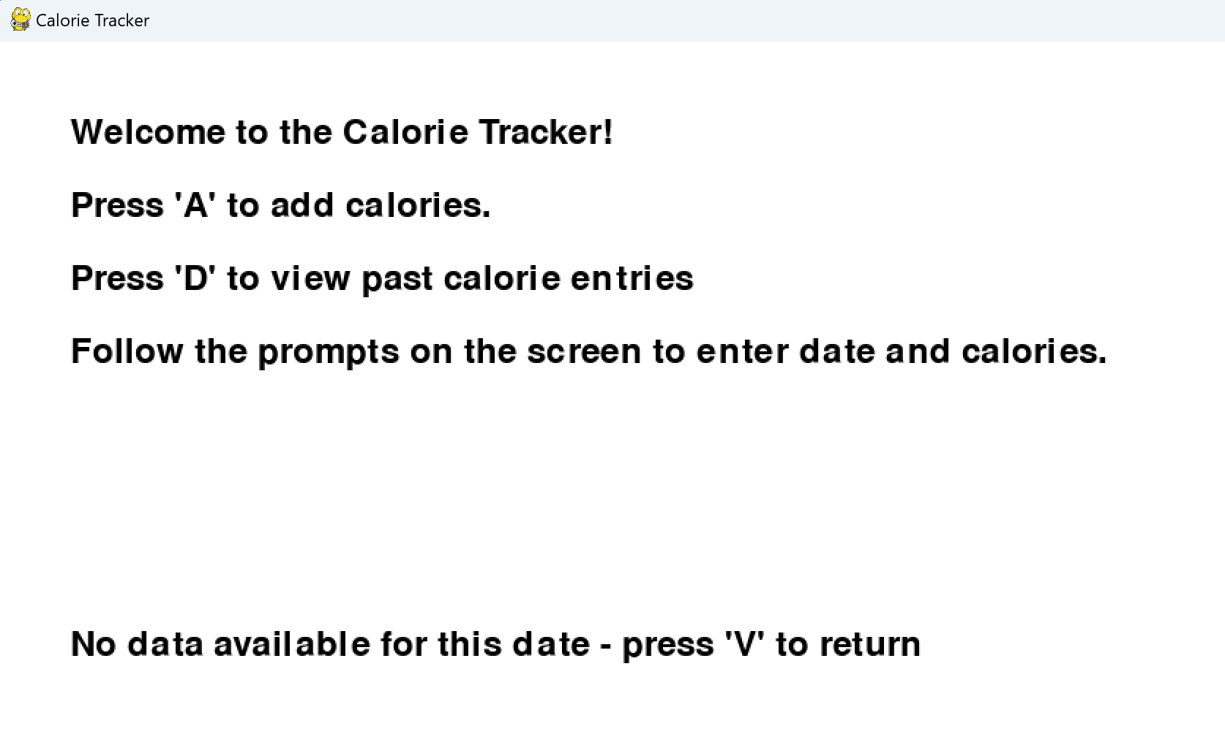
Goal:
Make a simple calorie tracker using Pygame –
The final product should be able to have calories entered, save that information, and then bring up a calendar view showing current and previous entries on given dates.

Slide 3
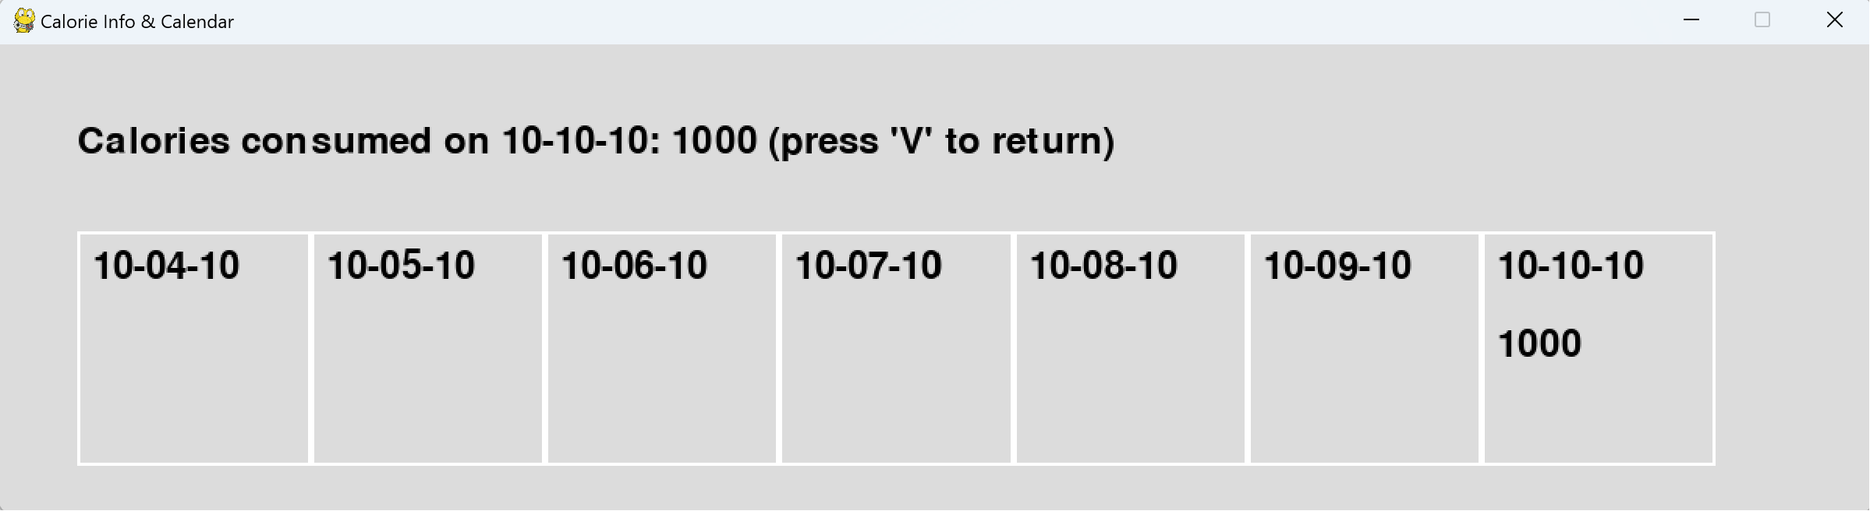
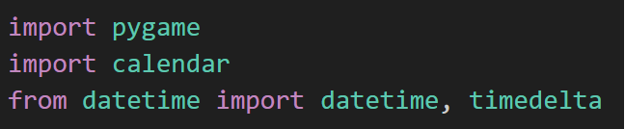
Modules
The code uses the calendar module in order to display a 7-day calorie history in the Pygame window.
The Datetime and Timedelta modules also help with this function, being crucial for entering the current date and manipulating that information in the code.

Slide 4
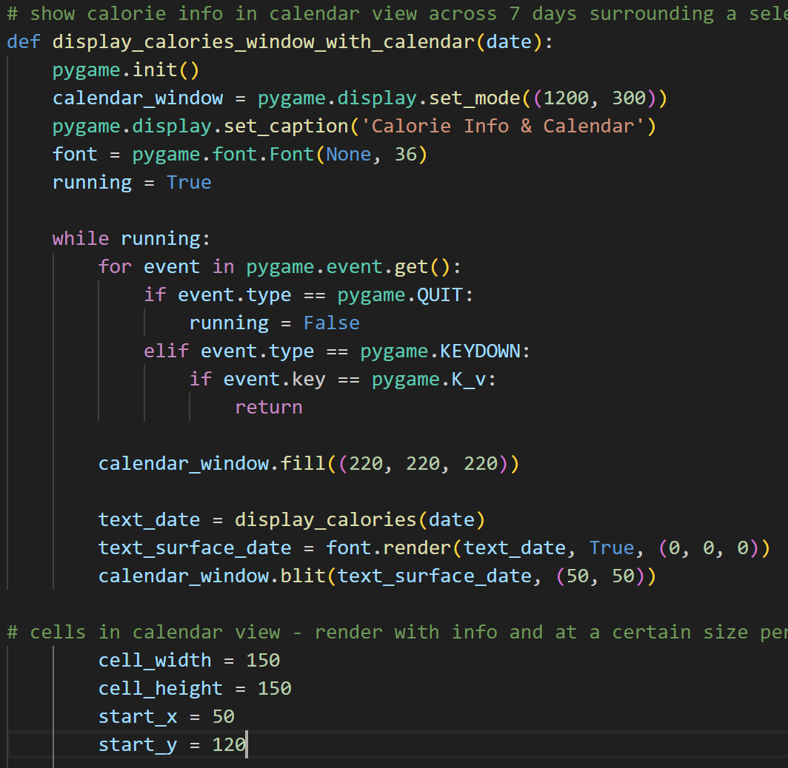
Important Code
Display Calories Window With Calendar
- Responsible for creating a Pygame window that displays calorie information for a specific date along with a calendar view.
- Enters a loop that continuously runs while the window is open
- Within the loop, it checks for Pygame events, primarily checking for the KEYDOWN event to detect if the 'V' key is pressed. If 'V' is pressed, the function returns, effectively closing the window.
- Retrieves calorie information for the specified date using the ‘display_calories(date)’ function and stores it in ‘text_date.’ It then renders it, along with the calendar cells

Slide 5
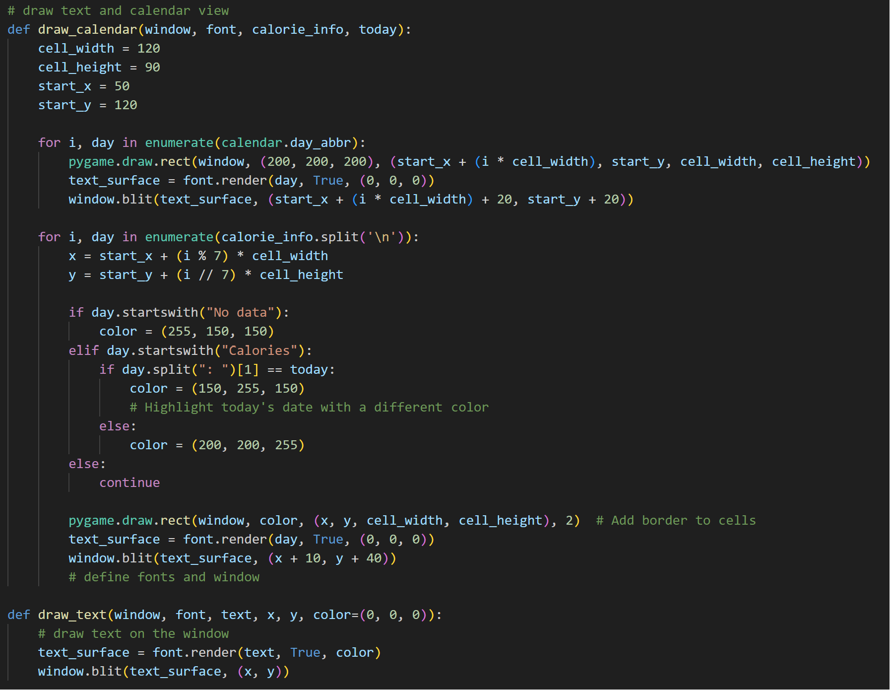
Important Code
Draw Calendar
- Creates a Pygame window displaying a calendar grid. It generates rectangular cells representing days of the week and renders them using the specific font.
- It uses ‘pygame.draw.rect’ to outline cells and ‘font.render’ to display calorie data.
- The ‘draw_text’ helper function aids in rendering text as well.
- ‘draw_calendar’ organizes a visual calendar with day labels and calorie info with the calendar module.

Slide 6
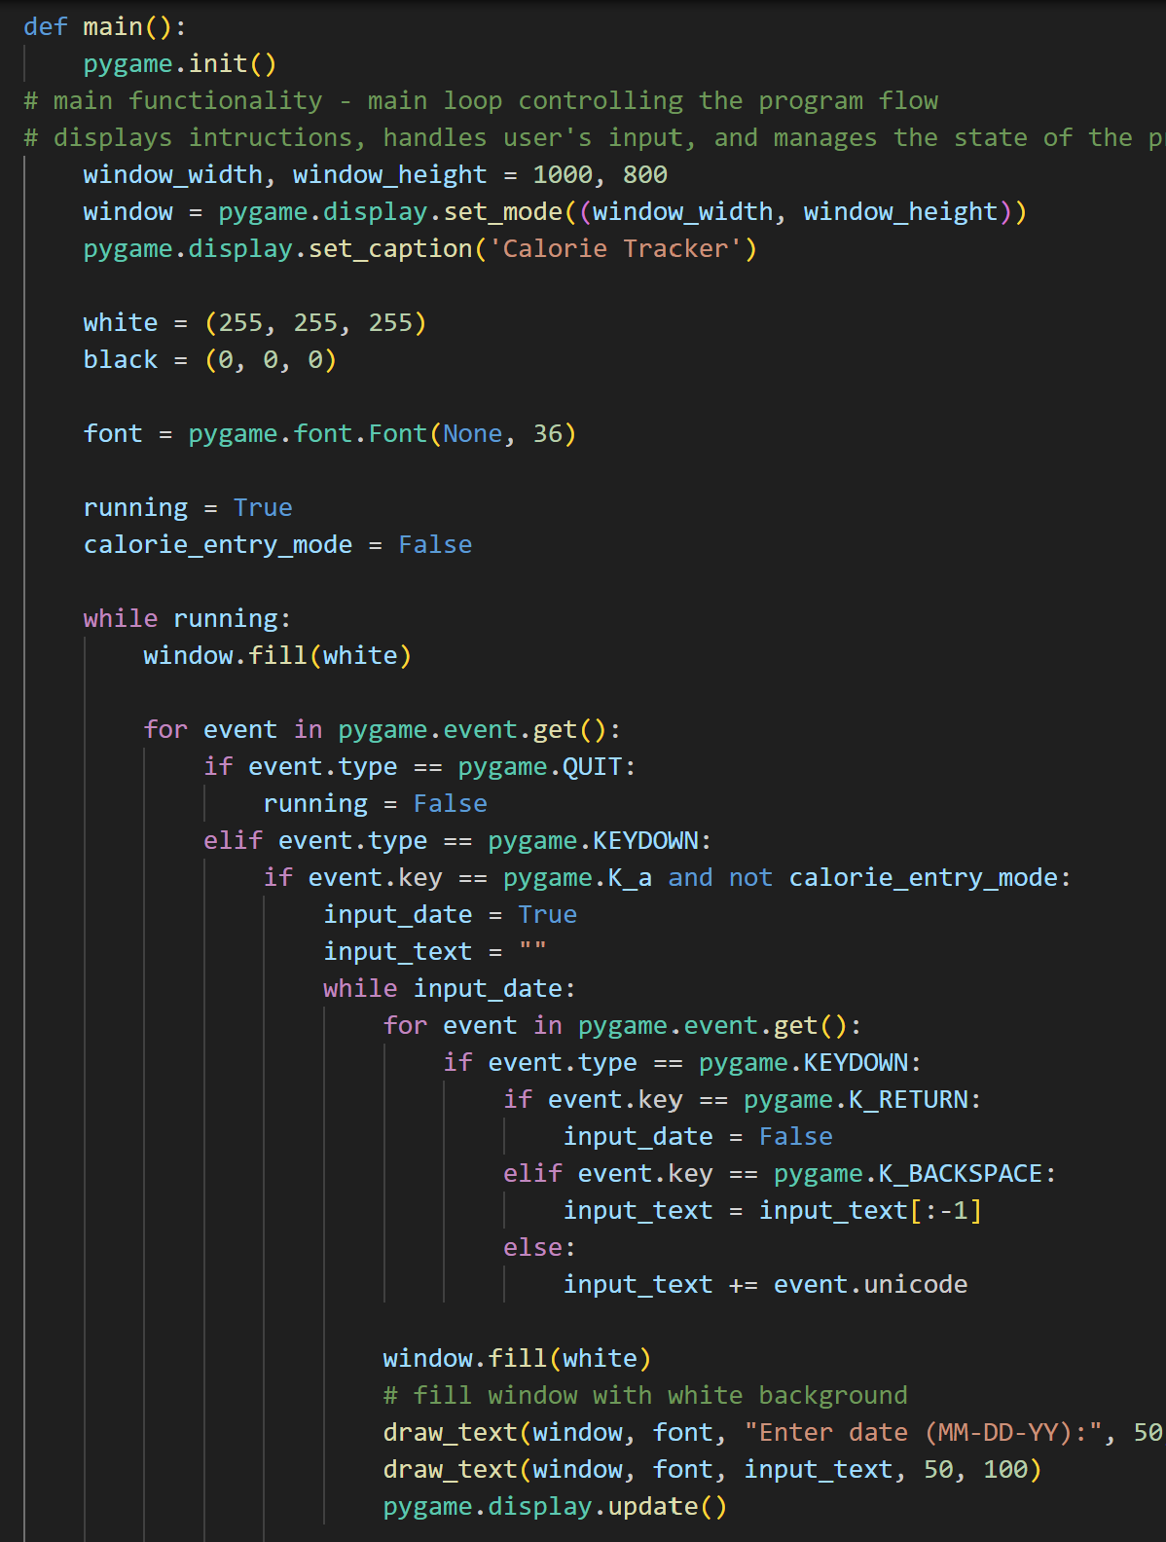
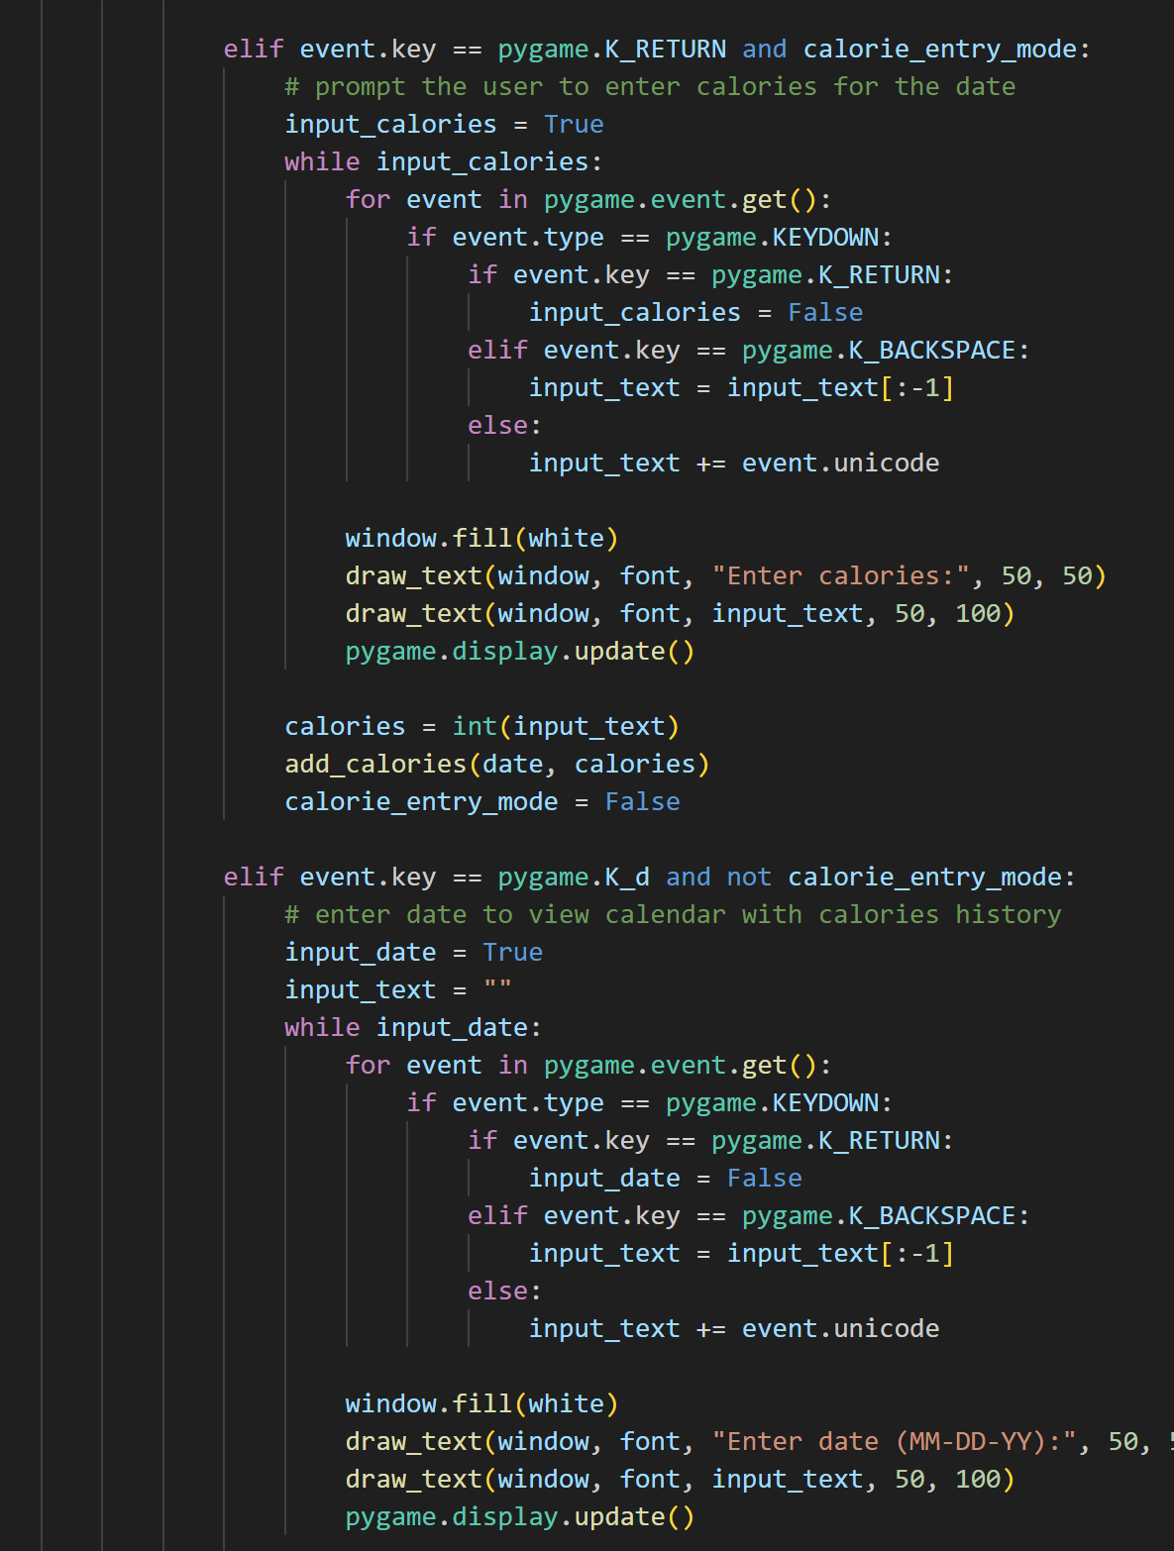
Important Code
Main Function
- Enters a loop that handles user interaction and continuously updates the display.
- Within the loop, it iterates through Pygame events using ‘pygame.event.get’ to manage user input and system events. It responds to events such as keyboard input ‘pygame.KEYDOWN’.
- If the user presses the 'A' key ‘pygame.K_a’, it initiates a process to add calories by prompting the user to input a date and calories consumed.
- Renders instructions for the user within the window, guiding them on how to interact with the application.
- Displays default calorie information for a specific date using the ‘display_calories’ function and renders it onto the window.

Slide 7
Video Sources
https://www.youtube.com/watch?v=jO6qQDNa2UY&ab_channel=TechWithTim
https://www.youtube.com/watch?v=e0Pys7H-sjM&t=242s&ab_channel=Amulya%27sAcademy
https://www.youtube.com/watch?v=msDgb2qU-EI&ab_channel=SundeepSaradhiKanthety
https://www.youtube.com/watch?v=eirjjyP2qcQ&ab_channel=CoreySchafer

