Slide 1
CSPrep
Project purposes: To teach algorithms and Computer Science concepts
Goals Statement: Represent alorightmic processes using Swift on the iOS platform.

Slide 2
Contact Information
Team Members: Loc Tran tranl2@mail.uc.edu 513-658-8523 Zach Carey Careyzr@mail.uc.edu 513-373-2659 | Project Advisor: Prof. Kenneth Berman bermanka@ucmail.uc.edu

Slide 3
Project Description
Description:
CSPrep is an iOS application that illustrates and teaches foundational to intermediate Computer Science algorithms and concepts. Users can easily view a variety of algorithms and watch them in action and learn about their performance and abilities. This app is perfect for studying concepts that are commonly tested in Computer Science, Data Structures, and Design & Analysis of Algorithms.
Using Swift and XCode, we are striving to create an application that is both responsive and has an easy to use experience for the user. This will be accomplished with abstracting front-end and back-end code, Computer Science paradigms such as DRY, and vigorous testing.

Slide 4
User Stories:
As a student using this app, I want to visualize algorithms so I can understand computer science concepts better.
As a teacher using this app, I wish to display how algorithms perform so that my pupils can become better problem solvers.

Slide 5
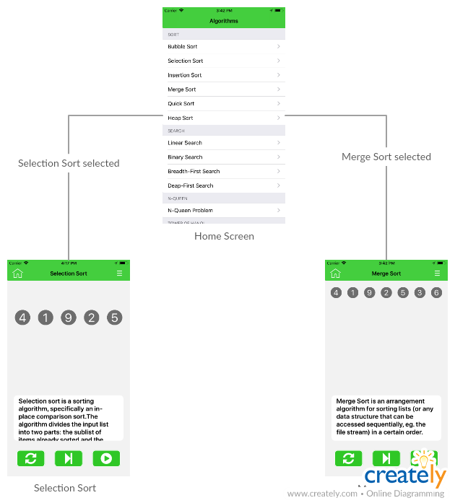
Design Diagram 1:

Slide 6
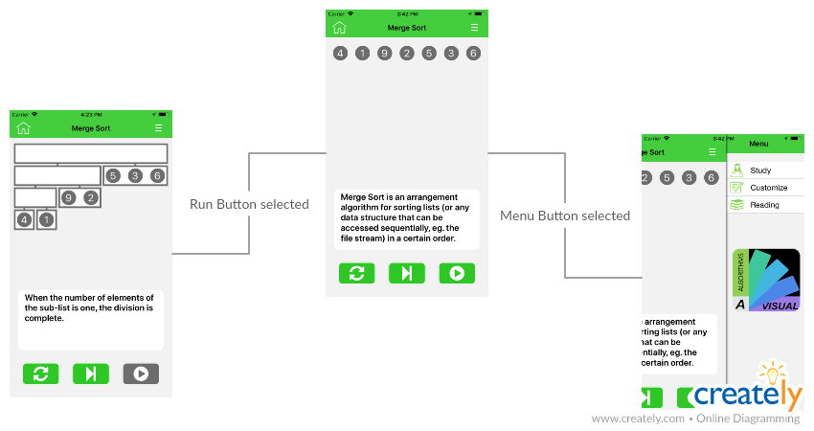
Design Diagram 2:

Slide 7
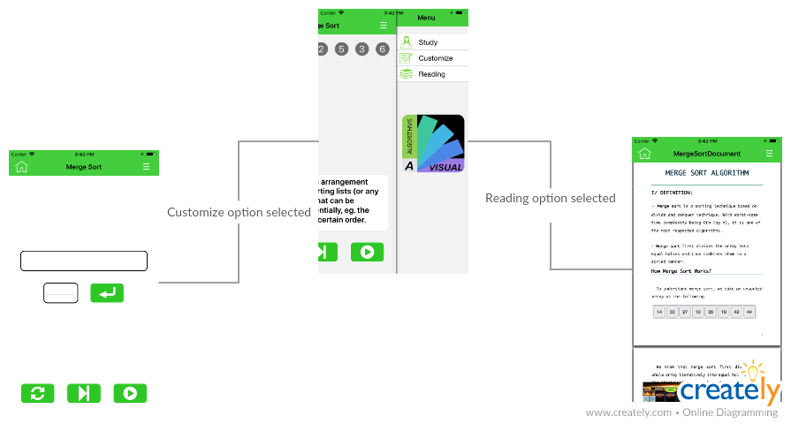
Design Diagram 3:

Slide 8
Review of Project Progress
Current state of project:
In it’s current state, the flow and architecture of the project is set. The home screen is simply a list of different algorithms and data structures. Clicking any of these items will open a module that steps through the alorgithmic process. We have 4 of these modules working and need to finish the other 12. We would like to get to all of these working sooner rather than later so we have time to expand on the project.
Accomplishments this term:
Documentation and implementation of the project’s paradigm.

Slide 9
Division of Work
Loc Tran:
Implementation of Sorting Algorithms.
UI design.
Zach Carey:
Implementation of Searching Algorithms.
Documentation of all Algorithms and Data Structure.

