Slide 1
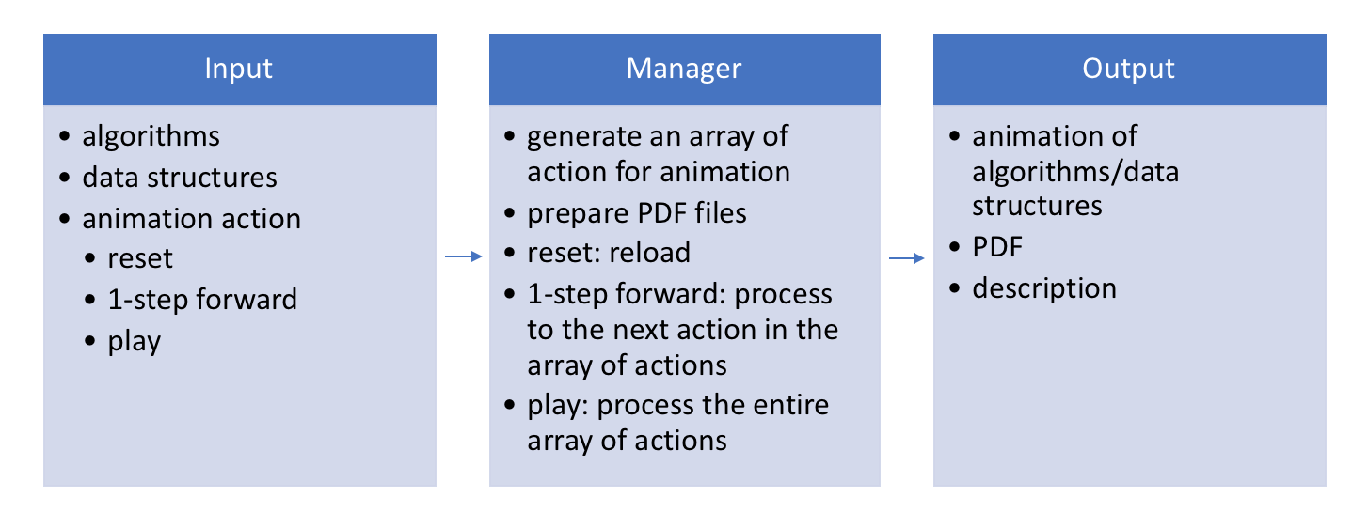
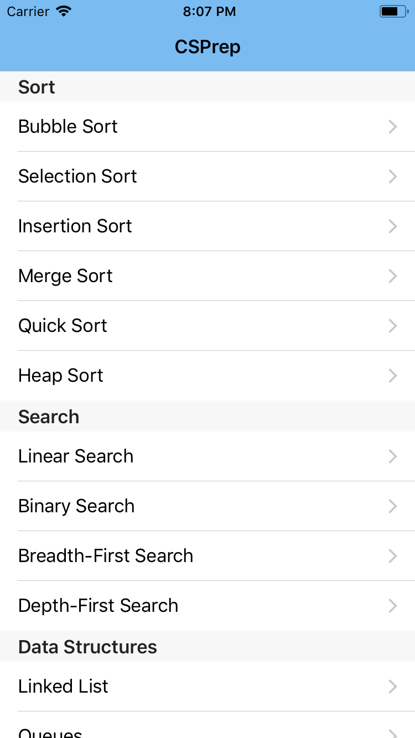
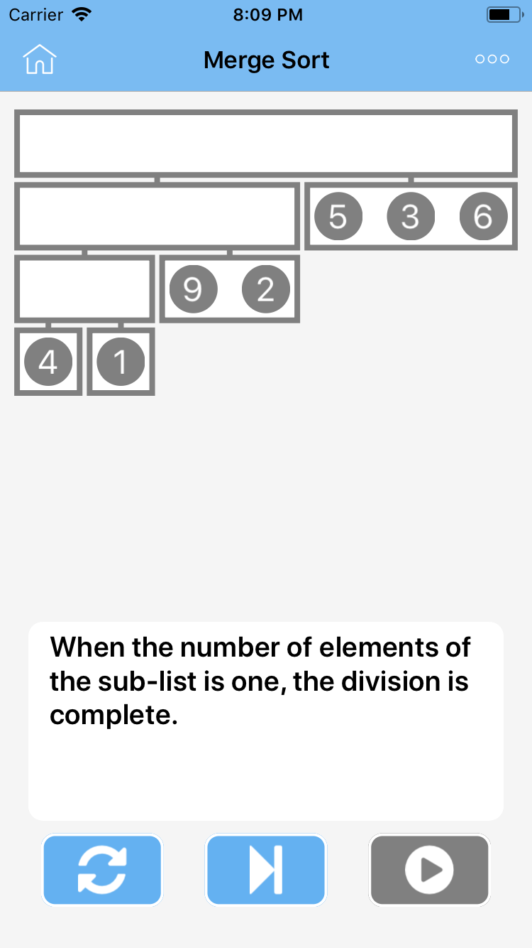







C
S
P
r
e
p
Advisor: Dr. Kenneth Berman
A Computer Science Preparation Application
Background
Design
Results
Info
Computer Science (CS) can be a daunting undertaking. It’s a challenging subject and that is exactly why it has one of the highest dropout rates among universities [1]. That’s why we created CSPrep.
CSPrep is an iOS Application that aims to simplify complex, but foundational CS concepts. Our application illustrates and describes these concepts simply and intuitively to the student for an enjoyable and unintimidating experience.
Goals
Build an iOS Application that can be used in a teaching or learning context.
Implement animations for varying sorting and searching algorithms as well as common Data Structure visualizations.
Use simple and easy to understand language to describe processes, but also provide detailed documentations and mathematical formulae.
A fully functioning iOS Application covering iOS device 8.0 and higher
Sorting algorithms covering Bubble, Insertion, Selection, Quick, Merge, and Heap Sort
Searching algorithms covering Linear, Binary, Depth-First, and Breadth-First Search
Data Structures Linked List, Stack, and Queue
Overview
Concepts are presented in a subject divided UITableView.
Students simply select an item to display the Concept View, which can play the process animation or iterate through the process step-by-step.
All Concepts have additional reading material in their respective settings pane.
Next
Publish to App Store
Open-source the project
Promote as a Computer Science preparation tool for the AP and/or College level student.
Tech
Team
Loc Tran
tranl2@mail.uc.edu
Zach Carey
Careyzr@mail.uc.edu
Citations: [1] http://bit.ly/2GeClJc

