Slide 1

http://www.automatedbuildings.com/news/mar16/reviews/1602180356haystack.html

Slide 2


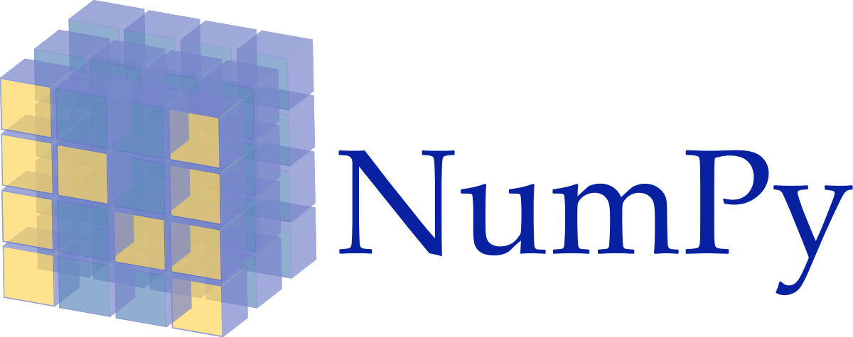

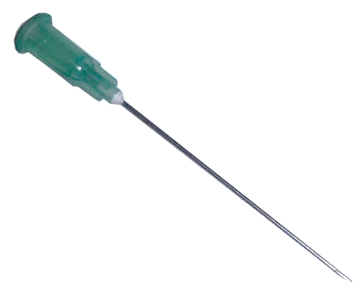

Global Max Pooling
512
256
Softmax
128
Input
1
96
https://upload.wikimedia.org/wikipedia/commons/thumb/1/11/TensorFlowLogo.svg/522px-TensorFlowLogo.svg.png
https://keras.io/
https://upload.wikimedia.org/wikipedia/commons/1/1a/NumPy_logo.svg
https://blog.thedataincubator.com/wp-content/uploads/2017/01/jupyter-logo-300x298.png

Slide 3





