Slide 1
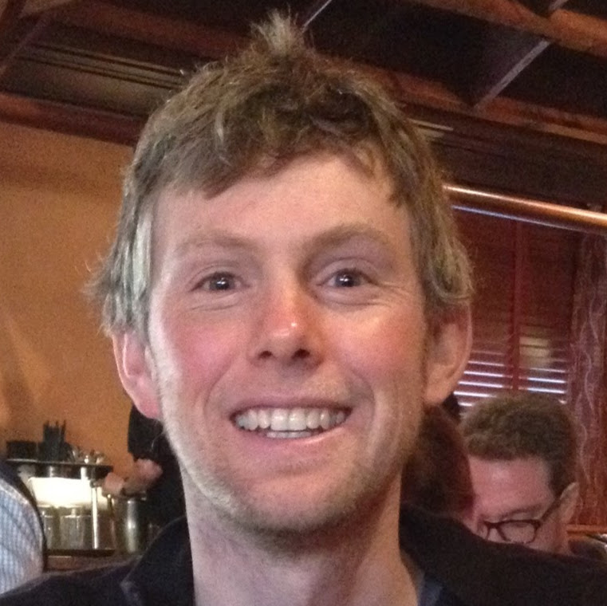


Slide 2






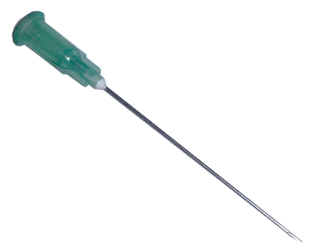
{ 0 , 1 }
✓
Notes:
On previous slide: In words of the clinician we want to identify when a needle is present in the subcutaneous environment.
This slide: In the words of the engineer, we want to find a FUNCTION that is a surjection from the hypothetical domain of all possible ultrasound images to the set {0,1}, where zero indicates the ABSENCE of a needle, and one indicates the PRESENCE of a needle. Many ways to define this function. Recalling that neural networks are just FUNCTION APPROXIMATORS, we chose a CNN. This solution is practical & valuable. CNN can be trained, and can identify new test data cases.

Slide 3
4,681 Ultrasound Images
60% Train
25% Validate
15% Test
Notes:
How did we partition the data? Nice diagram here.
Need training and testing data 70/30

Slide 4


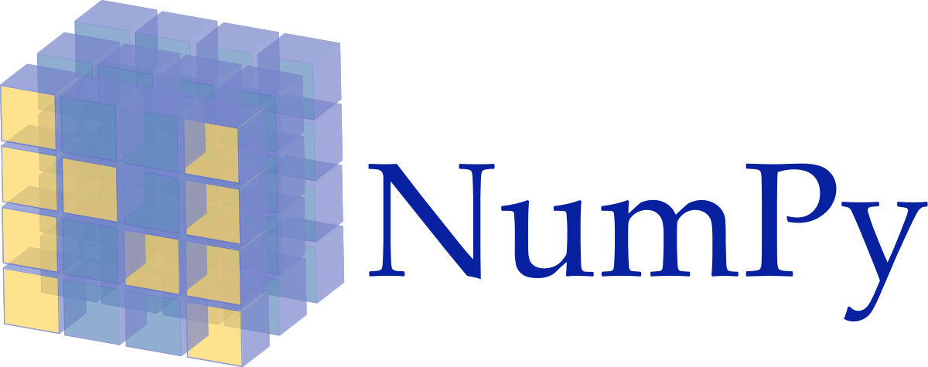


✓
Global Max Pooling
512
256
Softmax
128
Input
1
96
https://keras.io/
https://upload.wikimedia.org/wikipedia/commons/1/1a/NumPy_logo.svg
https://blog.thedataincubator.com/wp-content/uploads/2017/01/jupyter-logo-300x298.png
https://upload.wikimedia.org/wikipedia/commons/thumb/1/11/TensorFlowLogo.svg/522px-TensorFlowLogo.svg.png
Notes:
What does our CNN look like?
Flow diagram of the CNN. Explain what is it in greater detail and reiterate importance

Slide 5

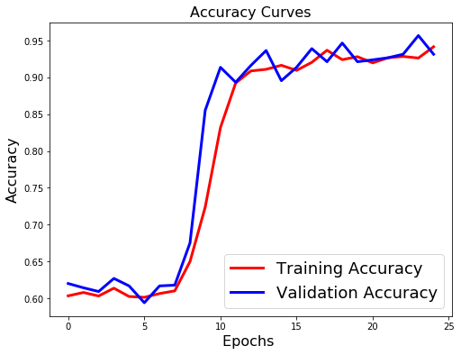
 |  | Ground Truth
 |  | Present | Absent
CNN | Present
 | Absent
93.8%
Notes:
These are the results.
94% accuracy with the annotated testing data in water.
Really clean image, so not practical. How about a phantom?

Slide 6



9,388 Ultrasound Images +
60% Train
25% Valid.
15%
 |  | Ground Truth
 |  | Present | Absent
CNN | Present
 | Absent
93.8%
Notes:
Created a new data set with speckling and noise.
How did it perform?
One step further, let’s use a real phantom?

