Slide 1
Hardware

Slide 2
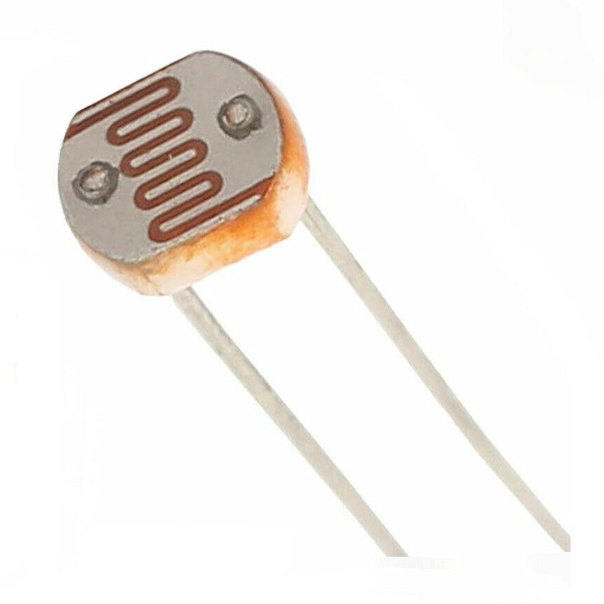
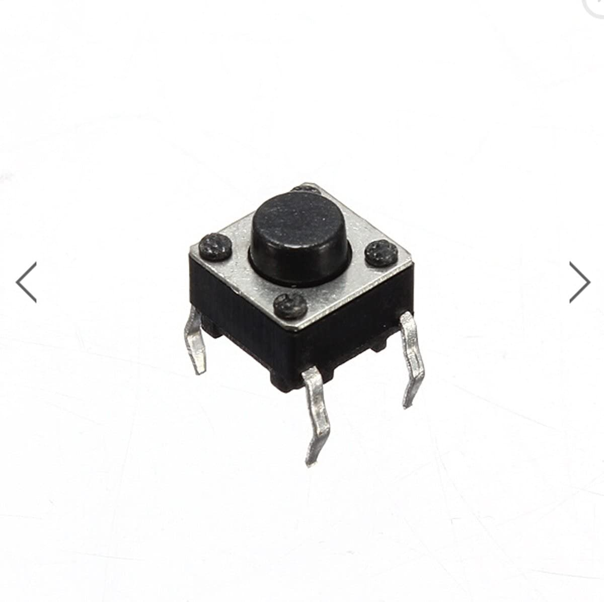
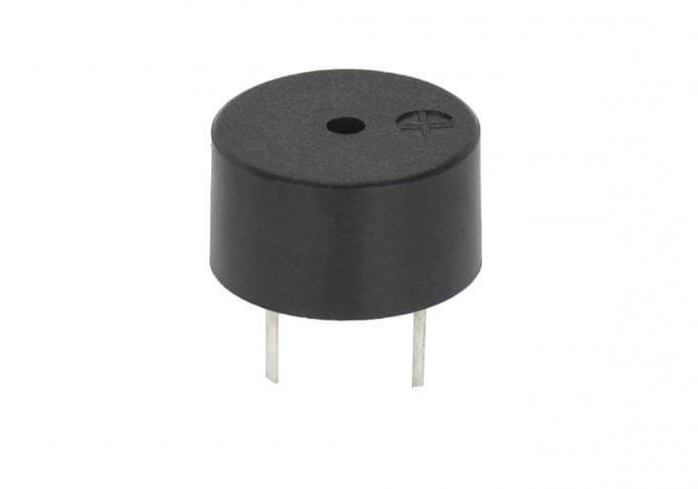
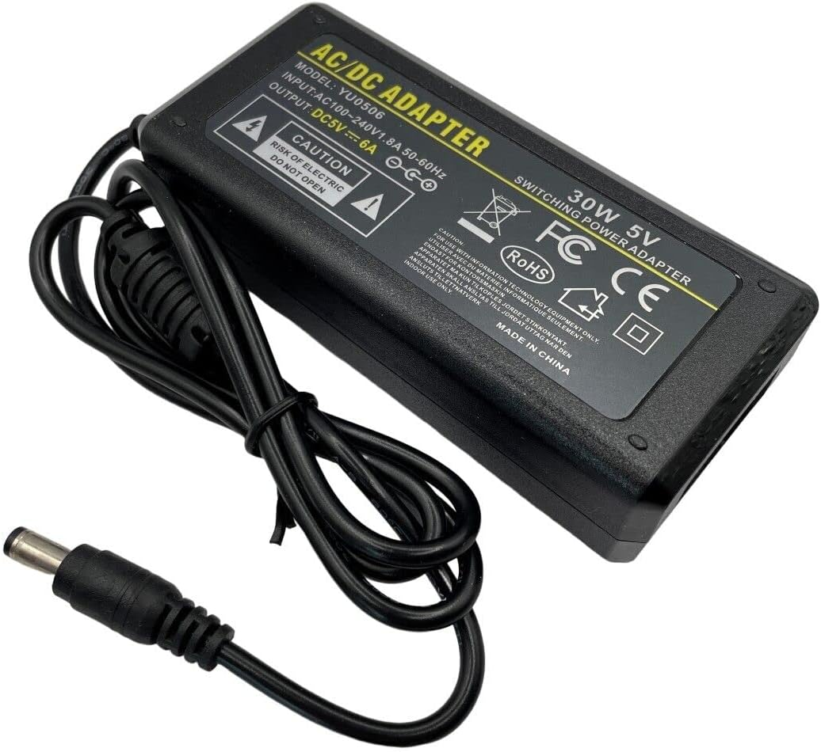
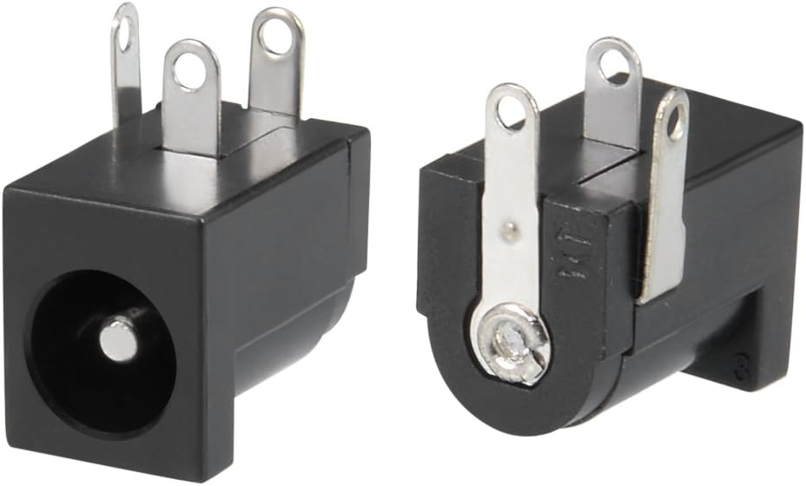
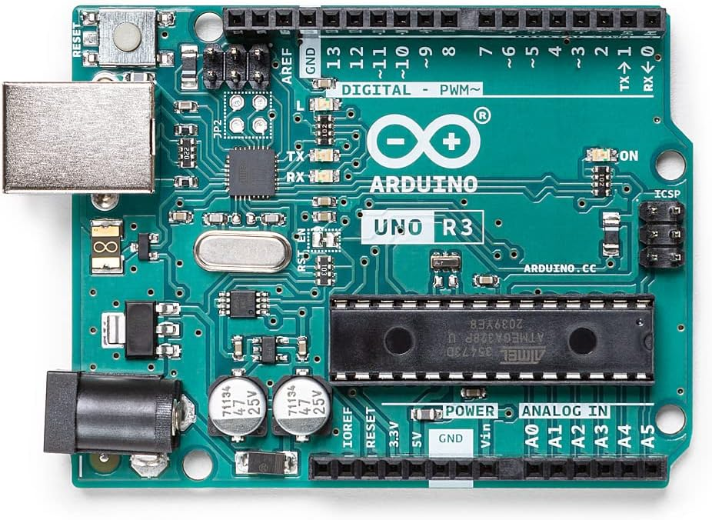
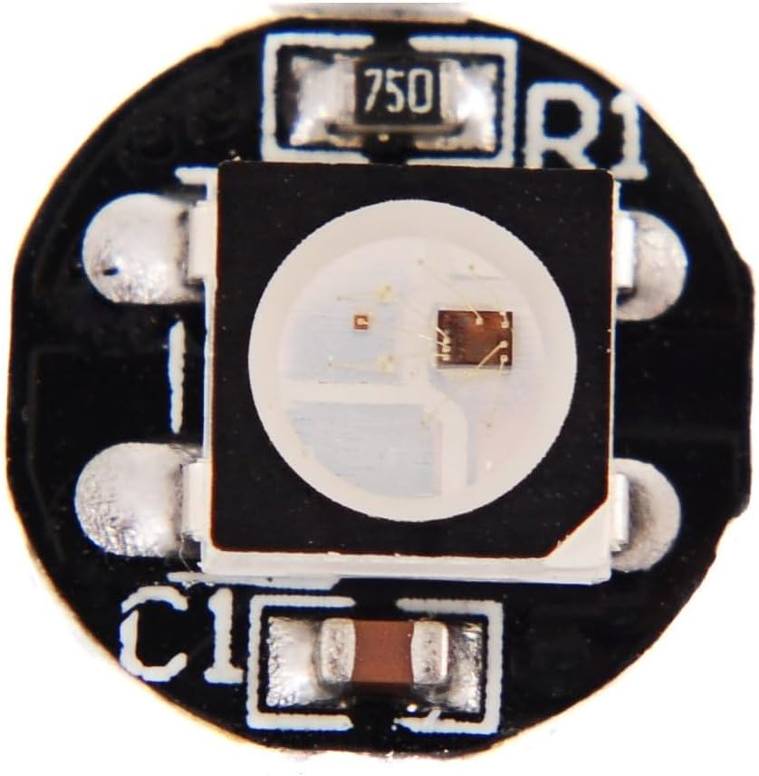
Hardware Overview
Top level block diagram:
Input
Output
LDR
(Analogue Input)
Mini Push Button x2 (Digital Input)
Peizo Buzzer
Arduino UNO R3 Microcontroller
WS2812B Intelligent Control Integrated LED x64
Single Wire Control Protocol
5V 6A 30W PSU
DC Power Jack
5V 6A External Power Source

Slide 3
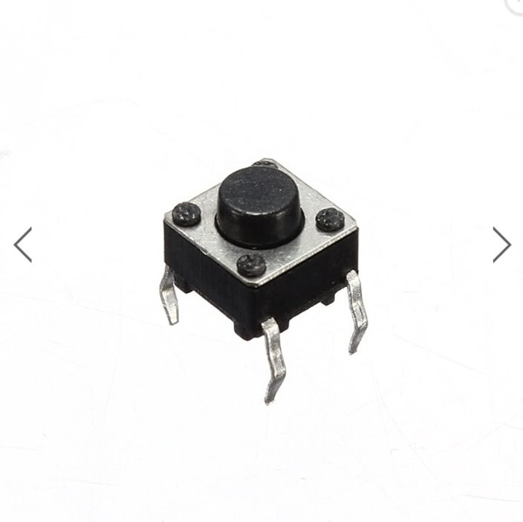

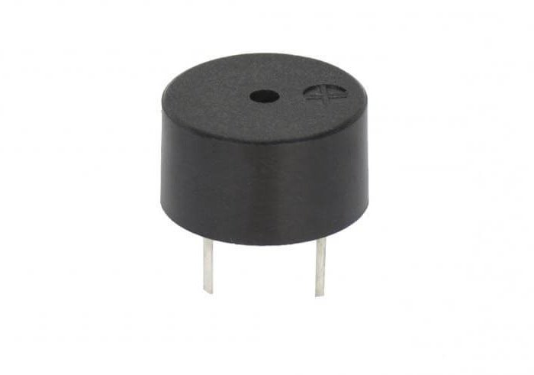

Top Level Hardware Summary
Parts description:
Image | Name | Description
D | Arduino UNO R3 Microcontroller x1 | Controls Neopixels, allows buttons and LDR to control the cube
 | 5V 6A 30W PSU x1 | Powers Arduino and Neopixels, supplying sufficient current.
 | DC Power Jack x1 | Allows easy connection of power supply
 | WS2812 intelligent Control Integrated LED x64 | 4x4x4 cube made from these, individually addressable and RGB
Image | Name | Description
 | Mini Push Button x2 | Allows user to control LED patters to turn the LEDS on and off
 | LDR x1 | Allows brightness of LEDS to change based on ambient light input
 | Peizo Buzzer x1 | Verbal confirmation that the cube has been powered
Notes:
Neo pixels – why we chose them what they do and their rating such as volatage and current
Power supply- what power supply we used and why and values of what it provides
PCB – why we chose this over the original idea of no pcb
Arduino – why we chose this over other possible programming languages

Slide 4
Top Level Hardware Summary
Arduino pin description:
Pin number | I/O | Information
2 | Input | Power Button (high low digital input)
3 | Input | Mode Button (high low digital input)
4 | Output | Buzzer
6 | Output | Single Wire Control Protocol (Serial bus type)
A0 | Input | LDR (analogue input)
GND |  | Connects to PSU ground, also used for pull down resistors for all 3 inputs. Connects to buzzer ground
5V |  | Connects to PSU +5V, used for all 3 inputs and the buzzer

Slide 5
Top Level Hardware Summary
Voltage and current requirements:
Each WS2812B LED has 3 colours, each using 20mA at peak brightness, 60mA maximum for each LED (3 x 20).
64 LEDS used for the 4x4x4 cube. 64 x 60 = 3840mA, 4A when rounded.
The Arduino can supply a maximum current of 500mA when powered by USB, and 900mA when using the built-in barrel jack input. Either way this is insufficient to power all the LEDS.

