Slide 1
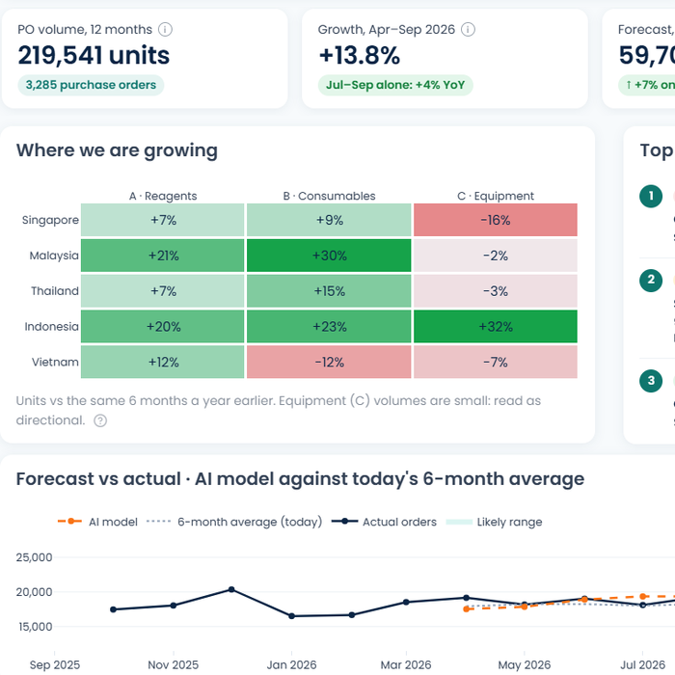
+
OneRecord
Clean records in. Better decisions out.
Modernising Master Data Management at Lives Group
Megan · Zacchaeus · Darryl · Chloe
SMU DSA Data Case Competition 2026 · Finals
Notes:
MEGAN (0:15). Good afternoon. We're OneRecord. Our promise in one line: clean records in, better decisions out.

Slide 2
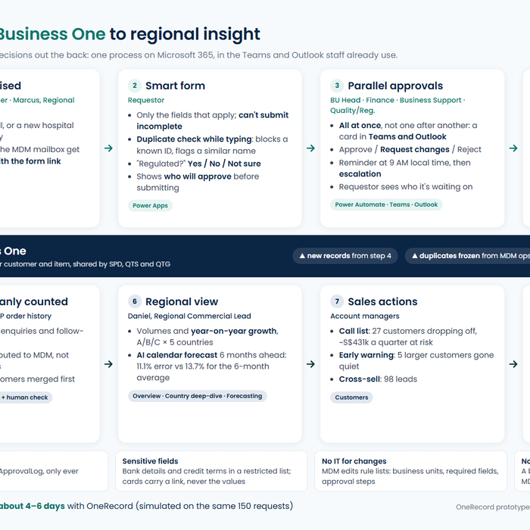
The problem
01
Megan
Why a new record takes 18.8 days, and why the sales view can't be trusted
Notes:
MEGAN. Hand-off line is not needed here, Megan continues straight into Amy's story.

Slide 3
Amy needs one item code. It takes 18 days
Day 0
Day 2
Day 7
Day 8–17
Day 18
Copies an old email, leaves the QA field blank
MDM spots the gap and emails Amy
Amy replies from her trip
QA, then BU Head, then Business Support, one at a time
Her sales order fails. The item still isn't in SAP
The brief asks ➜ faster record creation, clean master data, sales growth in 5 countries
Where the time goes today (150 past setup requests)
18.8 days
median time to SAP
28+ days
for the slowest 10%
41%
bounced back at least once
62%
of the time is waiting for approvers
Notes:
MEGAN (1:00). This is Amy from the brief. [click] Day 0 she copies an old email and leaves the QA field blank because she isn't sure. Day 2 MDM notices. Day 7 she replies from a trip. Then three approvers, one after another. Day 18 her sales order fails. [click] The brief asks us to fix exactly this, and to find growth. [click] And it's not a one-off: across 150 past requests the median is 18.8 days, 41% bounce back, and 62% of the time is just waiting for an approver to notice an email.

Slide 4
Five pain points, one root cause
No standard form. Duplicates like 'NUH' slip through
Approvals scattered in email. Bank details sent in plain email
A 6-month average misses seasons, drop-offs, cross-sell
Data quality
Speed
Audit & security
Flexibility
Forecasting
Approvers miss emails: 20–30 a day, like your SMU Outlook
A new business unit means rewriting templates and lists
Root cause: bad data gets in at the setup request, and ends up as wrong sales decisions
Notes:
MEGAN (1:15). [click] The brief lists five groups of pain points. Quick show of hands: how many emails hit your SMU Outlook today? 20, 30? Wei Jie's inbox is the same. His four-day delay isn't him being slow, it's email. [click] Our reading: these share one root cause. Bad data gets in at the setup request, the moment someone emails MDM. Duplicates then split one hospital into three customers, and the regional sales view is wrong. So we fix the front door first, then use the clean data.

Slide 5
Why OneRecord on Microsoft 365
Year-1 cost
Time to build
Needs developers?
Stops bad data at entry?
Better email template
Almost nil
Days
No
No: nothing enforces it
Custom portal
High
Months
Yes, which Lives Group doesn't have
Yes
OneRecord on M365 (our pick)
S$58k
~10 weeks
No: IT 2 days, one-off
Yes, while typing
Already licensed, the MDM team can change it themselves, and it fixes data where it enters.
Notes:
MEGAN (0:45). We looked at three options. [click] A better email template costs nothing but nothing enforces it. A custom portal fixes it but needs developers Lives Group doesn't have and takes months. [click] Our pick: build on Microsoft 365, which Lives Group already pays for. About S$58k in year one, around 10 weeks, and IT only needs about two days. [click] And the MDM team can change it themselves.

Slide 6
What we deliberately left out of version 1
Not in V1
Why
Direct write into SAP B1
An import file removes retyping at almost no risk. A live link needs an SAP partner, so Phase 3
Auto-merging duplicates
Merges touch open orders and invoices. The matcher proposes, a person confirms
Custom-trained AI models
12–18 months of history is too short to train. A calendar-based forecast needs no upkeep
A custom web portal
Needs developers Lives Group doesn't have. Power Apps is already licensed
Premium connectors
Standard licences keep cost and IT approval small
Full security redesign
First: bank details in a locked list with an audit trail. More only if audit asks
Notes:
MEGAN (0:45). The brief asks what we would deliberately not build. [click] Six things. The two that matter most: no direct write into SAP yet, because an import file removes the retyping at almost no risk. And no automatic merging, because a merge touches open orders and invoices, so a person confirms. HAND-OFF: 'Zacchaeus will now show you OneRecord.'

Slide 7
OneRecord
SHOT-01
New request form (Amy)
02
Zacchaeus
Amy's same request, through the new front door
Notes:
ZACCHAEUS. Let's replay Amy's request through OneRecord.

Slide 8
One front door for every setup request
Smart form: only the fields that apply
01
04
Reminders at 9 AM local, then escalation
OneRecord
Customer · Item · Vendor · Cost centre
Duplicate check while typing
02
05
Audit log + locked bank details
Parallel approvals in Teams
03
06
SAP B1 import file: no retyping
Rules the MDM team edits itself: add a business unit, field or approver without IT
Notes:
ZACCHAEUS (0:45). [click] OneRecord is one front door for all four kinds of setup request. [click] Six things happen behind it: a smart form, a duplicate check while you type, parallel approvals in Teams, reminders, an audit log with locked bank details, and an SAP import file so Priya stops retyping. [click] And the rules behind all of it are lists the MDM team edits themselves.

Slide 9
Live: Amy raises her item request
LIVE DEMO · onerecord-livesgroup.streamlit.app
SHOT-02
New request · Amy · type = Item, item fields showing
1
Picks 'Item'
Only the item fields appear. Submit stays off until it's complete
SHOT-03
New request · 'Is this regulated?' = Not sure, QA/RA added to approvers
SHOT-04
New request · duplicate warning: matches A-1001
2
'Is this regulated?' → Not sure
Quality/Regulatory is added for her. No guessing
3
Types 'Dengue NS1 rapid test 25T'
Warned while typing: it matches item A-1001
Notes:
ZACCHAEUS (1:30, LIVE). Switch to the browser (open it 5 minutes before, press Reset demo data, user = Amy). Go to New request. 1) Pick Item: only item fields appear. 2) Regulated? Not sure: QA/RA gets added. 3) Type 'Dengue NS1 rapid test 25T': the duplicate warning fires. Say: 'This is our web copy. The same form runs in Teams, as you'll see in the video.' If the live demo fails, click through this slide: each click shows the next screenshot, or jump to the next hidden slide and play the backup video.

Slide 10
Backup: the same steps on video
VIDEO-01
Backup clip of the live demo (form, regulated = Not sure, duplicate warning). Insert > Video, set to start on click
Notes:
HIDDEN SLIDE. Only use if the live demo fails: right-click in slideshow > See all slides, or type the slide number and press Enter.

Slide 11
Approvers sign off at the same time
Amy submits the item request
If nobody answers
Reminder at 9 AM in each approver's own time zone
Escalated to their manager after 4 days
Customer and Vendor requests also go to Finance (Wei Jie)
Amy sees who it's waiting on in My requests, without asking
at the same time
BU Head
Business Support
Quality/Regulatory (if regulated or 'Not sure')
Priya (MDM) · final check
Today: QA → BU Head → Business Support, a few days each
SAP B1 import file, with a proposed code
Audit-ready: every approval is logged. Bank details never appear on the card
Notes:
ZACCHAEUS (0:45). [click] Amy submits. [click] Every approver gets their card at the same time, in Teams. [click] Priya approves last, and the flow writes the SAP import file. [click] And if someone doesn't answer: a reminder at 9 AM in their own time zone, then escalation after four days. Amy can see who it's waiting on. [click] And for audit: every approval, from submission to SAP, is logged with who and when. Bank details sit in a locked list, so they never appear on the approval card.

Slide 12
Watch: approvals, reminders and the SAP file
VIDEO-02
Silent screen recording, 60–90 s: Teams approval cards → demo clock +4 days → escalation → My requests → Priya downloads the SAP file. Insert > Video, set to start on click
1
Teams card: Approve, Request changes or Reject
2
Demo clock +4 days: escalation fires
3
My requests: who it's waiting on
4
Priya downloads the SAP import file
Notes:
ZACCHAEUS (1:00). Play the clip and talk over it. Click to reveal each point as it happens in the video: 1) the approval card in Teams, 2) demo clock skips 4 days and the escalation fires, 3) My requests shows who it's waiting on, 4) Priya downloads the SAP file and marks it created.

Slide 13
Marcus's new team, added without IT
SHOT-05
Rules page (Priya): business units and approvers
1
A new business unit is one row
in the Rules list, added by Priya
2
Fields and approvers are rows too
change a required field or add a step, no IT ticket
3
Nobody set up for a step yet?
it goes to MDM instead of sitting untouched
Before: Marcus's first requests went to the wrong people and sat for two weeks.
Notes:
ZACCHAEUS (0:30). Marcus's team was just added to Lives Group. [click] In OneRecord his business unit is one row. [click] Fields and approvers are rows too, so a new regulatory step doesn't need IT. [click] And if nobody is set up yet, it goes to MDM rather than stalling. HAND-OFF: 'Now that the data coming in is clean, Darryl will show what it unlocks.'

Slide 14
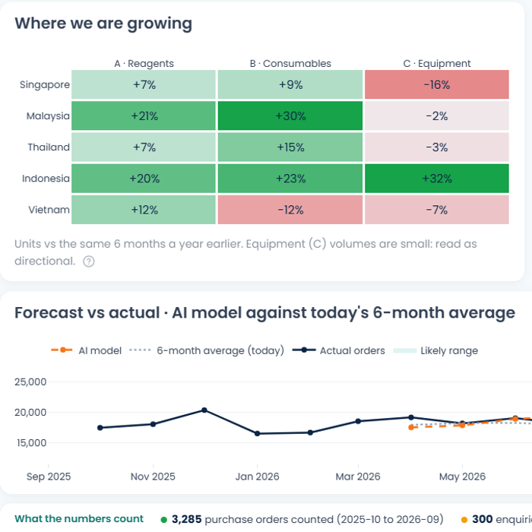
The regional view
03
Darryl
What clean data unlocks: growth, forecasts and who to call
Notes:
DARRYL. One hospital is now one customer across SPD, QTS and QTG, so the regional view can be trusted.

Slide 15
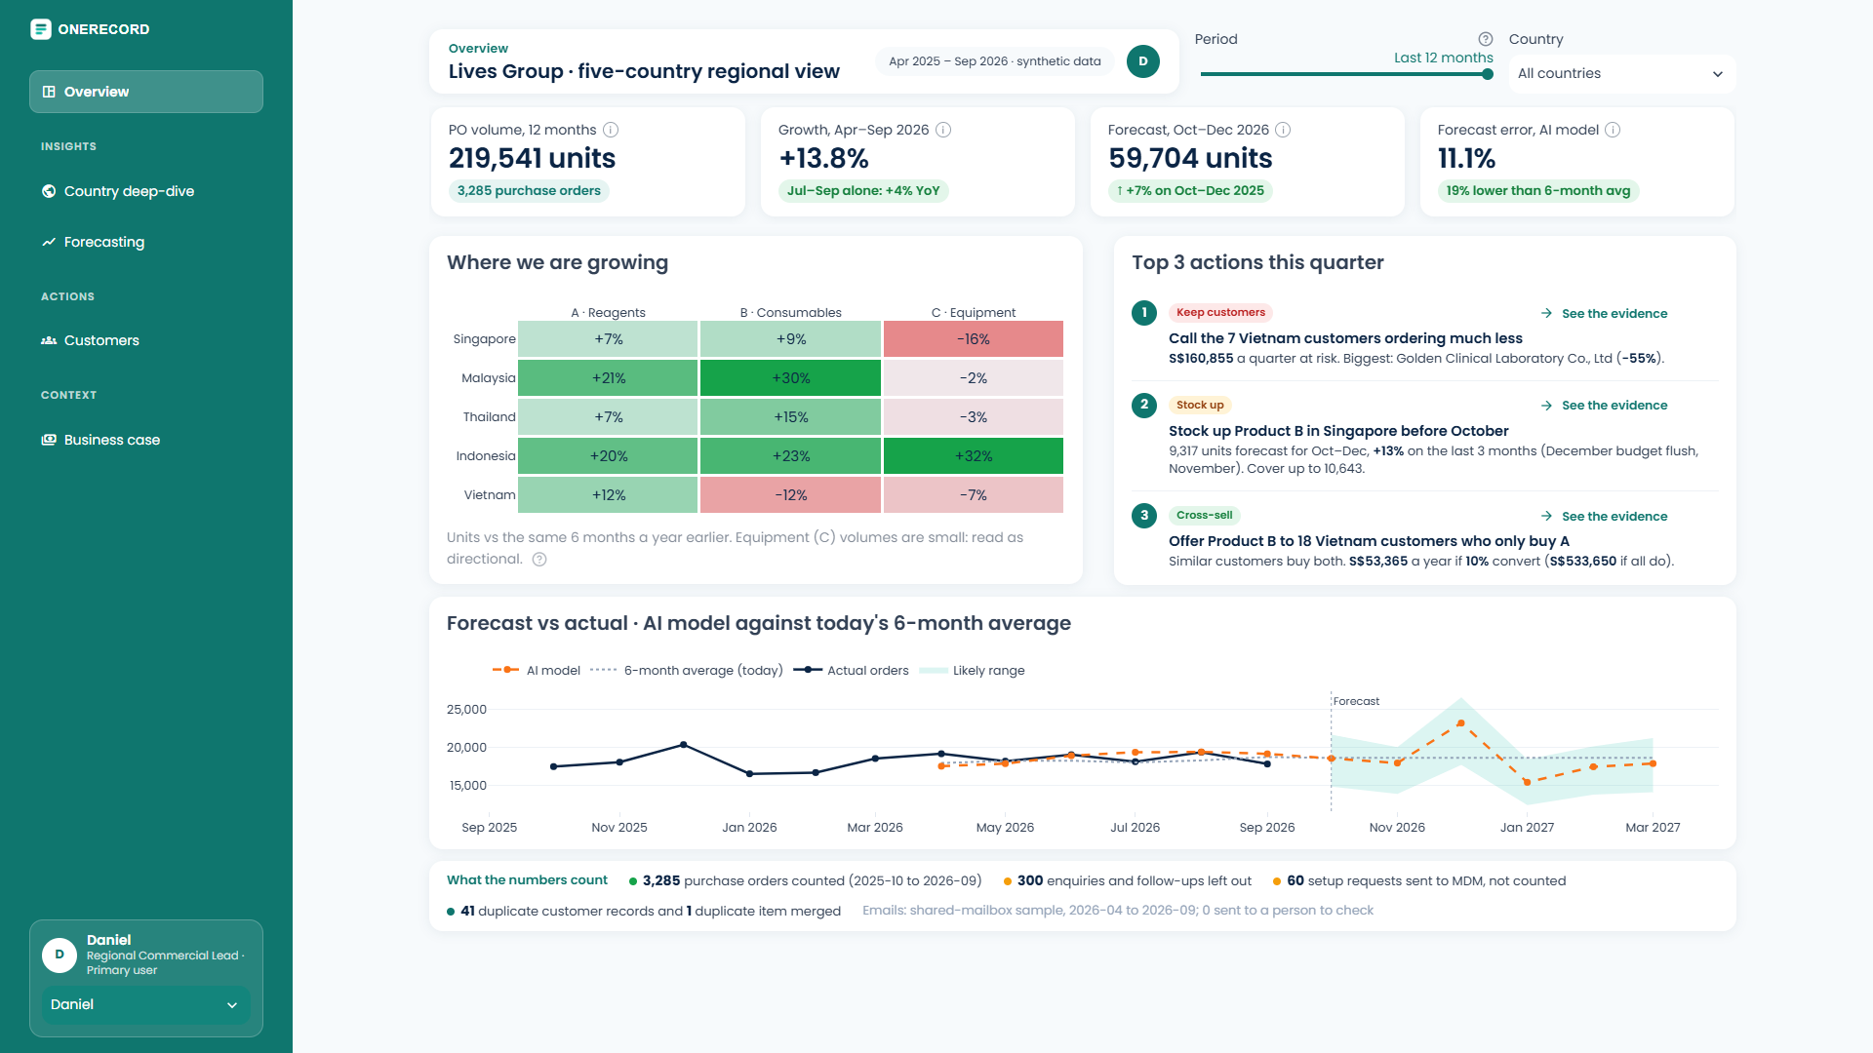
One regional view: 5 countries × Products A, B, C
1
Growth by country and product
Units ordered, Apr–Sep 2026 vs 2025. Customer orders only, never setup requests
1
2
2
Top 3 actions this quarter
Each with the evidence one click away
3
3
Forecast vs today's method
Our model against the 6-month average, with a likely range
3,285 purchase orders counted · 300 enquiries and follow-ups left out · 60 setup requests sent to MDM, not counted
Notes:
DARRYL (1:00). This is Daniel's overview, the regional view the brief asks for. [click] Growth is year-on-year units ordered, April to September 2026 against 2025, customer orders only. Malaysia and Indonesia are growing fast; Singapore equipment is down 16%. [click] Each quarter it gives the top three actions with evidence. [click] And our forecast against today's 6-month average.

Slide 16
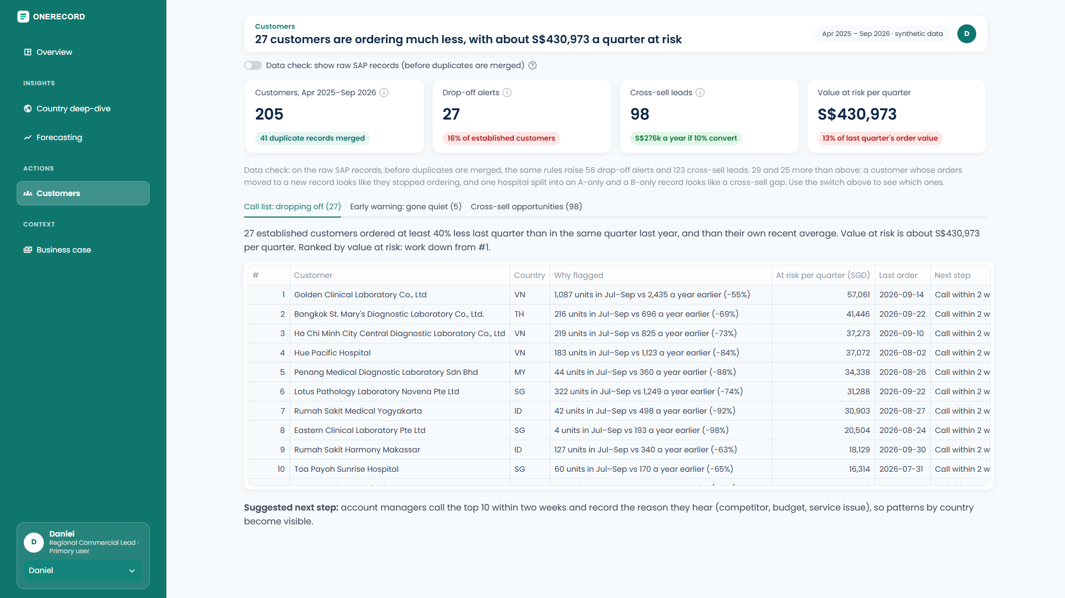
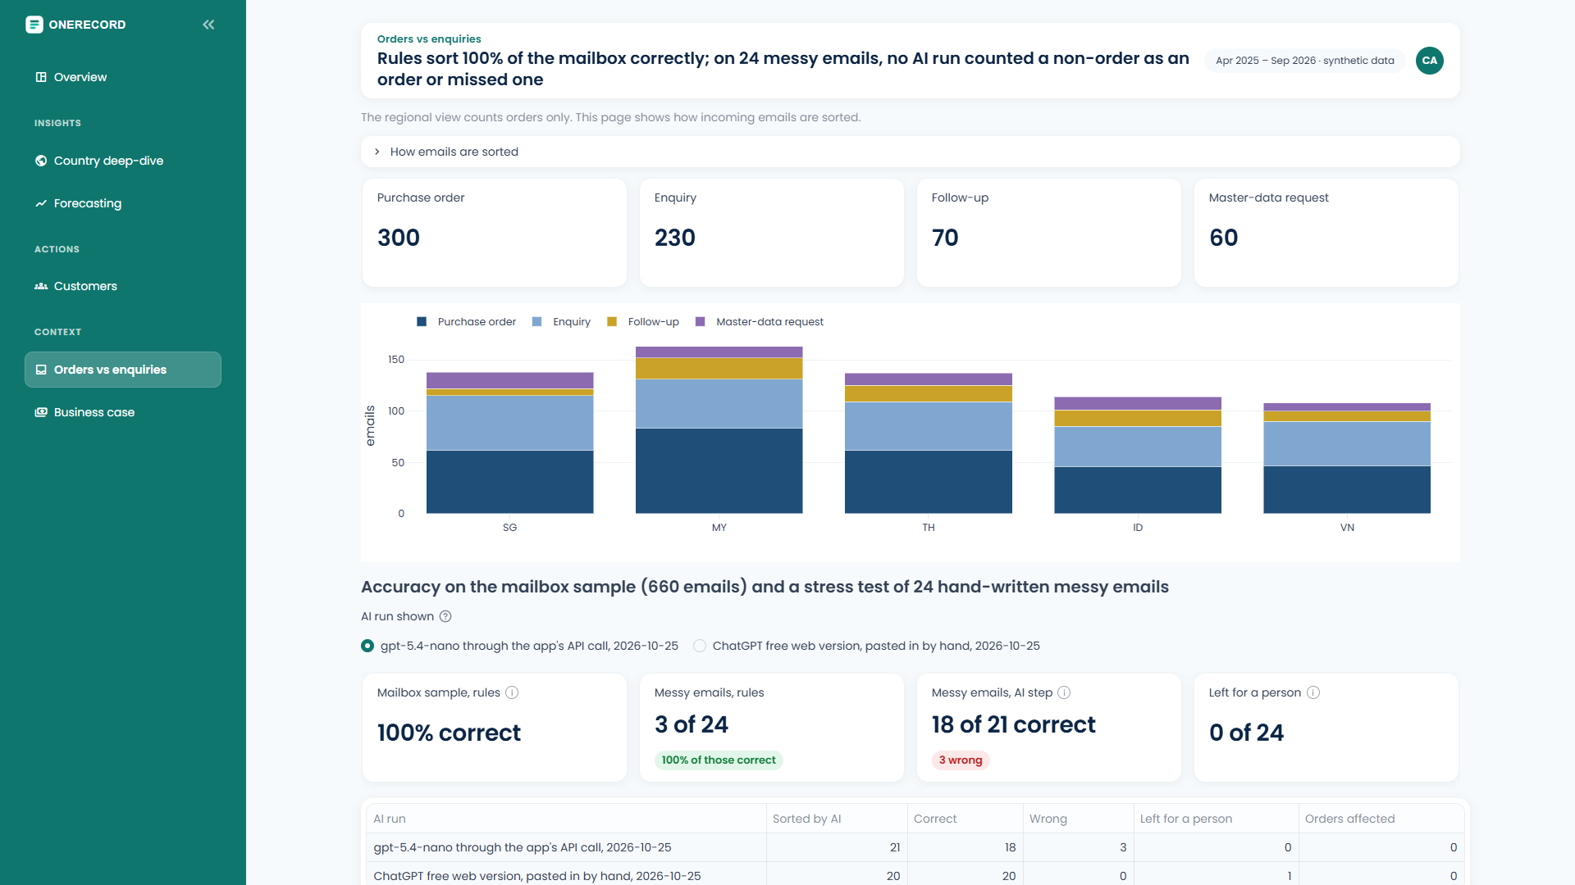
From clean data to sales actions
27
customers dropping off
S$431k
a quarter at risk
98
cross-sell leads
3,285
orders counted
300
enquiries left out
60
setup requests to MDM
Call list, ranked by value at risk
Shared-mailbox emails, sorted automatically
Notes:
DARRYL (1:00). [click] For sales: 27 established customers are ordering much less, about S$431k a quarter at risk, ranked so account managers call the biggest first. Plus 98 cross-sell leads, like Vietnam customers who buy A but not B. [click] The brief asks us to separate real orders from enquiries and setup requests. Our email sorter does that, so only the 3,285 real orders count as growth.

Slide 17
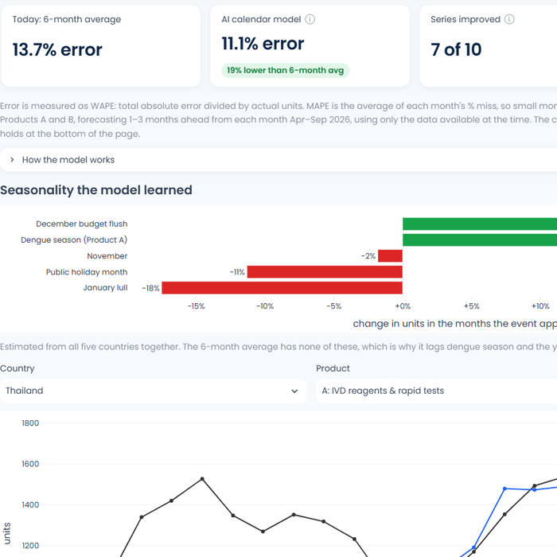
How it works, in plain words
Duplicate check
Forecast
Email sorter
Compares names like a person would: 'NUH' = 'National University Hospital'. Same registration no. = same customer
Knows the business calendar: dengue season, the December budget push, Lunar New Year, the January lull
Reads each shared-mailbox email and labels it: order, enquiry, follow-up or setup request
41 of 41 found, 0 false matches
11.1% error vs 13.7% today
Only real orders count as growth
No black box: rules and a calendar model the team can explain. Details in the appendix.
Notes:
DARRYL (1:15). Three pieces of data science, in plain words. [click] The duplicate check compares names the way a person would, so NUH and National University Hospital match. It found all 41 planted duplicates with no false matches. [click] The forecast knows the business calendar: dengue season, the December budget push, Lunar New Year. That cuts error from 13.7% to 11.1%. [click] The email sorter labels each email, so only real orders count. No black box.

Slide 18
The results
Facts and figures
4–6
days
41/41
11.1%
S$431k
98
to SAP, down from 18.8
duplicates flagged while typing
forecast error, vs 13.7% today
a quarter at risk, on one call list
cross-sell leads
And it stays quiet when it should: only 3% of genuinely new customers get a duplicate warning.
Notes:
DARRYL (0:45). [click] To sum up the evidence: 4 to 6 days to SAP instead of 18.8. All 41 duplicates caught while typing. Forecast error down to 11.1%. S$431k a quarter at risk on one call list, and 98 cross-sell leads. [click] And only 3% of genuinely new customers get a false warning. HAND-OFF: 'Chloe will show how Lives Group can actually roll this out.'

Slide 19
Making it real
SHOT-06
Real Teams approval card (M365 build)
04
Chloe
Feasibility, adoption, the business case and our ask
Notes:
CHLOE. This isn't a mock-up: it already runs on Microsoft 365.

Slide 20
Built with what Lives Group already has
Standard M365 connectors
no premium licence
Build it
IT: about 2 days
one-off, Teams site and permissions
Use it
~10 weeks
of one Power Platform contractor
MDM edits the rules
fields, approvers, business units
A Teams card, not one more email
approvers act where they already are
Status without asking
My requests shows who it's waiting on
Old habits caught
emails to MDM get the form link back
A clear cut-over
after go-live, MDM only actions form requests
Remember the 20–30 emails a day? Approvals leave the inbox and move into Teams.
Notes:
CHLOE (1:30). Is this feasible? [click] To build it: standard Microsoft 365 connectors only, so no premium licence. About ten weeks of one contractor. IT for about two days, once. After that, the MDM team edits the rules themselves. [click] Will people actually use it? Remember the 20-30 emails a day? Approvals come out of the inbox and into a Teams card. Emails sent to MDM out of habit get an auto-reply with the form link. Requestors see status without asking. And after go-live, MDM only actions requests from the form.

Slide 21
Pays back in 3.4 months
01
02
03
04
S$58k
year-1 cost
contractor, analyst, licences, MDM time
S$205k
benefit a year
mostly sales: drop-offs kept and cross-sell
3.4 months
payback
on the default assumptions
4–6 days
to SAP, from 18.8
simulated on the same 150 requests
Rates, hours, margin and conversion are placeholders to agree with Lives Group. Staff time alone doesn't pay for the build: most of the value is sales acting on clean data.
Notes:
CHLOE (1:00). [click] Year one costs about S$58k. The benefit is about S$205k a year, so it pays back in about 3.4 months, and setup requests reach SAP in 4 to 6 days instead of 18.8. [click] To be upfront: staff time alone doesn't pay for the build. Most of the value comes from sales acting on clean data: keeping customers who are dropping off and cross-selling. Every assumption can be changed on our Business case page.

Slide 22
Roadmap, and our ask
01
Fix the front door Weeks 1–10
Form, parallel approvals, SAP file, clean up the 41 duplicates. Target: ≤5 days to SAP
Our ask
A 4-week pilot with SPD
owned by Priya's MDM team
Success = ≤5 days to SAP and ≥90% of setup requests through the form
02
Use the clean data Months 3–6
Regional view in Power BI in Teams, monthly forecast, call lists, email sorting
03
Connect and scale After month 6, only if targets are met
Direct SAP B1 link; items and vendors clean-up
Notes:
CHLOE (1:00). [click] Three phases. First, fix the front door in ten weeks. Second, use the clean data: the regional view in Power BI inside Teams. Third, a direct SAP link, but only if the first two hit their targets. [click] So our ask is small: a four-week pilot with SPD, owned by Priya's team. If setup requests reach SAP in five days or less and 90% go through the form, roll it out to QTS and QTG.

Slide 23
Clean records in.
Better decisions out.
Questions? Ask us to show any page live.
App onerecord-livesgroup.streamlit.app
Code github.com/zacchaeus-tan/SMUDataCaseCompeittion
Megan · Zacchaeus · Darryl · Chloe
Notes:
CHLOE. Close: Clean records in, better decisions out. Thank you, we'd love your questions, and we're happy to show any page live. (Keep the app open in a browser tab for Q&A.)

Slide 24
Appendix A · Duplicate check in detail
Bulk matcher (records already in SAP)
Compare only within the same country
Same registration no. = match; different = never a match
Name similarity on cleaned names (typo- and word-order-safe), backed by city and address
Acronym check: 'NUH' = National University Hospital
≥90% same city: match · 80–90%: review queue for Priya
No auto-merge: the matcher proposes, a person confirms
Form check (new setup requests)
Same registration no., part no. or tax ID: blocked, names the code to use
Similar name: 'Possible match'; going ahead needs a reason every approver sees
Checks SAP records and requests still waiting
Results (synthetic data)
41 duplicates among 246 records (17%), 0 false matches
Form flags all 41 planted duplicates; 3% of new customers warned
Thresholds tuned on synthetic data: re-check in the pilot
Notes:
Backup for Q&A on matching.

Slide 25
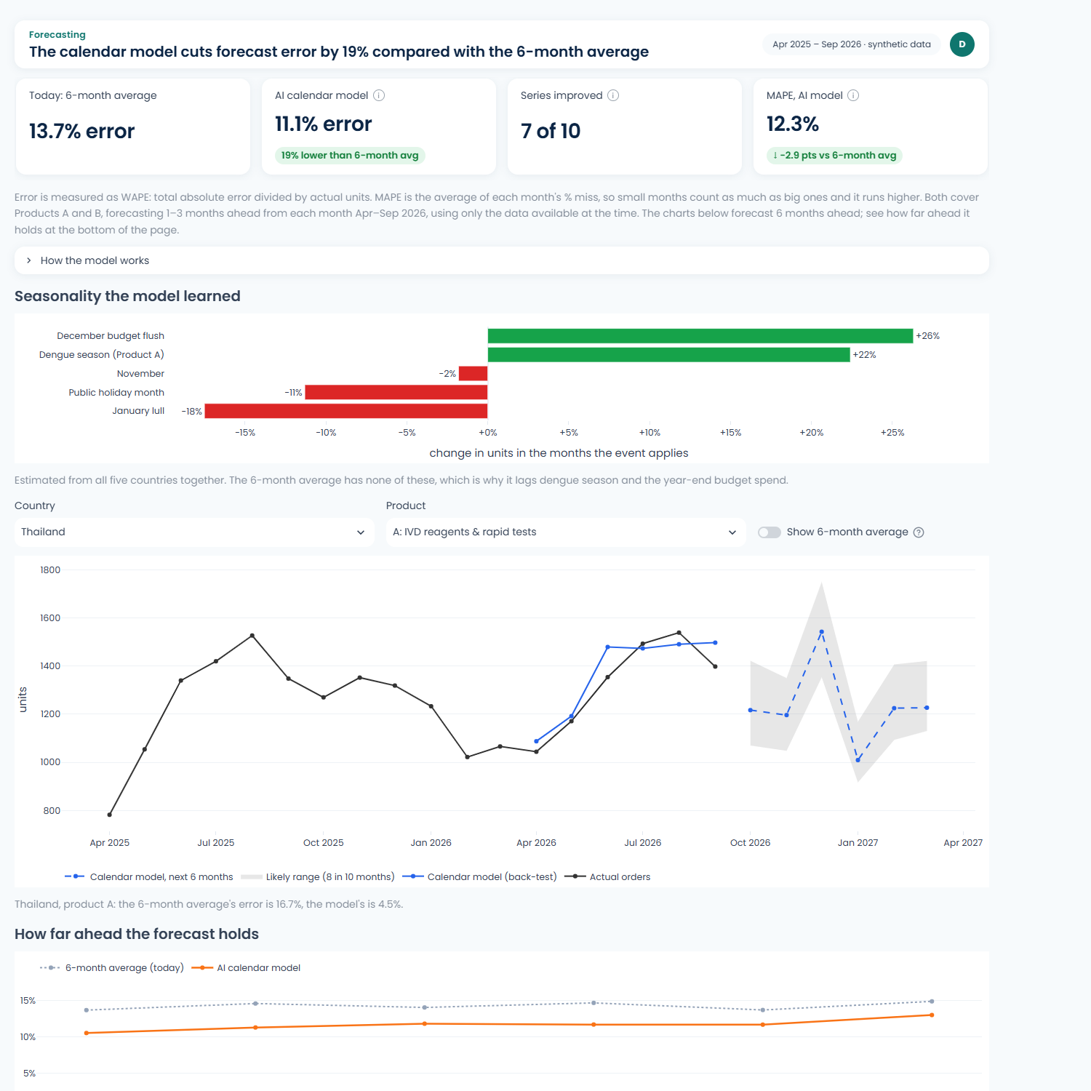
Appendix B · Forecast method and test
Today: 6-month moving average of past purchase-order units
Ours: a 'business-calendar' model for each of 15 country × product series: a level, a gently shrunk trend, plus known events
Events: dengue season (Product A, by country), the Nov/Dec hospital budget push, the January lull, public-holiday months (Lunar New Year, Tet, Songkran, Hari Raya)
Few parameters, so it learns from 12–18 months of history, where a full seasonal model can't
Test: rolling backtest, forecasting 1–3 months ahead from each month Apr–Sep 2026
Measure: WAPE = total absolute miss ÷ total actual units (lower is better)
Result: 11.1% vs 13.7% (Products A and B)
Notes:
Backup for Q&A on forecasting.

Slide 26
Appendix C · Business case breakdown (year 1, SGD)
Benefit | SGD / year
Staff time (requests × hours × rate) | 7,500
Gross profit pulled forward (accounts live sooner) | 11,620
Gross profit kept (drop-offs recovered) | 103,434
Gross profit from cross-sell | 82,896
Total | ≈205,450
Cost | SGD, year 1
Workflow build (contractor, 8 weeks) | 32,000
Analytics build | 15,000
Licences and AI credits | 3,000
MDM team time (rules, training) ~4 weeks | 8,000
Total | 58,000
Sales benefits are counted at gross margin (30%), not order value. Rates, hours, margin and conversion are placeholders to agree with Lives Group; all adjustable on the app's Business case page.
Notes:
Backup for Q&A on the business case.

Slide 27
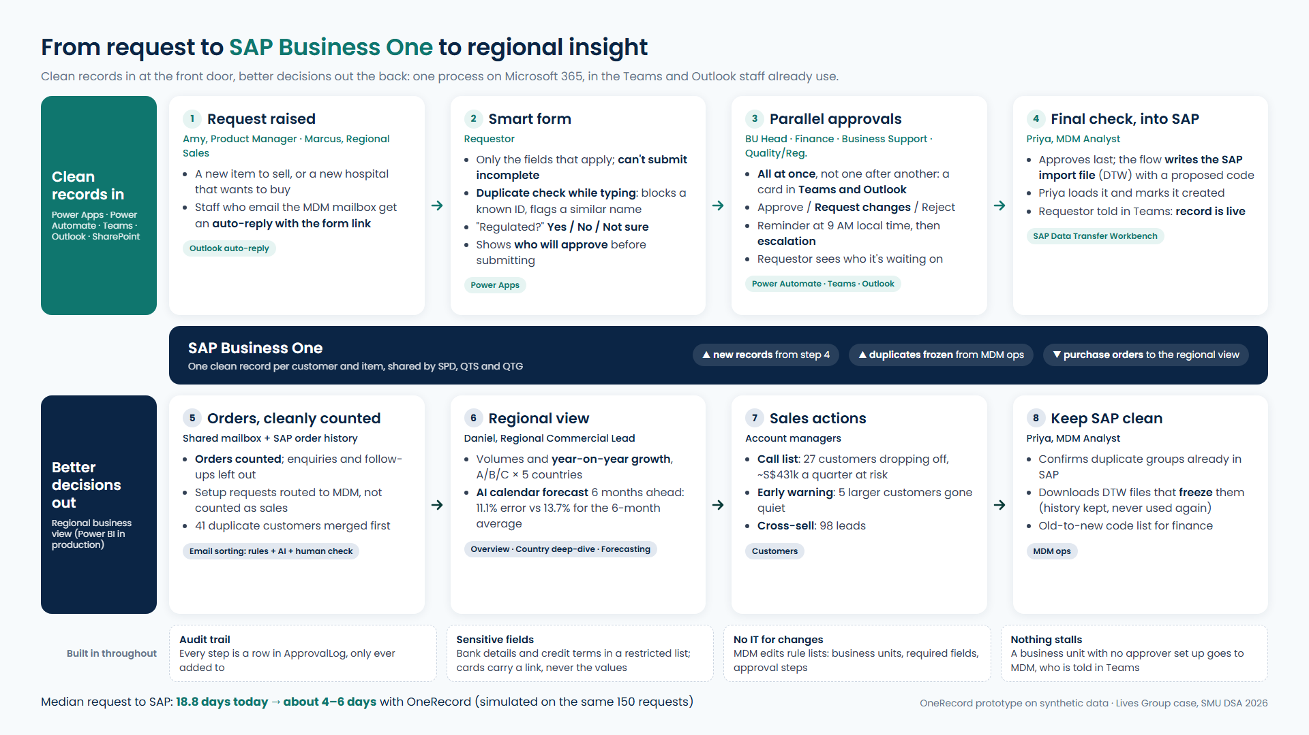
Appendix D · End-to-end process
Notes:
Backup: the whole process on one page.

Slide 28
Appendix E · Security and audit
Locked bank details
Bank details and credit terms sit in a separate restricted list. Only Finance, MDM and the requestor can see them
Cards carry a link, not values
Teams approval cards never show bank details, so nothing sensitive sits in a chat or inbox
Every step logged
ApprovalLog records who approved what and when, from submission to SAP. Rows are only ever added
Restricted SAP files
Import files are written to a restricted folder that only MDM can open
Notes:
Backup for Q&A on governance.

