Slide 1
Object interaction
Creating cooperating objects
5.0

Slide 2

A digital clock

Slide 3
Abstraction and modularization
Abstraction is the ability to ignore details of parts to focus attention on a higher level of a problem.
Modularization is the process of dividing a whole into well-defined parts, which can be built and examined separately, and which interact in well-defined ways.

Slide 4



Modularizing the clock display
One four-digit display?
Or two two-digit displays?

Slide 5
Implementation - NumberDisplay
public class NumberDisplay
{
private int limit;
private int value;
Constructor and
methods omitted.
}

Slide 6
Implementation - ClockDisplay
public class ClockDisplay
{
private NumberDisplay hours;
private NumberDisplay minutes;
Constructor and
methods omitted.
}

Slide 7
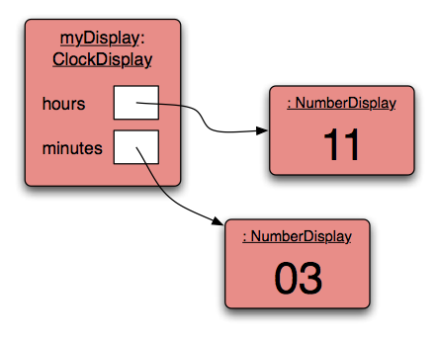
Object diagram

Slide 8
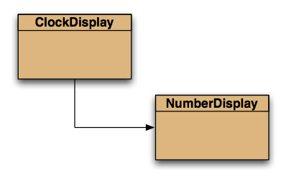
Class diagram

Slide 9
Primitive types vs. object types
SomeObject obj;
object type
int i;
primitive type
32

Slide 10
Quiz: What is the output?
int a; int b; a = 32; b = a; a = a + 1; System.out.println(b);
Person a; Person b; a = new Person("Everett"); b = a; a.changeName("Delmar"); System.out.println(b.getName());

Slide 11
Primitive types vs. object types
ObjectType a;
ObjectType b;
b = a;
int a;
int b;
32
32

Slide 12
Source code: NumberDisplay
public NumberDisplay(int rollOverLimit)
{
limit = rollOverLimit;
value = 0;
}
public void increment()
{
value = (value + 1) % limit;
}

Slide 13
The modulo operator
The 'division' operator (/), when applied to int operands, returns the result of an integer division.
The 'modulo' operator (%) returns the remainder of an integer division.
E.g., generally: 17 / 5 gives result 3, remainder 2
In Java: 17 / 5 == 3 17 % 5 == 2

Slide 14
Quiz
What is the result of the expression 8 % 3
For integer n >= 0, what are all possible results of: n % 5
Can n be negative?

Slide 15
Source code: NumberDisplay
public String getDisplayValue()
{
if(value < 10) {
return "0" + value;
}
else {
return "" + value;
}
}

Slide 16
Concepts
abstraction
modularization
classes define types
class diagram
object diagram
object references
object types
primitive types

Slide 17
Objects creating objects
public class ClockDisplay
{
private NumberDisplay hours;
private NumberDisplay minutes;
private String displayString;
public ClockDisplay()
{
hours = new NumberDisplay(24);
minutes = new NumberDisplay(60);
…
}
}

Slide 18
Objects creating objects
in class ClockDisplay:
hours = new NumberDisplay(24);
actual parameter
in class NumberDisplay:
public NumberDisplay(int rollOverLimit);
formal parameter

Slide 19
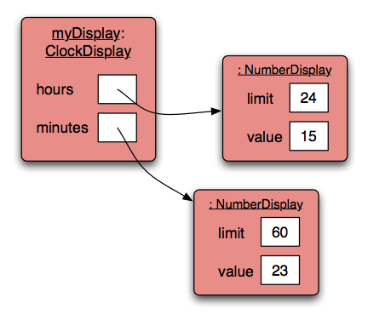
ClockDisplay object diagram

Slide 20
Method calling
public void timeTick()
{
minutes.increment();
if(minutes.getValue() == 0) {
// it just rolled over!
hours.increment();
}
updateDisplay();
}

Slide 21
External method call
external method calls
minutes.increment();
object . methodName ( parameter-list )

Slide 22
Internal method call
internal method calls
updateDisplay();
No variable name is required.
this
could be used as a reference to the invoking object, but not used for method calls.

Slide 23
Internal method
/**
* Update the internal string that
* represents the display.
*/
private void updateDisplay()
{
displayString =
hours.getDisplayValue() + ":" +
minutes.getDisplayValue();
}

Slide 24
Method calls
NB: A method call on another object of the same type would be an external call.
‘Internal’ means ‘this object’.
‘External’ means ‘any other object’, regardless of its type.

Slide 25
null
null is a special value in Java
Object fields are initialized to null by default.
You can test for and assign null: private NumberDisplay hours; if(hours != null) { ... } hours = null;

Slide 26
The debugger
Useful for gaining insights into program behavior …
… whether or not there is a program error.
Set breakpoints.
Examine variables.
Step through code.

Slide 27
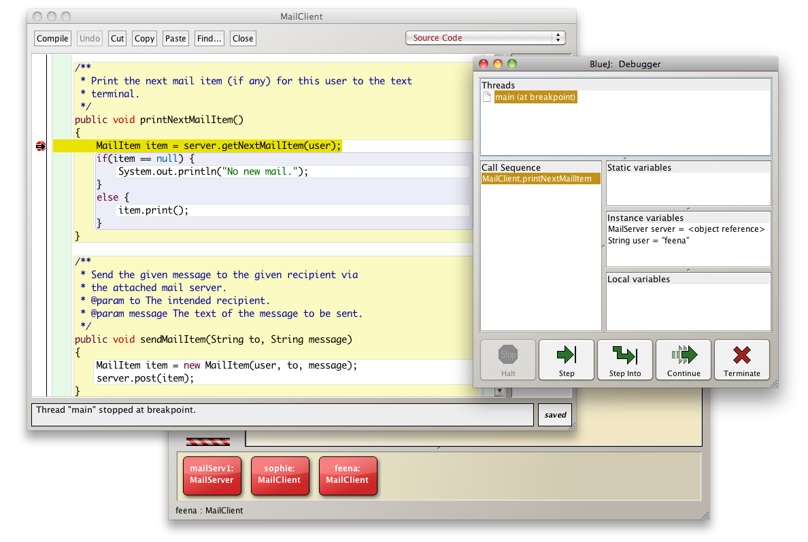
The debugger

Slide 28
Concept summary
object creation
overloading
internal/external method calls
debugger

