Slide 1
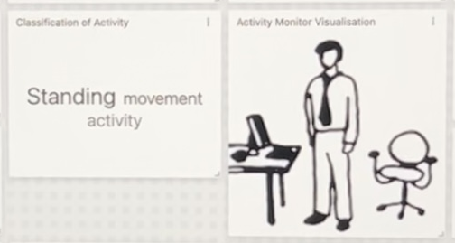
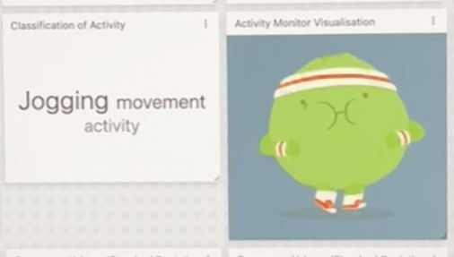
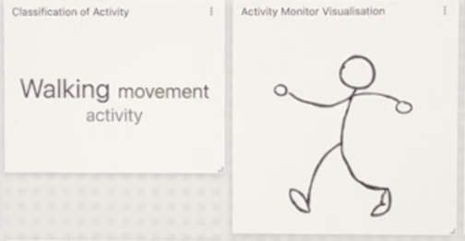
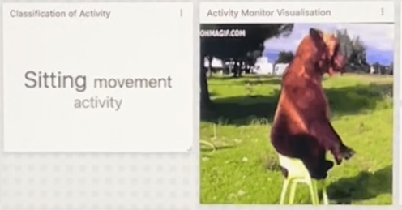
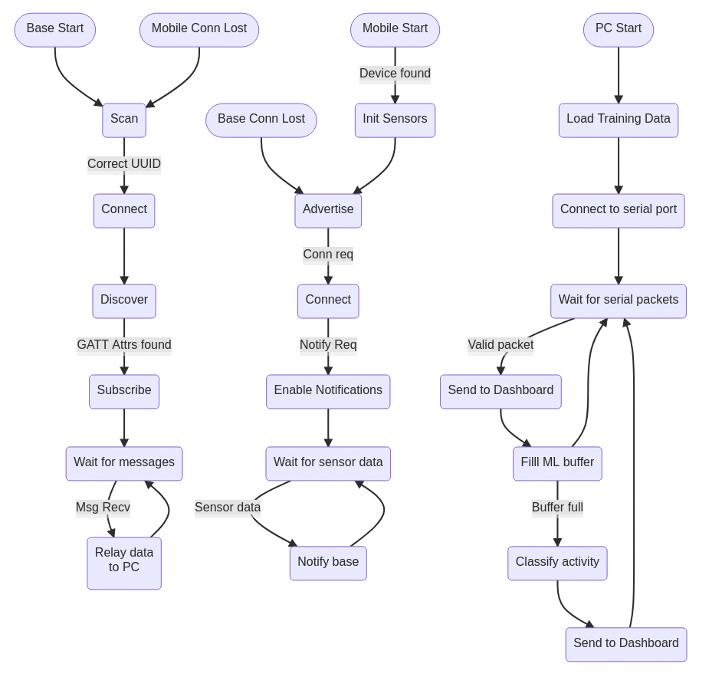
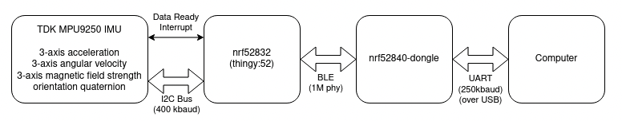
ACTIVITY CLASSIFICATION WITH THINGY:52
Matthew Kumar – 45303494 Zachary Querengasser - 43578074
AIMS (KPI)
Interfacing with the Thingy:52's onboard IMU and DMP
Using a Bluetooth and a serial connection to interface with a PC
Gathering the training dataset for the KNN algorithm
Successfully sending and receiving data from the IMU to the web dashboard
Testing the ML algorithm with sample data to classify activities
Sensor integration with the Machine Learning algorithm in real time
Displaying the classification results on the dashboard in real time
Battery life should be greater than 8 hours
Solution is extensible to more sensor nodes
RESULTS
CONCLUSIONS
All the KPI’s that were set at the beginning of the project were successfully achieved
The Machine Learning algorithm classifies activities including walking, jogging, standing, sitting and rolling
The IMU and DMP values are displayed on the web dashboard as well as the activity classification
Additionally, an example of the movement is displayed on the dashboard
SYSTEM OVERVIEW: Top Level Flow Chart
SYSTEM OVERVIEW: Block Diagram

