Slide 1
Unnamed Video Player
WPF C# Application for CSCI 352
Developed by Logan Walsh and Zachary Rose

Slide 2

Background
What is it? WPF media player
Why we chose to make a media player:
Interesting
Practical
Fun?
Other important information about the project

Slide 3
Our Approach
During development:
Applied what we learned in class
Design patterns
Pain(t)
Practiced new things
File I/O in C#
Event handler logic
Design Patterns implemented
Abstract Factory
Decorator

Slide 4
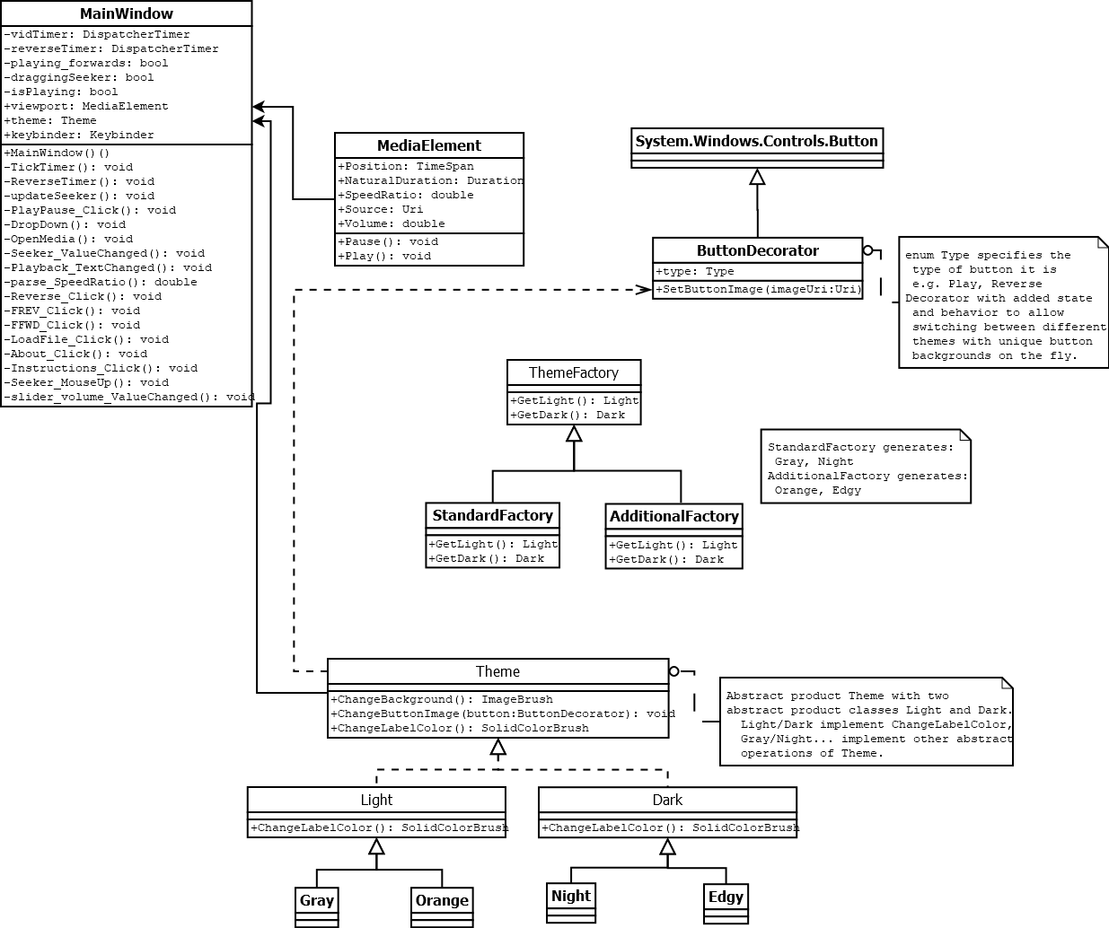
UML Diagrams

Slide 5
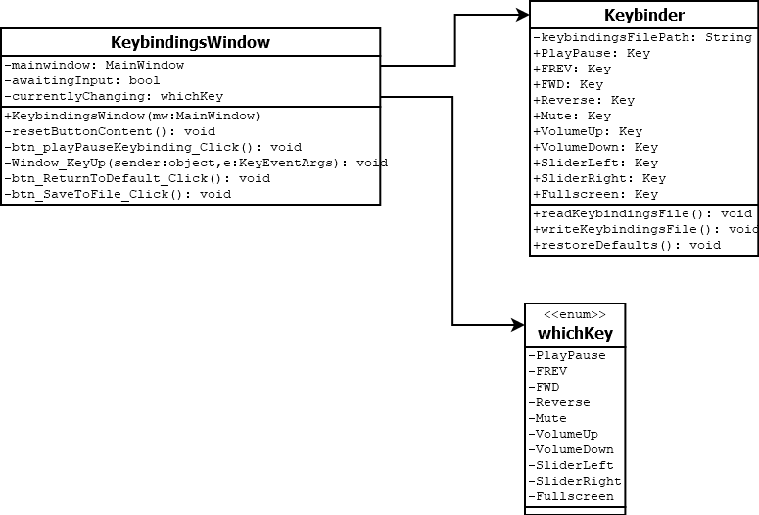
UML Diagrams

Slide 6
Demo
To use the program, simply launch it and load a file from the menu
Player supports MP4, AVI, and WMV video formats
MP3 and WAV audio formats
Different themes
Customizable hotkeys
Playback control

Slide 7
Future Work?
Video Queue
Improved UI
Options to add filters on video such as inverting colors or making the video B&W
Make the program work with more obscure file types like MKV or BIK
Add more features for when the program plays audio.

Slide 8
Any Questions?
Zachary Rose
zacerose@ut.utm.edu
Logan Walsh
lwalsh6@ut.utm.edu
Git Repository: https://github.com/zacerose/CSCI352-Final-Project-Zachary_Rose-Logan_Walsh

