Slide 1

Wiz Technical Exercise
Zach Antinelli
5.2.25
Notes:
I just want to cover a quick introduction to Wiz before we get into the demo
First off, why does Wiz exist? We feel our calling is to deliver security that accelerates business
Security that allows you to confidently use cloud to move faster, be more agile, and beat your competition
To do this we had to solve the biggest security challenge of our era, which is to find and eliminate the risks in every cloud environment that make them susceptible to a breach

Slide 2
Intro
Thank you for the opportunity to interview with you today!
I am Zach Antinelli, I am currently working as a Principal Consultant at CrowdStrike. My primary area of focus at CrowdStrike is supporting the Cloud Security solution area (CSPM, CWP, ASPM) and developing and maintaining integration tooling for the org and customers.
I am passionate about automation, security and cloud. This process has been both a challenge and a fun experience for me.
Throughout the exercise, I aimed to automate everything use repeatable processes and storing all project artifacts in code.
More detailed documentation on my build and all resources can be found in this repository:
github.com/zach-antinelli/wiz/tree/main/tech-exercise

Slide 3
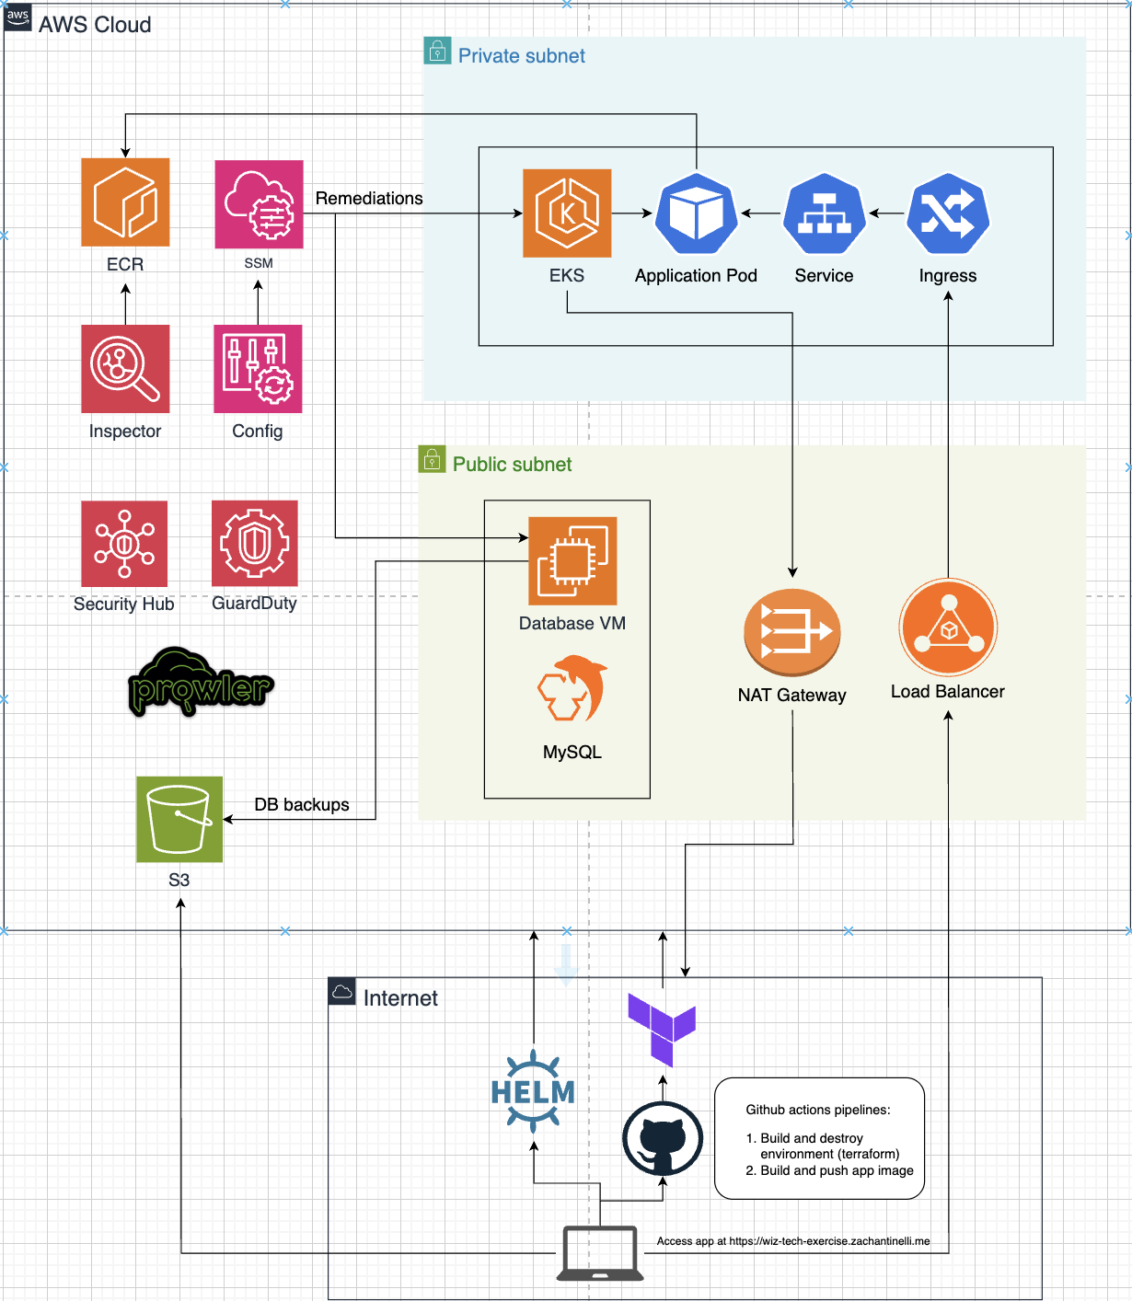
Architecture overview
Infrastructure deployment is handled through Terraform code stored in GitHub with a GitHub action triggered on push or manually initiated.
A Database VM using an older Linux distro (Ubuntu 20.04) and an older MySQL (8.0.41). Backups stored in S3 automatically executed through bash script/cronjob.
EKS Cluster with k8s 1.32, worker nodes in private subnets across two AZs with egress to the internet through NAT Gateway.
Custom web application running as a pod on the EKS cluster. Container image stored in ECR, built and pushed by GitHub action.
Web app deployed with custom helm chart. Internet ingress is automatically provisioned through AWS Load Balancer Controller.
App is available at https://wiz-tech-exercise.zachantinelli.me. Restricted access to my public CIDR only.

Slide 4
Architecture overview cont.
AWS Config for misconfiguration detection and remediation through EventBridge and SSM automation.
Inspector is performing vulnerability detection and image assessment.
GuardDuty to provide runtime detections.
Security Hub for centralized findings.
Prowler and Security Hub findings are stored in the MySQL DB and queried with the web application.
Intentional misconfigurations were introduced for IMDSv1 on the DB VM as well as public access to the EKS API Endpoint. Both are remediated with Config > EventBridge > SSM.

Slide 5
Build details
All of the main infrastructure was built and deployed with Terraform via GitHub Action.
This allows for a repeatable and clean approach to deployment. Terraform state is managed within the action as an encrypted artifact.
Image build is done through a GitHub action that leverages a Bash script. Within ECR and the Helm chart, I am using version pinning with the commit hash.
Version pinning is a good practice for image tagging to more easily identify breaking issues and support reproducibility vs a tag like “latest”.
Some configurations were manually made, like the configuration of the security tools, remediations for misconfigurations, and deployment of the helm chart for the web app.

Slide 6
Challenges
Managing an encrypted Terraform state within the GitHub action can be a bit tricky to debug.
SSM Automation through AWS Config rules took a bit of time to get implemented, but nothing too challenging.
Ensuring that nearly all of the infrastructure was deployed through code. It can be time consuming to develop and test these solutions.
I considered fully automating the deployment of the web app with ArgoCD through pipeline, but decided against that step in favor of continuing to refine the custom web app.

Slide 7
Architecture Security Outcome
From a deployment perspective and security tool coverage, the posture is not bad. We are detecting vulnerabilities, runtime, misconfigurations, etc and performing automated remediation on misconfigurations that were intentionally introduced.
However, there are big issues introduced by the architecture:
The web application pod is running privileged as well as having cluster admin role (I added both due to uncertainty about the instructions).
This is bad because the web app pod which is publicly available (only to my IP) has near-root access to the worker node. Additionally, it has full access to the K8S API and could wreak havoc on the cluster.
The DB VM is assigned an instance role that has AdminAccess and is publicly available (only to my IP).
This is worse because, if compromised, the threat actor would have full account access.
The S3 Bucket is publicly available (only to my IP), exposing contents of the database backup to the world if there was no condition for my public CIDR only.

Slide 8
Thank you!
Notes:
I just want to cover a quick introduction to Wiz before we get into the demo
First off, why does Wiz exist? We feel our calling is to deliver security that accelerates business
Security that allows you to confidently use cloud to move faster, be more agile, and beat your competition
To do this we had to solve the biggest security challenge of our era, which is to find and eliminate the risks in every cloud environment that make them susceptible to a breach

