Slide 1

Wiz Technical Exercise
Candidate Name
Notes:
I just want to cover a quick introduction to Wiz before we get into the demo
First off, why does Wiz exist? We feel our calling is to deliver security that accelerates business
Security that allows you to confidently use cloud to move faster, be more agile, and beat your competition
To do this we had to solve the biggest security challenge of our era, which is to find and eliminate the risks in every cloud environment that make them susceptible to a breach

Slide 2
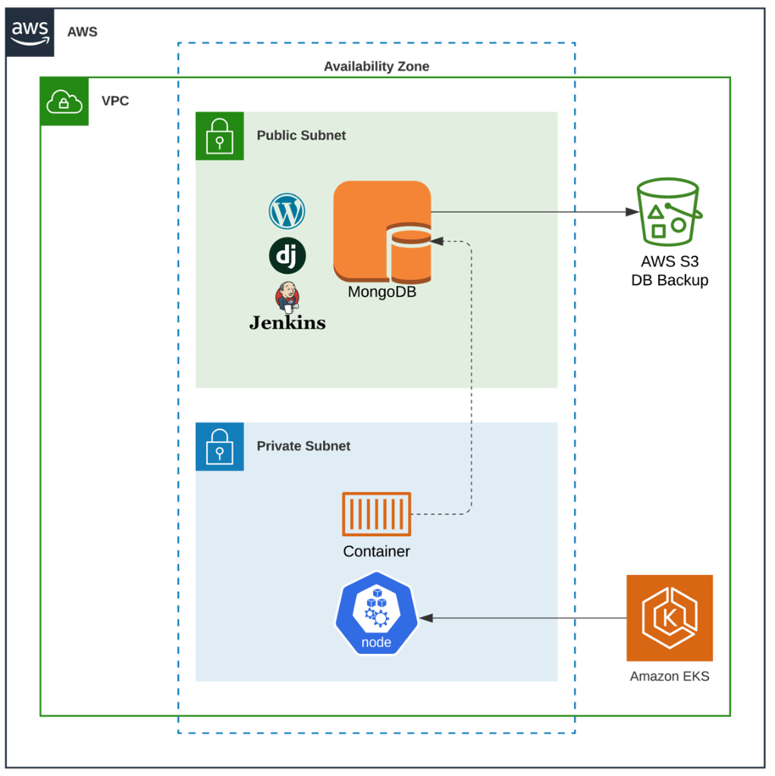
Overview
Sample Architecture: Replace with the reference architecture for the deployment for the CSP you chose.
<Tech Assignment Overview>
SAMPLE

Slide 3
What you built
<Architecture Overview>

Slide 4
How you built it
<Overview of how you built this architecture and the tools you use to complete the task>

Slide 5
The challenges you faced
<Challenges you experienced when building the technical assignment architecture>

Slide 6
Architecture Security Outcome
<What is the security outcome of building the technical assignment architecture? >

Slide 7
Resources Used
<Referenced resources (docs, blogs, videos) used for the technical assignment >

Slide 8
Thank you!
Notes:
I just want to cover a quick introduction to Wiz before we get into the demo
First off, why does Wiz exist? We feel our calling is to deliver security that accelerates business
Security that allows you to confidently use cloud to move faster, be more agile, and beat your competition
To do this we had to solve the biggest security challenge of our era, which is to find and eliminate the risks in every cloud environment that make them susceptible to a breach

