Slide 1
ScheduleMe
Zachary Bowman, Matthew DelGrosso, Chandler Furman, Ricky Sharma, Shiliang Wang

Slide 2
Agenda
Project Overview
Demonstration
Architecture and Deployment
Code Overview and Code Organization
Advanced Use-cases
Project Status

Slide 3
Project Overview
Goal: to build a single-paged web application to handle scheduling and rescheduling for small businesses
Core features:
Customers
Schedule and view appointments
Manage appointments (email reminders, find availabilities, etc.)
Businesses
Manage customer scheduling and waitlists
Manage employee schedules
Analytics
Notes:
Chandler
Goals:
Primary domain model: hair salons. But we also want to make it extensible to other industries as well. Mention the hub for businesses. Very similar to OpenTable, but for other types of businesses. With a different domain model, we have slightly different requirements that we have to meet
For customers, select an appointment based on a preferred time, or browse openings.
Other features include:
Managing waitlists for customers and businesses
Handle cancellation of appointments
Allow for different types of services
A feature to check in customers
Business reviews
…
A number of other edge cases

Slide 4
Demonstration
Notes:
Zach
Twitter bootstrap for looks
Highlight login business, customer, etc.
Talk about different types of accounts
Differences between business, employee and customer
How an employee account is created (create a key, email to the employee, etc)
Walk us through creating an account and signing up
Enter wrong password and those types of things

Slide 5
Architecture
Server
(Deployed on heroku)
Client
(BackboneJS framework)
ExpressJS
View
Socket.io
Twitter Bootstrap
Socket protocol
Model
MongooseJS
Custom classes/methods
MongoHQ
JSON
MongoDB
Controller
Server
Deployed on heroku
ExpressJS app to interact with MongoDB
Socket.io to push real time updates to the client
Client
Backbone.js framework

Slide 6
Dependencies
package.json:
{
"name": "application-name",
"version": "0.0.1",
"private": true,
"scripts": {
"start": "node app.js"
},
"dependencies": {
"express": "3.4.4",
"ejs": "*",
"mongoose": "~3.8.0",
"passport-local": "~0.1.6",
"passport": "~0.1.17",
"underscore": "~1.5.2"
}
}

Slide 7
Code Overview
MVP (Model-View-Presenter) application design
Similar to a Model-View-Controller except:
view is passive
presenter handles all data retrieval and display formatting
Notes:
Matt
- MVC design, but slightly different than the traditional MVC

Slide 8
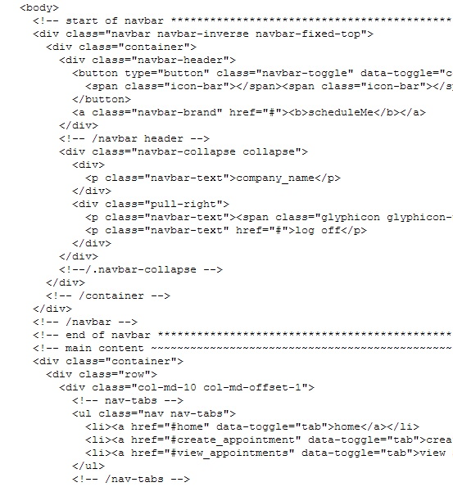
Code Overview
Before Backbone
Notes:
Matt
- MVC design, but slightly different than the traditional MVC

Slide 9
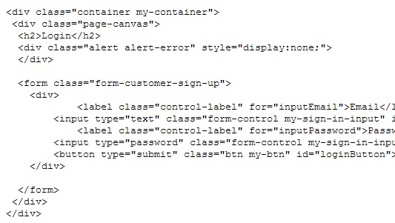
Code Overview
Before Backbone
After Backbone
Notes:
Matt
- MVC design, but slightly different than the traditional MVC

Slide 10
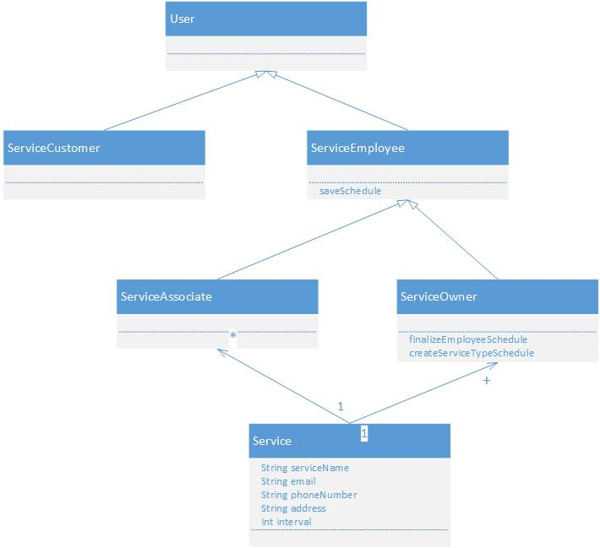
UML Overview – User
Notes:
Matt
- MVC design, but slightly different than the traditional MVC

Slide 11
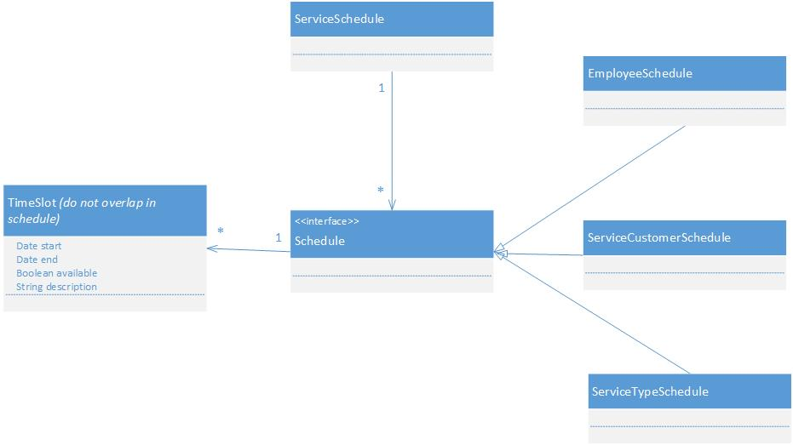
UML Overview – Schedule
Notes:
Matt
- MVC design, but slightly different than the traditional MVC

Slide 12
Advanced Use-Cases
Schedule an appointment
Cancel an appointment
Notes:
Peter
Main points:
Talk about nuances of a single-page app, and how routes work to store the state of the webpage
Talk about live updates to clients

Slide 13
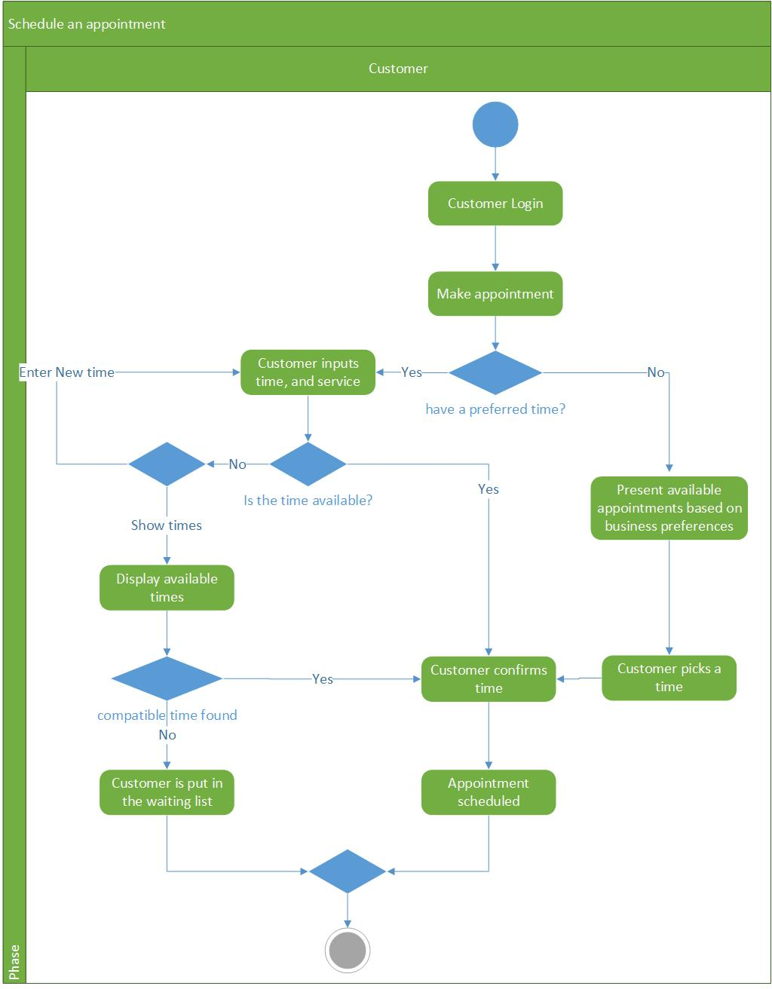
Schedule an Appointment

Slide 14
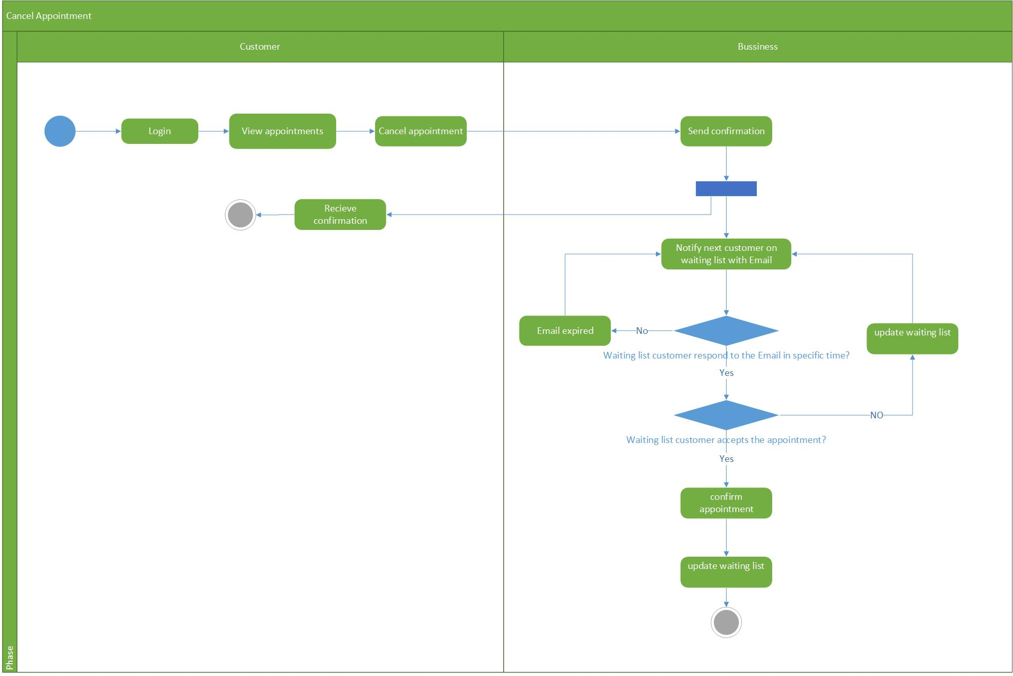
Cancel an Appointment

Slide 15
Project Status
Current status
Account creation and login are enabled
Database connection and backend management
Dynamic, single-paged app; MVC framework
Iteration 5
Manage employee schedules and schedule shifts
Add/remove employees
Iteration 6
Customer schedule appointments
Waitlist functionality
Extended features (time permitting)
Notes:
Chandler
Main point: talk about where we are at and where we are going from here
Iteration 5: business functionality
Iteration 6: customer functionality

Slide 16
Thank you!
Notes:
Chandler
- Also talk about current status of the project

