Slide 1
Flipping Homes in a College Town
Zachary Brown, Data Scientist

Slide 2
Overview
Problem
Set Features
Model
Analysis
Renovation Features
Conclusion

Slide 3
Problem Statement
Identify key unchangeable factors affecting home sale price in college towns.
Quantify renovation return on investment.

Slide 4
Today
Learn 3 features to look for when buying homes to flip.

Slide 5
Set Features
Size
Low-density residential
Single Story

Slide 6
Model
Answers:
What factors drive up sale price?
Which property to flip

Slide 7
Data
Ames, Iowa
2006 – 2010
2049 homes

Slide 8

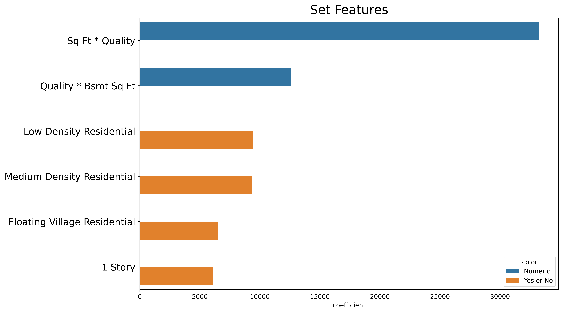




Slide 9
Model
Answers:
Renovation return on investment.

Slide 10
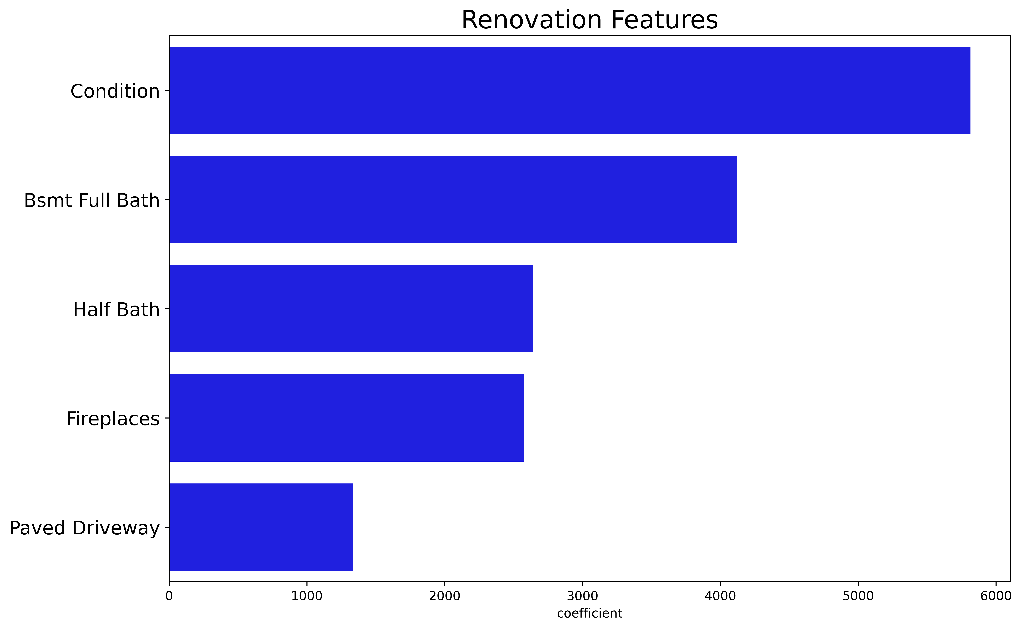

Slide 11
E.G. Bathrooms
Feature | Price Increase per Additional
Basement Full Bath | $ 7900
Full Bath | $ 5445
Half Bath | $ 5275

Slide 12
Insights
Access to the full predictive power of this housing model.
Detailed list of renovation ROI.

Slide 13
Conclusions
We can identify key unchangeable features to seek when buying a home to flip.
We can quantify the ROI on renovation jobs.

Slide 14
Conclusions
Large homes
Single story
Low-density residential
Bathrooms - TBD

