Slide 1
How Much Data Do You Need?
Zachary Brown, Data Scientist

Slide 2
Decrease cost by gathering the perfect amount of data.
Notes:
Answering the title question will help you reach this goal. I will tell you how to do this at the end of the presentation.

Slide 3
TABLE OF CONTENTS
1.
4.
2.
3.
ABOUT THE PROJECT
Solutions
Problem statement
Scope
Alternative approaches
The Data
Oceans, Diving subreddits
The Models
Logistic regression
Naive Bayes

Slide 4
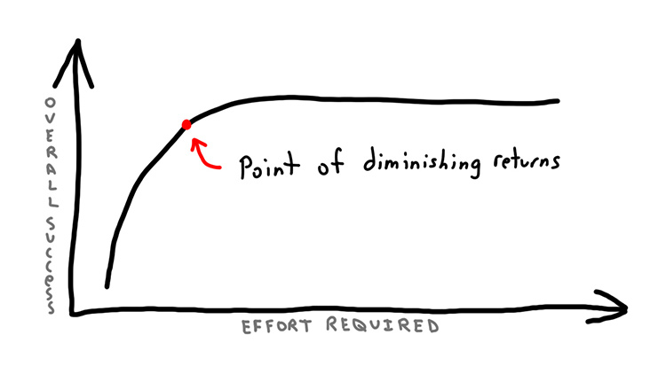
Demonstration
How much does the accuracy of a classification model improve as more training data is added?

Slide 5

Data Collection
Costs:
Gathering
Storage
Cleaning and archiving
Time
Benefits:
More accurate models

Slide 6
2
The Data
Reddit’s Pushshift API

Slide 7


Subreddits
Oceans
Diving
?

Slide 8
Datasets of Different Sizes
Large
7500 Posts
Medium
Small
5300 Posts
3000 Posts

Slide 9
Datasets of Different Sizes
Large
150% more data
Medium
Small
77% more data
Baseline

Slide 10



Preprocessing and Feature Engineering
Remove Words
Post/Title Length
Sentiment Analysis
Remove words that have no contribution to the model’s predictive power.
Engineer additional features.
Common feature for NLP models.
Notes:
Shape the data into a polished form to feed to the model.

Slide 11
3
The Models

Slide 12

Models
Logistic Regression
Naive Bayes
Baseline

Slide 13

The Models
Logistic Regression
Naive Bayes
Tuned models based on:
Word frequency
Word importance
Word removal
Different size chunks

Slide 14
Results
 | Logistic Regression | Naive Bayes | Baseline
Large (+150%) | 88% | 88% | 55%
Medium (+77%) | 86% | 86% | 55%
Small | 83% | 83% | 60%
Notes:
Add the data % increase per dataset.

Slide 15
Accuracy Increase / Data pool increase | Accuracy Increase / Data pool increase
Large (+150%) | .033%
Medium (+77%) | .039%
Notes:
Add the data % increase per dataset.

Slide 16
Diminishing Returns

Slide 17
4
Solutions

Slide 18

Data Science Consultant
Analyze and quantify the effect of gathering new data on the performance of your current and future models.

Slide 19

Next Steps
Techniques for maximizing the value of preexisting data.
e.g. Bootstrapping

Slide 20
THANKS!
DO YOU HAVE ANY QUESTION?
Please keep this slide for attribution.

Slide 21
ALTERNATIVE RESOURCES
Diminishing Returns Image: https://jeffreyeverhart.com/wp-content/uploads/2017/09/have-you-hit-the-point-of-diminishing-returns-as-a-developer-dab85385ef9a5da4b6717c87f92d138e78d712fd28c339f0dfdf79a92835e2e3.jpg
Data Image: https://www.cio.com/article/3245386/the-data-warehouse-in-2018.html
Ocean Image: https://kids.nationalgeographic.com/content/dam/kids/photos/articles/Nature/H-P/Habitats/Ocean/wave.ngsversion.1500050062134.adapt.1900.1.jpg
Diving Image: https://www.aussiediversphuket.com/wp-content/uploads/2015/07/scuba-diving-phuket-with-aussie-divers.jpg

