Slide 1

Car Crash Fatalities
Zach Chase
Data Science Tools 2

Slide 2
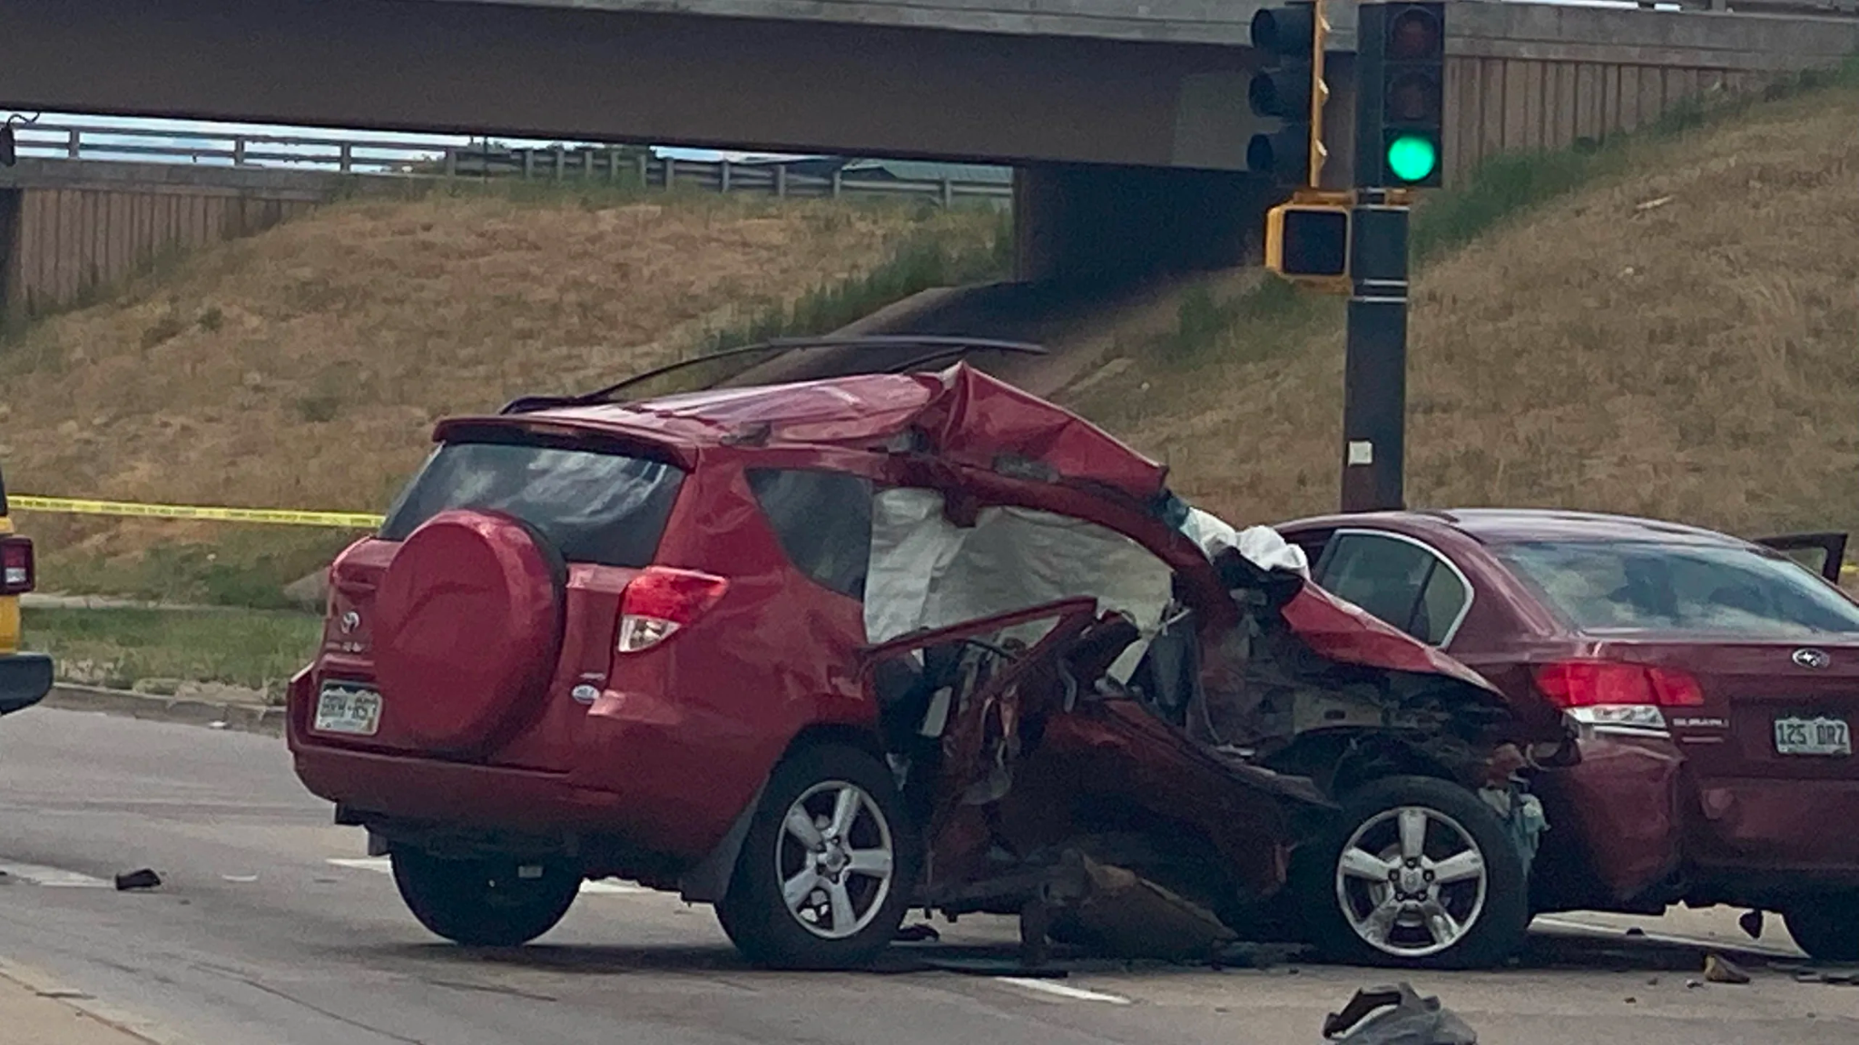
Purpose
The purpose of this project is to compare the performance of the algorithms Logistic Regression, Support Vector Machine, Decision Tree, Random Forest, and K-Nearest Neighbor in predicting deaths from car accidents using car crash data.

Slide 3
Significance
The National National Highway Traffic Safety Administration estimated that 42,915 people died in motor vehicle traffic crashes nationwide in the year 2021 - a 16 year high.¹
In 2016 The New England Journal of Medicine determined that motor vehicle crashes were the leading cause of death for children and adolescents, representing 20% of all deaths.²

Slide 4
Research Question
How do the algorithms of Logistic Regression, Support Vector Machine, Decision Tree, Random Forest, and K-Nearest Neighbor compare in predicting vehicle fatalities using known car accident information such as year of the model, if an airbag is deployed, etc.?

Slide 5
Description of the Dataset (Inputs)
Year of Vehicle (Int)
Year of Accident (Int)
Airbag in Car (Categorical)
Airbag Deployment (Categorical)
Occupant Role (Categorical)
Age of Occupant (Int)
Sex of Occupant (Categorical)
If Accident was Frontal Collision (Categorical)
Seatbelt Usage (Categorical)

Slide 6
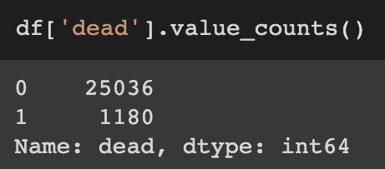
Description of the Dataset (Output)
dead: binary response of if occupant was killed in crash
Data is imbalanced:

Slide 7
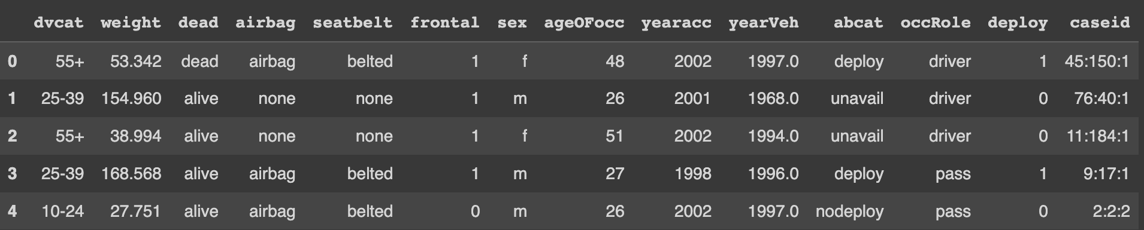
Exploratory Data Analysis
No missing values
26,217 observations
No duplicate entries

Slide 8
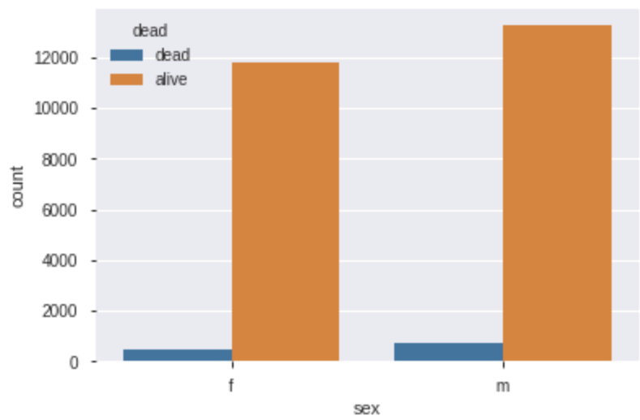
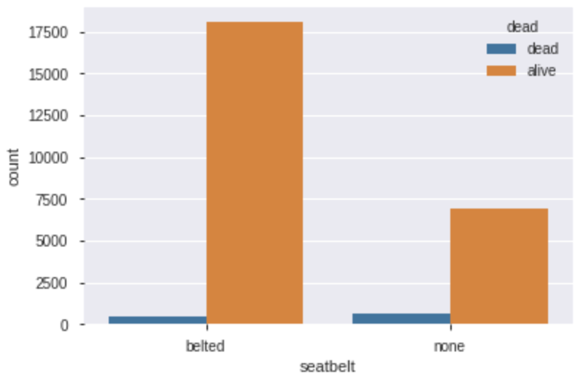
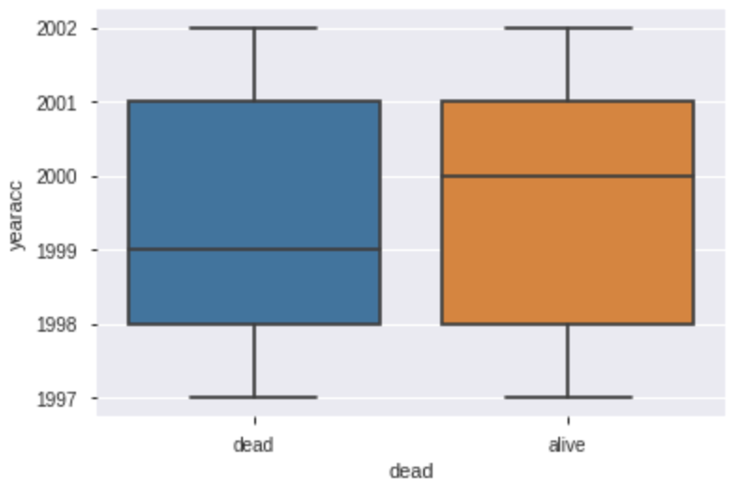
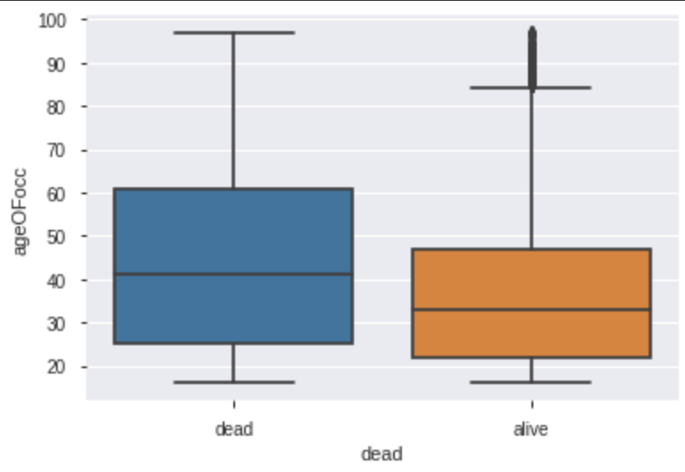
Visualizations

Slide 9
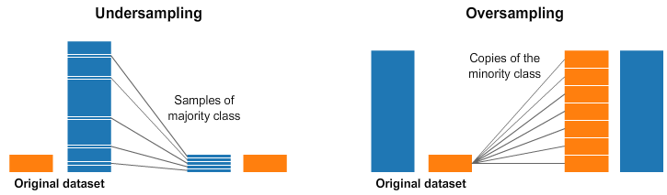
Imbalanced Data
Undersampling deletes examples in the majority class
Oversampling duplicates or replicates examples in the minority class

Slide 10
Oversampling
Random Oversampling supplements the data with random copies of the minority class.
SMOTE (Synthetic Minority Over-sampling Technique) creates synthetic data points by selecting pairs of minority class observations, and creating a synthetic point that lines on the line connecting these observations.

Slide 11
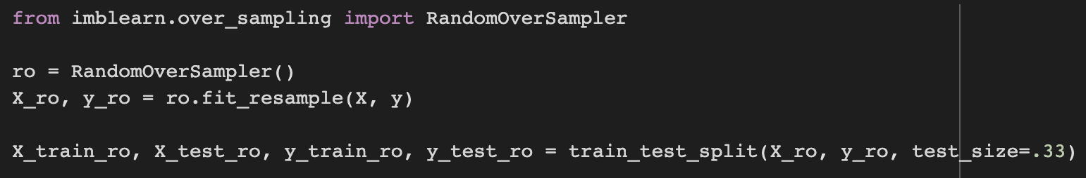
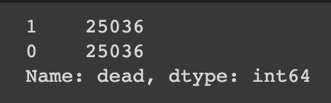
Oversampling

Slide 12
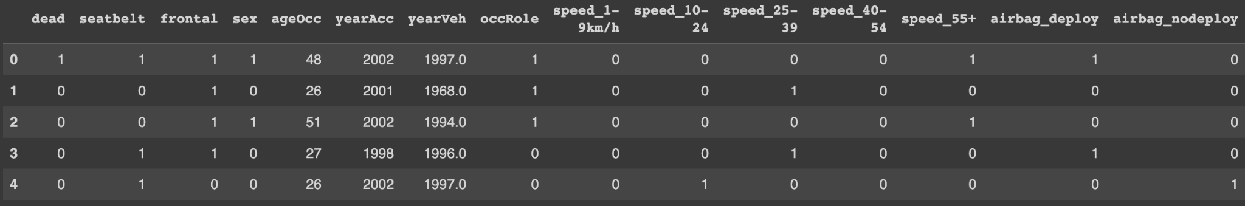
Cleaning
StandardScaler()
One-Hot Encoding
Dropped not needed columns

Slide 13
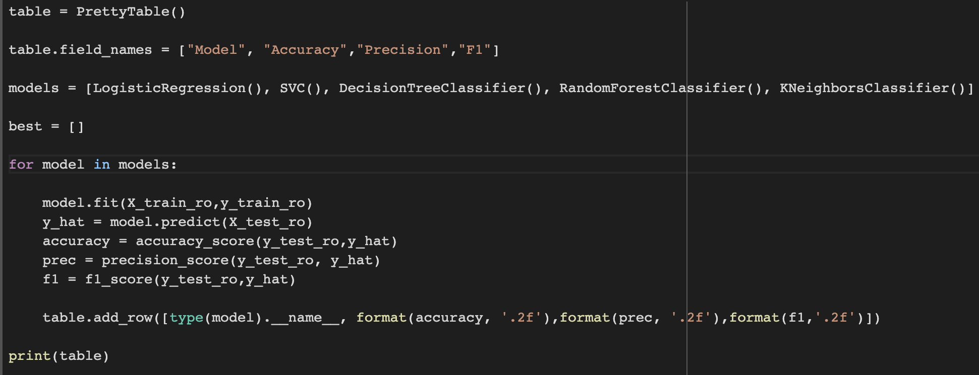
Model Building

Slide 14
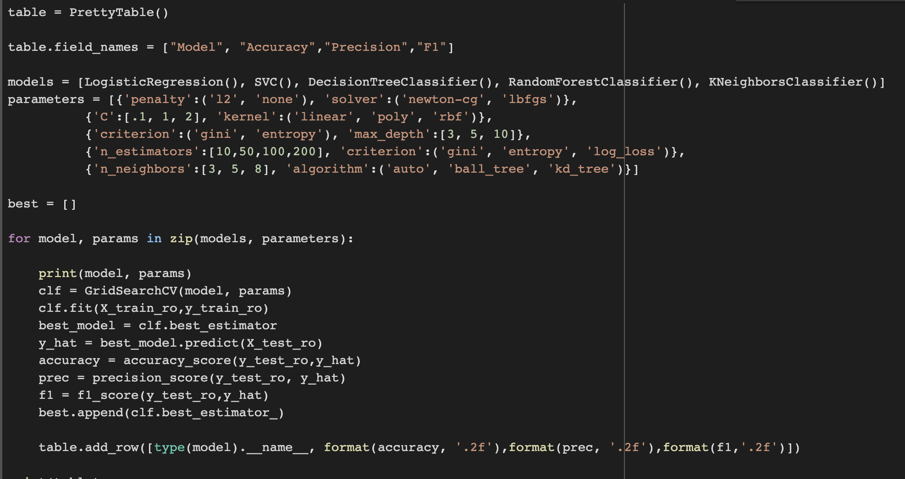
Model Optimization and Model Selection

Slide 15
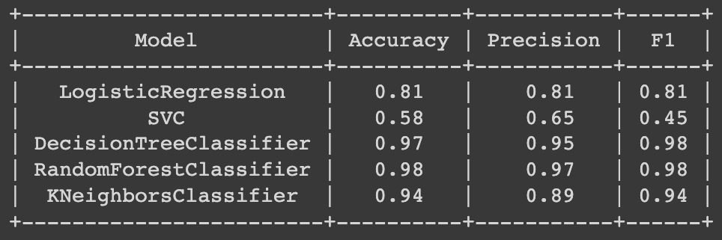
Model Comparison

Slide 16
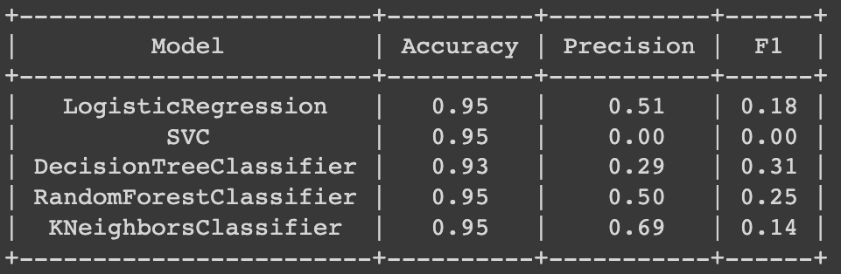
Model Comparison (without oversampling)

Slide 17
Conclusion
Importance of handling imbalanced data.
Importance of using various metrics to measure performance.
Random Forest performs the best at predicting fatalities of car crashes on the given data.
Support Vector Machine performed the worst in predictions.
Future: more hyperparameters and look at feature importance.

Slide 18
Works Cited
https://crashstats.nhtsa.dot.gov/Api/Public/ViewPublication/813283
https://www.nejm.org/doi/full/10.1056/nejmsr1804754#:~:text=Motor%20vehicle%20crashes%20were%20the,responsible%20for%2015%25%20of%20deaths.

