Slide 1
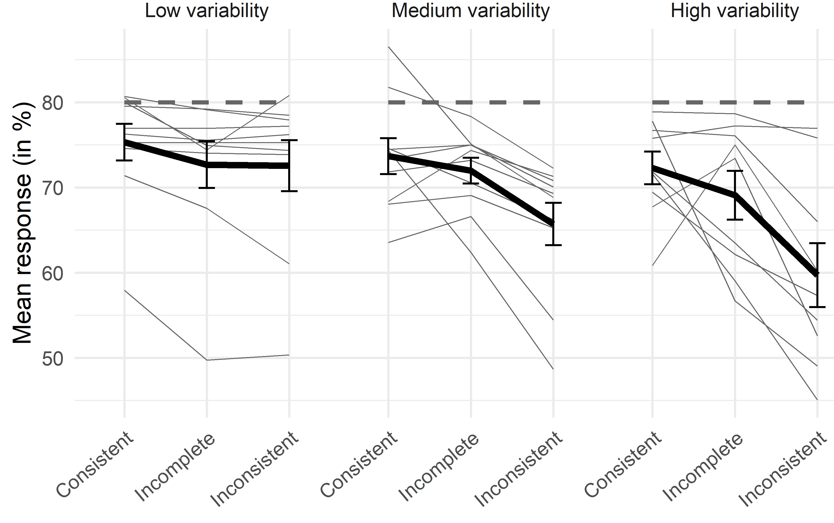
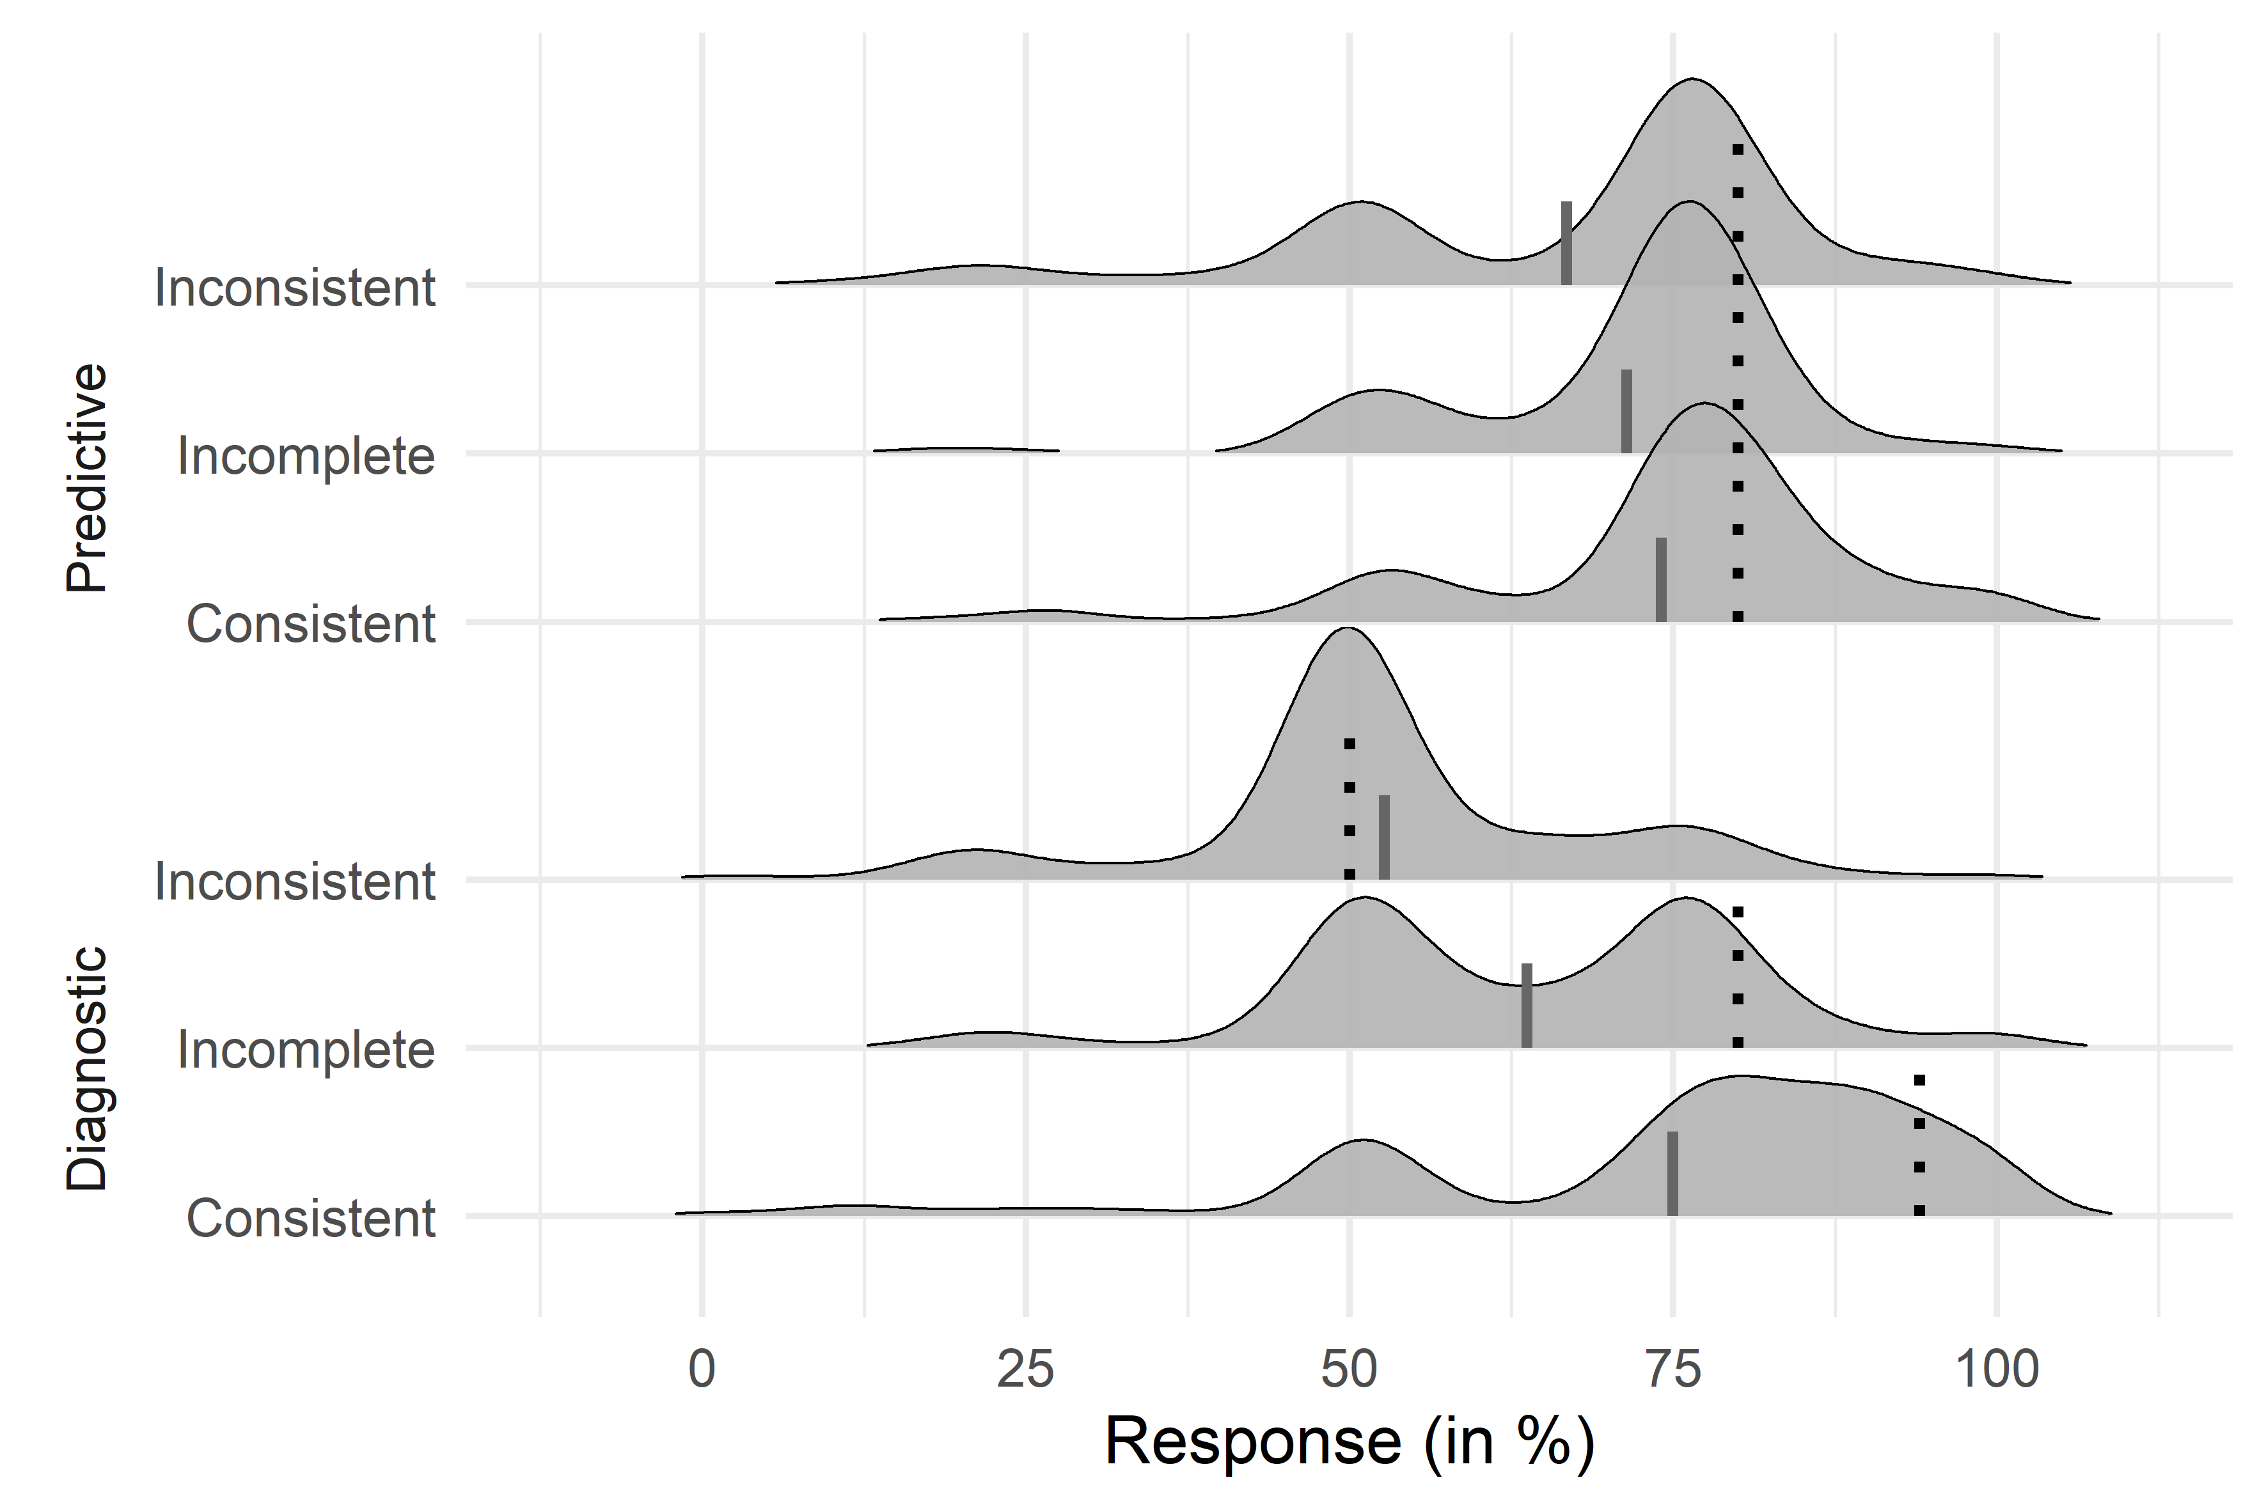
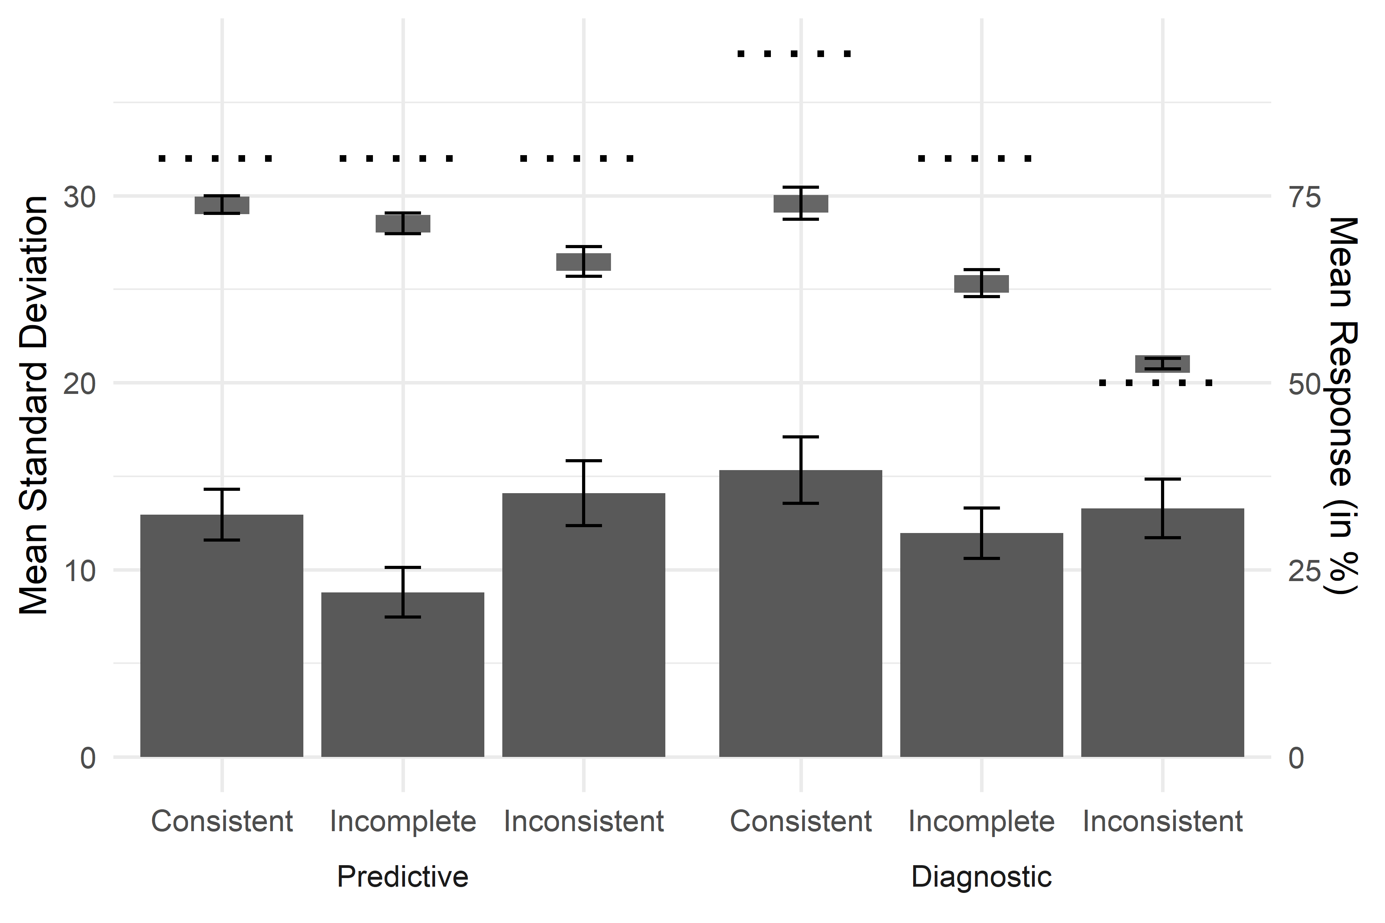
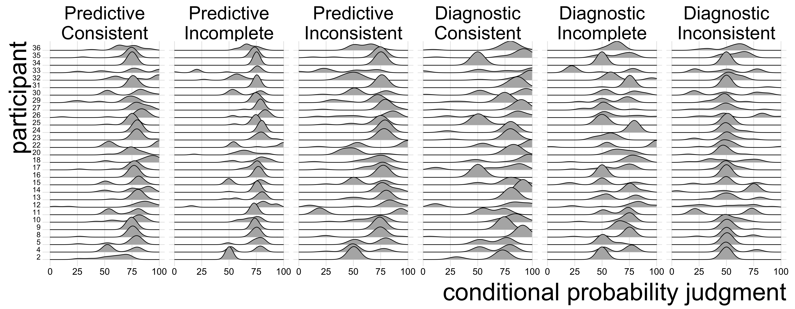
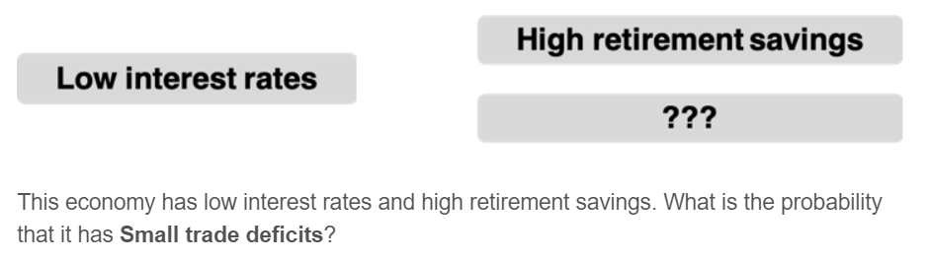
Variability in Causal Reasoning
Ivar Kolvoort¹, Zachary J. Davis¹, Leendert van Maanen, & Bob Rehder
1 equal contribution. IR: i.r.kolvoort@uva.nl, University of Amsterdam. ZD: zach.davis@stanford.edu, Stanford University
Background
Experiment
Results
Markov violations
We investigate the source of the considerable variability of causal judgments.
6 inference types
“Spikes” at 50%
vary by query
example distributions from Rottman & Hastie (2016)
consistent
incomplete
inconsistent
Many multi-
modal responses!
predictive
1
1
1
–
1
0
?
?
?
?
1
1
1
diagnostic
1
?
–
?
0
We do so by analyzing full response distributions of participant judgments, instead of just mean responses.
?
queried variable
–
variable’s state is unknown
More variable participants committed larger Markov violations. A common process might drive both Markov violations and a part of the observed variability
1
present variable
0
absent variable
Repeated independent measurements
Questions
To get multiple measurements of a single inference type we collapsed over:
5 different domains
Flipping the two effects
Absence and presence P(Y=1) = 1- P(Y=0)
Resulting in 20 measurements of each inference type, and 120 queries per participant.
Sources of variability
normative response
mean participant judgment
Is there meaningful within-participant variability?
Does variability differ across inference types?
Predictive vs diagnostic reasoning
Effect of conditional information
Is individual level variability related to violations of Markov independence?
Can existing models explain within-participant variability?
Variability per inference type
Motor or general task noise cannot explain the variability, as it varies systematically and is multi-modal.
Distributions are not centered on the normative response, counter to predictions of e.g. the Beta inference model (R&H, 2016)
Uncertainty about the parameters of the causal network is unlikely as a source. It could explain increased variability for diagnostic inferences, but cannot explain other findings.
Default responding might explain spikes at 50%. A possible explanation of changes in spikes might be that guessing is more likely with more ambiguous information.
The Mutation Sampler (D&R, 2020) can explain the changing spikes and predicts within-participant variability.
Raw results
Setting
within-participant
variability differs
by inference type!
50% base rate
Y
X
75% causal strengths
Z
Within-participant variability (bars) does not follow mean response (floating boxes) and varies systematically per inference type:
Variability is lower for inferences with incomplete information.
Variability is higher for diagnostic inferences.
These findings indicate that the observed within-participant variability reflects (at least partly) a decision-making process, and not just noise.
Inference task
given state of 1 or 2 variables
predict unknown variable’s state (0 – 100)
Conclusions
Within-participant variability in causal reasoning can be probed experimentally and is related to the type of inference
Variability can’t be explained by simple additions to normative CGM model
Computational models need to account for (systematic variation in) variability
References:
D&R: Davis & Rehder (2020) A Process Model of Causal Reasoning. Cog. Sci.
Rehder (2014) Independence and Dependence in Human Causal Reasoning. Cog. Psy.
Rehder (2018) Beyond Markov: Accounting for independence violations in causal reasoning. Cog. Psy.
R&H: Rottman & Hastie (2016) Do People Reason Rationally about Causally Related Events? Cog. Psy.

