Slide 1
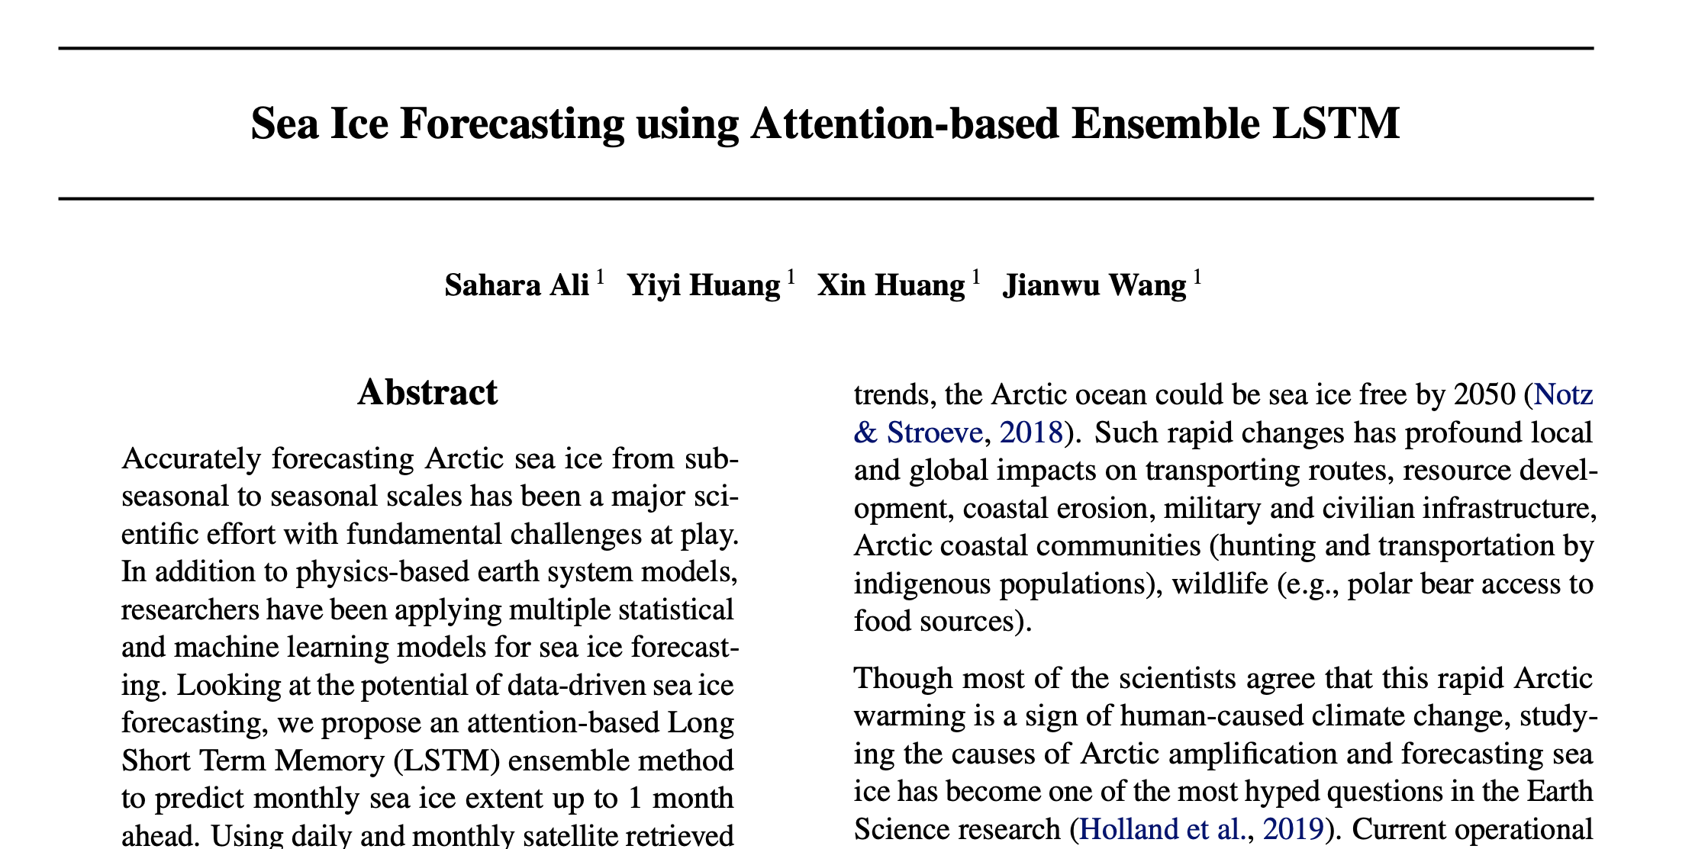
SYDE 675: Project paper: Sea Ice Forecasting using Attention-based Ensemble LSTM
Zacharie Gousseau & Nishad Rajmalwar Systems Design Engineering

Slide 2
Presentation outline
Overview of the original paper
Compare with ML methods & statistical baselines
Investigating improvements

Slide 3
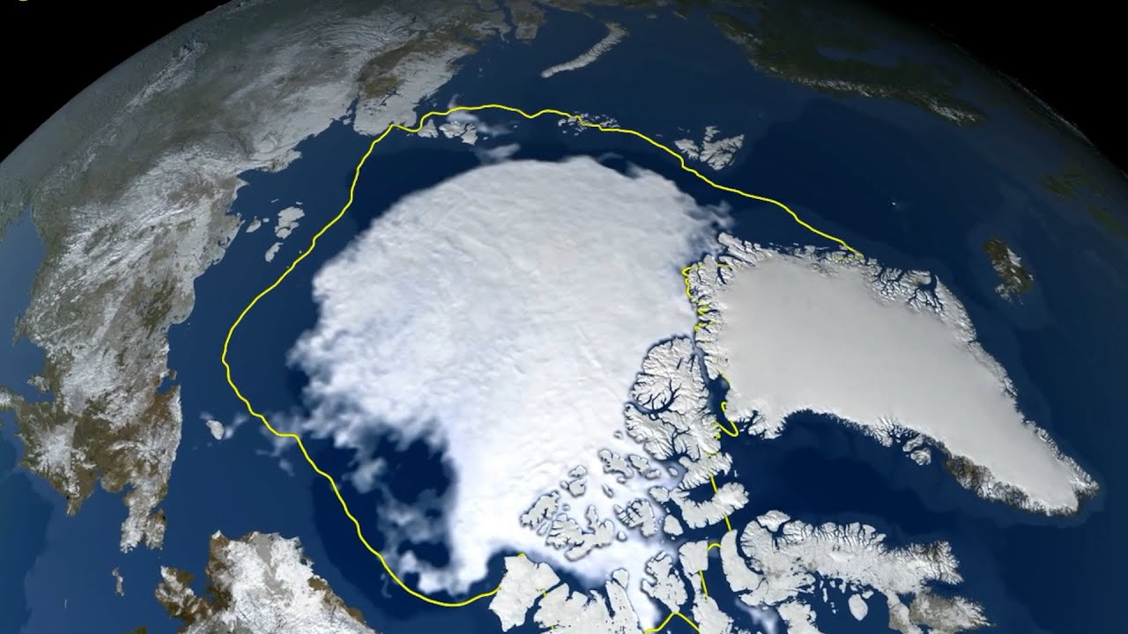
Overview: Ali et al.
Sea ice extent prediction using attention-based LSTMs

Slide 4
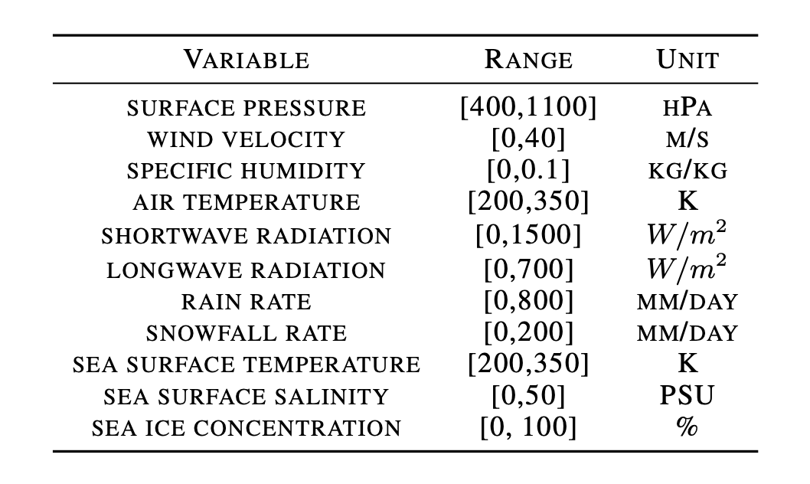
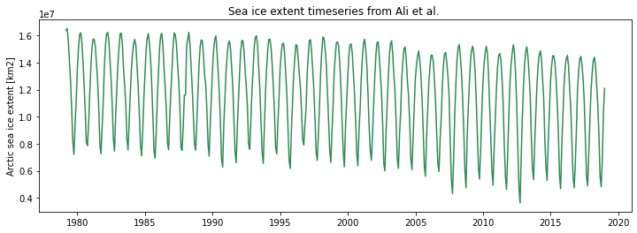
Problem statement
Goal: Predict arctic sea ice extent (SIE) with a 1-month lead time
i.e., the average SIE for the next month
Input variables sourced from the ERA5 global reanalysis product, and averaged over everything North of 25˚N
Target variable (SIE) calculated from NSIDC’s sea ice concentration product (from Nimbus-7 passive microwave data)
Input variables
Target variable
SEA ICE EXTENT [0, 1e7] km²
Notes:
(Introduce paper, state goal, state inputs and outputs
Can note that we do not understand how an average of, say, wind velocity over that big a region can be indicative of anything

Slide 5
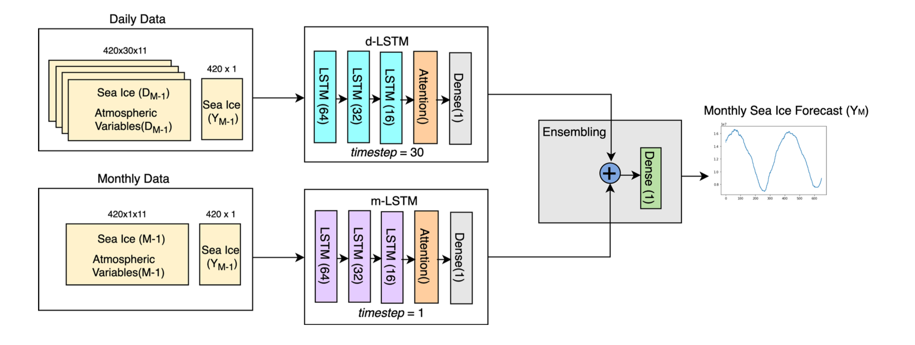
Innovations
Combine daily and monthly observations as an ensemble model
Implement attention to learn to focus on specific features of the hidden states
Notes:
They introduce two main innovations
1. combining timescales, to account for the influence of short- and long-term trends and influences
- to accomplish this: reshape data to 30*11, w/ monthly data having one timestep, daily data having 30 timesteps
2. adding attention layers on the outputs of the two LSTM layers to learn to focus on specific features of the hidden states
- (they do not go into detail about why they think this should improve performance, nor test whether it does; in our tests, it did but only marginally)

Slide 6

Metrics used
R² score
$R^{2}=1−\sqrt{\frac{\sum_{i=1}^{N}{{\left(y_{i} − ŷ_{i}\right)}^{2}}}{\sum_{i=1}^{N}{{\left(y_{i} −u\right)}^{2}}}}$
Percent Root Mean Squared Error (%RMSE) using mean
$RMSE=\sqrt{\frac{\sum_{i=1}^{N}{{\left(y_{i} − ŷ_{i}\right)}^{2}}}{N}}$
% $RMSE$ = $\frac{RMSE}{mean(ŷ)}$

Slide 7
Replicating their results
Summary: Could not replicate their results, despite having the original code and data available
The models do not produce consistent results between random model initializations, likely due to poor regularization.
We suspect their results are the product of a single model run, rather than an average of multiple trials.
Model | R² Score |  | % RMSE
 | Mean | Std. Dev. | Mean | Std. Dev.
d-LSTM | 0.983 | 2.72e-3 | 4.15 | 3.30e-3
m-LSTM | 0.974 | 7.56e-3 | 4.86 | 7.15e-3
EA-LSTM | 0.964 | 6.56e-3 | 5.78 | 5.19e-3
Model | R² Score | % RMSE
d-LSTM | 0.980 | 4.45
m-LSTM | 0.981 | 4.21
EA-LSTM | 0.982 | 4.11
Table 1. Original results by Ali et al.
Table X. Results obtained in this work using n=20 model runs.
Notes:
Note that our d-LSTM r2 score is actually higher than theirs & that the ea-LSTM performs the worst & has highest Std Dev

Slide 8
ML Methods & Baselines
How do simple algorithms compare?

Slide 9
Comparison of ML model performance
Model | R² Score |  | % RMSE
 | Mean | Std. Dev. | Mean | Std. Dev.
Linear Regression | 0.975 | 1.14e-16 | 4.85 | 2.14e-15
Ridge Regression | 0.975 | 2.28e-16 | 4.87 | 2.14e-15
Lasso Regression | -0.12 | 0.00 | 32.4 | 5.69e-15
Decision Tree | 0.967 | 4.41e-3 | 5.57 | 3.82e-3
Random Forest | 0.981 | 5.45e-4 | 4.25 | 6.01e-4
Gradient Boosting | 0.975 | 2.18e-4 | 4.85 | 2.11e-4
XGBoost | 0.979 | 2.28e-16 | 4.45 | 7.12e-16
Polynomial Regression (deg=2) | 0.927 | 1.14e-16 | 8.31 | 1.42e-15
SVM Regression | 0.969 | 1.14e-16 | 5.43 | 0.00
Table 4. Results from traditional machine learning methods on Sea Ice prediction with a lead time of 1 month calculated over 20 experiments
Notes:
Random forest gives the best results with low standard deviation
Linear regression, Ridge regression, Gradient Boosting and XGBoost perform well with very low standard deviation
Decision Tree and SVM regression performs slightly worse than the above models
Polynomial regression with degree 2 leads to a decrease in performance. Increase in degree leads to lower performance
Lasso regression does not generalize at all. L1 norm penalty does not work for the problem.

Slide 10
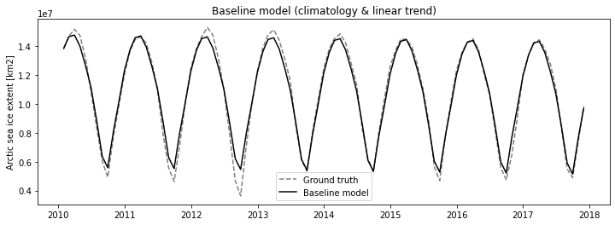
Comparing to a baseline
To properly assess the skill of their model, we compare their results to a simple statistical baseline: climatology with a linear trend
Climatology: Monthly averages of the entire training set
Linear trend: Linear trend of the residuals after removing climatology (to account for the steady decrease in SIE)
Model | R² Score | % RMSE
d-LSTM | 0.983 | 4.15
m-LSTM | 0.974 | 4.86
EA-LSTM | 0.964 | 5.78
Baseline | 0.986 | 3.60
The baseline model performs best & can account for 98.6% of the variation!

Slide 11
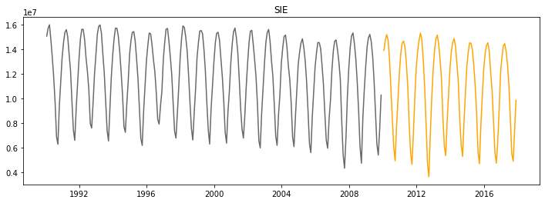
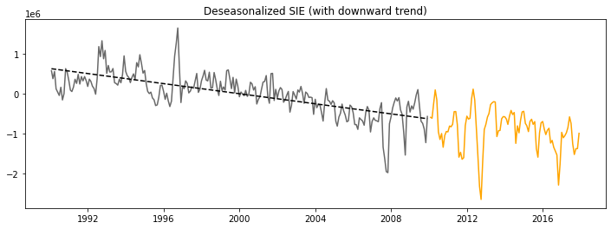
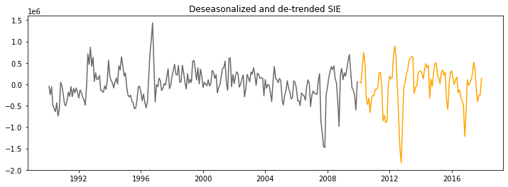
Beating the baseline
A skillful model should be able to predict variations in the target variable after having removed seasonality and linear trend (i.e. be able to predict anomalies)
Removing the seasonality and linear trend from the target data allows the model to focus on capturing non-obvious variations
Can we use Ali et al.’s architecture to predict these anomalies?
Notes:
Note: give the "why”

Slide 12
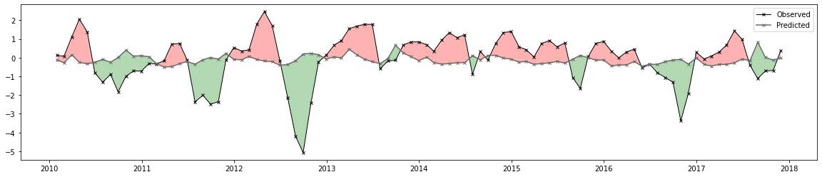
Beating the baseline
Can we use Ali et al.’s architecture (& modifications) to predict anomalies?
Modifications:
Remove seasonality from inputs and target variables
Add several new timeframes (3-day, 10-day, 15-day) to the ensemble
Train the ensembles separately before combining with a dense layer
Increase/decrease number of LSTM layers & cells
Short answer: No.
Figure #. Arbitrary example of a poorly-performing model

Slide 13
Improvements
Can we do better?

Slide 14
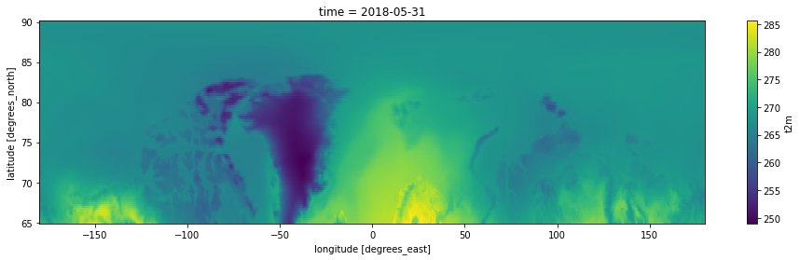
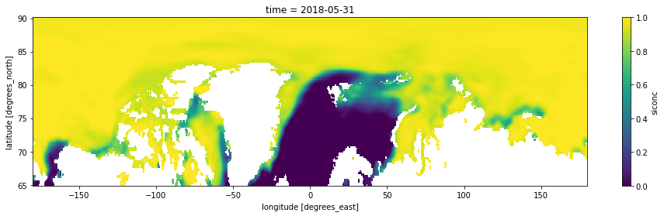
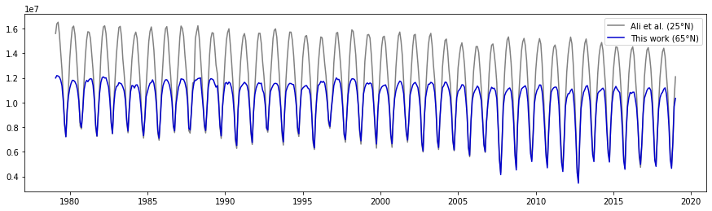
Introducing spatial information
Ali et al.’s model uses 1-D inputs, thereby ignoring any spatial information
New input dataset: ERA5 data North of 65N* & aggregated to monthly means to keep data size manageable
Note that we are using ERA5 sea ice concentrations to calculate SIE
*65N is a more common definition of the pan-Arctic domain

Slide 15
Climatological variables (19)
Variable | Units
u-component of wind (u10) | m s⁻¹
v-component of wind (v10) | m s⁻¹
Dewpoint temperature (d2m) | K
2m temperature (t2m) | K
Total precipitation (tp) | m
Snowfall (sf) | m of water eq.
Sea surface temperature (sst) | K
Sea ice area fraction (siconc) | %
Surface solar radiation downwards (ssrd) | J m⁻²
Surface sensible heat flux (sshf) | Jm⁻²
Variable | Units
Surface latent heat flux (slhf) | Jm⁻²
Mean sea level pressure (msl) | Pa
Evaporation (e) | m of water eq.
Snowmelt (smlt) | m of water eq.
Total cloud cover (tcc) | %
Significant wave height (swh) | m
Mean wave period (mwp) | s
Mean wave direction (mwd) | Deg
10 metre wind gust (fg10) | m s⁻¹
Notes:
Note that these are all variables which are related to ocean physics, but that we do not necessarily have good theory for how each would affect sea ice formation / melt / etc. and that we plan to do a sensitivity analysis to find variable importance
Sensitivity analysis

Slide 16
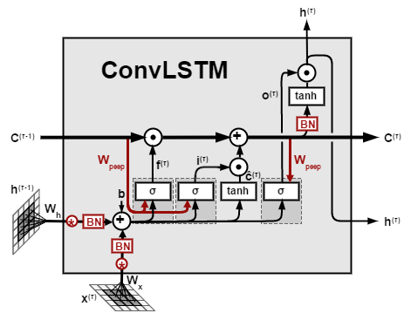
Convolutional LSTMs (ConvLSTM)
LSTMs cannot directly be used on spatial data, therefore we introduce convolutional LSTMs
ConvLSTM = LSTM where cell inputs and outputs, hidden states and gates are 3D tensors where the first two dimensions are the spatial dimensions.
Notes:
We can say we won’t go into detail about ConvLSTMs or LSTMs due to time constraint ?

Slide 17
General architecture
Spatiotemporal input
Temporal input (SIE)
ConvLSTM (stacked)
LSTM (stacked)
Pooling & Conv2D
(stacked)
Attention
Flatten
+
Dense
Next timestep prediction
Notes:
Maybe explain why we think this general architecture works.
i.e. spatial branch learns spatio-temporal system while temporal input learns

Slide 18
Model Improvements and Hyperparameter Tuning
Hyper-parameter | Range
Image size (i.e. degree of downsampling) | [1440×101, 720×50, 360×25]
Choice of variables | [19 variables]
Number of ConvLSTM layers | [1 - 4]
Number of Conv2D layers | [1 - 4]
Number of LSTM layers | [1 - 4]
Number of hidden units | [16 - 256]
Kernel size | [1x1, 3x3, 5x5]
L1, L2 kernel regularization | [1e-4, 1e-3, 1e-2, 1e-1]
Dropout | [0.1, 0.2]
Global average pooling | [True, False]
Learning rate | [1e-4 – 1e-1]

Slide 19
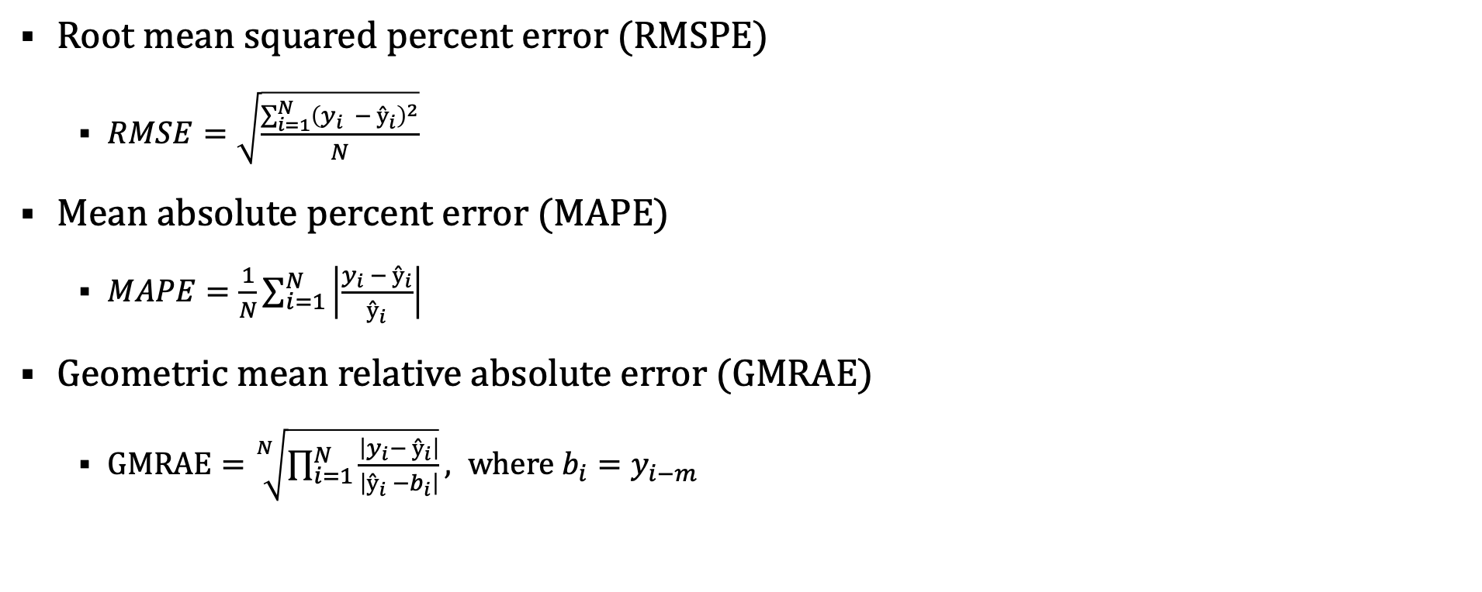
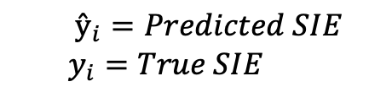
Metrics
Root mean squared percent error (RMSPE)
$RMSE=\sqrt{\frac{\sum_{i=1}^{N}{{\left(y_{i} − ŷ_{i}\right)}^{2}}}{N}}$
Mean absolute percent error (MAPE)
$MAPE=\frac{1}{N}\sum_{i=1}^{N}{\left|\frac{y_{i} − ŷ_{i}}{ŷ_{i}}\right|}$
Geometric mean relative absolute error (GMRAE)
$GMRAE=\sqrt[N]{\prod_{i=1}^{N}{\frac{\left|y_{i}− ŷ_{i}\right|}{\left|ŷ_{i} −b_{i}\right|}}}, where b_{i}=y_{i−m}$
$$ŷ_{i}=Predicted SIE$$
$$y_{i}=True SIE$$
Notes:
Explicitely say we are not using R2

Slide 20
Sample architecture
Spatiotemporal Input
(3, 25, 360, 19)
MaxPooling2D
2x2 conv.
ConvLSTM
5x5 conv. | 64 filters
Conv2D
3x3 conv. | 32 filters
ConvLSTM
3x3 conv. | 32 filters
MaxPooling2D
2x2 conv.
ConvLSTM
1x1 conv. | 32 filters
Conv2D
3x3 conv. | 1 filters
Flatten
Temporal Input
(3, 1)
LSTM
64 filters
Dense
64 filters
Concatenate
Output
Mean Squared Error loss
LSTM
32 filters
Dense
1 filter
LSTM
1 filter
Notes:
Explain what each “block” does?

Slide 21
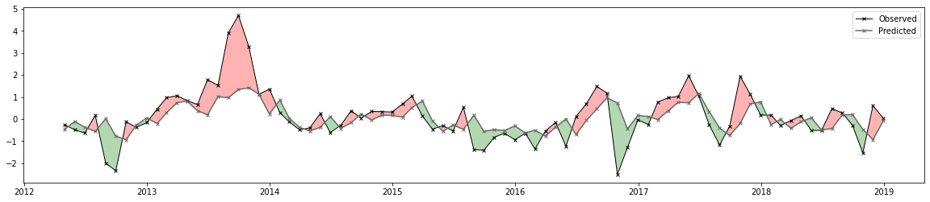
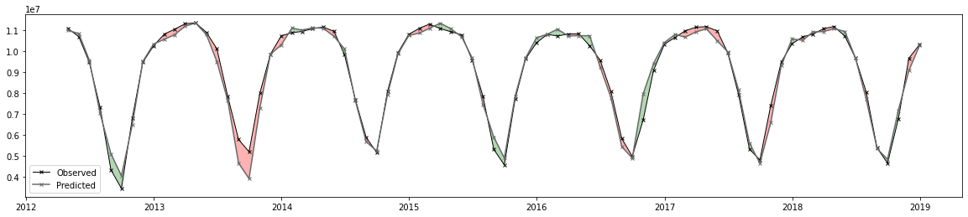
Preliminary results
Anomalies
Model | RMSE | MAE
ConvLSTM | 0.961 | 0.678
Persistence | 0.995 | 0.730
Sea ice extent
Model | RMSPE | MAPE
ConvLSTM | 6.40 | 3.67
Climatology | 8.70 | 4.65

Slide 22
References
Original paper: https://arxiv.org/abs/2108.00853
ERA5: https://www.ecmwf.int/en/forecasts/datasets/reanalysis-datasets/era5
ConvLSTM: https://arxiv.org/abs/1506.04214

