Slide 1

Portable Raspberry Pi Honeypot System
Name: Zachary Weaver
Date: April 25, 2025
Major: B.S in Cybersecurity
Project Advisor: Julie Henderson

Slide 2
SOP and Problem Statement
Modern networks face constant threats from unauthorized access.
NIDS (Honeypots) can be used to help prevent attacks and analyze threat actor behavior.
Goals:
Design a portable Honeypot system that emulates decoy services.
Visualize attacker activity and behavior in real-time.
Provide a low-cost, hands-on platform to explore intrusion detection and log analysis.

Slide 3

Research & Background
Influenced by real-world honeypot deployments and open-source tools.
Researched common application exploits.
How to collect threat intelligence without exposing the infrastructure.
Interest in physical, deployable tools.

Slide 4



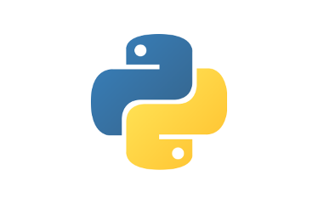

Languages, Software, and Hardware
Languages:
Python
MySQL
YAML
Bash
Software:
Raspberry Pi OS
Docker
Grafana
Promtail
Loki
Prometheus
cAdvisor
MySQL
Hardware:
Raspberry Pi 4
64GB microSD
Internet connectivity
ThePhoto by PhotoAuthor is licensed under CCYYSA.

Slide 5

Core Requirements
Physical Device
SSH and SQL containers configured with general logging
Centralized log monitoring and visualization through Grafana
Custom dashboard for container heath and attacker behavior
Container orchestration with persistent configuration on startup

Slide 6
Implementation – Setup
Container Orchestration:
Docker used to deploy and isolate each honeypot on the host.
Containerized decoy services (SSH and MySQL) log all interactions.
Logs are monitored by Promtail and then ingested into Loki to be visualized on the dashboard.
Auto-start: All docker run commands are executed on system startup with crontab.
Grafana Dashboard:
Configured data sources Loki (for logs), and Prometheus (container metrics).
Prometheus receives metrics from cAdvisor container scraping.
Grafana alerts fire when new connections are made.
GitHub Repository: https://github.com/zach-weav/HoneyPi

Slide 7
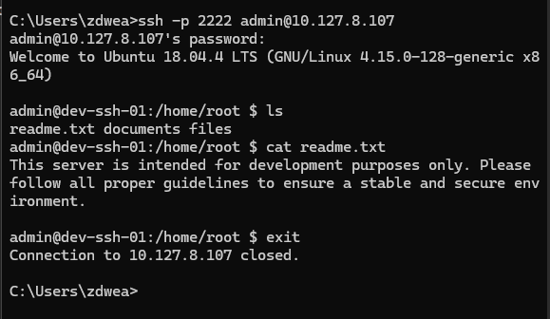
Implementation – SSH Container Interaction
Fig. 1. Decoy SSH Server

Slide 8
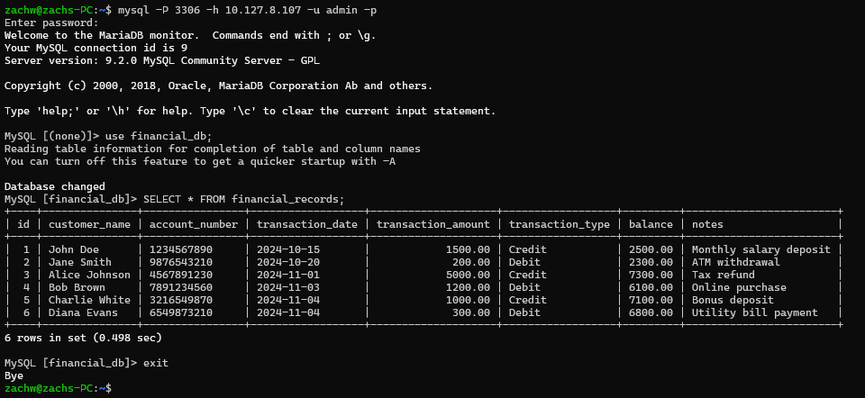
Implementation – MySQL Container Interaction
Fig. 2. Decoy MySQL DB

Slide 9
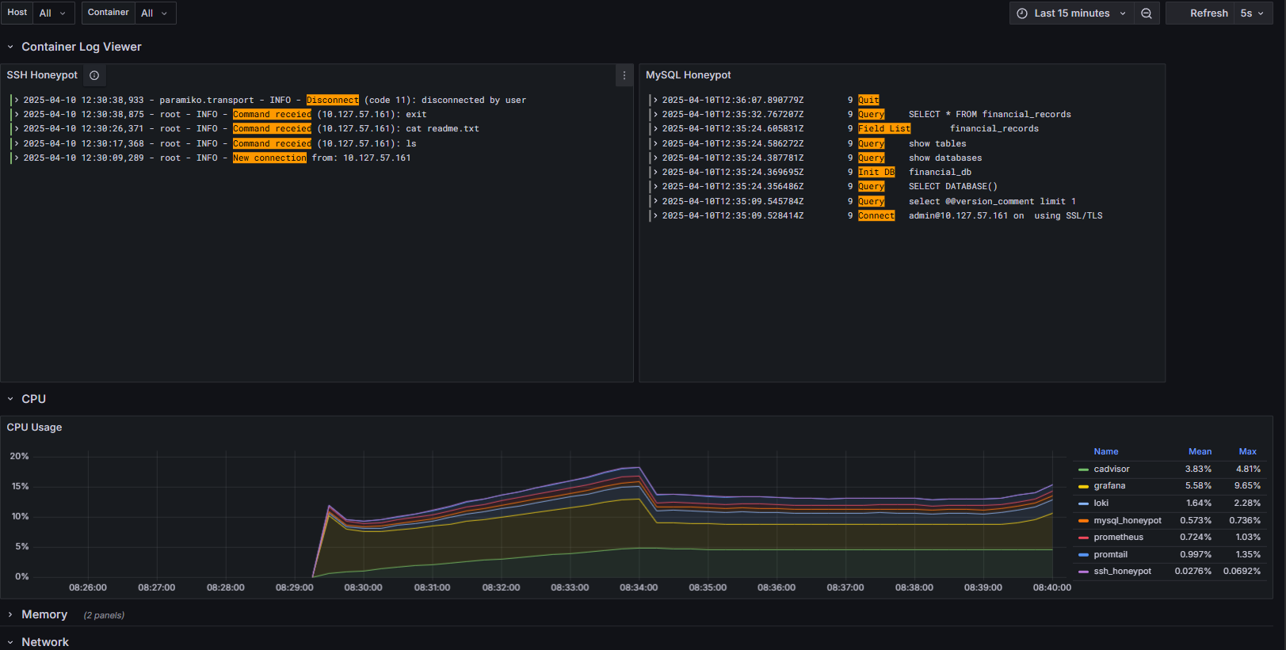
Implementation – Container Interaction
Fig. 3. Grafana Dashboard

Slide 10
Implementation – Live Demo
Demo

Slide 11
Test Plan
Testing Phases:
Ad hoc tests during development.
Unit tests using detailed test cases.
Crowdsource tests from fellow CSCI students.
Primary Focus:
Log ingestion.
Dashboard accuracy.
Capturing successful connections.
Container health monitoring.
Raspberry Pi Host Security.

Slide 12
Test Results
Initial test cases passed successfully:
Container orchestration and networking.
Log ingestion.
Dashboard visibility.
Simulating attacker interaction.
Valuable feedback from peer testing:
Updating MySQL user permissions. (implemented)
Firewall port forwarding (future)
Allowing multiple container connections (future)
More realistic SSH shell commands (future)

Slide 13
Challenges Overcome
Container and host networking conflicts.
Log forwarding failures.
Grafana alerting mechanisms.
Container and dashboard persistence.
Peer testing recommendations.

Slide 14
Future Enhancements
Further enhancing host security:
Port forwarding to minimize attack surface
limit direct external access to container health information.
Stealthier network presence:
Hiding unused ports from external scans to reduce exposure.
Making the device more realistic
More advanced emulated ssh commands:
Simulate more realistic Linux shell behavior.
Command responses, file systems, user accounts.
Signature based detection to find specific malware.
Additional decoy services.

Slide 15
Thank You!

