Slide 1
Gaussian Data Regression
Error mitigation for a hybrid qubit–qumode circuit
Same idea as Clifford Data Regression: learn the noise from circuits whose ideal answer is classically easy.

Slide 2
Inspired by Clifford Data Regression
The shared idea
Both methods use a known, classically easy family to get the exact ideal output. They never need the ideal of the hard target circuit.
CDR (Czarnik et al., 2021)
Replace most gates by Cliffords.
Those circuits are cheap to simulate (Gottesman–Knill).
Run them on the noisy device. Fit noisy → ideal.
Apply the fitted map to the target.
GDR (this work)
Replace the hard bosonic gates by Gaussians.
Those circuits are cheap to simulate (means + covariance, or a product coherent state).
Run the same noisy channel on the twins. Fit noisy → ideal.
Apply the fitted map to the target histogram.

Slide 3
CDR and GDR, one to one
 | CDR | GDR
Easy gate set | Clifford | Gaussian
Hard leftover | T, CZ | generic SNAP, ECD
Noise analog | global depolarizing | phase-covariant (loss, thermal, n-dephasing)
What is fitted | linear map on a scalar observable | transfer matrix on the joint histogram
Classical cost | poly in Cliffords, exp in non-Cliffords | poly in Gaussians, exp in non-Gaussians

Slide 4
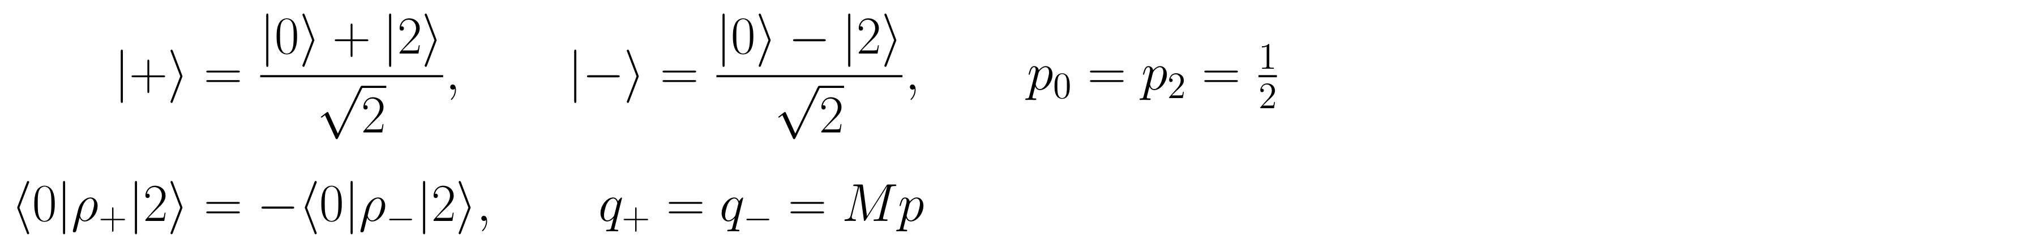
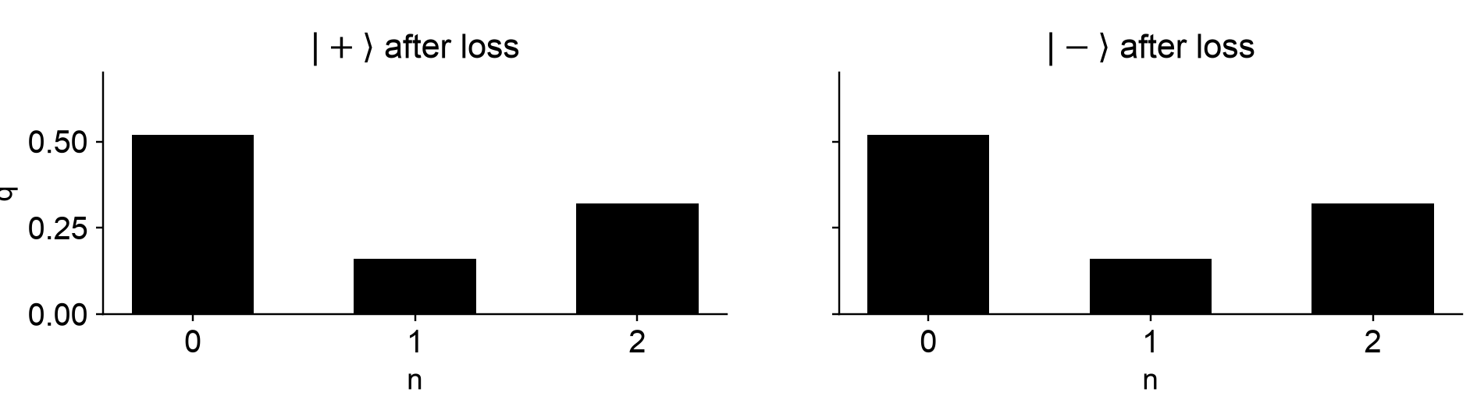
The name
Phase-covariant means the noise does not pick a preferred cavity phase. Rotating the oscillator before the noise is the same as rotating after.
Positive example — one M exists
Photon loss (also thermal loss, number dephasing). Take two states with the same number histogram but opposite coherence.
Both have p0 = p2 = 1/2. Under loss, the sign of that coherence never enters the photon-number bins, so both produce the same q = Mp.
One column-stochastic M works for every state (end-of-circuit). That is why GDR can learn M on Gaussian twins and apply it to the target.

Slide 5
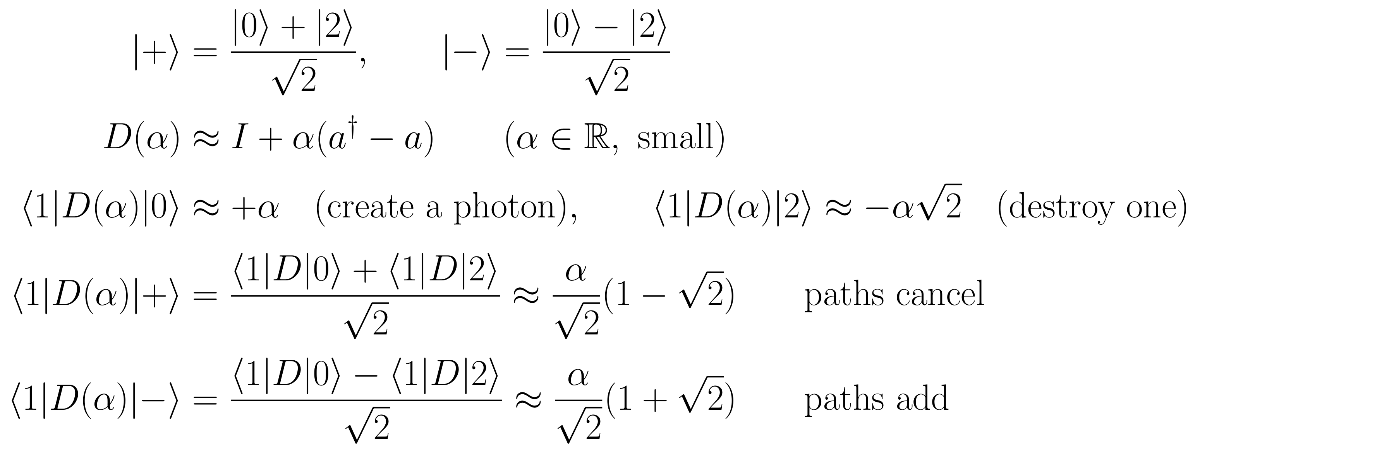
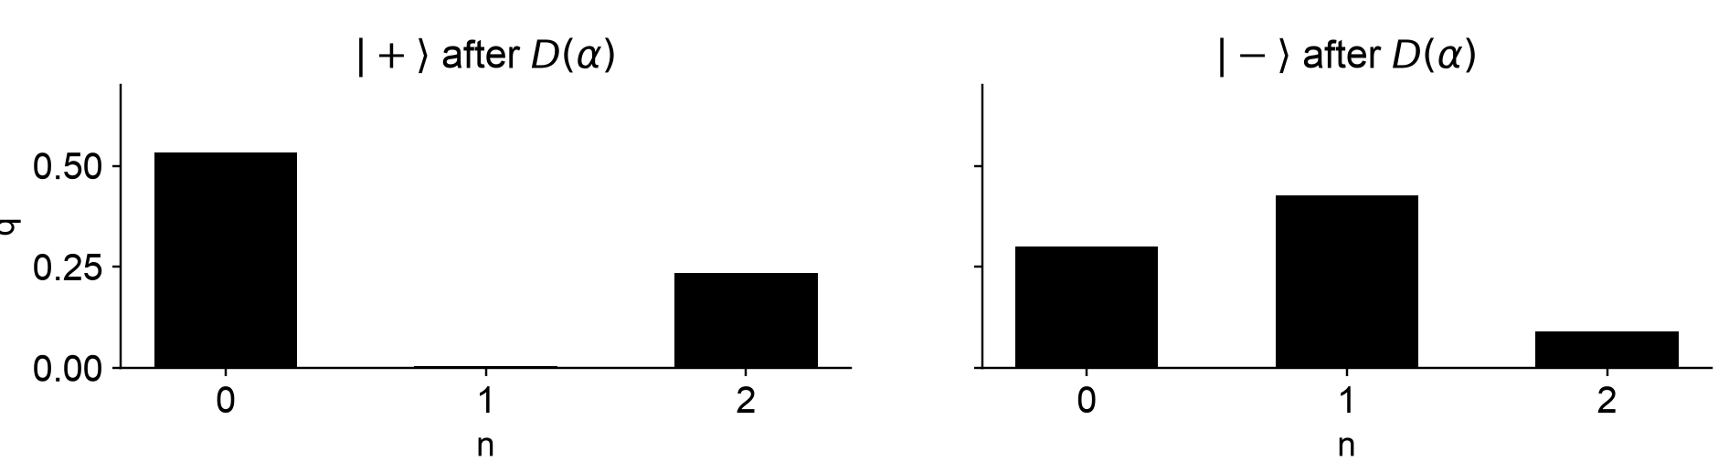
When a single M cannot exist
How D(α) treats |+⟩ and |−⟩ differently
Two paths into n = 1: create a photon from |0⟩, or destroy one from |2⟩. The sign in |±⟩ decides whether those amplitudes cancel or add.
Same p, but the n = 1 probabilities differ, so q+ ≠ q−. No single M can map that p to both histograms. A fit on twins need not apply to a target with different coherences.
A squeeze is the same kind of failure. Comprehensive noise (transmon T1/T2, ECD control error) is this on the hybrid space: M is only an effective fit.

Slide 6
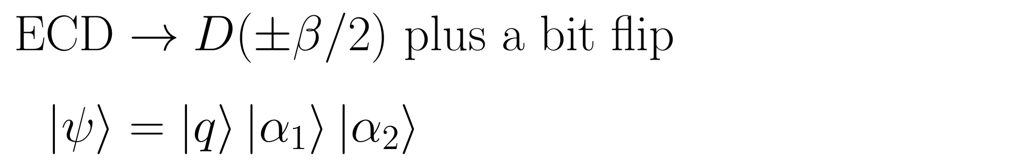
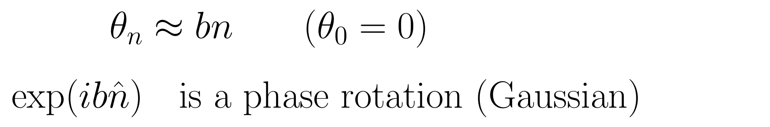
Gaussian gates, and how ECD / SNAP become them
What a Gaussian gate is, and why it is cheap
Generated by a Hamiltonian at most quadratic in q, p. Common gates: displacement, rotation, squeezing, beam splitter.
A Gaussian state is fixed by a 2m-vector of means and a 2m by 2m covariance. Updates are polynomial in the number of modes, independent of any Fock cutoff.
Cost of the leftover hard gates is exponential in how many you keep (Gaussian rank / cutoff). Same split as Clifford vs T.
ECD to Gaussian
Snap each ancilla angle onto {0, pi}.
The ancilla stays in the computational basis.
SNAP to Gaussian
Replace each phase list by its least-squares affine fit (constant term zero).
From vacuum that is the state. The ideal histogram is the truncated one-mode product evolution (approximately Poisson).
What remains is displacements and rotations.
A few original SNAP / ECD gates can be left in (t_free = 2) so the twins sit closer to the target.

Slide 7
How GDR is run
1. Target
ECD depth 5 or SNAP depth 2. Score the joint q, n, m histogram against the ideal.
2. Twins
40 twins, same depth and gate count as the target. Mix is 75% / 25% of the twins
75% (30) fully Gaussian (t_free = 0): every ECD angle snapped to {0, pi}; every SNAP phase list replaced by an affine fit.
25% (10) keep t_free = 2 original hard gates, drawn uniformly at random among the (layer, cavity) slots: two of 10 ECD–rotation pairs, or two of 4 SNAP lists.
ECD leftover: unsapped angles, so those ECDs stay the original conditional ECD, not the unconditional displacement plus bit-flip. SNAP leftover: original non-affine phases, not the affine fit. All other gates in those twins are still Gaussianized. Gaussian rank is 2 to the power t_free.
3. Ideal twins
Classical. Fully Gaussian twins use product one-mode evolution, checked against the statevector (TVD below 1e-6).
4. Same noise
Target and twins see the same circuit-noise family, the same readout, and 8,192 shots.
5. Fit M
11 bounded parameters (Kronecker M above), multinomial MLE on the twins.
6. Unfold
Richardson–Lucy on the observed histogram. Keeps probabilities non-negative and normalized. This is gdr_param.

Slide 8
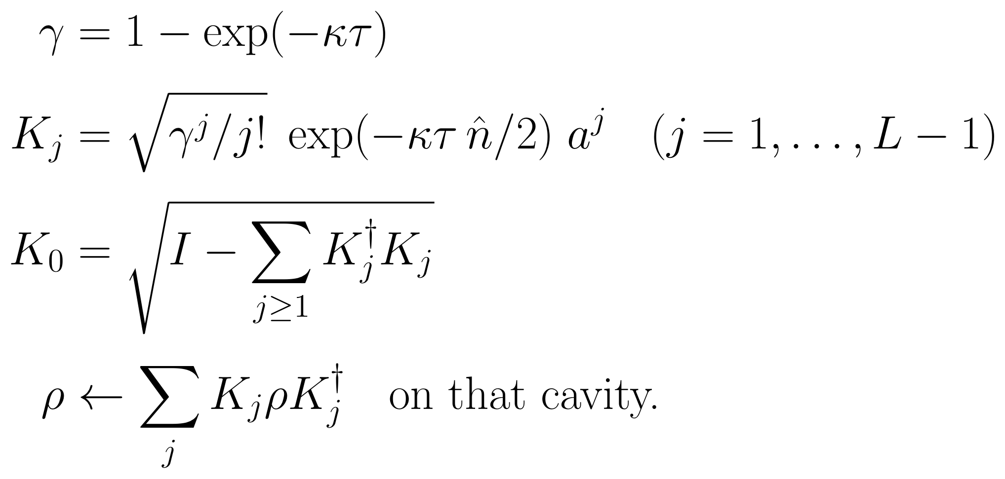
Loss family: paper amplitude-damping Kraus
Pure photon loss, n_th = 0. The same Kraus set is applied independently to each cavity. No qubit channel. No Kerr. This is the only Kraus set in the loss family.
Operators on one cavity (cutoff L = 8)

Slide 9
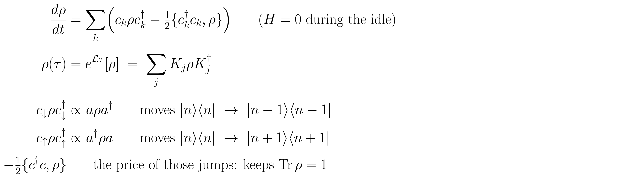
Lindblad, acting on the density matrix
During each idle of length τ the code uses H = 0. Dissipation is a first-order ODE on ρ, not a single matrix multiply.
The jump term c ρ c† actually moves probability. The anticommutator is only bookkeeping so that Tr ρ stays 1. The finite-time map is then written as Kraus operators and applied locally.
Concrete photon loss: if the cavity is in |n⟩⟨n|, the jump a ρ a† produces |n−1⟩⟨n−1| at a rate proportional to n. That is why loss is a classical hop on the histogram.
Transmon T1 is the same idea on the qubit: σ− ρ σ+ sends |1⟩⟨1| to |0⟩⟨0|. Number dephasing uses c = √κφ n̂: no hops in n, only extra decay of coherences ⟨n|ρ|m⟩.

Slide 10
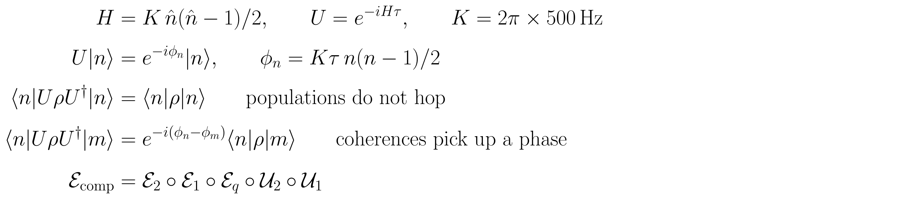
Self-Kerr, acting on the density matrix
Self-Kerr is not a jump. It is ordinary Hamiltonian evolution of the cavity, U ρ U†, from the photon-photon interaction in the oscillator.
Every Fock state |n⟩ only picks up a phase that grows like n(n−1). The number histogram does not change. Superpositions |n⟩+|m⟩ pick up a relative phase, so later non-covariant errors (transmon, control) can see a different state.
Comprehensive apply order on ρ, after the (warped) gate: Kerr on cavity 1, Kerr on cavity 2, then transmon Lindblad, then cavity-1 Lindblad, then cavity-2 Lindblad. Each Lindblad map is Σ K ρ K† on that factor.
Readout is after p(q,n,m) = ⟨q n m|ρ|q n m⟩, never inside these maps. Cross-Kerr and residual σz(n1+n2) exist in code and are off.

Slide 11
The transfer matrix: 11 parameters, not 16,384
Histogram is 2 by 8 by 8 = 128 bins. A free 128 by 128 matrix has 16,384 entries. Even a free Kronecker model is 4 + 64 + 64 = 132. GDR keeps a physics-shaped kernel with 11 numbers. The suffix 1 vs 2 is cavity 1 (photon number n, factor C1) vs cavity 2 (m, factor C2).
# | Parameter | What it does to M
1–2 | eta_1, eta_2 | Per cavity. Transmission in that mode’s 8 by 8 thermal-loss kernel. With n_th = 0, only lowers n. Circuit-like.
3–4 | n_th1, n_th2 | Per cavity. Mean thermal photons in that mode’s bath. Opens n to n+1 heating in the same kernel. Not the state’s mean photon number, not readout.
5–7 | p_down, p_up, eps | Shared by both cavities. Extra n-independent hops n to n-1 / n to n+1, then leak toward a uniform Fock row. Circuit residual.
8–9 | p01, p10 | Only Cq. Qubit readout: P(measure 1 | 0) and P(measure 0 | 1). Moves q = 0 or 1. Leaves n and m alone.
10–11 | p_nn1, p_nn2 | Per cavity, applied last. Detector n to n+1 or n-1 at p_nn/2 each way. Rate does not scale with n. Readout-like.

Slide 12
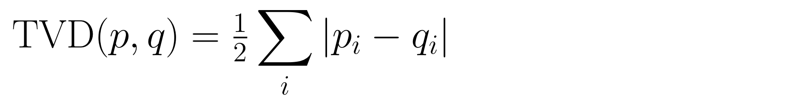
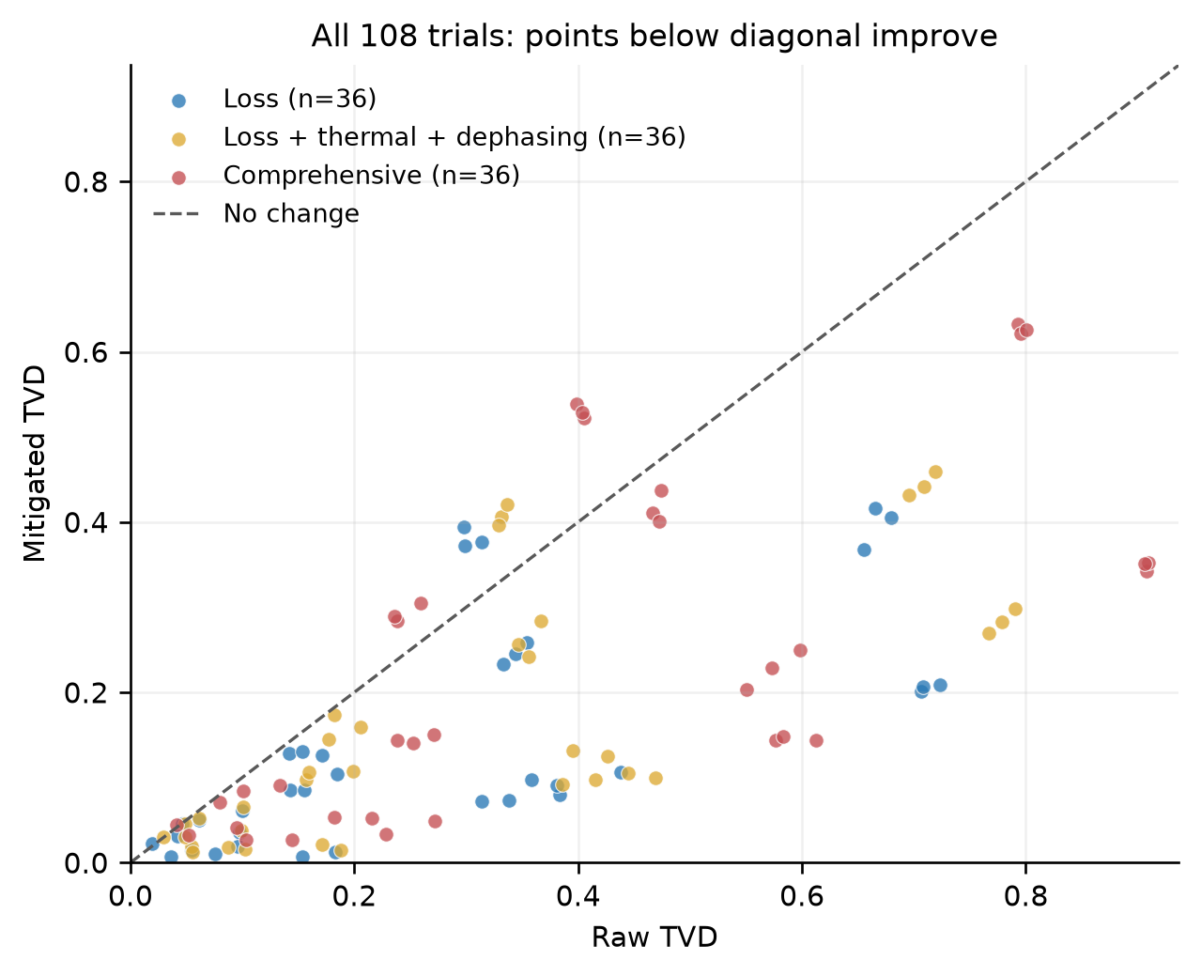
How well it works (official gdr_param, 108 trials)
What the 108 trials are
2 ansatze (ECD, SNAP) × 2 circuits (random / optimized) × 3 noise families × 3 κτ × 3 readout levels.
Families: loss, thermal+dephasing, comprehensive. κτ ∈ {0.003, 0.03, 0.1}. Readout: ideal, realistic, strong.
One instance (H000). Every trial: 8,192 shots and 40 twins.
Mean TVD
0.331 → 0.185 (44% down)
Median TVD
0.285 → 0.127
TVD improves in 93 / 108 trials
Optimized circuits: 54 / 54
Mean-TVD drop by family
loss 49% · thermal 46% · comprehensive 39%
by κτ
0.003 → 65% 0.03 → 57% 0.1 → 33%
The 15 regressions are almost all ECD / random at κτ ≥ 0.03 (over-correction).

Slide 13
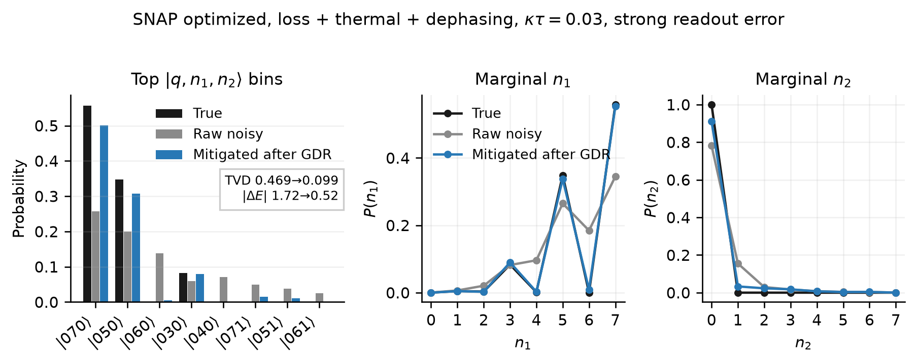
Example: SNAP, mid noise, strong readout error
Optimized SNAP · loss + thermal + dephasing · κτ = 0.03. Strong readout: qubit flips (p01, p10) = (0.03, 0.08) and Fock n to n+1 or n-1 total hop 0.10. TVD 0.469 → 0.099.

Slide 14
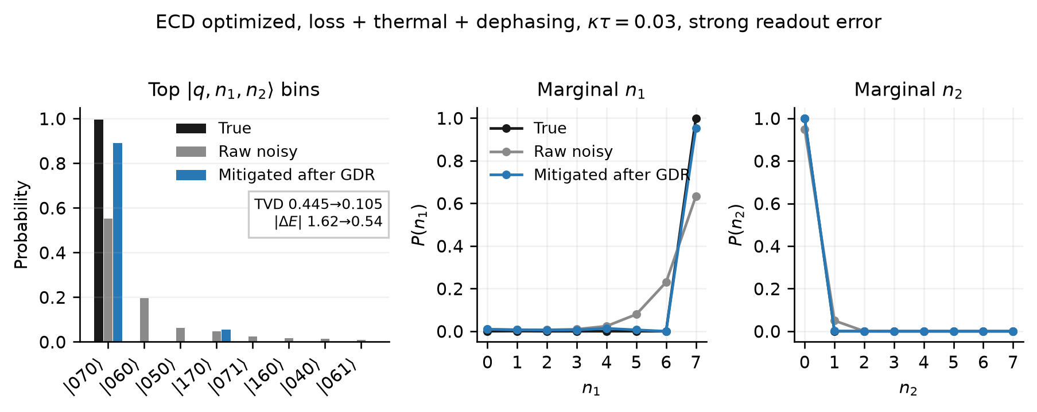
Example: optimized ECD, mid noise, strong readout error
Official H000 trial, same noise as the SNAP trial. Optimized ECD · loss + thermal + dephasing · κτ = 0.03 · strong readout. Ideal peak is ket 070. TVD 0.445 → 0.105.

Slide 15
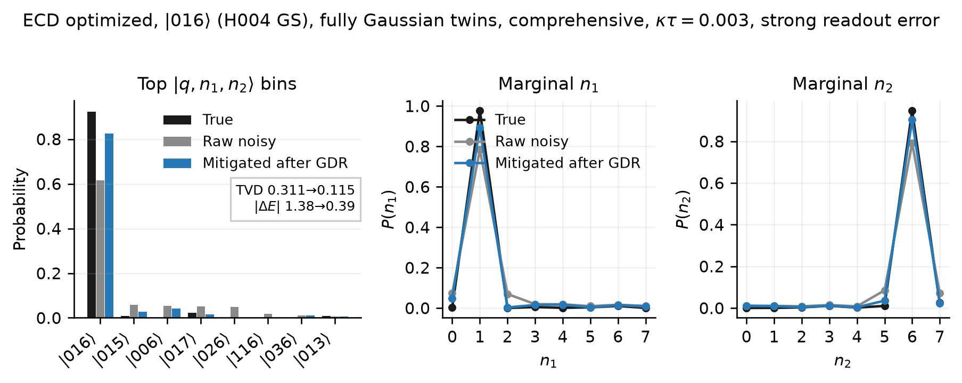
Example: optimized ECD on ket 016, fully Gaussian twins
Research replay on H004 (not the official 108-trial H000 matrix). Ideal peak is the true GS ket 016 (p about 0.93). Comprehensive, κτ = 0.003, same strong readout. All 40 twins fully Gaussian. TVD 0.311 → 0.115.

Slide 16
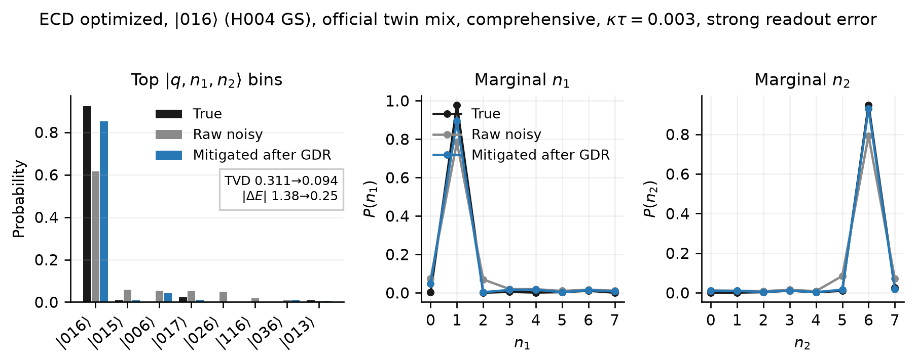
Example: optimized ECD on ket 016, official twin mix
Same H004 ket-016 target and strong readout. Official twin mix: 30 fully Gaussian plus 10 that keep two leftover ECD gates. TVD 0.311 → 0.094.

