Slide 1
Get Comfortable with Git
Zachary Reynolds | NGiSCAAN Team
Notes:
Explanation of why I chose Git version control as a topic:
Thinking back, I was halfway through college before I dove into version control. I worked on some of my own projects before that, so I know what’s it like to use VC and not. I would never go back. I am very passionate about Git and so I wanted to give a talk on it.
Git has become the leading version control tool and will likely need to know it at some point.
If you are using it, I’m sure we can learn some things to help us better harness Git’s power.
My goal is—if you’ve never used Git, to convince you to try it out, or if you’re using it, to get a little more comfortable with and rely on some of its powerful features.

Slide 2
Outline
History of version control
Git data representation
Git operations
Committing
Syncing with a remote repository
Integrating changes
Undoing work
Recovering work
Notes:
Today we’ll look at a history of version control (and Git specifically), how Git represents your data, and (as time permits) how to perform Git operations:
I’ll demo things as we go

Slide 3
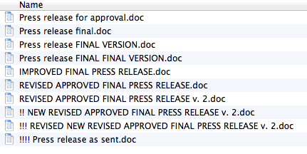
The Need for Version Control
Notes:
We’ve all done poor man’s version control…more or less like this picture. You started out with good intentions, but the revisions soon got out of control.
You know the need for more effective version control.
Before the 1970s, this was pretty much the only option for version control.

Slide 4
History of Version Control
First generation: Local data model
1972: Source Code Control System (SCCS)
1982: Revision Control System (RCS)
Notes:
Version control has come through 3 generations in the last 45 years:
First generation: Local (there was no network)
All users had to be on the same file system.
Used locks at the file level. Only one person could be working on a file at a time.

Slide 5
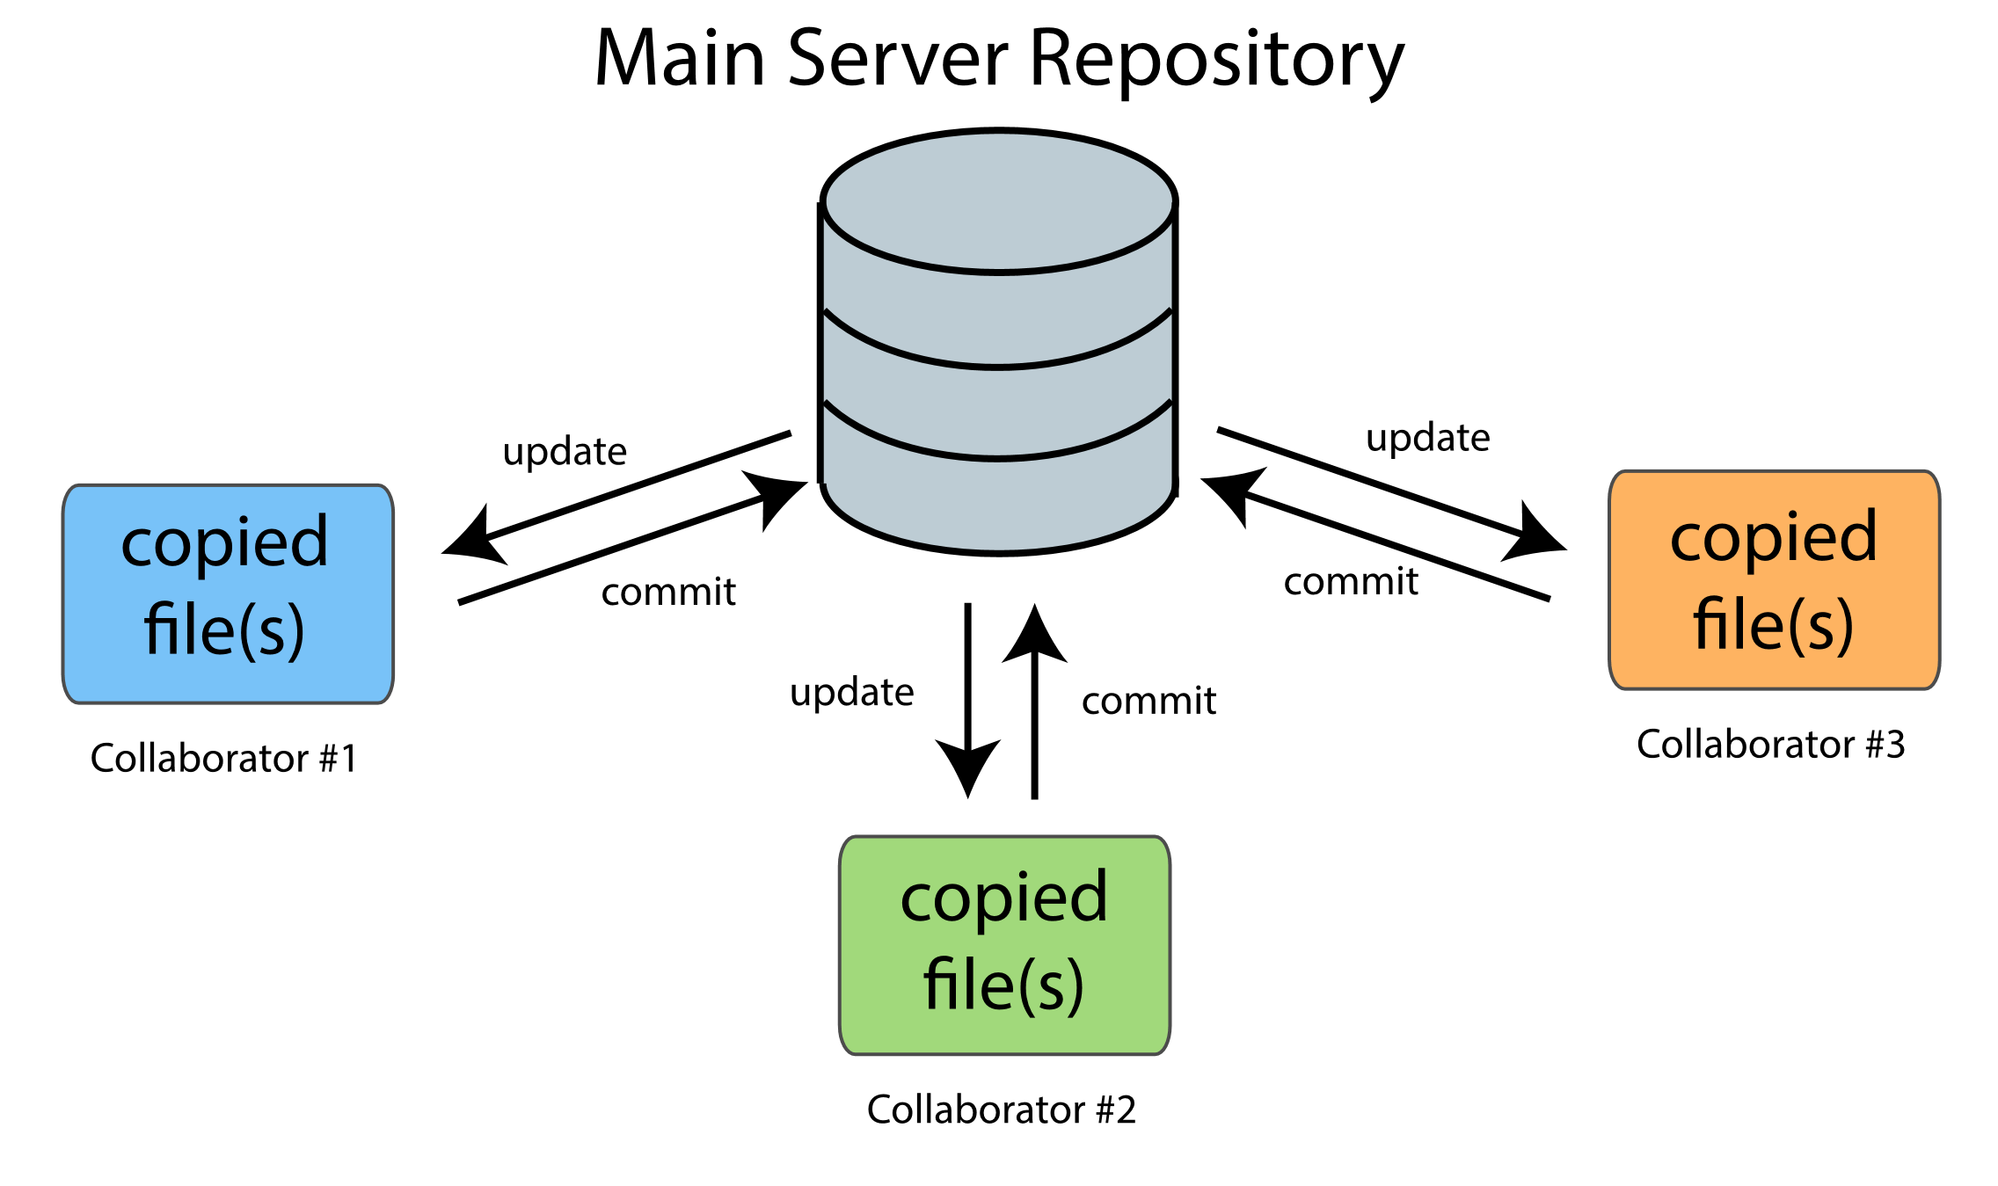
Centralized Version Control
https://code.snipcademy.com/tutorials/git/introduction/how-version-control-works
Notes:
Second generation: Centralized
Client-server model: users would checkout files from the central server to work on, make changes, and commit the changes back to the server. Most operations required server connection and came with that overhead latency.
Revisions needed to be merged before committing
Merging a branch was hard! Had to plan ahead for a week, and set aside a day for doing it.

Slide 6
History of Version Control
Second generation: Centralized data model
1986: Concurrent Versions System (CVS)
1992: IBM Rational ClearCase
1995: Perforce
2000: Subversion
Team Foundation Version Control
Notes:
Here are some second generation tools:
You may have heard some negative things about CVS. In fact, Git tries to be very different from CVS on purpose. Merges were pain!
ClearCase: very expensive, but could handle large merges
Perforce came out in 1995 and many big companies like Google would use it, as it performed well on large repos.
Subversion: similar but improved version of CVS. Still widely used today.
There’s also TFVC, which Microsoft provides with Team Foundation Server and Visual Studio Team Services.

Slide 7
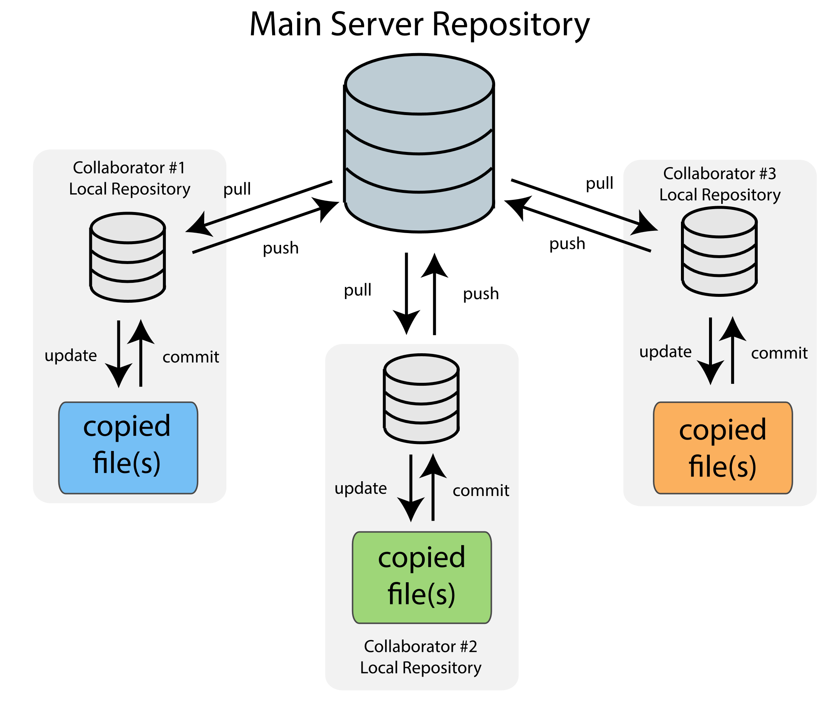
Distributed Version Control
Notes:
Third generation
Distributed
Everyone has a local copy of the entire project and history.
Allows users to work on features in isolation and then integrate with other people’s work when done.
Allows offline work. Even in 2018, a regular connection with the server is not guaranteed. It may be behind a VPN, and not convenient to run keep VPN client running.
Easy, lightweight branching to encourage experimental work—encourages smaller, focused work.
Separate merging and committing.

Slide 8
History of Version Control
Third generation: Distributed data model
2003: Monotone
2005: Bazaar, Mercurial, Git
Notes:
Tools:
Monotone: focus on integrity over performance
Bazaar: designed to be either centralized or distributed
Mercurial: similar to Git, but designed to be easy for those coming from Subversion
Git: has higher learning curve than other tools but is also very powerful and fast.

Slide 9

2005: Git Was Born
Linus Torvalds’ alternative to BitKeeper
Design goals
Scalability
Large code size
Massive concurrent development
Integrity
Originally a low-level engine
Flexibility
Notes:
In 2005, Git was born. Linus Torvalds had been using a free version of BitKeeper for the Linux kernel. The BitKeeper vendor and Linux developers did not get along well, and the vendor soon dropped its free version. So, Linus looked around for an alternative but didn’t find anything that met his needs. So, he created Git.
Git’s design needed to support a huge codebase and still perform efficiently. Git also needed to scale to a massive development team, supporting thousands of concurrent lines of development. (As we’ll see, cheap branching allows for this.)
Git ensures integrity by generating hashes from your data. If anything changes, the hashes are guaranteed to change, so you can be sure exactly what state your project is in. (more on integrity: https://git-scm.com/about/info-assurance)
Interestingly, Git was designed as a low-level engine that others could build version control systems on top of. The Git team soon made it usable by itself by making it more user-friendly. If you think Git is hard to work with, it’s come a long way!
Flexibility: can adapt to a variety of workflows—it doesn’t force any particular flow. Potential downside: There are multiple ways to do the same thing, which can be confusing and creates a learning curve.
(Interestingly, Linus took CVS as an example of what NOT to do. If in doubt, make the exact opposite decision, he said.)

Slide 10
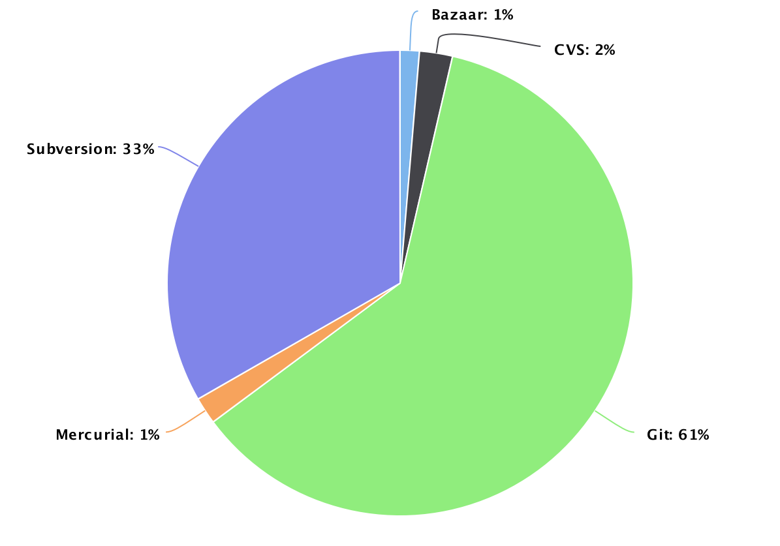
Open-Source Repositories by Tool (2018 data from Black Duck Open Hub)
Bazaar: 1%
CVS: 2%
Subversion: 33%
Mercurial: 1%
Git: 61%
Notes:
Today, 13 years later, Git dominates. One source that analyzes repositories found that 61% of repos were in Git! Subversion is still a big player.
(Git eclipsed Subversion popularity in 2014 to become the most popular version control tool.)

Slide 11
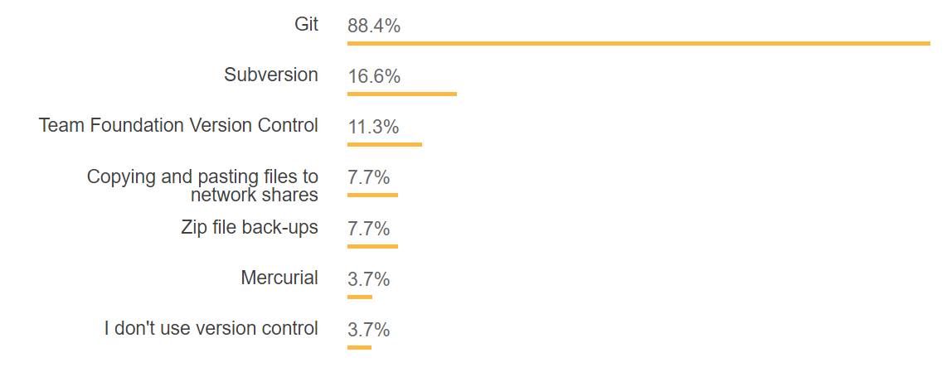
Developer Usage by Tool (Stack Overflow 2018 Developer Survey)
https://insights.stackoverflow.com/survey/2018/#work-version-control
Notes:
Stack Overflow’s developer survey this year is even more extreme. Almost 90% of developers use Git.
I’m guessing a lot of you are familiar with Git already—that’s great! Wherever you’re at, I hope you’ll learn at least one thing to make you a better Git user.

Slide 12
Git vs. GitHub
Git: version control tool
Command-line
Committing, branching, merging, etc.
GitHub: Cloud-based hosting service
Issue tracking, pull requests, forking, etc.
Notes:
Before we jump in, I just wanted to make this clear, Git != GitHub. I imagine this is confusing for those just starting out.
GitHub uses an implementation of Git behind the scenes.
GitHub’s popularity has played a major role in helping Git to become popular too.
Speaking of GitHub, Hacktoberfest is almost here. If you haven’t participated before, it’s a month-long promotion of open-source. If you make 5 open-source contributions next month, you’ll receive a free T-shirt!

Slide 13
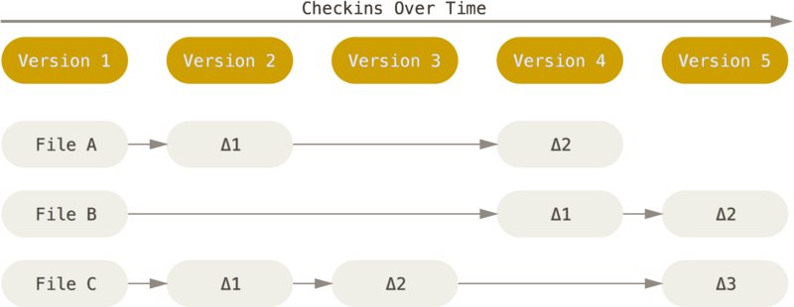
Traditional Version Representation
Notes:
The traditional way of representing data in version control tools is by storing deltas. The first version of a file stores the entire file, but later versions store only changes/deltas (e.g. couple lines added, one line removed).
Most tools use this strategy.

Slide 14
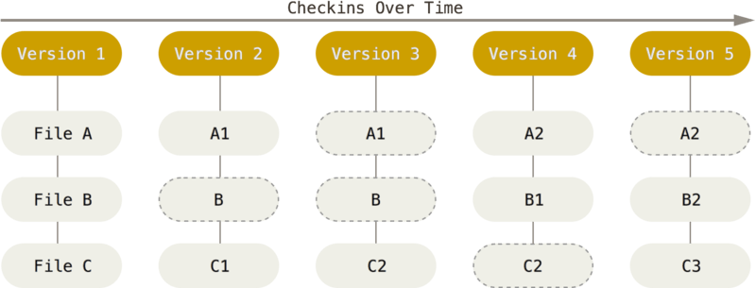
Git Version Representation
Notes:
Linus wasn’t heavily into version control. Traditional designs didn’t have a huge influence on his design.
Linus took a novel approach for Git. For each version, Git stores a “snapshot”—entire copy of the file. The diffs you see when you inspect a commit are computed on the fly. (go through example) If a file does not change, then it just keeps a reference to the old file.
Consider as files get big…. this will waste space. Git handles this with special compression.
Git regularly moves these objects to a single “pack” file. It then runs delta compression on all objects collectively.
In the end, Git does store deltas, but they’re not always relative to the previous version. They could be relative to and older version or an entirely different file if a chunk of code was moved. This strategy gives better compression.

Slide 15
State Lifecycle in Git
Untracked
Unmodified
Modified
Staged
stage
edit
stage
remove
commit
Notes:
There are four main states your files can be in.
When you first create a file, it’s in the Untracked state. Files in the other 3 states are tracked.
Unmodified = no changes since last version.
Editing an unmodified file moves it to the modified state, of course.
The “Staged” state keeps track of what’s in your staging area. The staging area is a intermediate area to mark what goes into your next commit. The staging area is unique to Git. It’s convenient if you have a lot of modified files but only want to commit a few. Note: Git uses the terms “staging area” and “index” as synonyms just to confuse users. Not really…index is a more technical, lower-level term, so I’ll stick with “staging area.”
Once you’ve carefully crafted your staging area, you commit. This creates a new saving point. The files you committed are unmodified with relative to the new commit. Now you can start the cycle over again.
---
Note to self: whole files (not small portions of files or diffs) are in these states. E.g. either an entire file or none of it is staged.

Slide 16
Commit
Representation of a version
Contents
Snapshot
Author/date
Committer/date
Message
Parent commit pointer
SHA-1 hash of contents
A
B
C
25562bc…
30d042a…
bcd2e9c…
Commits over time
Notes:
The basic object in Git is a commit. A commit represents a version of your entire project.
Git stores the entire snapshot of the project, not diffs. This means there’s enough info in a commit to recreate your project at that point. (It’s stored as a tree of objects in compressed format.)
The author first wrote the changes for the commit.
Git also tracks the committer, which could be different from the author if someone else applied your commit. We’ll see this later.
Each commit points back to the previous commit. In all my commit graphs, time moves ahead to the right.
Finally, Git uniquely identifies a commit with the hash of all the other contents. The full hash is 40 characters, but you’ll often see the first 7. That’s Git’s short version. In later slides, I’ll just use letters in place of hashes.
Snapshot = “Tree”
Here’s a visualization of a graph of 3 commits.

Slide 17
Commit Tips
Make logically focused commits
Keep subject line short
Use imperative mood for subject
“Applying this commit will <your subject>.”
Prefer these subjects… | …over these
Add blog endpoints | New blog endpoints
Remove unused factory method | Removed unused factory method
Fix broken company tests | Fixing broken company tests
See more tips: “How to Write a Git Commit Message” (https://chris.beams.io/posts/git-commit/)
Notes:
We could have a separate talk about tips for committing, but I highlight 3 here:
Keep commits logically focused on a single thing. It’s easiest to put all changes in a single commit, but you don’t have to do that. Give example….
Your subject should be short, no more than 50-70 characters. If you can’t come up with a concise subject, maybe your commit is doing too much. If you want to give more explanation, do that in the message body, which can be as long as you want.
Unless your team already has a convention, use the imperative mood. Imperative verbs are as is you’re giving a command. It’s usually shorter, and Git itself uses the imperative mood for auto-generated messages (e.g. when merging or reverting). A good template: “Applying this commit will _______”

Slide 18
Branch
Independent line of development
Lightweight
master
A
B
C
E
D
F
login
Notes:
A branch allows independent development on a feature. You can work in isolation until you need to sync up.
Creating branches in Git is very lightweight (Git excels in this area). A branch is just a pointer to a commit. Behind the scenes, Git simply writes 40 characters to a file. It doesn’t have to copy your code like some centralized tools.

Slide 19
HEAD Pointer
Tracks current state of workspace
A
B
C
D
D
master
master
HEAD
HEAD
Notes:
There’s a special pointer, or meta-pointer, in Git called HEAD. HEAD is a reference to the current commit. It points to the current branch.
Whatever HEAD points to, that will be the state of the files on your hard drive. “Switching branches simply changes the reference in the .git/HEAD file, and then proceeds to change the contents of your workspace with the ones defined in the commit.”
As you commit, your branch pointer moves ahead automatically to the next commit. HEAD doesn’t change…it is still pointing to the branch.
==== DEMO ====
Cleanup-menu branch: add allergy note, then add description

Slide 20
Committing and Branching Demo

Slide 21
Syncing with Remote Repository
Notes:
So far, we’ve been working just within our local repo. Let’s create a remote repo. Even if it’s just one person working on a project, you’ll want a remote for backup.

Slide 22
Integrating Changes
master
master
master
A
B
C
E
D
F
login
Notes:
Here’s a common development scenario: You’re implementing a new feature, say Login. You branch off your mainline “master” branch and create a couple commits. Meanwhile, your teammate works on some unrelated features. His features get applied to the mainline master branch. Now, you need to integrate both yours AND his changes….

Slide 23
Integrating Changes
Merge
Rebase
Notes:
Git supports two ways of incorporating these changes. We’ll cover merge first, since it’s safer and usually the first one taught.

Slide 24
Integrating Changes: Merge
HEAD
HEAD
git merge login
master
master
A
B
E
B
C
E
G
D
F
F
login
Notes:
First, you need to be on the branch you want to update. Run “git merge login.”
Git performs a 3-way merge. Git looks at the tips of the two branches and their common ancestor, B. (Git ignores everything else.) Git creates a new merge commit G to integrate the changes.
Lines that are unchanged in both branches are carried over to G.
Lines that are changed in only one branch carry the change over to G.
Lines that are changed in both branches in different ways cause a merge conflict. Git leaves it up to you to decide which one to keep, or some combination.
Login branch remains unchanged.
By default, Git names the commit message for G "Merge branch 'login’“.

Slide 25
Integrating Changes: Rebase
git rebase master
master
A
B
D'
F'
B
C
E
D
F
login
D
F
HEAD
login
HEAD
Notes:
Rebase is completely different. First, checkout your feature branch.
Git traces the two named branches to the first commit that is accessible from both. Then Git grabs the commits on your branch back to that commit (B), and puts these in a temporary area. Git then applies those commits in order, one-by-one, on top of the named branch (master).
This time the login branch changes since that was the checked out branch. Master is unchanged.
Notice I’ve given commits D and F new labels. They still introduce the same changes, but they’re actually different commits. The parents and committer dates will be different, so they’re assigned different hashes and they’re different commits.
It’s fine to rebase as long as you haven’t published your feature branch.

Slide 26
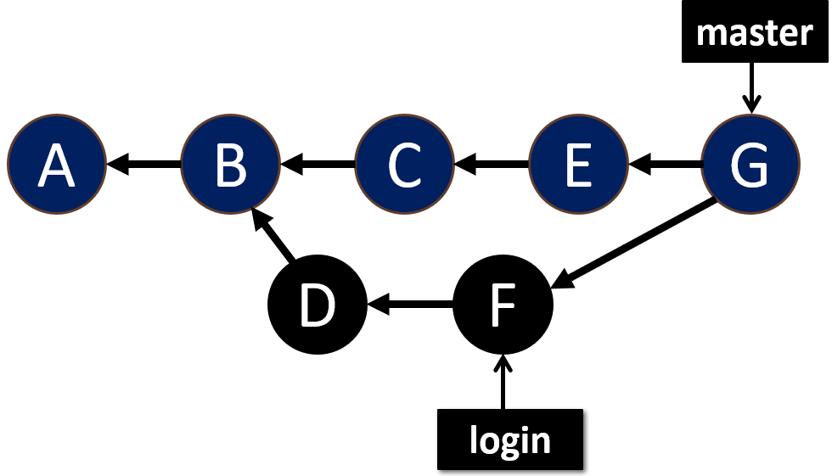
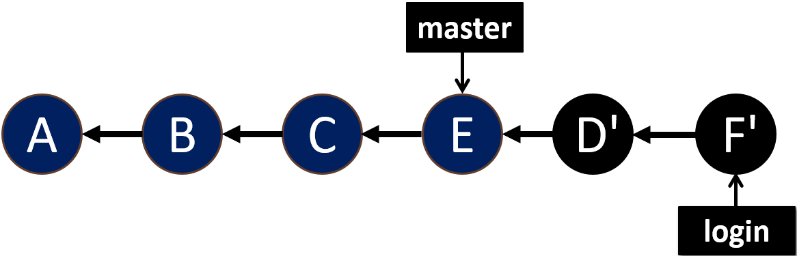
Merge vs. Rebase End State
Merge
Rebase

Slide 27
Merge vs. Rebase
Merge
Rebase
Preserves context
Terminology: Merge into other branch
Cleaner history
Rewrites history
Terminology: Rebase onto other branch
Notes:
BOTH
* modify the branch you’re currently on.
There is hot debate about which one is better
Rebase:
* Cleaner history since no merge commits. Also, linear history allows easier navigation back in time.
* Rewrites history, so do NOT rebase public branches that others may be working on!

Slide 28
Merging and Rebasing Demo

Slide 29
Undoing Work
Revert
Checkout
Reset
Notes:
One of the main points of version control is the ability to undo work.
Some of these commands are dangerous in that they erase work, but if you learn how to use them the way Git intends, they’re fairly safe.

Slide 30

Revert
git revert B
master
master
A
B
!B
B
C
D
master
Equivalent end states
A
C
D
Notes:
Revert is good option for undoing a commit (or series of commits) back in time (it doesn’t need to be the latest commit). Let’s say commit B introduced a bug, and commits C and D don’t depend on B. For now, we just want to quickly undo B.
Git creates a new commit that negates the old one. Anything originally added is removed; anything originally removed is added back.
This gives an equivalent end state to just having commits A, C, D, but these two are very different histories! Reverting does not erase the history, so it is a safe command. It’s perfectly fine to revert published commits (unlike rebase), because it adds to the history.

Slide 31
Checkout Discards Unstaged Changes
Untracked
Unmodified
Modified
Staged
stage
edit
stage
remove
git checkout foo.txt
checkout
commit
Notes:
Here’s our state diagram from before. We’ve already used the “checkout” command for switching branches. You can also use it to discard changes.
Using checkout in this way is a dangerous move. You have no way of restoring your changes if you didn’t commit them. Git does have a safeguard in that you cannot run “checkout” on staged files.

Slide 32
Reset Unstages Changes
Untracked
Unmodified
Modified
Staged
stage
edit
stage
remove
git reset foo.txt
reset
commit
Notes:
You can use “reset” to go from staged state to modified state. This is helpful if you accidentally staged all changes but only want to commit a few.
By default, reset is a safe command, so you won’t lose any of your changes…..

Slide 33
Reset Unstages Changes
Untracked
Unmodified
Modified
Staged
stage
edit
stage
remove
git reset --hard
reset
commit
Notes:
You can, however, go directly from staged to unmodified with the --hard modifier. This command basically erases everything directly out of your staging area. Don’t get into the habit of doing this…prefer stashing changes in case you want to get your changes back.
If you’re not familiar with a stash, it’s like a temporary last-in, first-out stack. When you stash, it’s as if you do a hard reset, but it moves all modified and staged files to the stack so you can get them back later.

Slide 34
Reset to Another Revision
git branch feature
git reset --hard C
git checkout feature
HEAD
HEAD
HEAD
master
master
master
A
B
C
D
E
feature
HEAD
Notes:
In general, you use the “reset” command to point your branch to another commit.
Example: happily working on a feature on the master branch…. Forgot to checkout a new branch.
The --hard modifier resets all files to the state they were in in commit C. As we saw, hard resetting is dangerous but OK here since we added the “feature” branch; we can still get back to commits D and E. Leaving off --hard preserves the changes made in D and E, but keeps them in the modified state (i.e. you’d see the changes with a “git status” after resetting).
If you don’t specify which commit to reset to, Git defaults to HEAD, the current commit. We did exactly that in the last slide. It didn’t update pointers—it just erased modified and staged changes.
====
Note: using --hard in this case is required. Otherwise, you will get an error when trying to checkout “feature” in the last step.

Slide 35
Revert vs. Reset
Revert
Reset
Undoes work with a new commit
Good for public branches
Ideal for old commits
“Revert commit X”
Moves branch pointer
Rewrites history and therefore dangerous
“Reset to commit X”
Notes:
It’s easy to confuse revert and reset, so let’s summarize them here.
Revert:
Creates new commit – does NOT delete a commit.
The only option for undoing old commits. Reset doesn’t allow undoing an old commit while keeping recent work.
Reset:
Moves current branch pointer – more general than just undoing work.
Can be used to delete commits
Here’s some language that helps me remember the difference…
- You revert the given commit.
- You reset to the given commit.
:::: Comparing Reset and Checkout ::::
How many C programmers do we have?? Reset is like dereferencing a pointer in C. Checkout is like setting the pointer itself.

Slide 36
Revert and Reset Demo

Slide 37
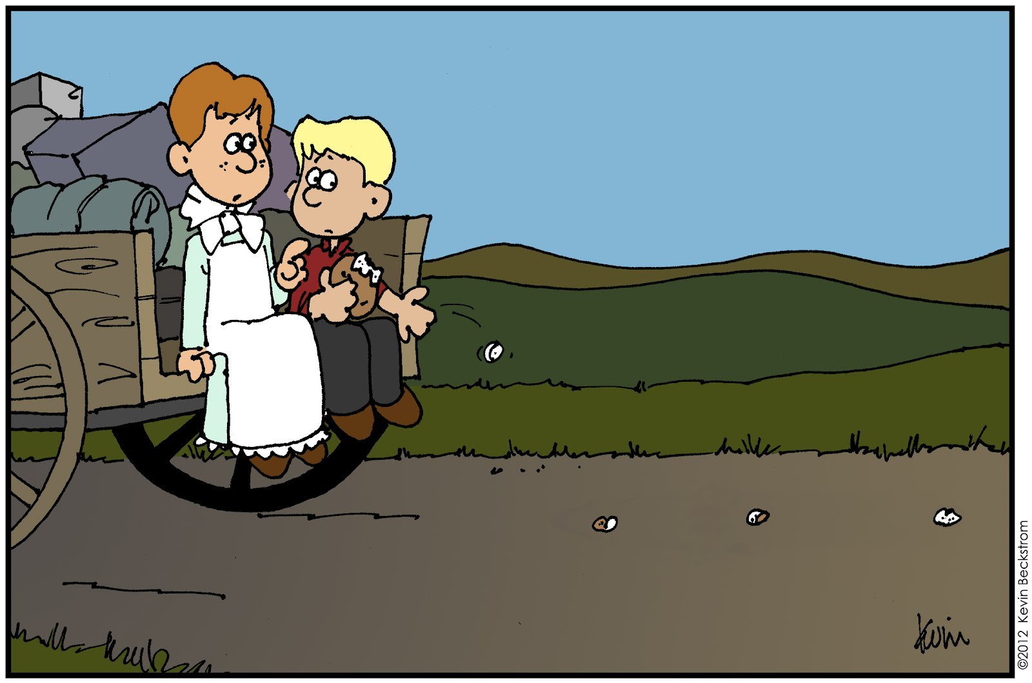
Recovering Data With Reflog
Records history of refs (branches, HEAD)
Specific to local repository
Notes:
We just went over some dangerous commands. A Git reset could leave you with dangling commits with no way to get them back. (It wouldn’t be right unless I showed you a safeguard.)
Thankfully, Git never deletes your commits…at least not right away. While you’re working away, Git silently records changes to your branch and HEAD pointers (or refs, as Git calls them). It records this in the reflog: a “log” of your “refs”. It’s like a breadcrumb trail, allowing you to retrace your steps as you navigate around your local repository.

Slide 38
Reflog Demo

Slide 39
Recovering Data With Reflog
Commit early and often, using descriptive commit messages!

Slide 40
Interactive Rebase
Modifications
Reword commit messages
Edit commits
Delete commits
Reorder commits
Squash commits
Notes:
Remember the rebase operation? It grabs a series of commits and applies them, one-by-one in the same order, on top of the branch you give it. Git has an interactive rebase mode that lets you customize how the commits are applied on the new branch.
Squash: combines two or more commits into one

Slide 41
Interactive Rebase
git rebase –i HEAD~3
HEAD
feature
A
B
B
C
C
D
E
D
E
Rebase last 3 commits
Notes:
Let’s say you want to perform some operations (like renaming, squashing) within the last 3 commits.
Without the –i modifier, we know what this operation does. Git finds the first commit reachable from both B and the current branch. That’s B itself, so Git grabs the commits up until B, and applies them on top of the named commit, which is also B. So this command wouldn’t do anything. But since we used the –i modifier, we get to customize how the commits are applied.
In fact, I use this command so much I forget all that and just read it as: “Interactively rebase the last 3 commits.”
=== DEMO ===
Show interactive rebase of 3 commits.
Explain/show shortcut to amend last commit: git commit --amend

Slide 42
Additional Resources
“Pro Git” book (Scott Chacon and Ben Straub)
Online content: https://git-scm.com/book/en/v2
Atlassian tutorials
https://www.atlassian.com/git/tutorials
“All Things Git” podcast (Edward Thomson and Martin Woodward)
https://www.allthingsgit.com
Coding Blocks “Comparing Git Workflows” episode
https://www.codingblocks.net/podcast/comparing-git-workflows/
Notes:
Pro Git: Helpful that it explains Git commands in terminology that’s understandable, not in terse language like the documentation.
All Things Git: once or twice a month episodes.
Lastly, but probably most importantly, create a test repo and try out commands and go through some “what-if” scenarios.

Slide 43
Appendix

Slide 44
Detached HEAD State

Slide 45
Advanced Rebase
git rebase A --onto B
Notes:
Reasons for doing this:
* needed to develop feature 2 that depended on feature 1, and didn’t want to wait until feature 1 was merged into master
* forget to base new unrelated feature off master
NOTE: Git is pretty smart at not applying commits that have already been applied. So you may not need to do this. This simpler command might be all you need: git rebase B
This magic seems to apply only if the commits already applied are not squashed…that is, the patches are the same.

Slide 46
Checkout
Kinds of operations
Switch branches
Discard unstaged changes
View old commits

Slide 47
Reset
Kinds of operations
Move branch pointer (erasing history)
Unstage changes

Slide 48
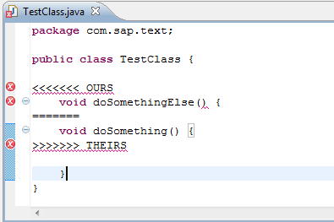
Merge Conflict Example

