Slide 1
Human Say, Monkey Do
Tech Review: Scientific Computing Package

Slide 2
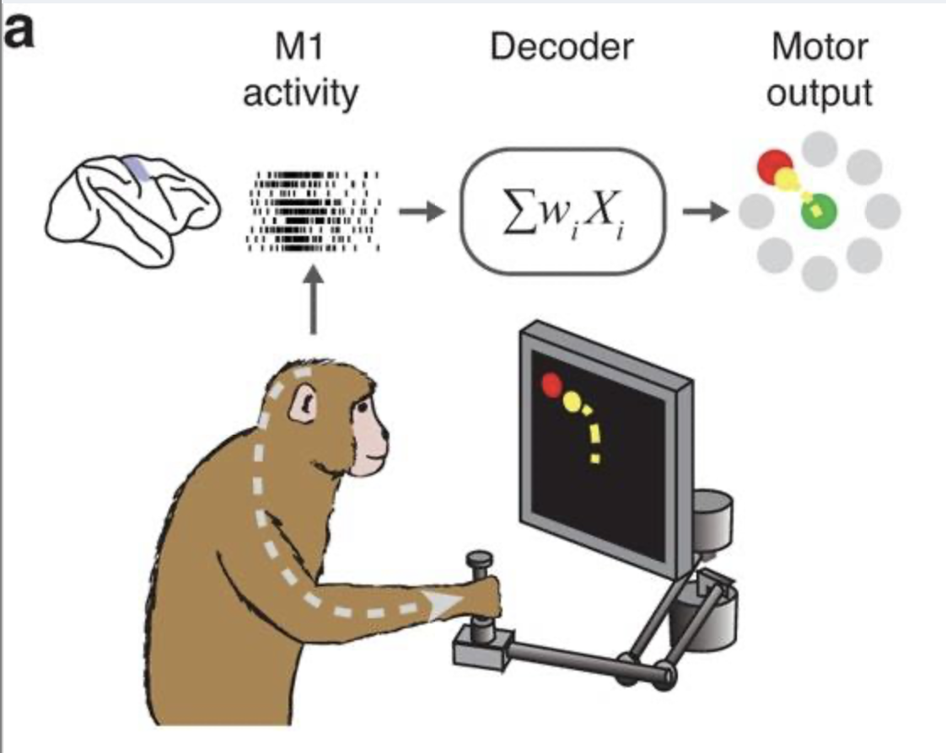
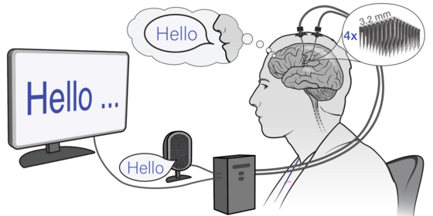
Project Overview
Monkey Dataset:
Motor cortex neural activity
Reaching behavior
Human Dataset:
Motor cortex neural activity
Speech generation
Question:
How are they similar?
How do decoders compare on these datasets?
Notes:
AJ

Slide 3
Scientific Computing Package Criteria:
Project Analysis Goals:
Movement onset detection
Tuning Curve analysis
Target/phoneme decoding
Specific Modeling Functions:
Supervised Classification
Linear Curve fitting
How plug-and-play is the package?
Future growth?
Candidates:
Scikit-learn: https://github.com/scikit-learn/scikit-learn
Pynapple: https://github.com/pynapple-org/pynapple
Statsmodels: https://github.com/statsmodels/statsmodels
Notes:
AJ

Slide 4
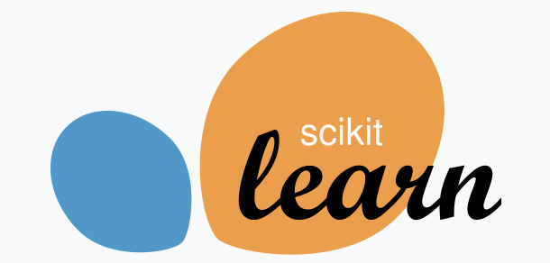
Scikit-Learn
https://github.com/scikit-learn/scikit-learn
Pros:
Built-in implementations for all needed models (classification, logistic regression)
Includes extensive tools for model validation (train/test split, cross-validation, performance evaluation metrics)
Good compatibility with other packages whether for visualization or further goals
Ease of use and consistent workflow, lowering barrier for team work
Computationally efficient backed by C python optimized implementations
Cons:
Limited statistical inference unlike statsmodels great for prediction accuracy but less suited for formal statistical inference
Operates in-memory which can become restrictive for large-scale neural datasets
No native neural data support

Slide 5
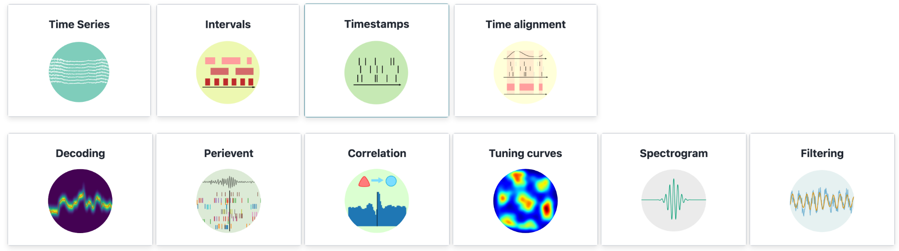

Pynapple
https://github.com/pynapple-org/pynapple
Pros:
Plug and play
Purpose built neural computing package
High growth potential: interfaces with advanced computing modules
Cons:
Highly Technical/Steep learning curve (Attend 3 day workshop to gain proficiency)
Poor support for simpler, linear classifiers
Notes:
Script:
Pineapple is a very cool neural computational toolbox custom built by labs from the Flatiron Institute of computational neuroscience in New York. Its plug and play for neural data, has purpose built modules for the types of analysis we want to do, and has high growth potential.
The core drawback of this package is that it is incredibly technical with a steep learning curve. The creators even offer a 3 day intensive in person workshop to train neuroscienctist how to utilize these tools. Because we don’t have that level of expertise or time for this project, this package is less than ideal.

Slide 6
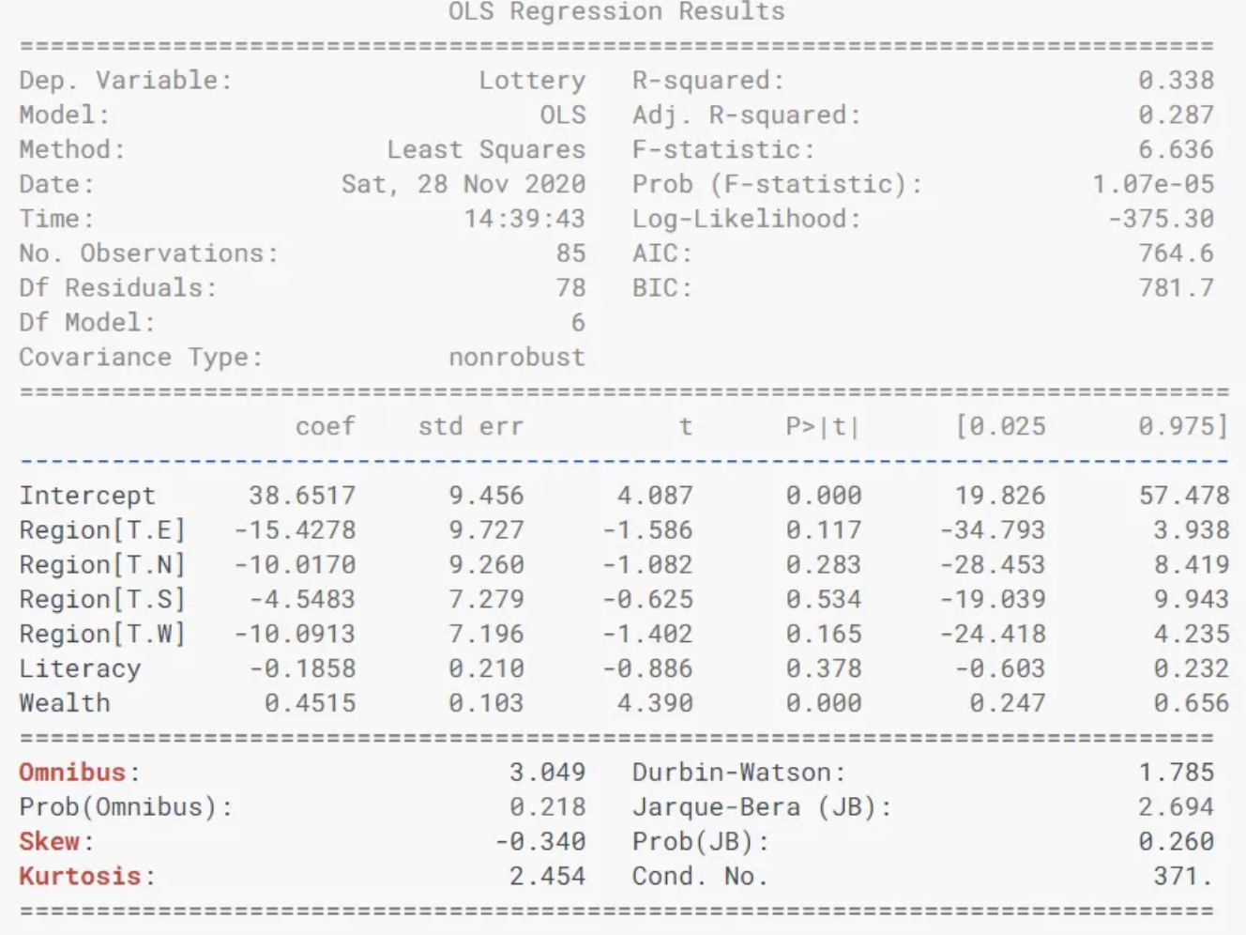

Statsmodels
https://github.com/statsmodels/statsmodels
Pros
Easy, transparent workflow for linear/logistic regression
Highly interpretable outputs (coefficients, SEs, p-values, CIs)
Great for understanding why a model makes decisions
Well-suited for tuning-curve–style, statistically oriented analyses
Cons
Not designed for neural data → manual spike-data formatting required
No built-in regularization or cross-validation
Less suitable for high-performance decoding tasks
Notes:
Yici

Slide 7
Summary of Selection:
All packages:
Built-in implementations for linear regression/classification models
Need some reformatting of neural data
Scikit-Learn
Model validation tools and compatibility with visualization packages
Important to validating our decoder models
Compatibility with other packages would make visualizations + statistical analysis easier later

Slide 8
THANK YOU

