Slide 1




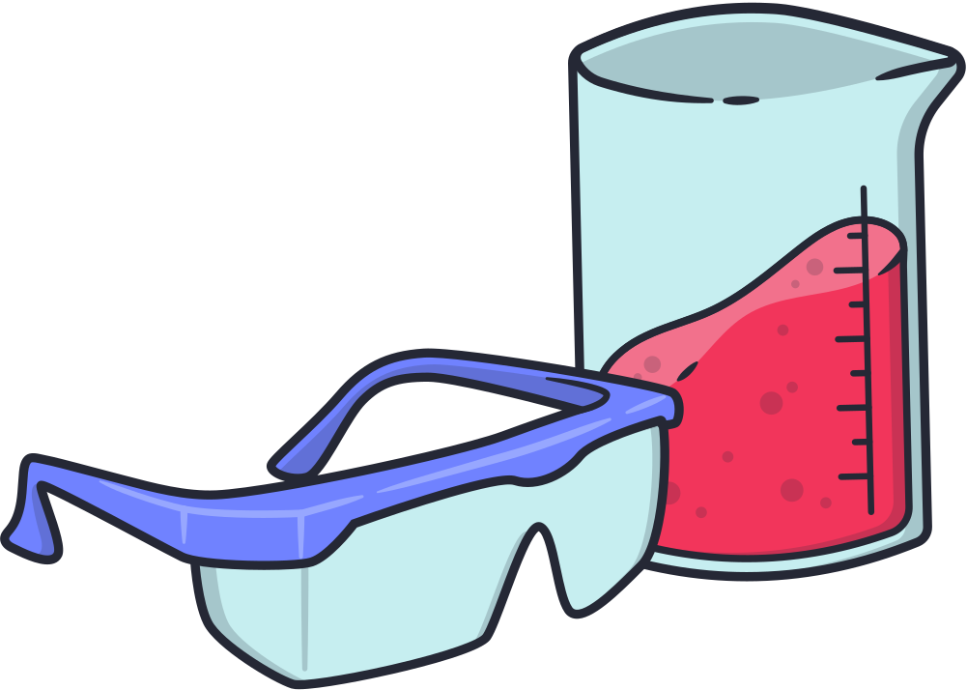

  CHEMICAL EQUATIONS AND REACTIONS

Slide 2




  LEARNING OBJECTIVES
  Define and explain what a chemical reaction is.
  Identify and describe the five main types of chemical reactions,
  Analyze everyday phenomena and relate them to specific types of chemical reactions.

Slide 3

  CHEMICAL REACTION
Is a process where one or more substances are changed into new substances with different properties.

Slide 4
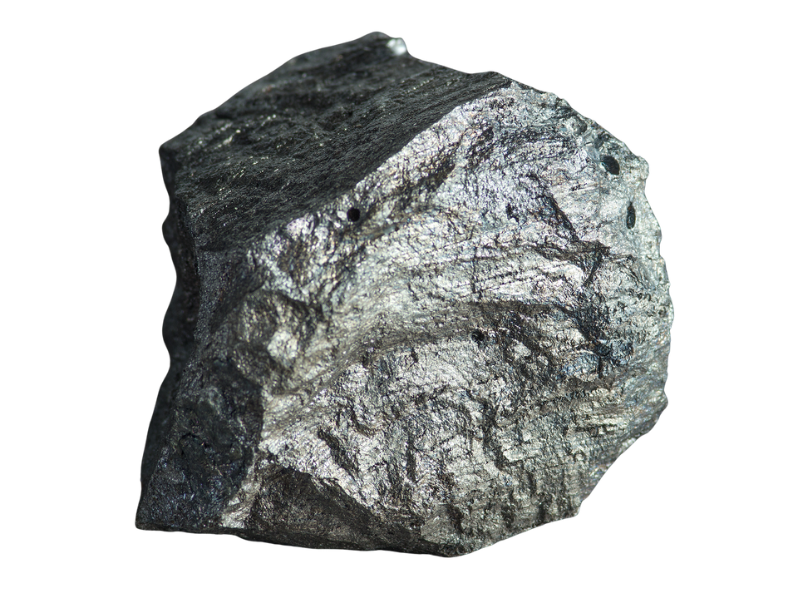

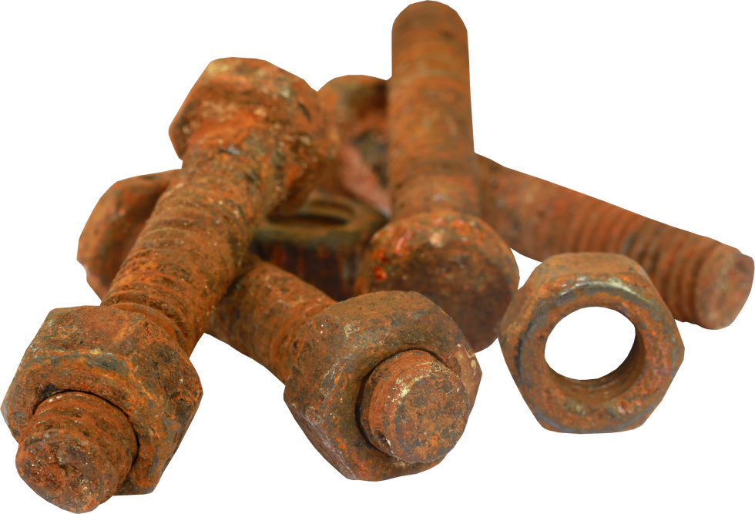
  EXAMPLES
+
=
iron
oxygen
rust

Slide 5
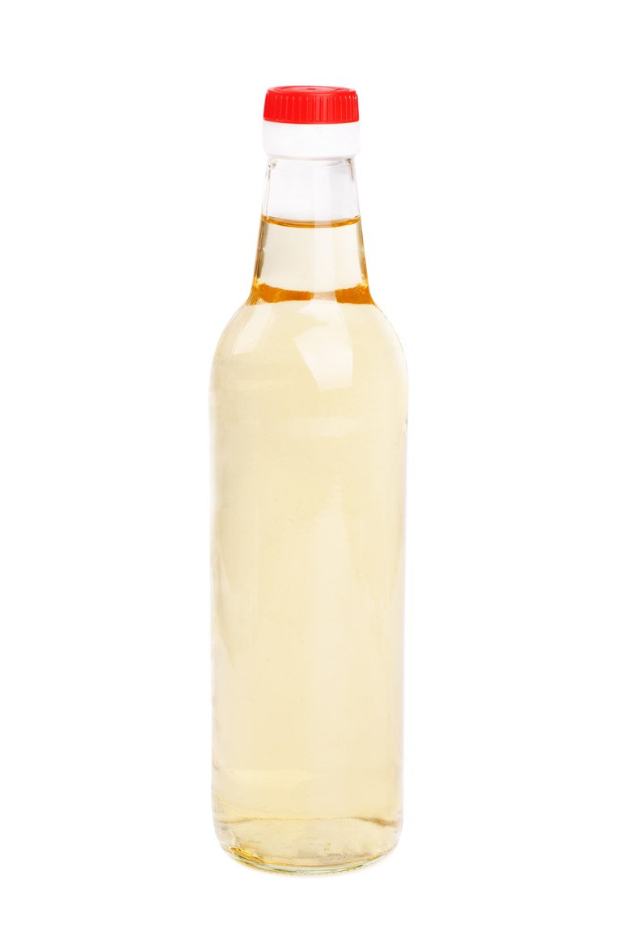
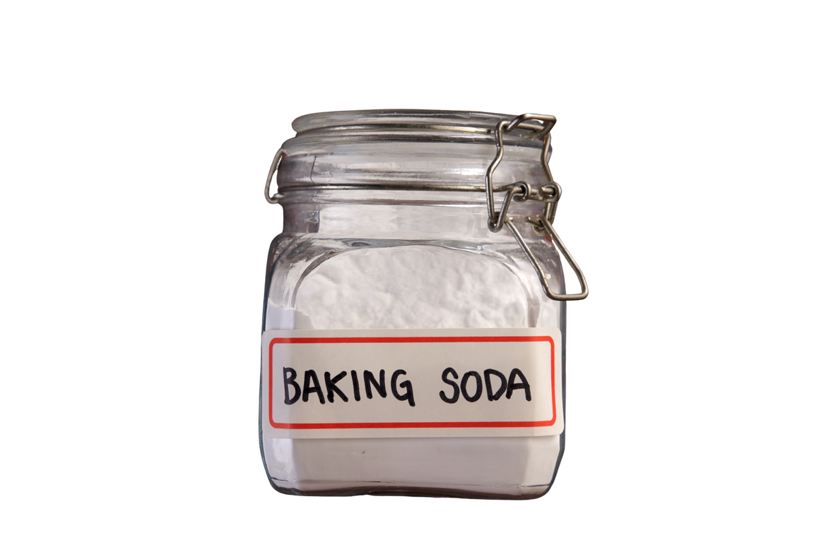
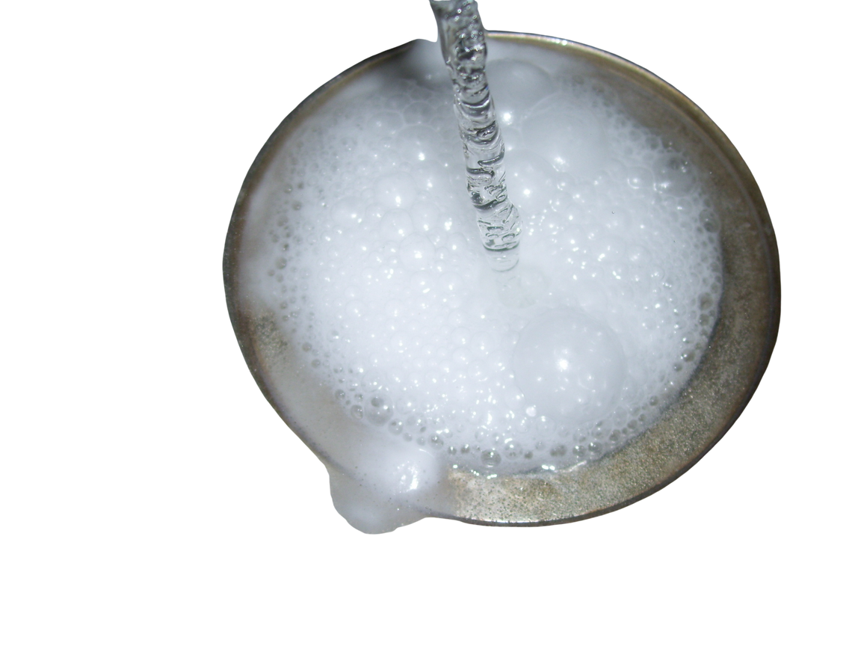
  EXAMPLES
+
=
vinegar
bubbles
baking soda

Slide 6

  EXAMPLES
=
Ash, smoke, and heat
burning wood

Slide 7
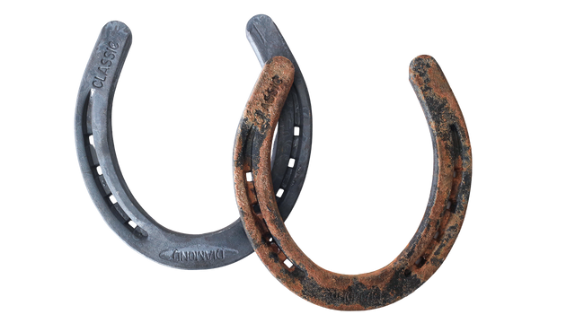
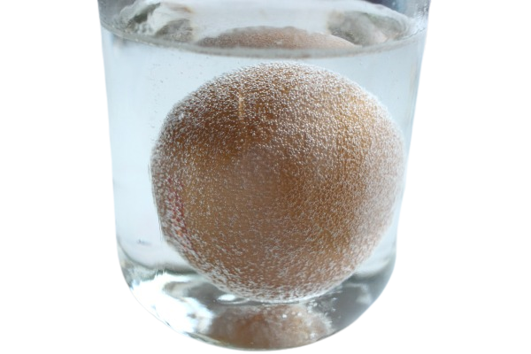


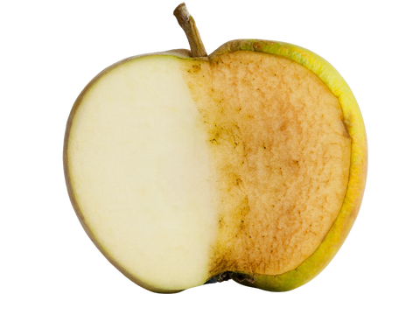
  SIGNS OF A CHEMICAL REACTION
  CHANGE IN COLOR
  BUBBLES OR GAS PRODUCED
  HEAT OR LIGHT GIVEN OFF

Slide 8
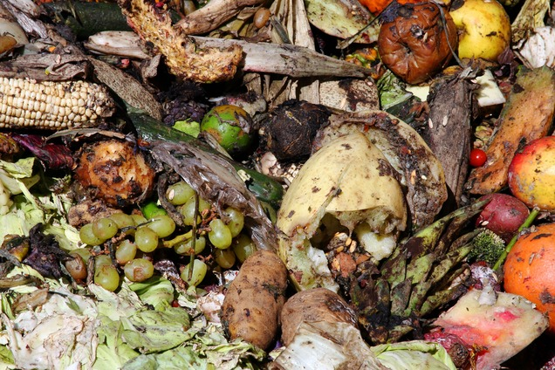
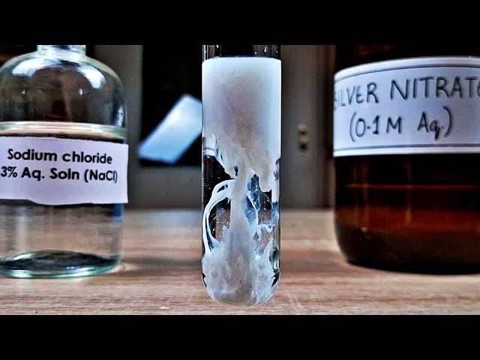
  SIGNS OF A CHEMICAL REACTION
  A SOLID FORMS FROM TWO LIQUIDS (CALLED A PRECIPITATE)
  A NEW SMELL

Slide 9

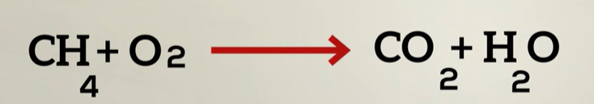
  CHEMICAL EQUATION BASICS
  reactants
  products

Slide 10


  CHEMICAL EQUATION BASICS
  CH
  +
  +
  O
  CO
  H
  O
  4
  2
  2
  2
  elements/compoundthat are combined
  yields
  (methane)
  (oxygen)
  (carbon dioxide)
  (water)

Slide 11

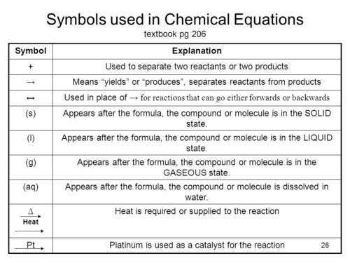

  SYMBOLS USED IN CHEMICAL EQUATIONS

Slide 12
  TYPES OF CHEMICAL REACTIONS

Slide 13

  COMBUSTION
A combustion reaction is a chemical reaction where a substance reacts quickly with oxygen (O₂) and gives off heat and light, usually in the form of a flame. It is also called burning.

Slide 14
  COMBUSTION
CxHy + O₂ → CO₂ + H₂O + energy (heat and/or light)
C₈H₁₈ + O₂ → CO₂ + H₂O
(g)
(g)
(g)
(g)
  octane
  (found in gasoline)

Slide 15
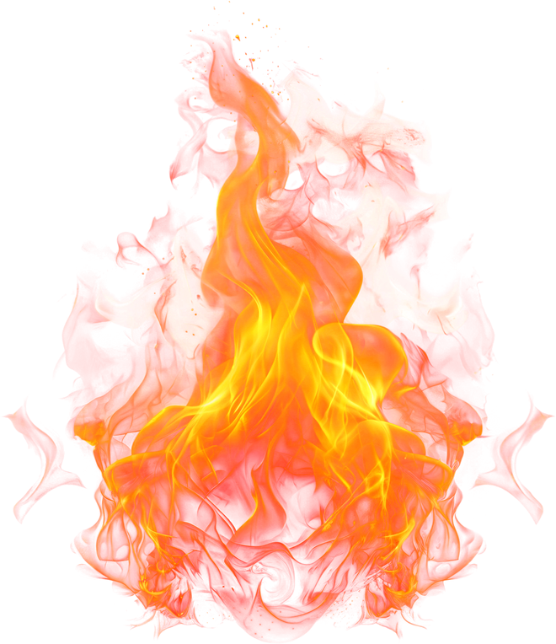
  COMBUSTION
(ethanol)
C₂H₅OH + O₂ → CO₂ + H₂O
(g)
(g)
(g)
(methane)
CH₄ + O₂ → CO₂ + H₂O
(g)
(g)
(g)
(g)
(propane)
C₃H₈ + O₂ → CO₂ + H₂O
(g)
(g)
(g)
(g)

Slide 16

  COMBUSTION FORMULA
  Hydrocarbon + O₂ → CO₂ + H₂O

Slide 17
  SYNTHESIS OR COMBINATION
Combining two smaller things to make something larger.

Slide 18
  SYNTHESIS OR COMBINATION
(A + B = AB)
Hydrogen + Oxygen → Water
H₂ + O₂ → H₂O

Slide 19
  SYNTHESIS OR COMBINATION
Sodium + Chlorine → Sodium chloride
Na + Cl₂ → NaCl
Carbon + Oxygen → Carbon dioxide
C + O₂ → CO₂

Slide 20
DECOMPOSITION
One compound breaks down into two or more simpler substances (elements or smaller compounds).

Slide 21
  DECOMPOSITION
(AB = A+B)
Hydrogen Peroxide
H₂O₂ → H₂O+O₂​

Slide 22
  DECOMPOSITION
Calcium Carbonate (Chalk or Limestone)
CaCO​ → CaO+CO​
3
2
Silver Oxide (when heated)
Ag ​O → Ag+O
2
2

Slide 23
  SINGLE REPLACEMENT
One element that starts out by itself replaces another element in a compound, kicking it out.

Slide 24
  SINGLE REPLACEMENT
A + BC → AC + B
Chlorine + Sodium Bromide
Cl​ + NaBr → NaCl+Br
2
2
Fe+CuCl→FeCl​ + Cu
2

Slide 25



  SINGLE REPLACEMENT
+
+
Magnesium + Hydrochloric Acid
Mg + HCl → MgCl ​ + H​
2
2

Slide 26
  DOUBLE REPLACEMENT
The positive and negative ions in two compounds switch places.

Slide 27

  DOUBLE REPLACEMENT
AB + CD → AD + CB
BaCl +Na ​SO​→BaSO +NaCl
2
2
4
4
AgNO ​+NaCl→AgCl↓+NaNO​
3
3

Slide 28

  DOUBLE REPLACEMENT
  +
  +
AgNO ​+NaCl→AgCl↓+NaNO​
3
3

