Slide 1






PERCENT AND THEORETICAL YIELD

Slide 2
MOST ESSENTIAL LEARNING COMPETENCY
Calculate percent yield and theoretical yield of the reaction
  1

Slide 3
When chemical reactions takes place, they are almost never 100% complete.
Why?

Slide 4
  Incomplete reaction – Some molecules may not collide with enough energy or in the correct orientation to react, so a portion of the reactants remains.
  Losses during the process – In real experiments, substances can stick to containers, evaporate, or spill, reducing the actual yield compared to the theoretical one.

Slide 5
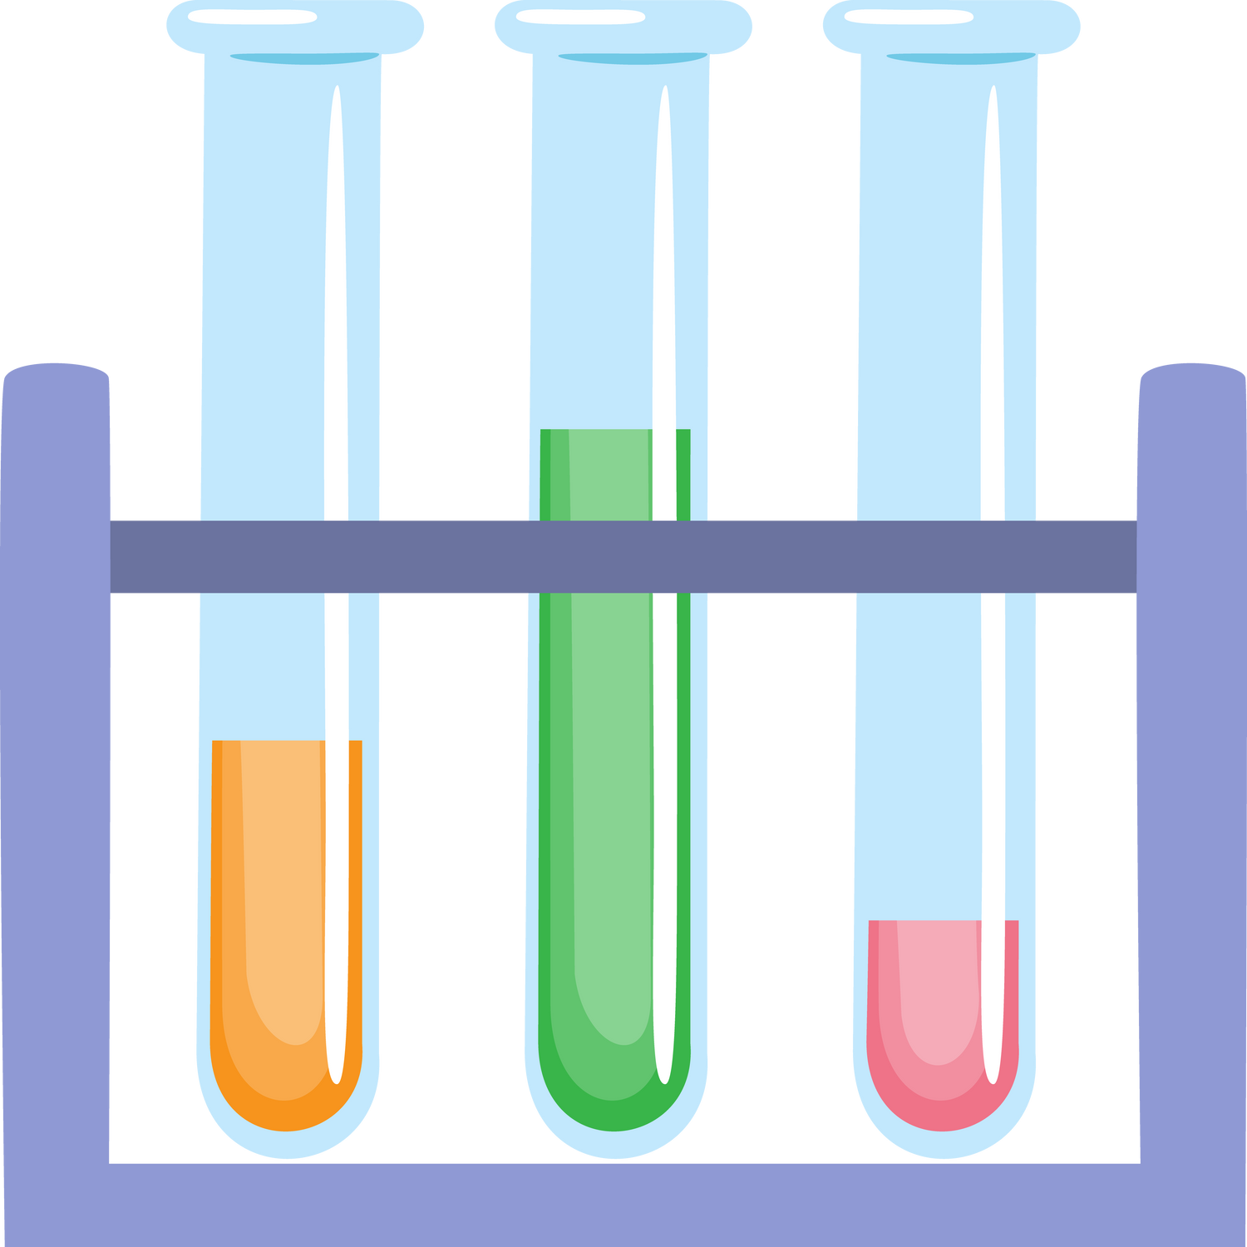



Slide 6
Percent yield is very important in the manufacturing of products.
Time and effort is spent in improving the percent yield for chemical production.

Slide 7
When complex chemicals are synthesized by many different reactions, low percent yield means large waste of reactants that leads to negative effects on businesses.

Slide 8
To compute the percent yield, it is first necessary to determine how much of the product should be formed based on stoichiometry which refers to theoretical yield.

Slide 9
The actual yield is the actual product collected and measured or experimentally determined.

Slide 10
The percent yield is a ratio of actual yield and theoretical yield which can be expressed as:
Percent Yield = Actual Yield x 100%
Theoretical Yield

Slide 11

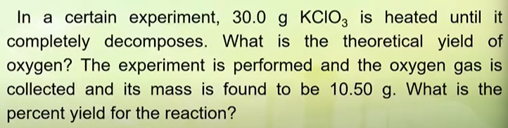
Potassium chlorate decomposes upon slight heating in the presence of a catalyst according to the reaction below:

Slide 12


ACTUAL YIELD
10.50 g
STARTING POINT
30.0 g KClO
3

Slide 13
SAMPLE PROBLEM 1
In a certain experiment, 30.00 g KClO is heated until it completely decomposes. What is the theoretical yield of oxygen? The experiment is performed and the oxygen gas is collected and its mass is found to be 10.50 g. What is the percent yield for the reaction?
3

Slide 14

Convert into moles
STEP 1
30.00 g KClO x 1 mol KClO
3 mol O
32 g O
3
3
x
2
x
2
11.80 g
2 mol KClO
=
122 g KClO
1 mol O
3
3
2
Theoretical Yield
STEP 2
% yield =
10.50 g
x
100 % =
89 %
11.80 g

Slide 15
SAMPLE PROBLEM 2
2. The combustion of methane (CH ) produces carbon dioxide. Assume that 2.0 mol of CH burned in the presence of excess air. What is the percent yield if an experiment the reaction produces 87.0 g of CO ?
4
2

Slide 16
2. The combustion of methane (CH ) produces carbon dioxide. Assume that 2.0 mol of CH burned in the presence of excess air. What is the percent yield if an experiment the reaction produces 87.0 g of CO ?
4
4
2
CH + 2O CO + 2H O
4
2
2
2
2.0 mol CH x 1 mol CO x 44 g CO
4
2
2
=
88 g CO
2
1 mol CH
1 mol CO
4
2
% yield = 87.0 g x 100% = 99%
88.0 g

Slide 17
SAMPLE PROBLEM 3
3. 15.3 grams of Lithium is dropped into a solution containing excess copper (II) phosphate. When the reaction is completed, 52.5 grams of copper is formed. What is the percent yield?

Slide 18
3. 15.3 grams of Lithium is dropped into a solution containing excess copper (II) phosphate. When the reaction is completed, 52.5 grams of copper is formed. What is the percent yield?
15.3 g Li x 1 mol Li x 3 mol Cu x 64 g Cu = 69.9 g Cu
7 g Li
6 mol Li
1 mol Cu
% yield = 52.5 g x 100% = 75.1%
69.9 g

Slide 19
SEATWORK

Slide 20
I hope you learn something new today!
THANK YOU
FOR LISTENING!

