Slide 1
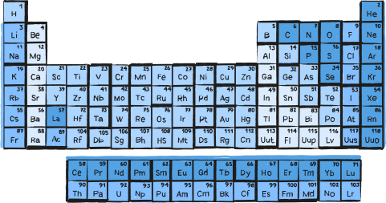

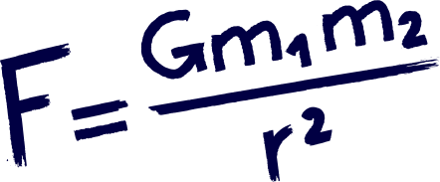



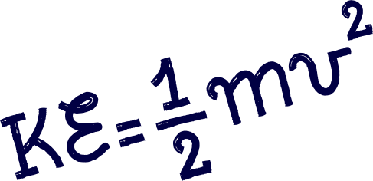

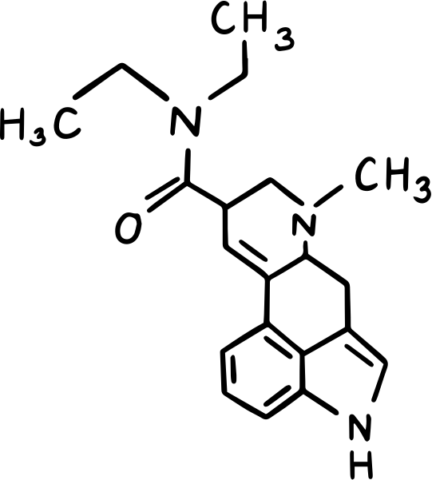

STOICHIOMETRY
PART 2

Slide 2


PROBLEM 1
If 90.5 grams of Ag was produced, how many grams of Cu reacted?
Cu + AgNO Cu (NO ) + Ag
3
3
2

Slide 3


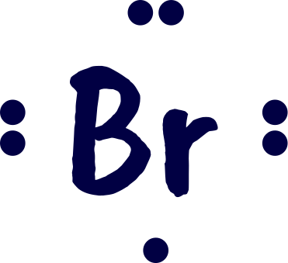





mole A
balanced equation
mole B
mass A
mass B

Slide 4

SOLUTION
Cu + 2AgNO Cu (NO ) + 2Ag
3
3
2
1 mol Ag
1 mol Cu
64 g Cu
90.5 g Ag x
x
x
=
26.81 g Cu
108 g Ag
2 mol Ag
1 mol Cu
PRACTICE PROBLEM
If 13.5 g of H is produced, how many grams of Al reacted?
2
Al + HCl AlCl + H
3
2

Slide 5
PROBLEM 2
If 72 g of H O is produced, how many grams of O were used?
2
2

Slide 6
SOLUTION
2H + O
2H O
2
2
2
Step 1:
Step 2:
Step 3:
Given: 72g H O
Find the molar masses
H O: 2 (1.01) + 16.00 = 18 g/mol
O : 2 (16.0) = 32 g/mol
Convert g H O to mol H O
2
2
2
Problem: g O
mol H O =
72 g = 4.0 mol
2
2
2
18.0 g/mol
2
Step 4:
Step 5:
mol O =
4.0 mol
H O
1 mol O
2
2
2
X
Convert moles O to grams O
mass O = 64 g
2 mol H O
2
2
2
= 2.0 mol
2

Slide 7
PRACTICE PROBLEM
If 112g of Fe is produced, how many grams of Fe O reacted?
2
3
Fe O + CO Fe + CO
2
3
2

