Slide 1

Populations at Risk for CHD
By: Zachary Greenberg & Jonathan Silverman

Slide 2
Business Problem
According to the CDC, Heart Disease is the #1 leading cause of death among Americans.
Heart Disease cost the US about $214 billion in 2015 and is increasing annually.
Identify populations at risk, and design an intervention for these populations.
In the long run, reduce the financial burden to the U.S. Healthcare system.

Slide 3
CHD Data
Public Dataset from Kaggle.
Data on 4000 individuals
Fifteen Measures of Health
Sex | Stroke | Diastolic Blood Pressure
Age | Hypertension | Body Mass Index
Smoking | Diabetes | Heart Rate
Cigarettes Per Day | Total Cholesterol | Glucose
BP Meds | Systolic Blood Pressure | Ten Year Risk for CHD

Slide 4
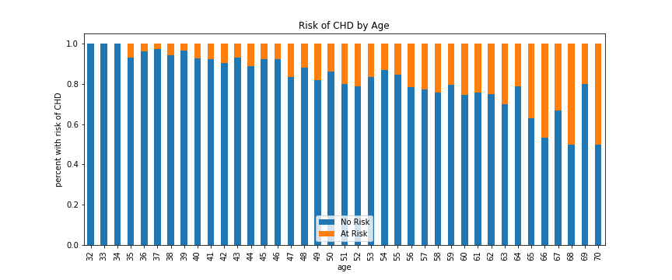
Prevalence of CHD As You Age
The risk of CHD seems to exponentially increase with age.

Slide 5
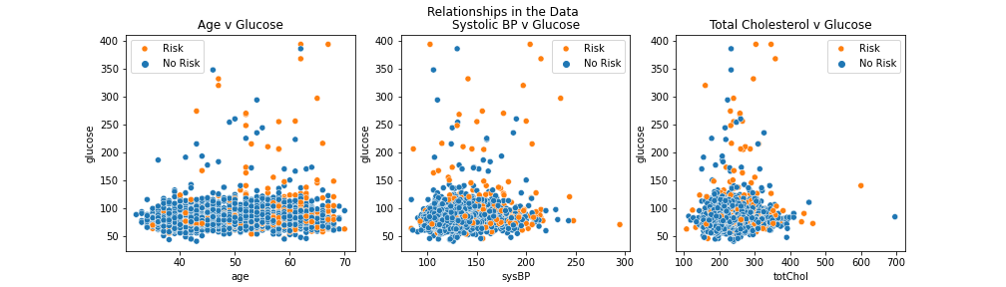
Other Insights
Given 2 conditions, the risk of CHD is made clear.
For example if age is greater than or equal to 50, and glucose greater than or equal to 140, 60% of people at in the dataset were at risk for CHD.
Notes:
Given SBP >=120, Glu >=140, 51%
Given Chol >=200, Glu >=140, 57%

Slide 6
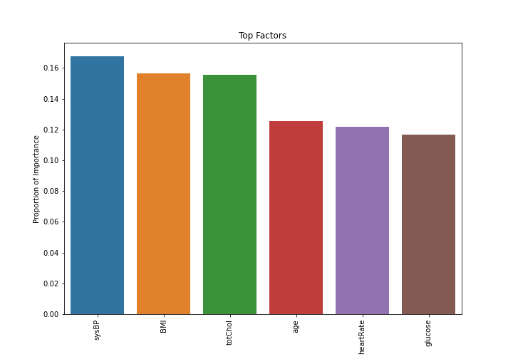
Biggest Risk Factors
The top 6 risk factors are:
Systolic BP, BMI, Cholesterol,
Age, Heart rate, & Glucose Levels.
Notes:
Slice top 6

Slide 7
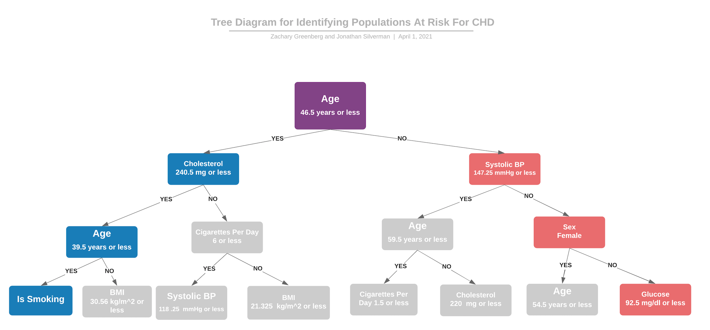
Notes:
If you are going right you are going to an unhealthy state, and left is going toward a healthy state.
Everything is asking or less. If you are true on or less you are getting healthier.
If features repeat on the left side and you register False, you will be less healthy.
BMI is a repeating feature
High Cholesterol is 240 or higher
Systolic BP is 140 or over
BMI > 25 is overweight
Glucose < 150, so the algorithm is even stricter about this, around 90 is fasting

Slide 8
Population Most At Risk
Down the Right-most Branch:
This population is over the age of 46,
has a Systolic BP greater than 147mmHg,
is male
has a glucose reading of over 92.5 mg/dl.

Slide 9
Conclusion & Next Steps
Population in most dire need:
over the age of 46
has a Systolic BP greater than 147mmHg
is male.
Insights from tree diagrams mostly parallel conventional medical wisdom:
Systolic BP,
BMI,
Cholesterol,
Age,
Heart rate,
Glucose Levels
Staging interventions
prioritizing dietary potassium
glucose management perhaps with fasting
Studying the left-most branch of the tree, the healthiest populations for insights into intervention techniques

