Slide 1
SELĒNE
Team Lead: Sarika Kothakonda
Co-Member: Richard Abishai

Slide 2
Problem Definition
Many people suffer with chronic illness which are a life long incurable disease, and along with this they suffer with mental health issues that plague their lives and these people can’t find a holistic support for the problems that they face in their lives.

Slide 3
Sustainable development Goal
Our solution aligns with UN Sustainable Development Goal 3: Good Health and Well-being, specifically targeting Goal 3.4 to reduce premature mortality from non-communicable diseases. Our inspiration is rooted in making a meaningful impact on individuals' health and well-being.

Slide 4
SOLUTION
Our holistic approach integrates personalized care plans, telehealth consultations, mental health support, and a community platform. Each element plays a crucial role in addressing the unique needs of individuals dealing with chronic conditions.

Slide 5
Solution Architecture
The architecture centers on personalized care plans supported by telehealth, mental health modules, and a community platform. This design addresses gaps in current healthcare systems, offering a more holistic and effective solution.

Slide 6
Technology stack
Our technology stack includes user-friendly interfaces, secure data storage, telehealth platforms, and community-building tools. The integration plan ensures a cohesive and integrated user experience, enhancing accessibility and usability.
Front End (HTML, CSS, Javascript)
Back End (Node.js, Flask, or Django)
AI Technologies (LLM, Tensorflow, Recommendation System)

Slide 7
Pain Points and aspirations
Our startup recognizes the daily challenges individuals with chronic illnesses, such as arthritis, endure, including navigating complex healthcare systems and coping with emotional and social isolation. By addressing these pain points, we aim to provide more than just physical relief; our solution is designed to understand and fulfill the diverse aspirations of individuals, fostering emotional well-being and empowering them to reclaim control over their lives.

Slide 8
Prototype
Our prototype showcases scalability, emphasizing a user-friendly interface, secure data handling, and the potential for widespread adoption. It illustrates the seamless integration of telehealth and community features.

Slide 9
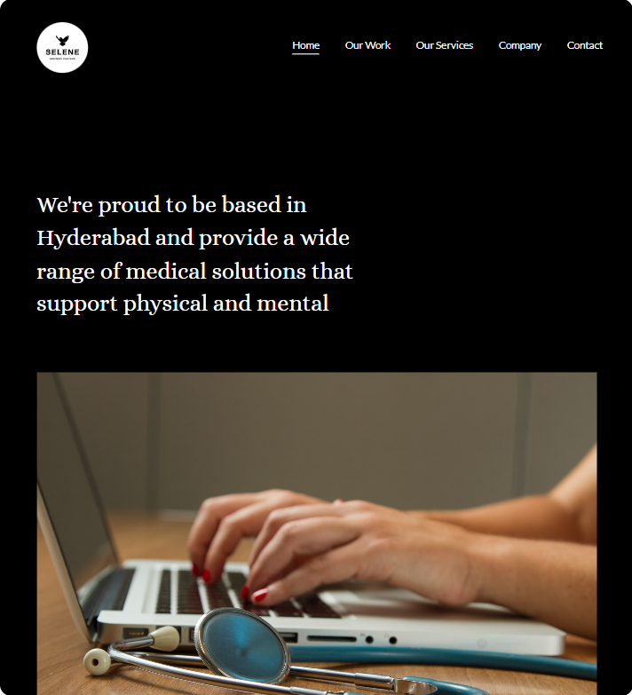
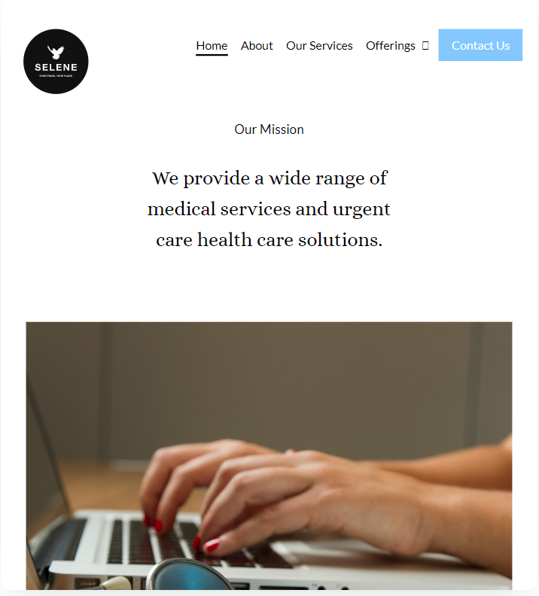

Slide 10
Future Expansion
Diversifying Chronic Conditions
Expand our solution to cover a broader spectrum of chronic illnesses, catering to diverse healthcare needs beyond arthritis.
Collaboration with Experts
Forge collaborations with additional healthcare experts, including specialists in various chronic conditions, to enhance the depth and breadth of our platform.
Community Enhancement
Continuously enhance community features, fostering engagement and peer support, creating a comprehensive resource for chronic illness management on a global scale.

Slide 11
Conclusion
In conclusion, our journey is driven by a commitment to transforming chronic illness management. Key insights focus on creating a world where individuals with chronic conditions can live with dignity, purpose, and hope. Our solution is a movement towards a healthier and more compassionate future.

Slide 12
THANK YOU

