Slide 1
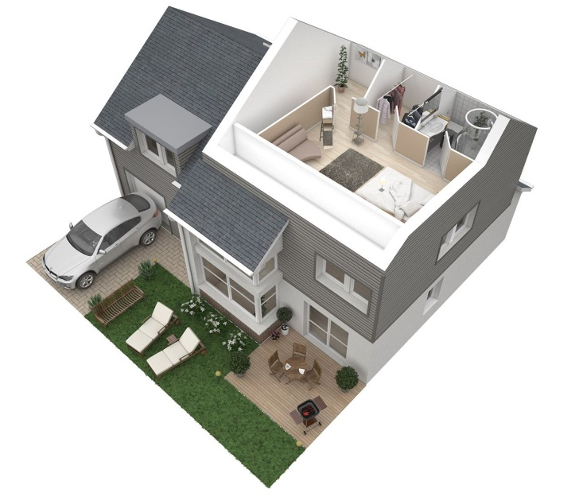


English Project
Rediscover your world !
Zacharie MEHNANA
Sarah EXBRAYAT
31/03/2016

Slide 2
Introduction
English Project
« The limits of my language are the limits of my world. »
Ludwig Wittgenstein
To help people improving their level in English, we tried to extend these boundaries.

Slide 3

Introduction
English Project
The application
Demonstration
Development

Slide 4
The application
English Project
The aim : Learning vocabulary regarding everything that surrounds us
We focused on the vocabulary covering home and its surroundings
The user can move through a virtual world

Slide 5
The application
English Project
The composition of the house :
A living room
A dining room
A bedroom
A bathroom
A kitchen
An office

Slide 6
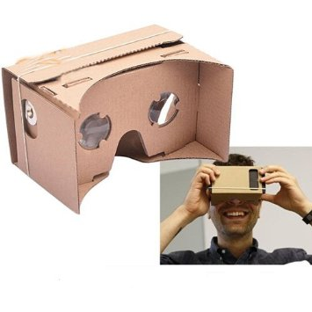
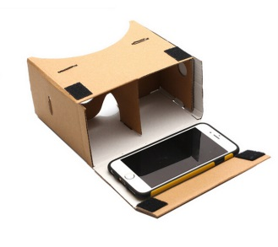
Demonstration
English Project
Please try with our glasses!

Slide 7

Development
English Project
Graphics : Unity software
Events : handled with Events Trigger (language C#)
Camera for smartphones : Google’s Demo

Slide 8
Development
English Project
Difficulties : 3D-elements are heavy and require power
Not enough time
Enhancements :
More rooms : a garage, a garden…
Two game play modes : an educational approach and an interacting approach

Slide 9
Conclusion
English Project
We remember :
50% of what we see and hear at the same time
90% of what involves us
This project : a good opportunity to discover 3D-graphics and to learn new vocabulary

Slide 10
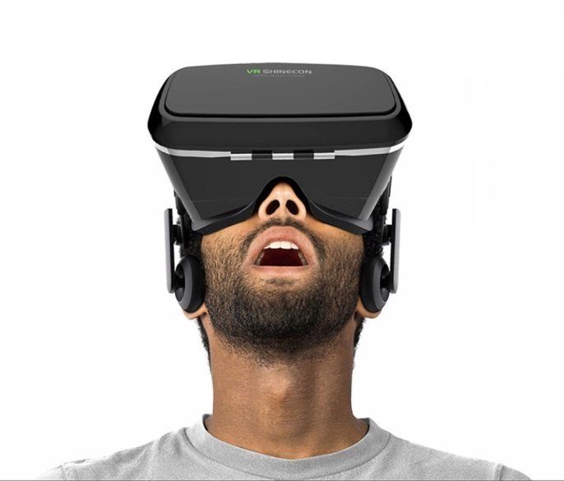
English Project
Thank you for your attention

