Slide 1
Thrasio Case Study
March 2, 2020

Slide 2
Problem Statement
We are interested in determining which SKUs will be most sensitive to PPC spend* in the next month
In particular, we want to know:
How accurate a forecasting model can we develop to predict one month into the future, at the SKU level, given historical sales and PPC spend?
Given this forecasting model, what is the expected predictive performance for Organic and PPC sales separately, for groups of SKUs with different degrees of missingness, and overall?
Given this forecasting model, which SKUs are likely to yield the highest increase in PPC units in response to a small change in PPC spend, in aggregate?
Given this forecasting model, for each SKU, what is the expected percentage change in PPC units associated with a 1% increase in PPC spend?

Slide 3
Approach
Aggregate historical data to the month-SKU level
Record missingness for each SKU by month
Classify each SKU into missingness groups: high (>70%), medium (between 30% and 70%) and low (below 30%)
Determine target variable
Since the magnitude of the “Units” columns varies substantially both among the SKUs and between Organic and PPC sales, we choose the natural log transformation of Units as the target
This transformation will prevent a model from “preferencing” the high-volume SKUs
Determine feature to reflect PPC spend
Of particular interest is the impact of PPC spend on PPC Units. Since the “PPC_Cost” column reflects the total PPC units, we need to factor out PPC units to avoid target leakage in our models
Ideally, we’d have PPC spend per click in our data. However, since this is absent, we choose PPC spend per (PPC) unit as a proxy. The logic is that assuming the number of clicks per unit for a given SKU is relatively stable, the PPC spend per click will be roughly a fixed proportion of PPC spend per unit.
To reflect PPC spend in the model, we use the log transformation of PPC spend per unit as a feature

Slide 4
Approach
Reshape data for modeling
Since we are interested in predicting both Organic and PPC units separately, we choose to reshape the aggregated data such that there is one “Units” column
In addition, we add the variable “sale_type” which indicates either Organic or PPC sales
Perform further EDA and hypothesize/generate features
Split data into training/validation/testing sets
Choose first X months as training, next X months as validation, next X months as test
Fit naïve model training set and iterate to improve performance on validation set

Slide 5
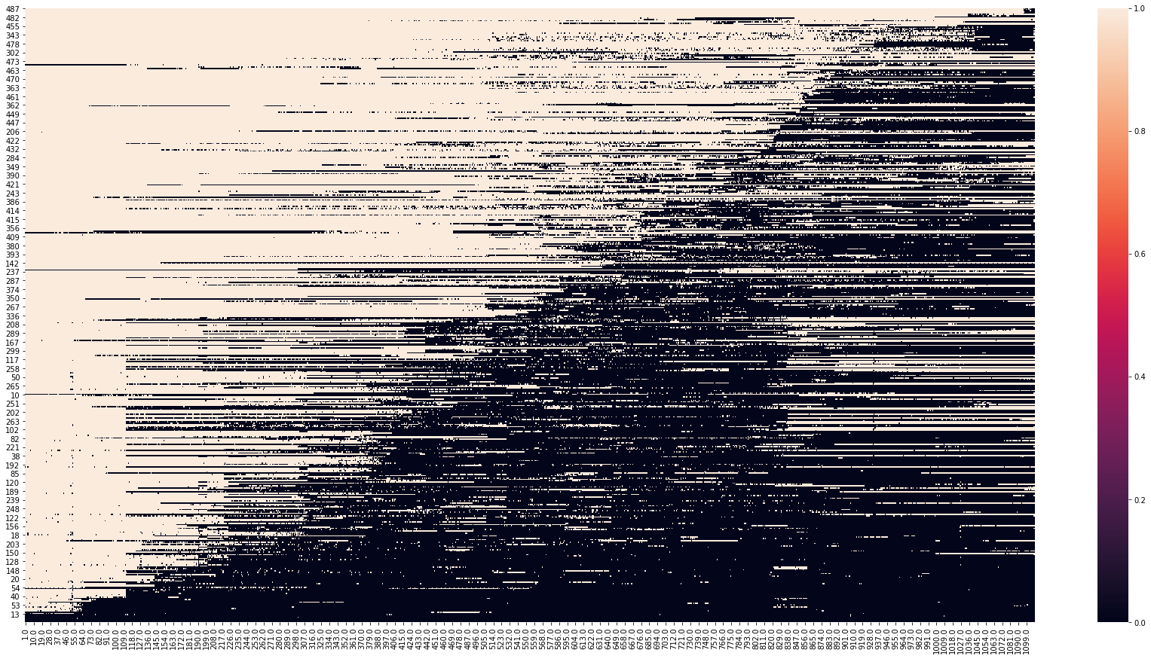
Appendix - missingness
There is significant missingness in the dataset
To account for this, we aggregate to the month level for each SKU and create a variable to track the percentage of missing days

