Slide 1

THE VERY DANGEROUS MARKET
by Zach Paulus

Slide 2
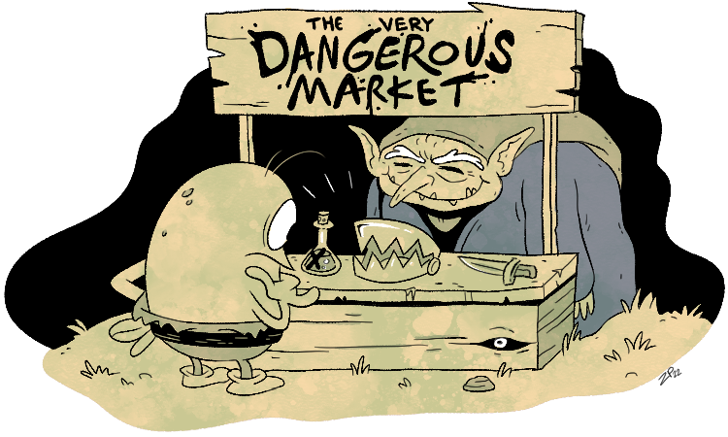

What is
THE VERY
DANGEROUS MARKET?
It's a command-line interface program that allows you to create a profile and purchase dangerous items to add to your inventory.
You can also view profiles of other customers on your friends list and see items in their inventory.

Slide 3




TECH STACK USED
Clone the repository at:
https://github.com/zachary852rev/Dangerous_Market

Slide 4

DEMO

