Slide 1
Classify each as a carbohydrate, protein or lipid.
_____starch
_____ long term energy storage
_____ contains C, H, N and O
_____ cellulose
_____ enzyme
_____ glycerol
_____ amino acid
_____ glucose
_____ unsaturated fatty acid

Slide 2
Identifying Macromolecules in the Lab
SPI 3210.1.4 Identify positive tests for carbohydrates, lipids, and proteins

Slide 3
Tests for Biomolecules
Benedict’s Solution – color change indicator for simple sugars (uses heat)
Iodine Solution – color change indicator for starch
“Paper Bag” test for lipids
Biuret’s Solution – color change indicator for protein

Slide 4
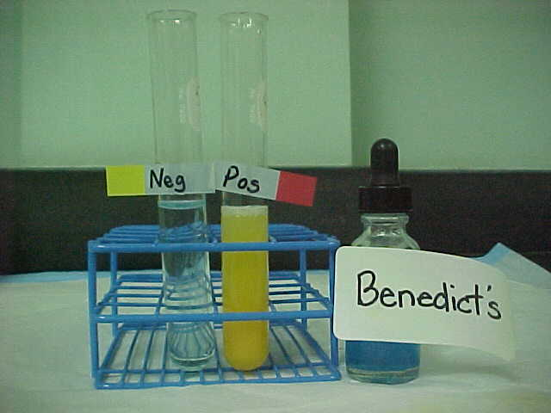
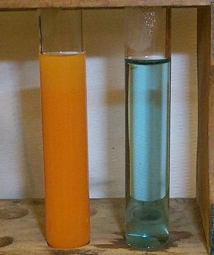
Test for Simple Sugars
Benedict’s solution
Benedict's solution is a chemical indicator for simple sugars such as glucose: C₆H₁₂O₆.
Aqua blue: negative test
yellow/green/brick red : positive test

Slide 5
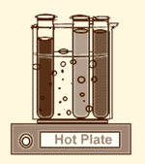
Test for Simple Carbohydrates
Benedict’s solution
Unlike some other indicators, Benedict’s solution does not work at room temperature - it must be heated first.

Slide 6
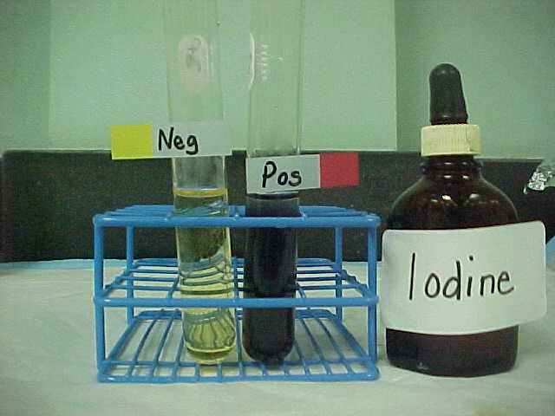
Test for Complex Carbohydrates
Iodine solution
Iodine solution is an indicator for a molecule called starch.
Starch is a huge molecule made up of hundreds of simple sugar molecules (such as glucose) connected to each other.

Slide 7
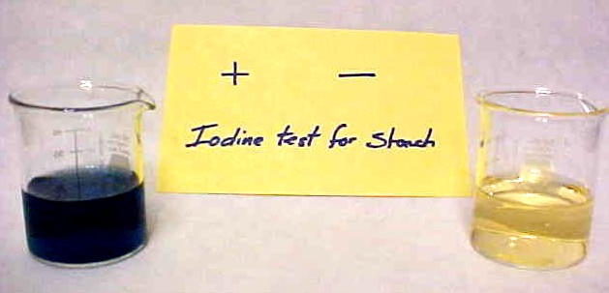
Test for Complex Carbohydrates
Iodine solution
Iodine solution → color change = blue to black

Slide 8
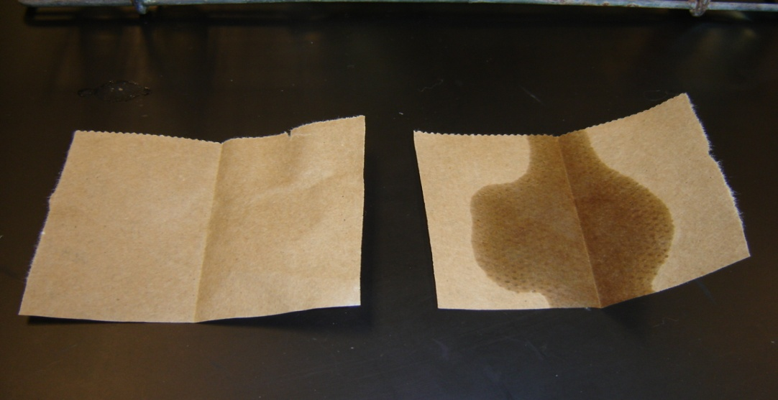
Test for Lipids
(“brown paper bag test” for the presence of lipids)
The sample of on the left is the result of the lipid test on tap water (control)
The sample on the right is a positive test for the presence of lipids tested on vegetable oil (note the translucent spot on the paper)

Slide 9
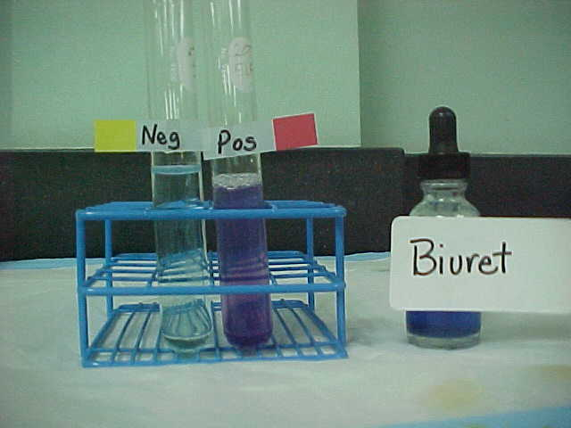
Test for Protein (amino acids)
Biuret solution
Biuret solution → dark violet blue to pinkish purple

Slide 10
Tests to Identify Carbohydrates, Lipids, and Proteins
SUBSTANCE | INDICATOR | START COLOR | POSITIVE TEST
Simple Sugars | Benedict’s Solution | Blue | ORANGE-RED or BRICK RED
Starch | Lugol’s Iodine Solution | Yellow-Orange | DARK PURPLE or BLACK
Proteins | Biuret’s Solution | Blue | VIOLET
Lipids | Sheet of Paper | Opaque | Translucent

Slide 11
A student tests an unknown colorless solution for the presence of sugars, starches, lipids, and proteins. The results are shown in the table below.
Unknown Solution Results
Testing Indicator | Observation
Iodine | Unknown solution turned from colorless to brownish-orange
Benedict’s Solution | Unknown solution turned from colorless to orange
Biuret Solution | Unknown solution turned from colorless to purple
Brown Paper Bag | No mark left; unknown solution dried completely
Based on the data
collected, which
molecules are present
in the unknown
solution?
starches and lipids
proteins and starches
sugars and proteins
lipids and proteins

Slide 12
Students conducted an investigation using Biuret reagent to determine the presence of proteins in different foods. The results are shown in the table below.
Substance | Color after adding Biuret reagent
Honey | Blue
Cottage Cheese | Purple/Lavender
Potato | Dark Blue
Water | Light Blue
Chicken Broth | Dark Purple
Yogurt | Light Purple
According to the data, which
foods tested by the students
contained proteins?
Honey & Potato
Potato & Chicken Broth
Cottage Cheese & Water
Cottage Cheese & Yogurt

