Slide 1
General Assembly Pre-Admissions Task: Analysis of Kickstarter Data
Zachary Ang

Slide 2
How does a successful Kickstarter Campaign look like, and how would we achieve it?
Focus and design your product
Funding Target
Set a realistic target
Build a following
Backers
Pledges
Time your launch
Run an

Slide 3
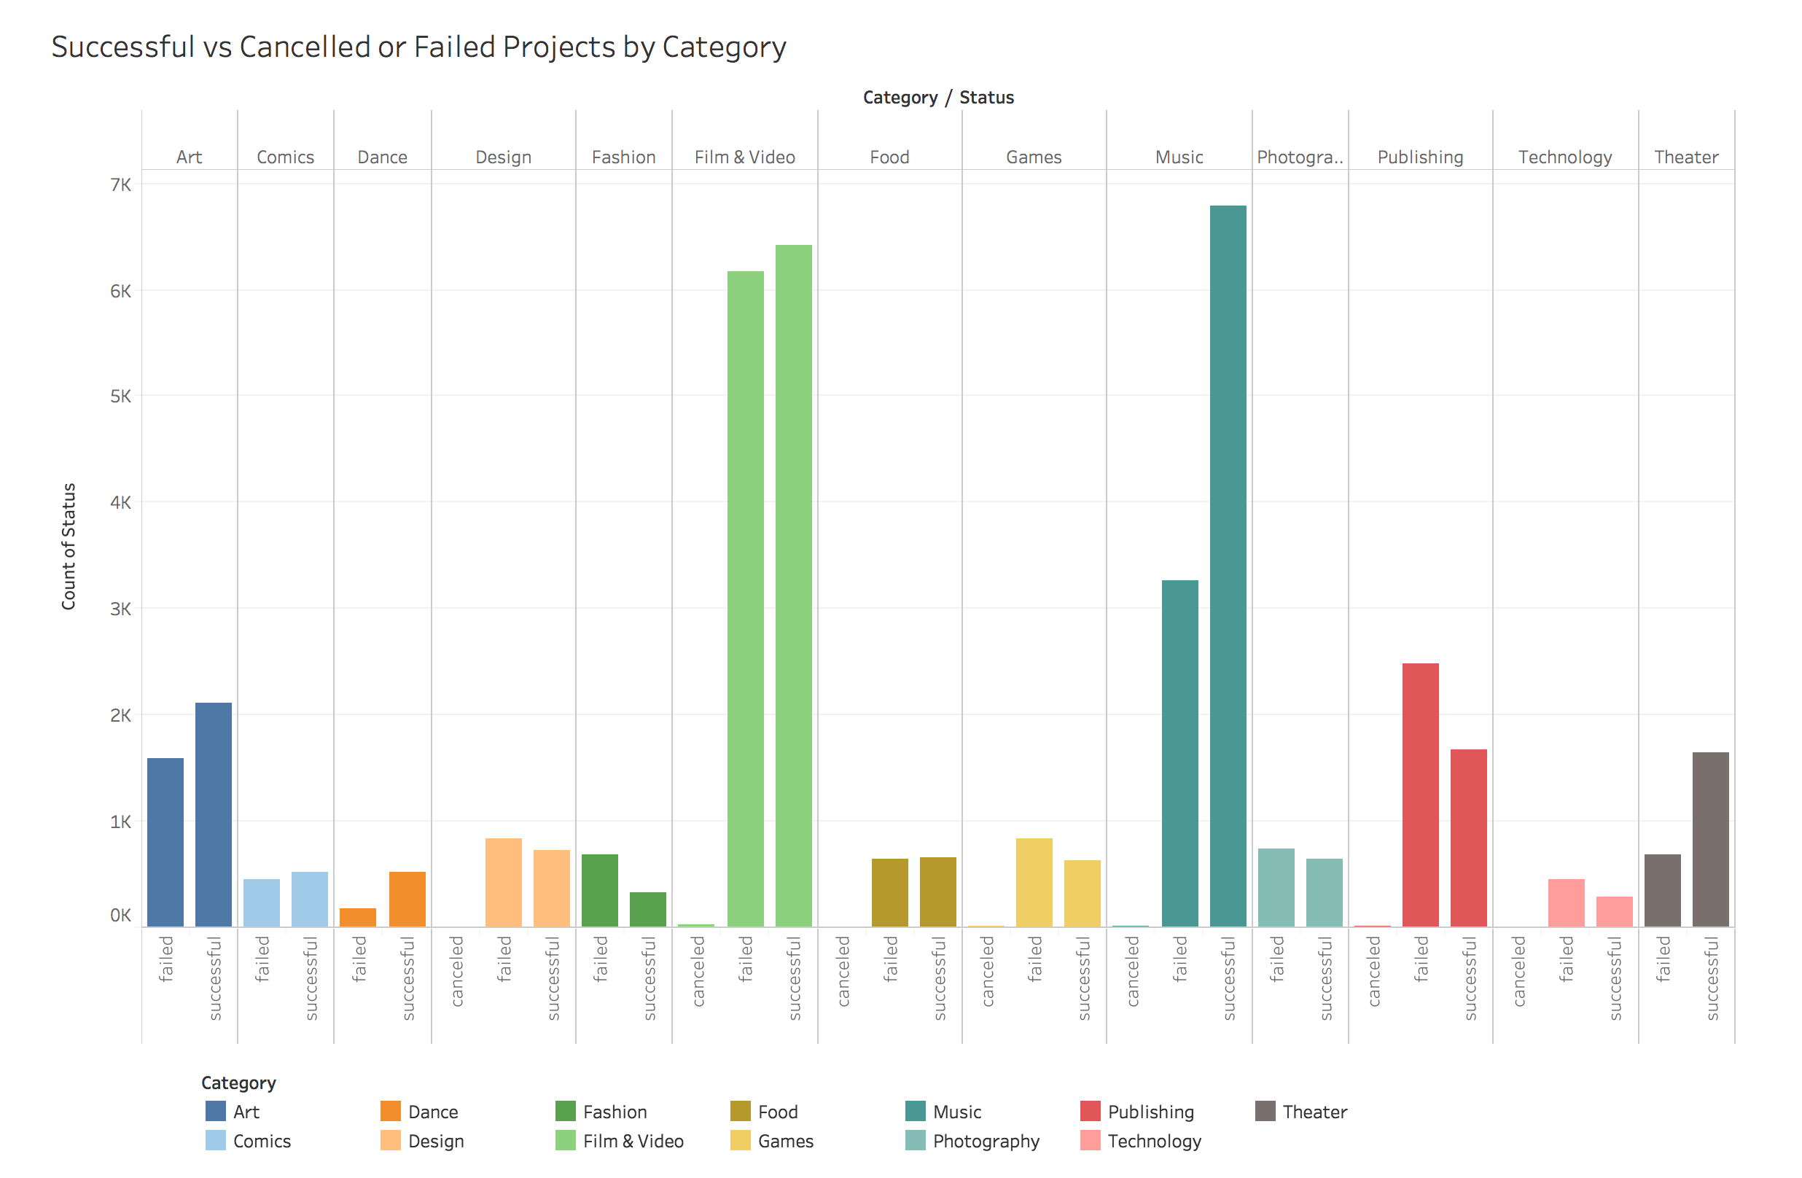
We see most successful launches in Music, Film & Video
We see high success rates also in Art, Theatre but high failure rates in Design, Fashion Games & Publishing
However, there are no significant difference in pledged contributions across different categories

Slide 4
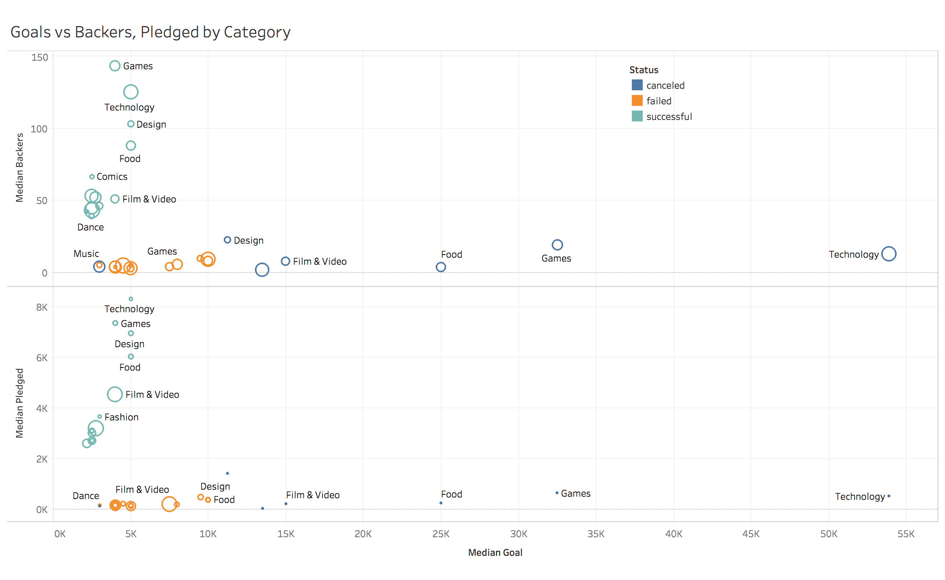
Most successful campaigns were not overly ambitious with their goals
But it depends on what kind of project you’re starting!
Most successful projects don’t set too high a goal (~5k)
Failed projects have had a tendency to aim for higher goals
Coefficients of Quantile Regression of Pledged, Backers vs Goal
But setting higher goals may be necessary if you require a lot of backers and contributions

Slide 5
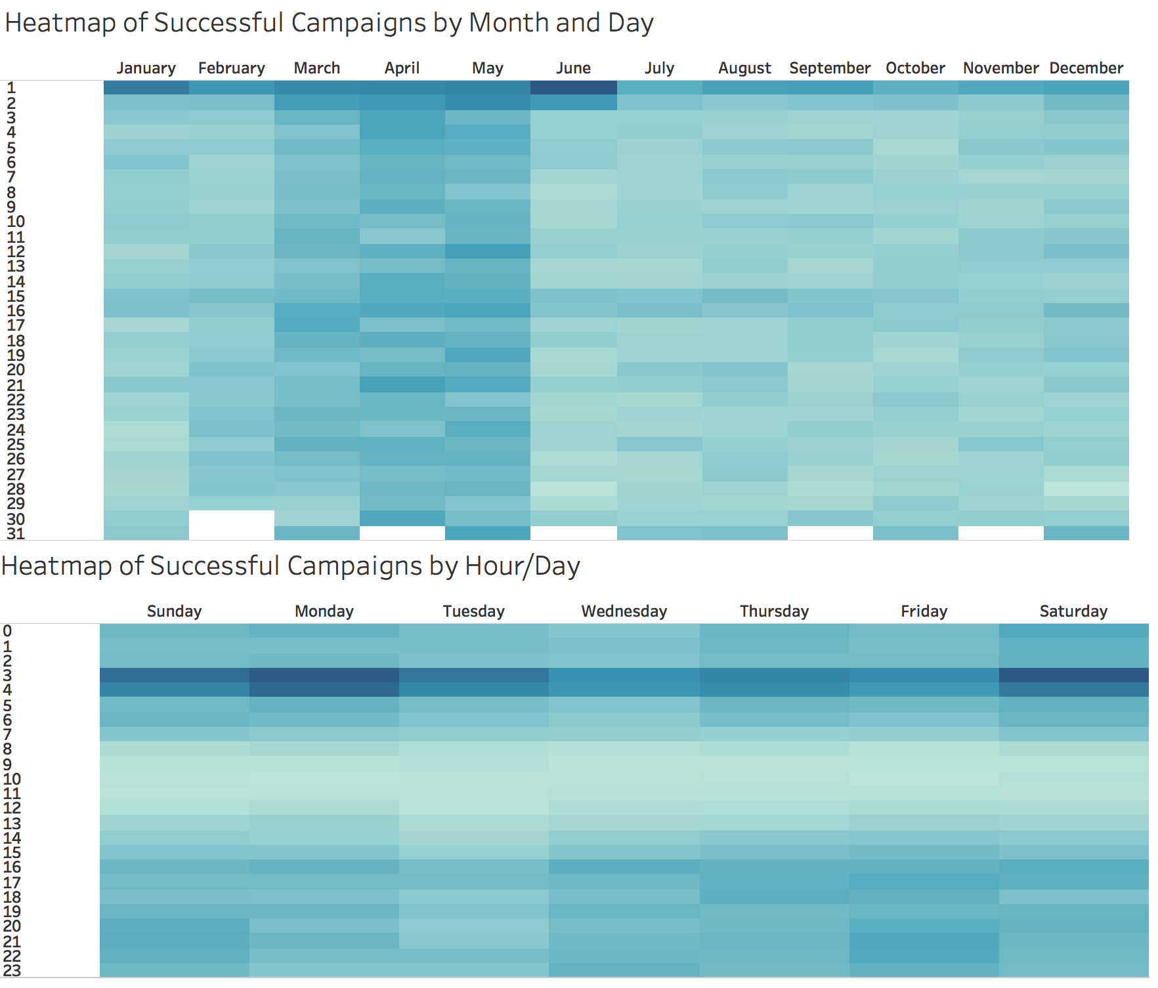
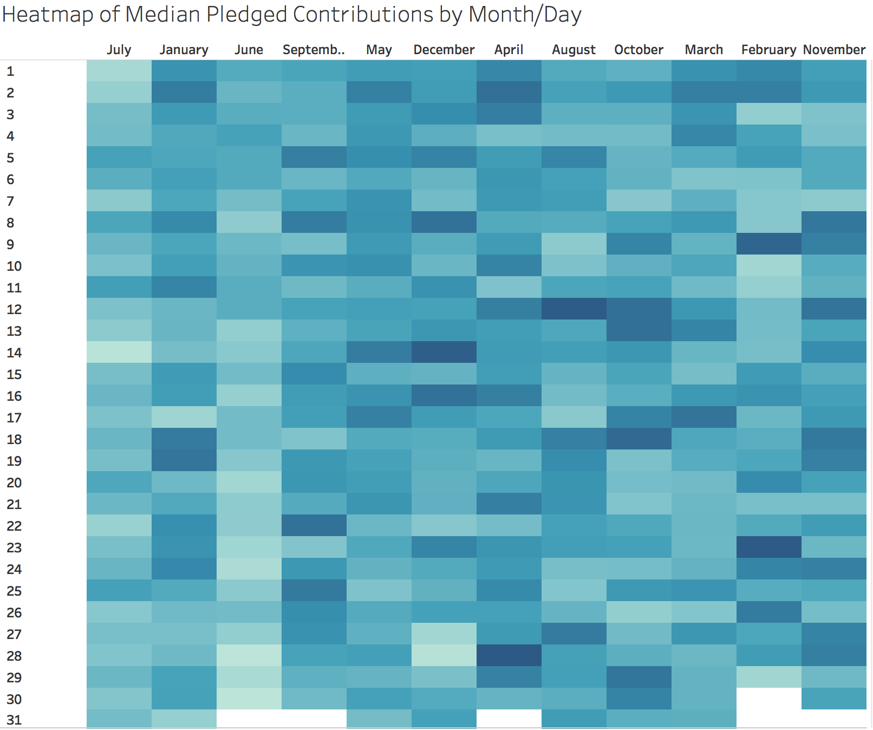
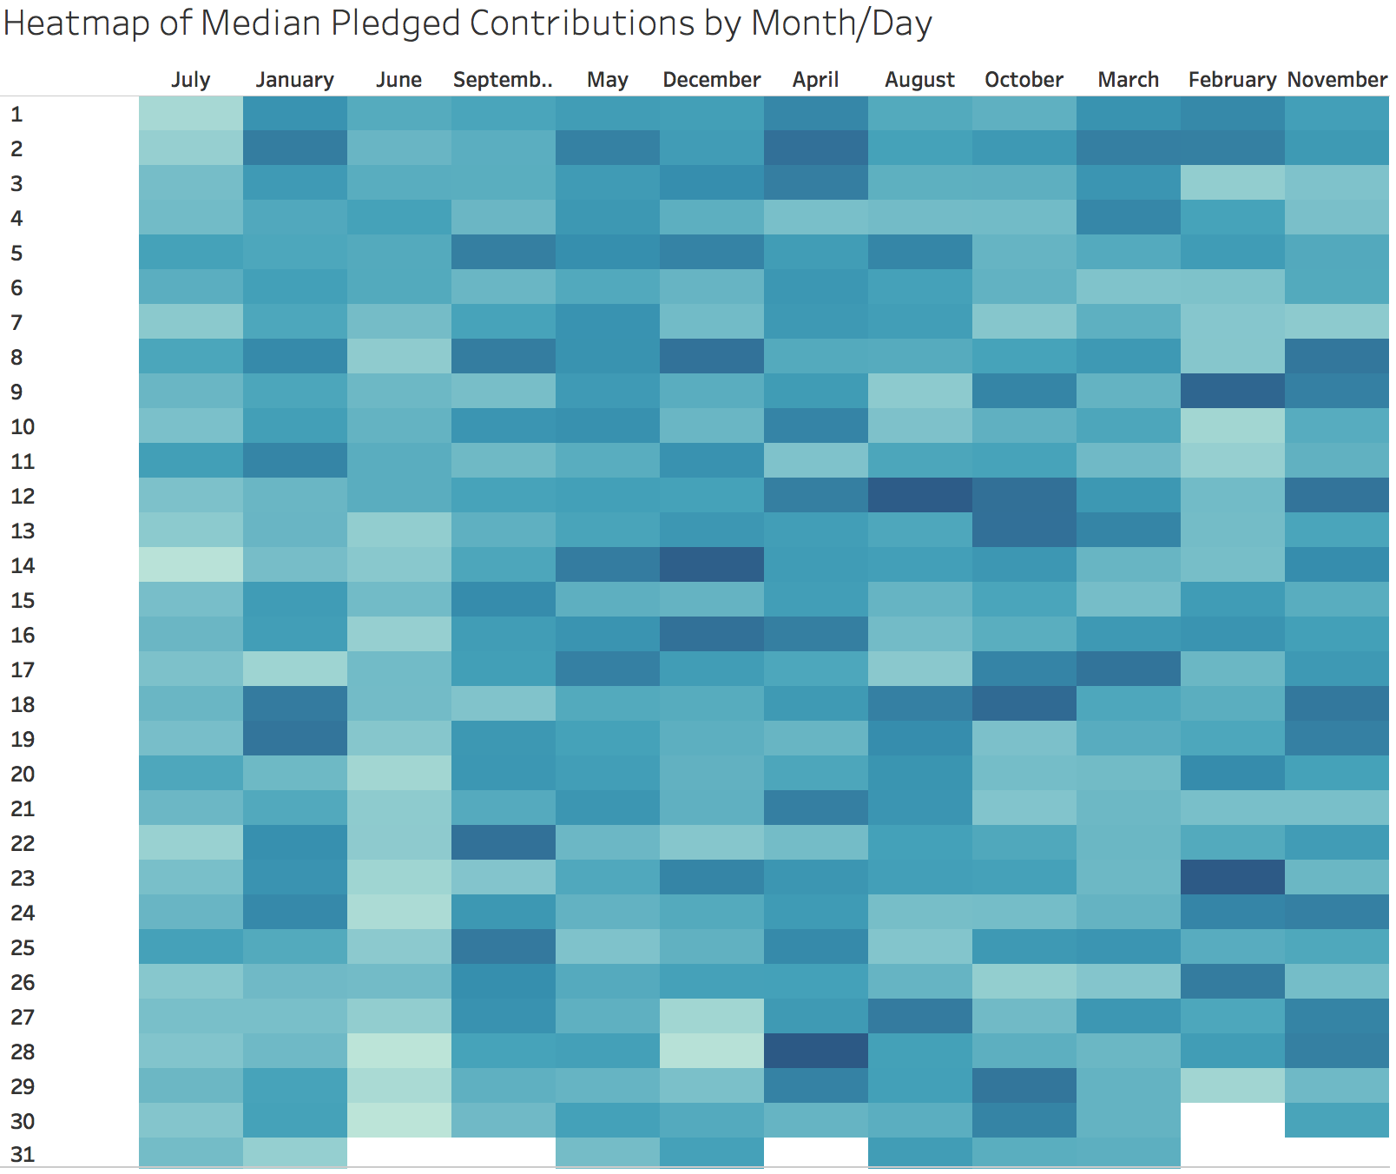
Successful launches were in the Mar-May period and in the early hours of the morning
However, it is less clear whether we can secure more backers or contributions by timing the launch of a campaign

Slide 6
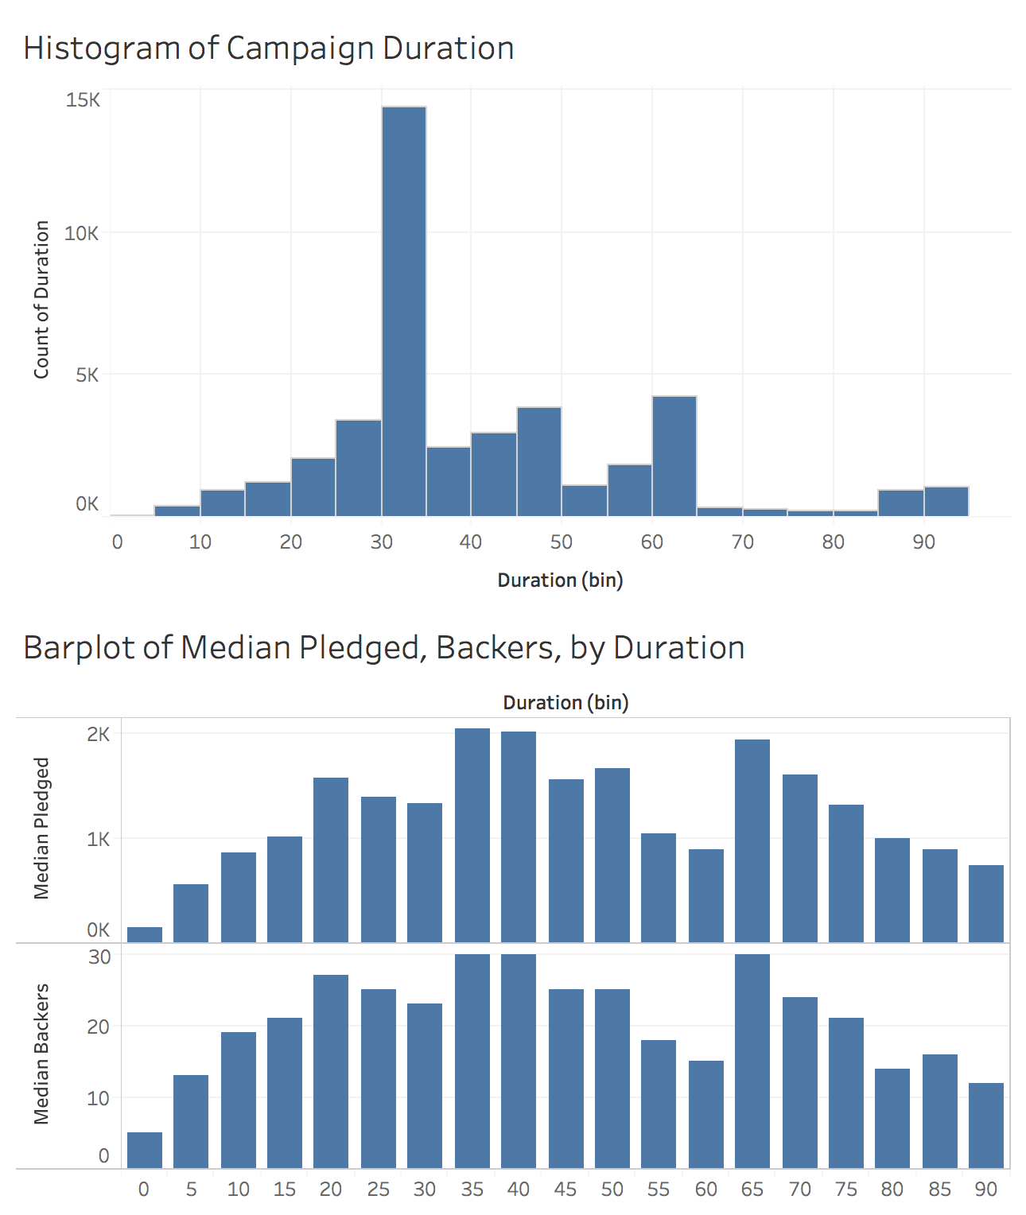
Stick to a 30-day campaign
Campaigns typically stick to the recommended 30 day length that Kickstarter recommends
But there does not appear to be a significant influence of campaign duration on the median pledged contributions or number of backers
Most successes and failures are observed at the 30 day mark
However, there is a noticeable higher failure rate at the 50-60 day mark, and >80 mark.
There is also evidence to suggest that this is statistically significant

