Slide 1
zero to 60 in 16.66666666667 milliseconds
Problem Set 05
Capabilities & Implementation
Zach Graber (zegraber@iu.edu)
Student Presentation
CSCI-B 481
Fall 2022
12/9/2022

Slide 2
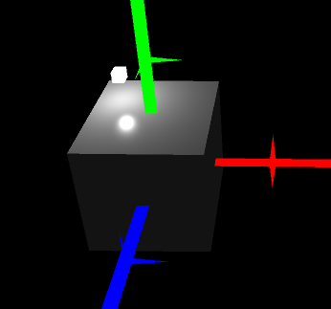
Main Features
Custom Transform Implementation
Custom Camera Object & Polygon Pipeline
Interactive Elements
Phong Shading
Procedural Height-Mapped Meshes

Slide 3
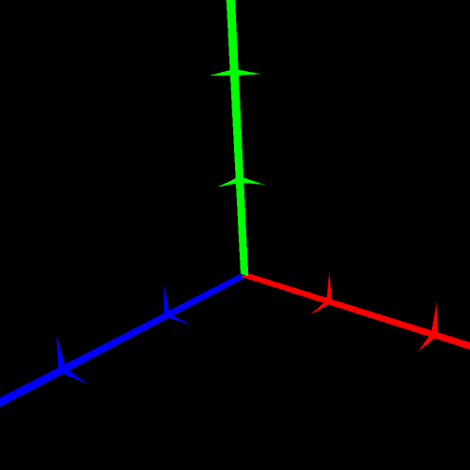
Reinventing the Wheel
Can’t really remove Unity stuff
Can’t extend Component
Lots of MonoBehaviour scripts
Reference other objects by saving them in a [SerializeField]
Need coordinate system
Right-handed coordinate system

Slide 4
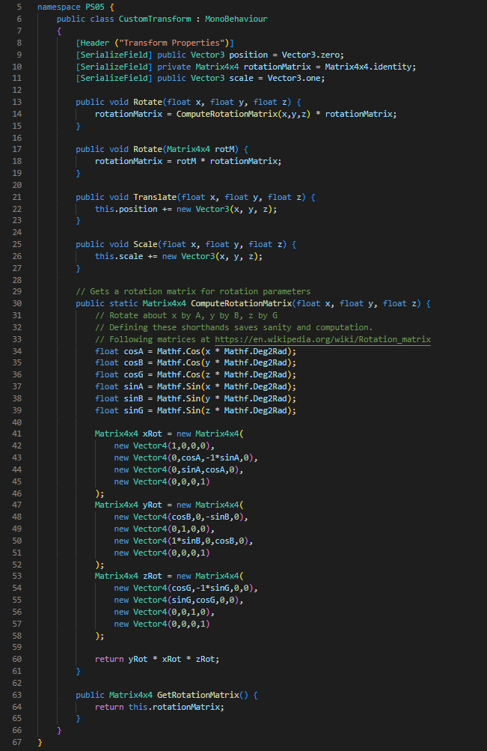
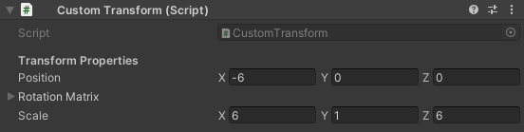
Simple transformation helpers
Enables interaction in play mode
Allows saving positions in scene
Saving rotation matrix

Slide 5
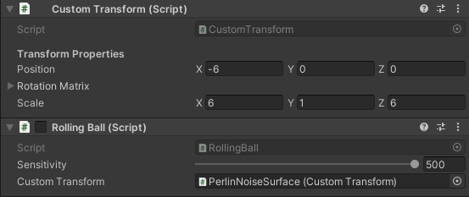
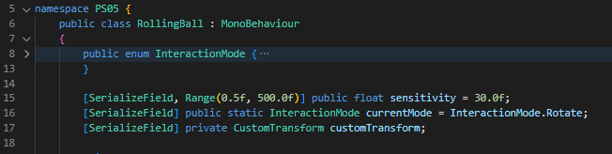
Accessing info from other scripts
GameObject has multiple scripts
Script A needs the object instance from Script B:
Namespace all scripts
Give reference in [SerializeField] member

Slide 6
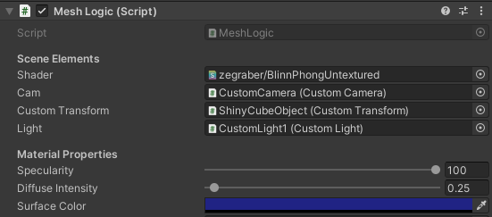



Special Script: MeshLogic
Everything rendered needs it (or similar)
Creates a material from a given shader
Passes mesh data to MeshFilter/MeshRenderer
Passes uniforms to shader
Vertex data via MeshFilter
SetMesh(…)
material.SetMatrix(…)
Other Script
MeshLogic.cs
Custom Shader
Uniforms
creates
New Material

Slide 7
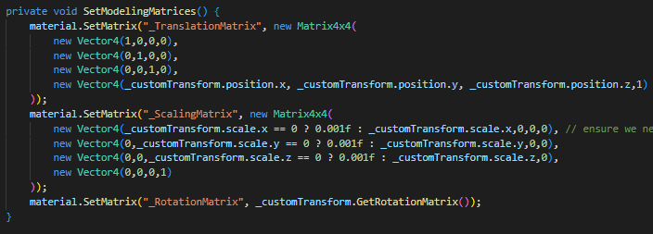
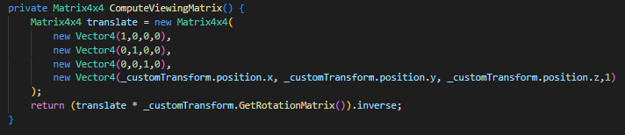


Polygon Projection Pipeline
$$v^{′}=PV(TRS)∙v$$
$$T,R, and S:$$
$$V:$$

Slide 8
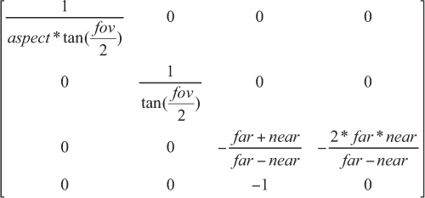
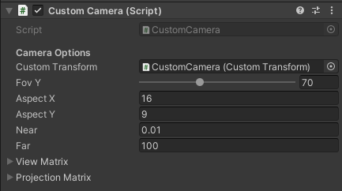
Projection Matrix & Camera
Projection Matrix
Camera Inputs
gluPerpective(…) implementation

Slide 9
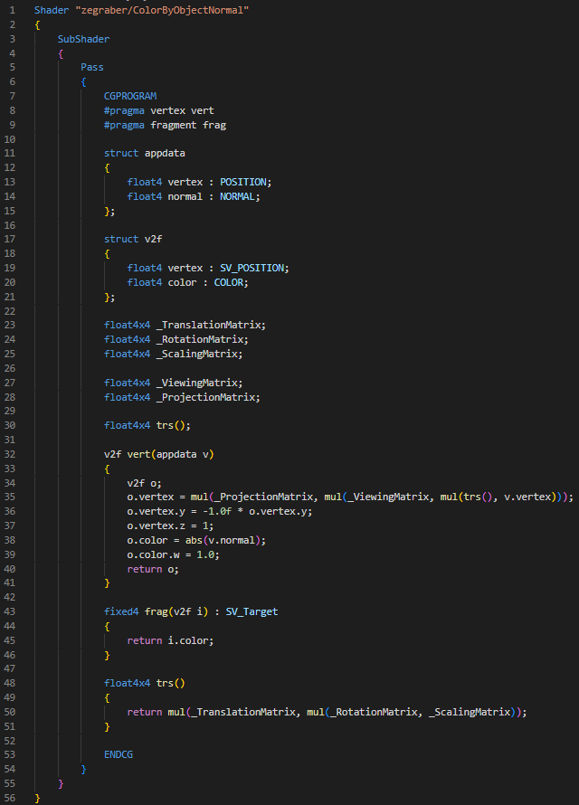
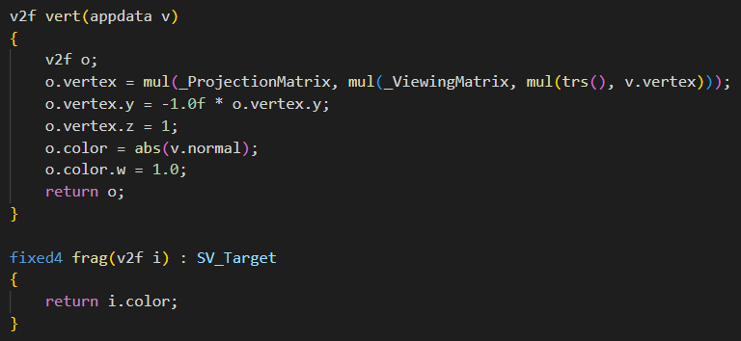
Putting it Together
Vertex shader takes in position and normal vector
Uniform input matrices
Helper function to calculate modeling matrix

Slide 10
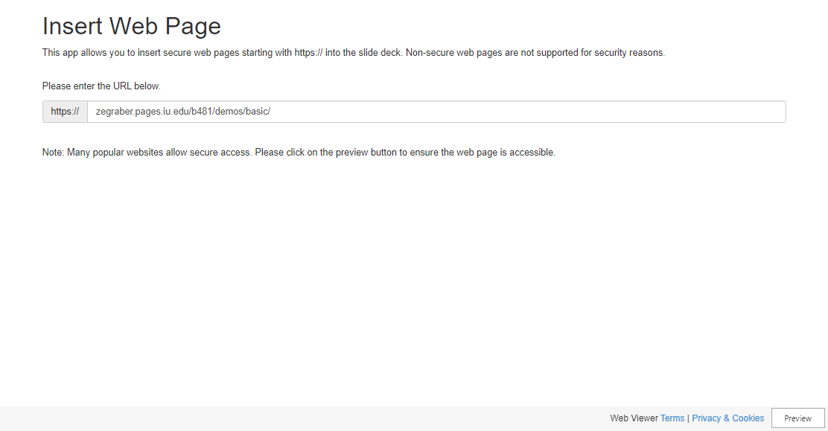
https://zegraber.pages.iu.edu/b481/demos/basic/

Slide 11
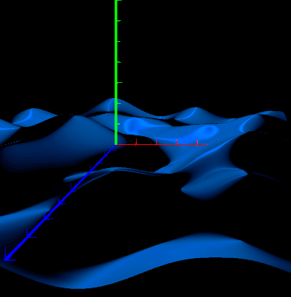
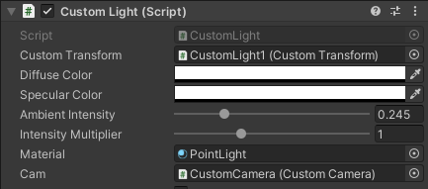
Illumination
Phong shading
Currently only supports 1 light
Custom MonoBehaviour script for light
Light has properties and material has others

Slide 12
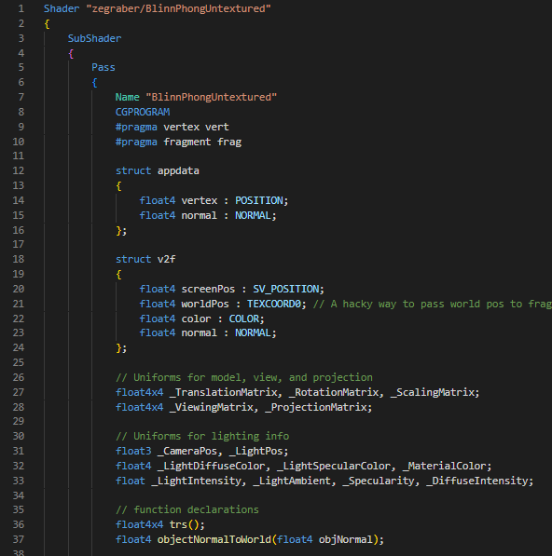
Vertex shader takes in only position and normal vector
Vertex shader outputs:
screen-space coordinates
vertex color
vertex normal
world-space position
to the fragment shader. Interpolated!

Slide 13
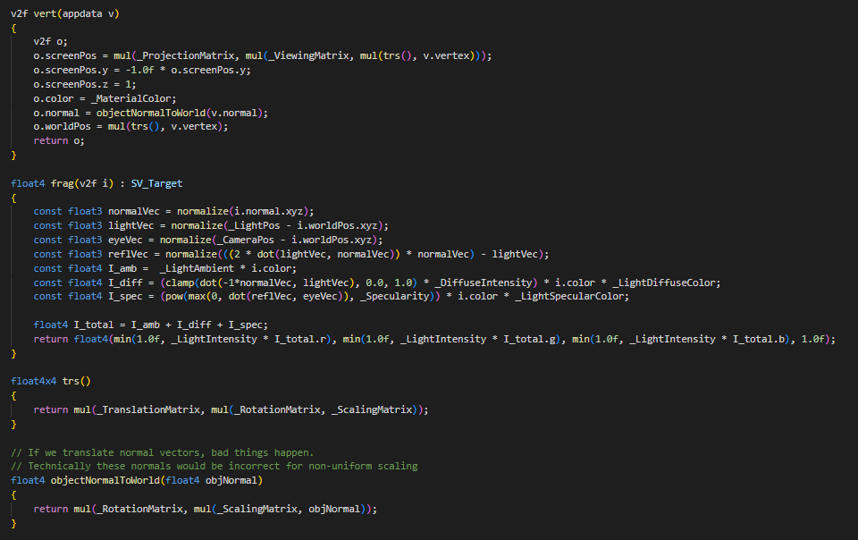

Slide 14
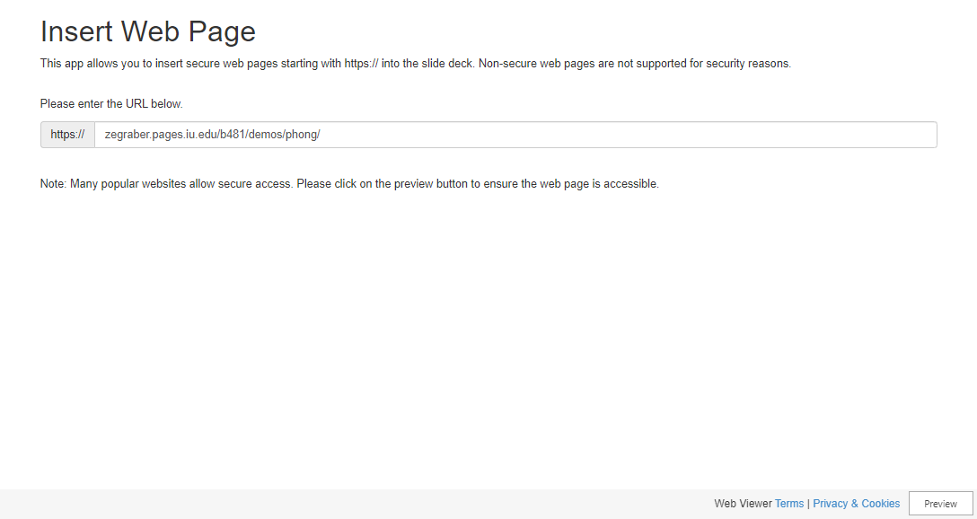
https://zegraber.pages.iu.edu/b481/demos/phong/

Slide 15
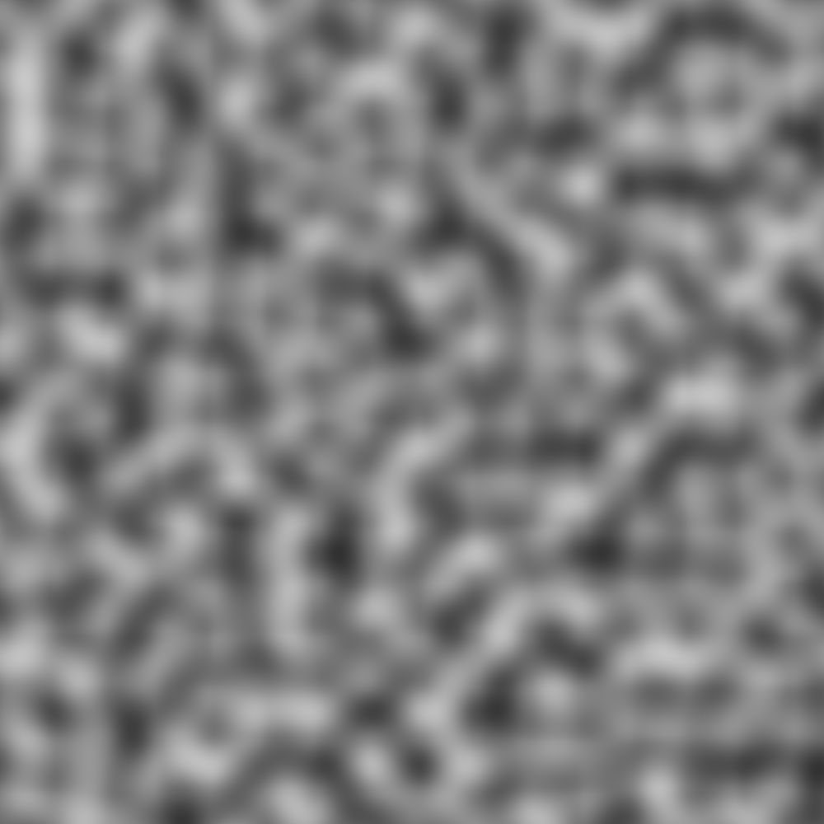
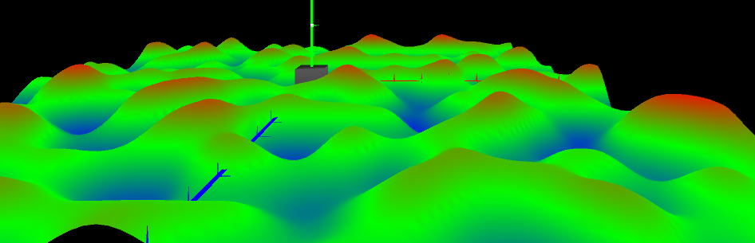
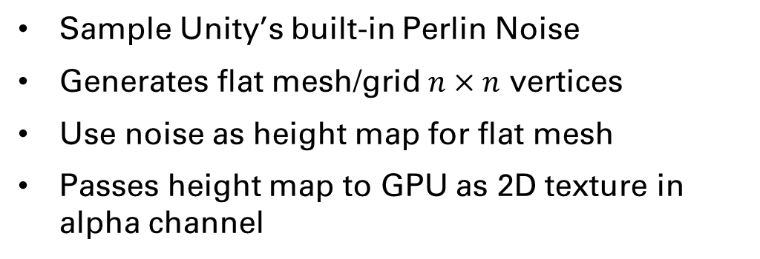
Perlin Noise Meshes
Sample Unity’s built-in Perlin Noise
Generates flat mesh/grid $n×n$ vertices
Use noise as height map for flat mesh
Passes height map to GPU as 2D texture in alpha channel

Slide 16
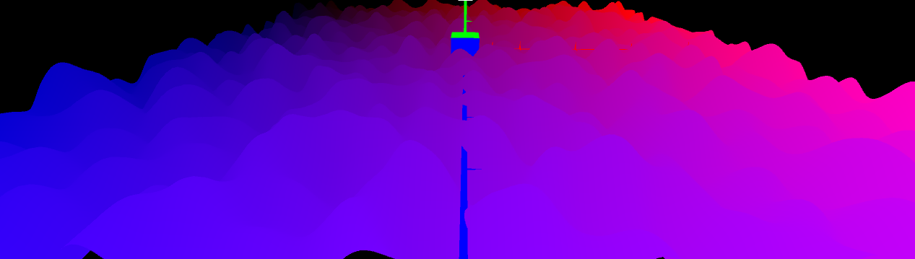
Perlin Noise Meshes (cont.)
uv-map flat mesh from corner to corner
Sample texture (height map) in vertex shader and modify object-space height
New mesh made in vertex shader… what are its normals?

Slide 17
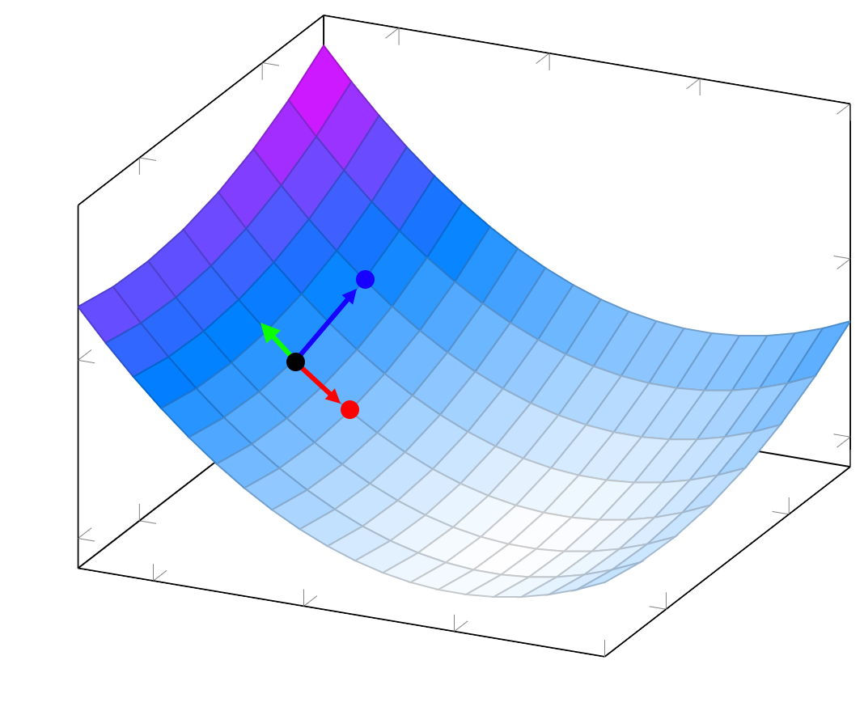
Recalculating Normals
Sample points on the surface close to the point in question, one in Z direction, one in X direction.
Use those points to find vectors almost tangent to the surface
The cross product of those vectors is our new normal
3D Surface image modified from the one found at:
https://latexdraw.com/three-dimensional-plotting-in-latex/

Slide 18
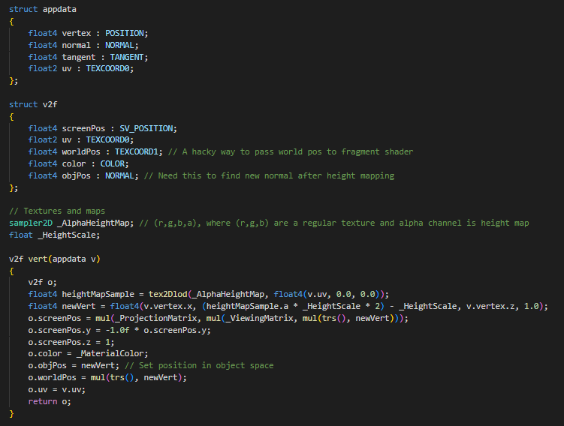
Now taking in UVs
Fragment shader now takes in interpolated UVs and object-space positions.
Perlin noise height map and a scalar value.
Samples the alpha channel of the height map, then applies that value to object-space height

Slide 19
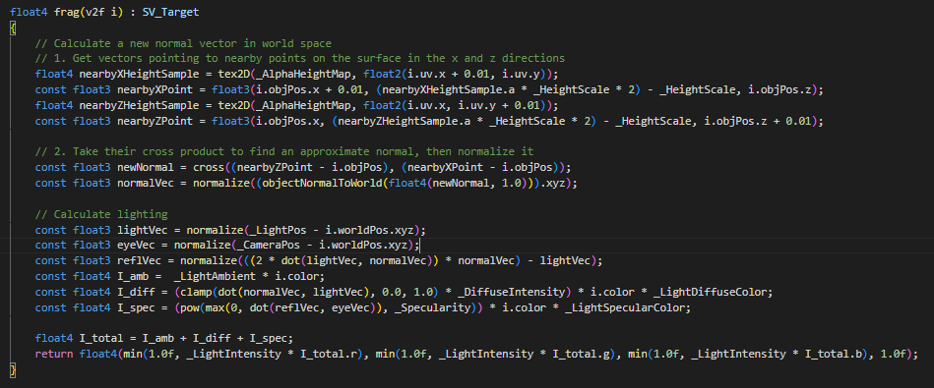

Slide 20
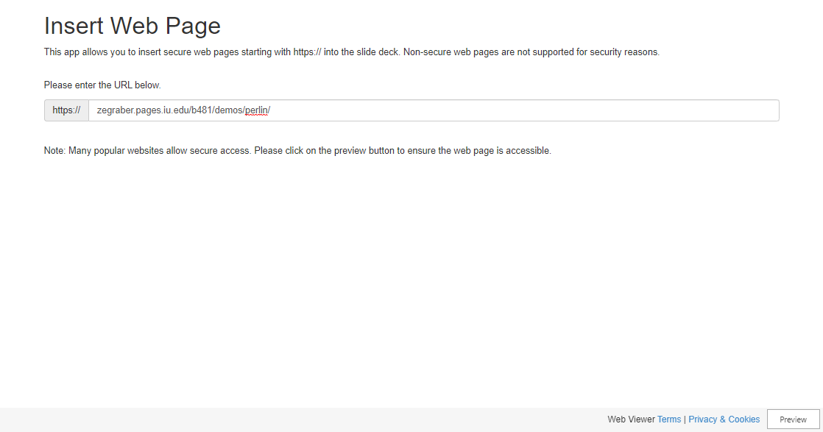
https://zegraber.pages.iu.edu/b481/demos/perlin/

Slide 21
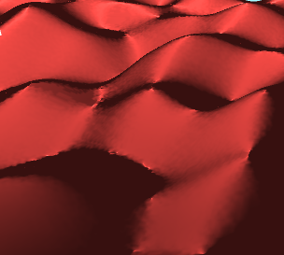
Next Steps
Implement proper texture mapping
Increase resolution of Perlin height map
Implement height-based texture mapping/blending

