Slide 1
Making audio plugins in Matlab
A Practical Guide

Slide 2
Overall flow
Subclass from Matlab’s audioPlugin
Define some plugin properties and parameters
Write your DSP (or use Matlab’s baked-in functionality)
Use audioTestBench() to evaluate your plugin
Design a layout and control types for your GUI
Add a background and custom controls
Generate a JUCE project
Compile in Xcode

Slide 3
audioPlugin() base class
Matlab’s base class for developing AU and VST3 plugins
classdef myAudioPlugin < audioPlugin
Contains:
Properties – these include plugin information, internal values, and parameter descriptions
These can have multiple, varying levels of Access
Methods – these define the behavior of the plugin
Constructor
Process
Reset
Set/Get functions
Other custom functions

Slide 4
Standard Properties
Variables that store data relevant to the plugin’s operation
These are usually variables relating to parameters or your DSP in some way
For example, if gain is one of my parameters, I would define a variable called GAIN as a standard property, which can be accessed by plugin.GAIN

Slide 5
Constant Properties
Unchangeable values once the plugin is compiled
These are things that don’t change, like the parameter definitions, the layout of the GUI, the range of the parameter controls, and other plugin information like name, vendor, version, etc.

Slide 6
Hidden Properties
Variables not exposed to the user interface
No get/set functions to modify these values
Private Properties
Variables accessible only within the plugin class
Can be accessed by plugin.VariableName, but is an internal variable, such as filter states, coefficient values, etc

Slide 7
DiscreteState Properties
Stores state information between calls to the processing function
These properties persist across ‘process()’ calls
Useful for things like filter states, envelopes and oscillators
These are usually required when using Matlab System Objects
(if you plan to use built-in Matlab functions like ‘compressor’ or ‘reverberator’ then these are System Objects, and they often but not always require use of a DiscreteState variable)

Slide 8
Basic template to get started…
classdef Template < audioPlugin
properties
% PARAMETER_NAME = some value;
end
properties (Constant)
% put your pluginInterface and parameters here
end
properties (Access = private)
%if you have any internal variables, put them here
end
methods
function plugin = Template()
% This is your constructor – you might initialize things here
end
function out = process(plugin,in)
% DSP section
end
function reset(plugin)
% this gets called if the sample rate changes or if the plugin gets reloaded end
end % of methods
end % of plugin class

Slide 9
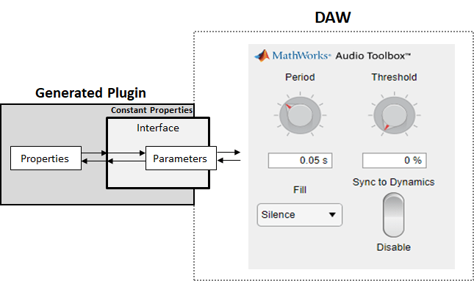
audioPluginInterface
The interface holds:
Plugin Name
Vendor Name
Version
Unique ID
Input/Output channels
All the plugin parameters
Additional information about the GUI, including:
Layout
Background image

Slide 10
Adding Parameters
These are the controls that can be set by the user
Step 1: create a Standard Property to hold the parameter value
For example, I might create a variable called GAIN;
Step 2: add a parameter to the audioPluginInterface, and link it to your Property
For example, audioPluginParameter(‘GAIN’);
Note, many more parameter attributes can be set
Step 3: create a set function to define the behavior when the control is manipulated by the user
For example, we might convert from dB to scalar for the GAIN parameter

Slide 11
Parameter attributes
Display Name: This is what the user sees on the plugin
Label: If the parameter has a unit (Hz, dB, etc), put it here
Mapping: this defines the range and how the values are mapped
Enumeration – this results in a drop-down style menu or check box
Linear, Logarithmic, or Integer – these vary based on a defined range
Example 1: 'Mapping',{'lin',-60,12} %gain level
Example 2: 'Mapping', {'log', 20, 400} %freq cutoff
There are others relating to the GUI and layout, we will cover those later

Slide 12
Using Matlab built-in effects
Matlab includes the following audio effects:
Crossover filter
Multi-band parametric EQ and Graphic EQ
Octave filter, Shelving filter, and Gammatone filter
Compressor and Limiter
Expander and Noise gate
Reverb
Pitch shift

Slide 13
But wait, there’s more…
Some effects are hidden inside the ‘audioexample’ namespace:
Automatic gain control
Chorus
Echo
Flanger
Different (Freeverb algorithm) reverb
Full wave integrator
Additional utilities for onset detection, pitch detection, LFO generation

Slide 14
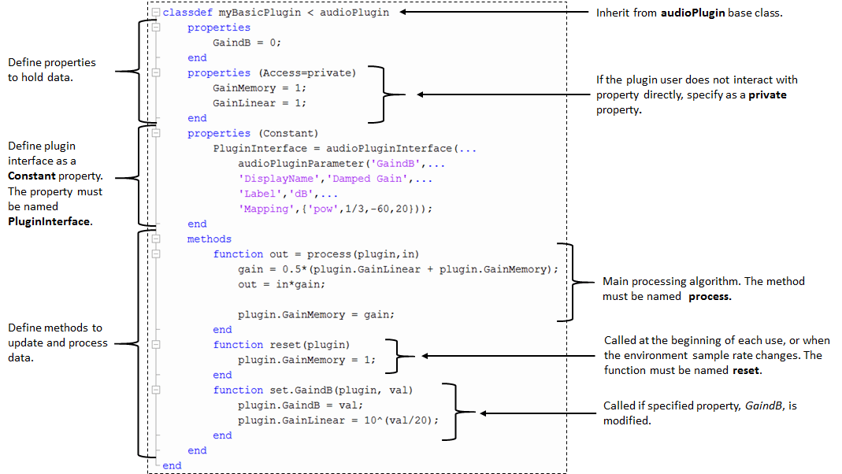
Template

Slide 15
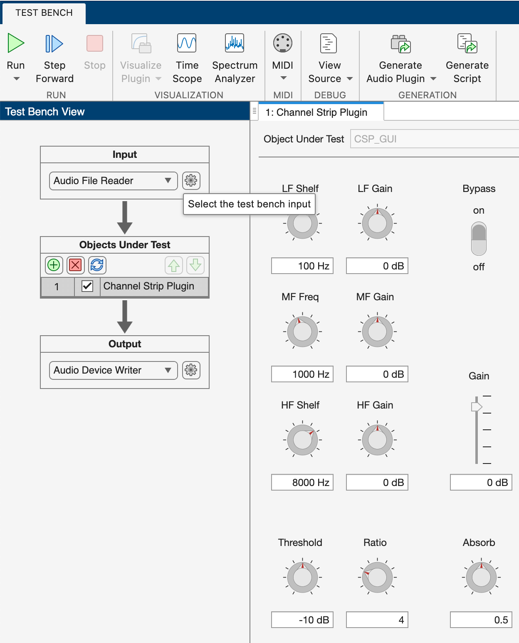
Audio Test Bench
You can easily evaluate your plugin with Matlab’s audioTestBench
Launch with: audioTestBench(‘MyPlugin’);

Slide 16
Overview of audioTestBench
Loading Audio Files: You can load various types of audio files (WAV, MP3, etc.) into ‘audioTestBench’ for testing. The loaded audio can be played back, and you can observe how your plugin processes the signal.
Comes with various examples of music, speech, and other audio
Analysis Tools: waveform visualizer, spectral analysis, metering
Validation :
Consistency Checks: Ensure that your plugin behaves consistently across different operating conditions. For example, test it with various buffer sizes and sample rates.
Parameter Limits: Test the edge cases by setting parameters to their minimum and maximum values to ensure the plugin handles them gracefully.
Performance Evaluation: Check the CPU load and memory usage to ensure that the plugin can run in real-time
Exporting: You can export your plugin as a VST, AU, or AAX plugin using ‘generateAudioPlugin’
This command will export your plugin to the specified format based on your system’s configuration, enabling you to use it in a Digital Audio Workstation (DAW).
The plugin will automatically be placed in the correct system folder

Slide 17
Export JUCE code
generateAudioPlugin -juceproject MyPlugin
Give it a couple of minutes…
ProJucer code will be saved to a .zip file
Unzip this file…
Open the .jucer file in ProJucer
Configure Project Settings
Verify the project name and plugin formats are correct
Enable MIDI support (if needed) in Modules > juce_audio_plugin_client
Verify the plugin type (Effect vs Synth)
Export the project to Xcode

Slide 18
Edit / compile in Xcode
Open the .xcodeproj for your project
Select a target (VST, AU, Standalone, or All)
#define JUCE_VST3_CAN_REPLACE_VST2 0
Click the Run (triangle) button

Slide 19
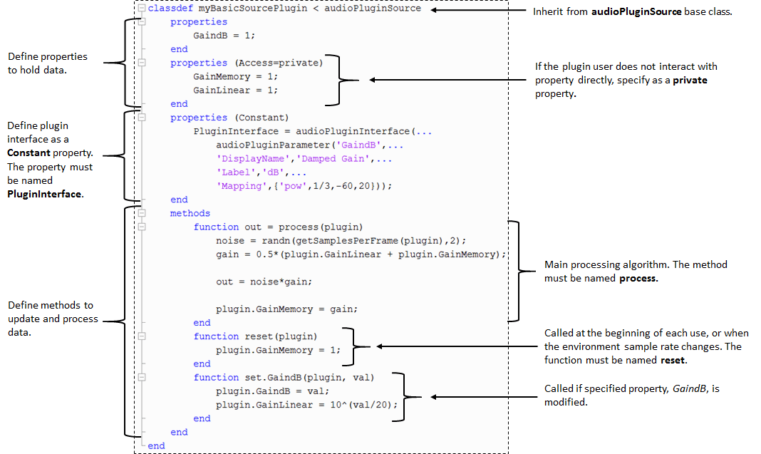
To-Do’s…
Customizing in Xcode
Code signing (for distributing)
How to add deep learning networks, audioPluginConfig
How to build synths (plugin sources)
Integration with MIDI devices

