Slide 1

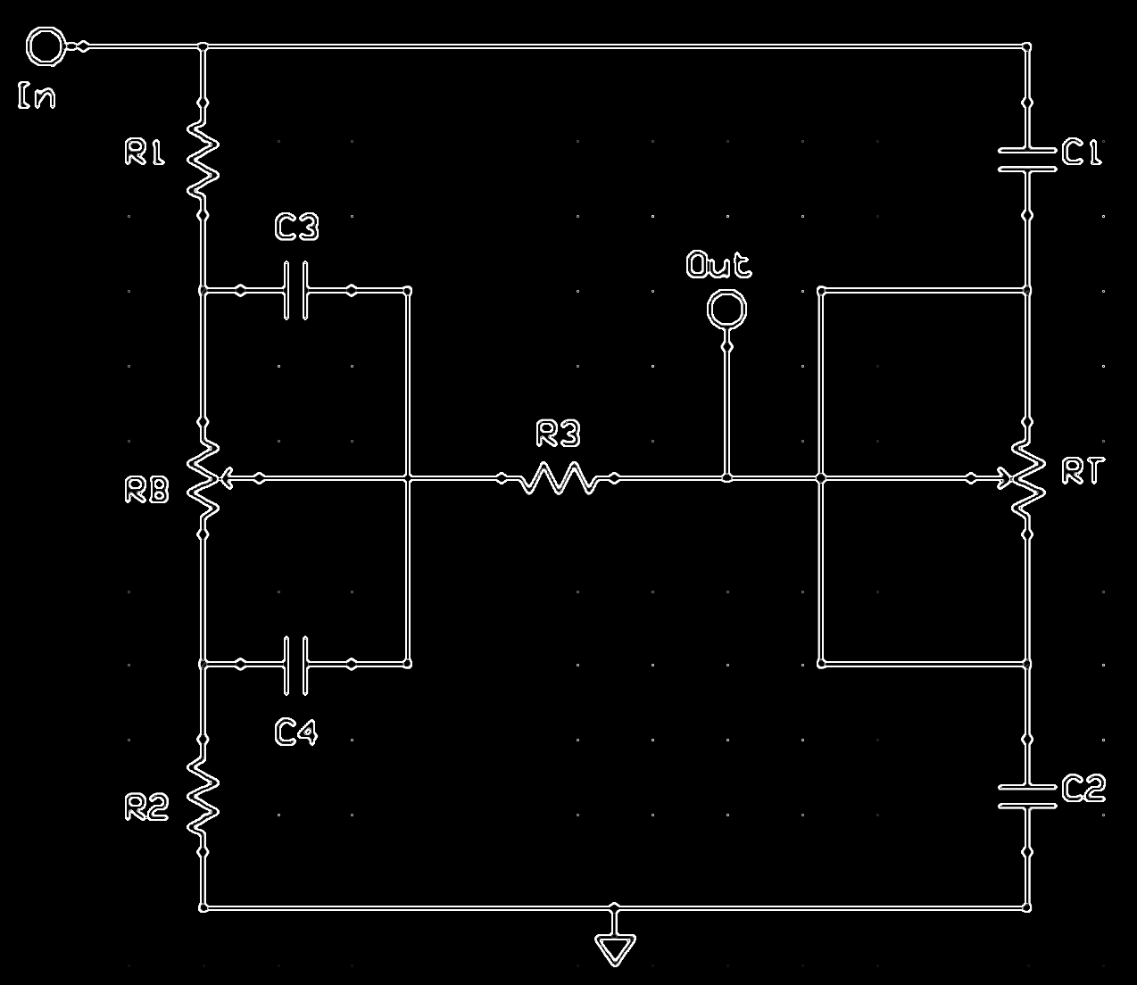
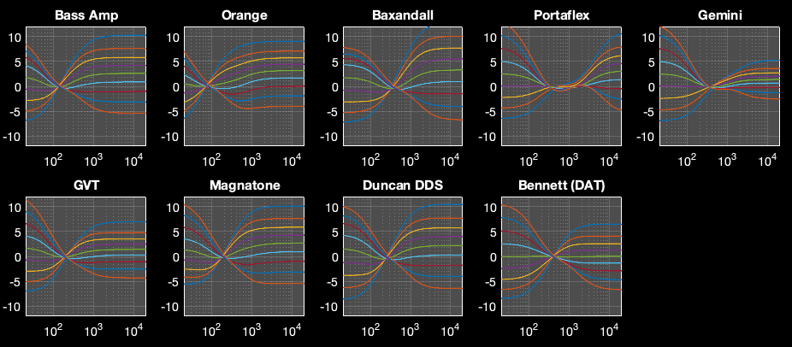
James Tone Stack
In
R1
C1
C3
Out
R3
RB
RT
R2
C4
C2

Slide 2
