Slide 1
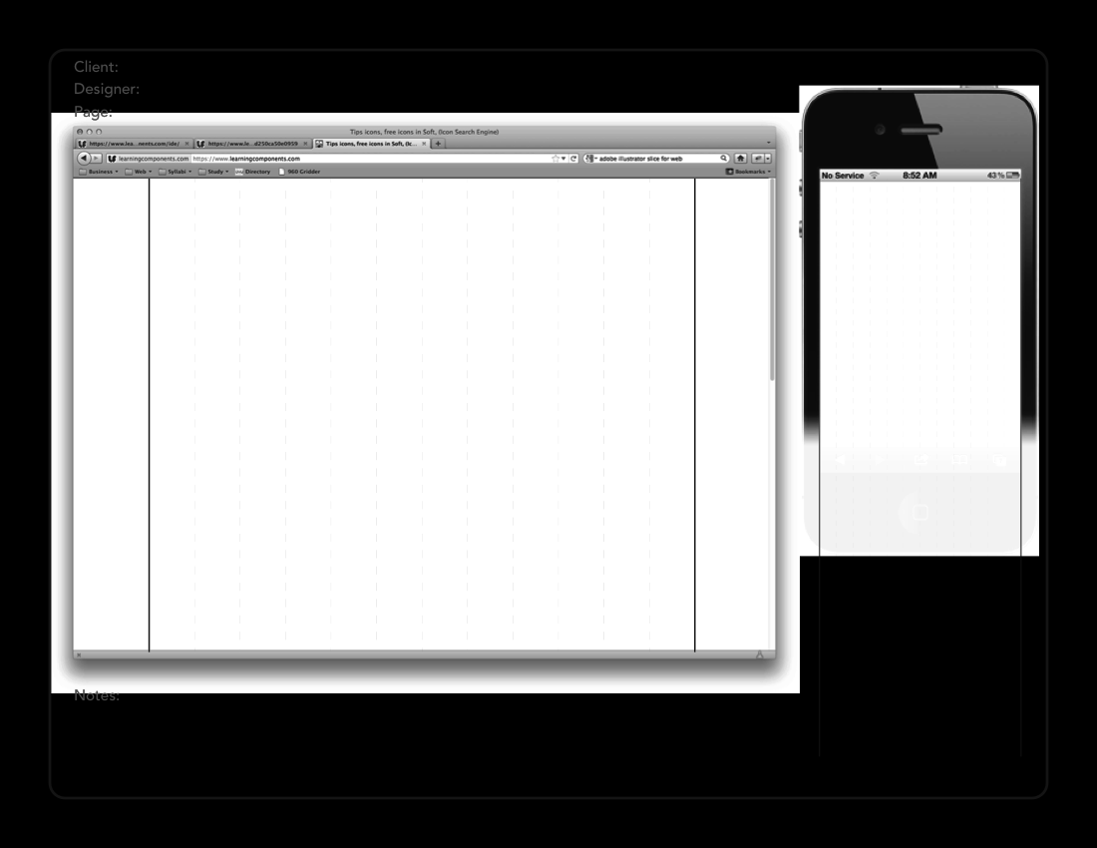
ALC
Zach Gines
About/Home
Student Portfolio
Student Portfolio
All About Zach!
All About Zach!
About
About | Portfolio | Skills | Contact
Portfolio
About Me
Skills
Contact
About Me
ⓒ 2018 – ALC LLC – Built by Zach Gines
2018 – ALC LLC – Built by Zach Gines

Slide 2
ALC
Zach Gines
Portfolio
Student Portfolio
Student Portfolio
All About Zach!
All About Zach!
About
About | Portfolio | Skills | Contact
Portfolio
Skills
Contact
ⓒ 2018 – ALC LLC – Built by Zach Gines
2018 – ALC LLC – Built by Zach Gines

Slide 3
ALC
Zach Gines
Skills/Awards
Student Portfolio
Student Portfolio
All About Zach!
All About Zach!
About
About | Portfolio | Skills | Contact
Portfolio
Skills and Awards
Skills
Contact
Skills and Awards
ⓒ 2018 – ALC LLC – Built by Zach Gines
2018 – ALC LLC – Built by Zach Gines

Slide 4
ALC
Zach Gines
Contact
Student Portfolio
Student Portfolio
All About Zach!
All About Zach!
About
About | Portfolio | Skills | Contact
Portfolio
Skills
Contact
Name
Contact Me!
Contact Me!
Email
Name
Email
Message
Message
Submit
Submit
ⓒ 2018 – ALC LLC – Built by Zach Gines
2018 – ALC LLC – Built by Zach Gines

Slide 5
Site Map
About/
Home
Skills/Awards
Portfolio
Contact

Slide 6

Color Scheme

