Slide 1
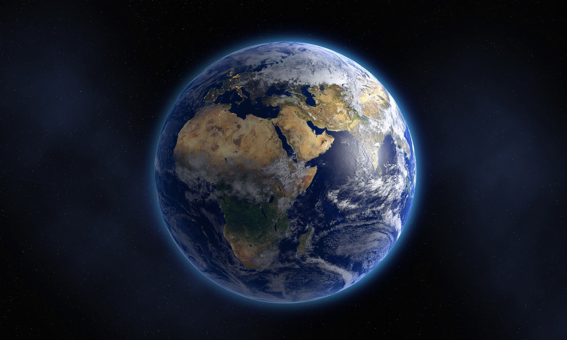
Population Center Formation PDE and Simulation
Zachary Beisler

Slide 2
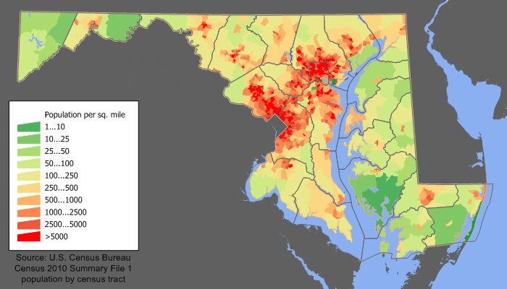
Background
In modern times, it is common for population density to be highly concentrated at points of heightened economic activity (cities).
I wish to investigate how these areas form while making as little assumptions as possible and imposing a very simple set of rules.

Slide 3
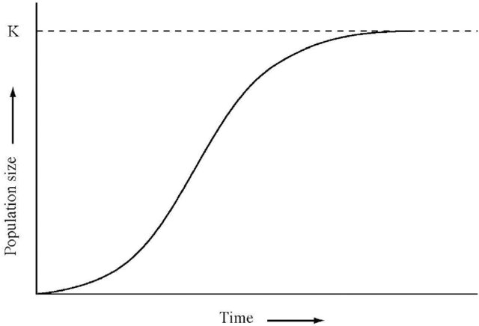

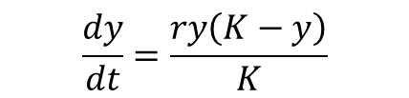

Background
$$\frac{dy}{dt}=\frac{ry\left(K−y\right)}{K}$$
Partial Differential Equations (or PDEs) are mathematical modelling tools that can capture situations in which the quantity of interest is changing.
Differential Equations and PDEs have seen extensive use in physics, biology, ecology, economics, and demography.
$$\frac{∂V}{∂t}+\frac{1}{2}σ^{2}S^{2}\frac{∂^{2}V}{∂S^{2}}+rS\frac{∂V}{∂S}−rV=0$$

Slide 4
Modelling Assumptions
The modelled region is Isolated: no migration occurs across its boundaries.
The modelled region is Homogenous: there are no geographic features that prevent habitation or migration.
Internal migration is dominated by Economic Gain: Individuals migrate primarily for better economic opportunity.

Slide 5
The Equation
The equation is derived from simple population conservation.
We will walk through each term and what it does qualitatively.
We will avoid going to heavily into the math, as its not important for the larger ideas

Slide 6
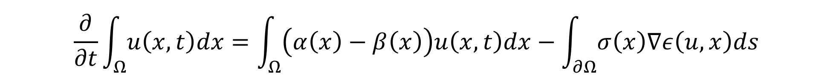

Conservation of Population
$$Total Population Change=\left(Birth Rate −Death Rate\right)×Population+Change Due to Migration$$
$$\frac{∂}{∂t}\int_{Ω}{u\left(x,t\right)dx}=\int_{Ω}{\left(α\left(x\right)−β\left(x\right)\right)u\left(x,t\right)dx}−\int_{∂Ω}{σ\left(x\right)∇ε\left(u,x\right)ds}$$
$$\frac{∂u}{∂t}=\left(α\left(x\right)−β\left(x\right)\right)u−∇⋅\left(σ\left(x\right)∇ε\left(u,x\right)\right)$$

Slide 7
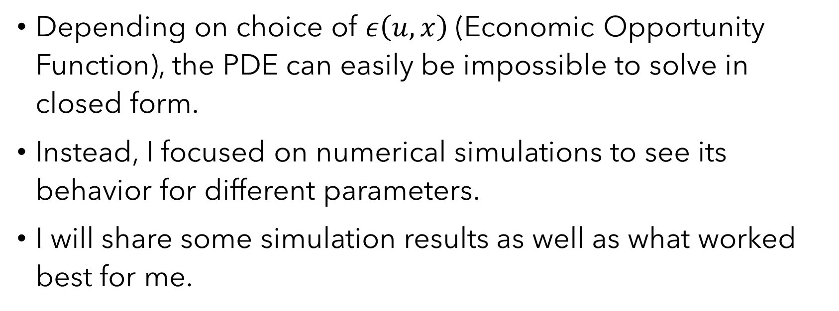
Simulation
Depending on choice of $ε\left(u, x\right)$ (Economic Opportunity Function), the PDE can easily be impossible to solve in closed form.
Instead, I focused on numerical simulations to see its behavior for different parameters.
I will share some simulation results as well as what worked best for me.

Slide 8
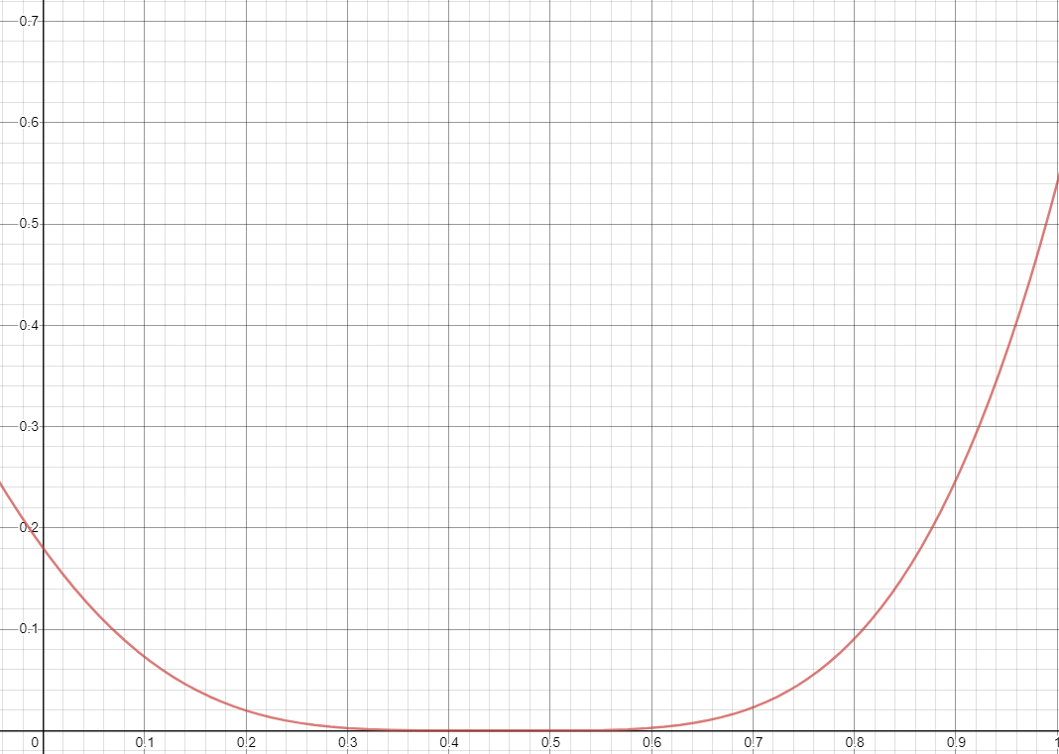
Polynomial Economic Opportunity
Economic Opportunity vs. Population Density

Slide 9
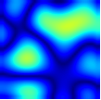
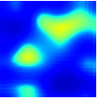
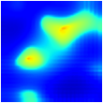
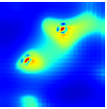
Simulation Results

Slide 10
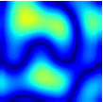
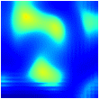
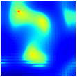
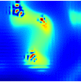
Simulation Results

Slide 11
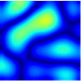
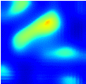
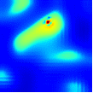
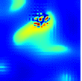
Simulation Results

