Slide 1
Tweet Analysis of the Presidential Election
Zach Beisler, Zack Vliet

Slide 2
Choosing our Topic
Motivation
Innovation
Feasibility
  Covering a Current Event
  Finding a topic that could lead us to useful information
  Comparing Twitter campaign strategies
  Using Twitter data to show which issues mattered most
  Finding a topic that was widely tweeted about
  Finding a topic which people are passionate about

Slide 3
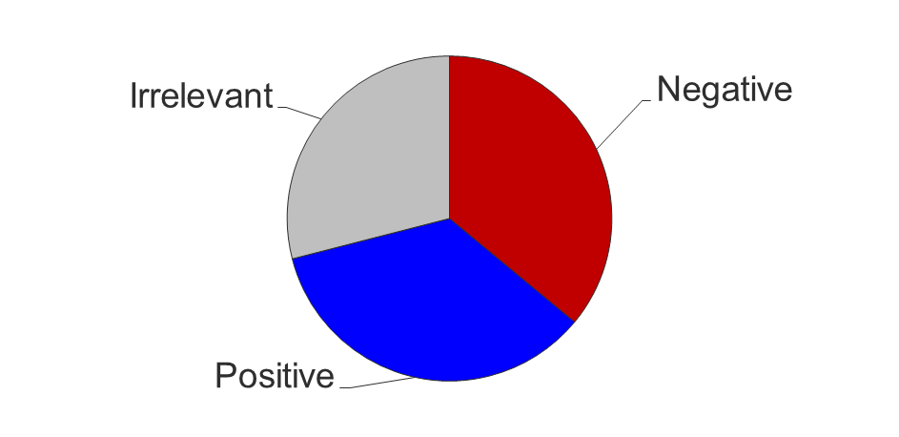
Data Collection
Pilot Tweet Collection
Consisted of 100 Tweets 76 Relevant tweets Of those: 35 Positive 36 Negative Keywords used: “trump”, “donald trump”, and “#trump”

Slide 4
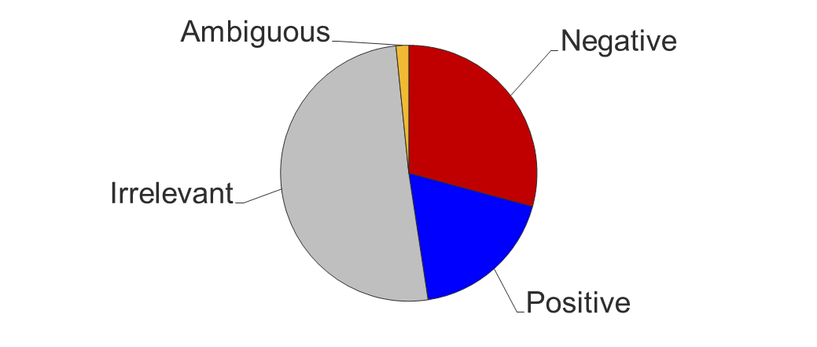
Data Collection
Test-Data Tweet Collection
Consisted of 250 Tweets 123 Relevant tweets Of those: 73 Positive 46 Negative 4 Ambiguous Set the rules for tagging

Slide 5
Data Collection
Gather
Tag for Relevancy
Tag for Sentiment

Slide 6
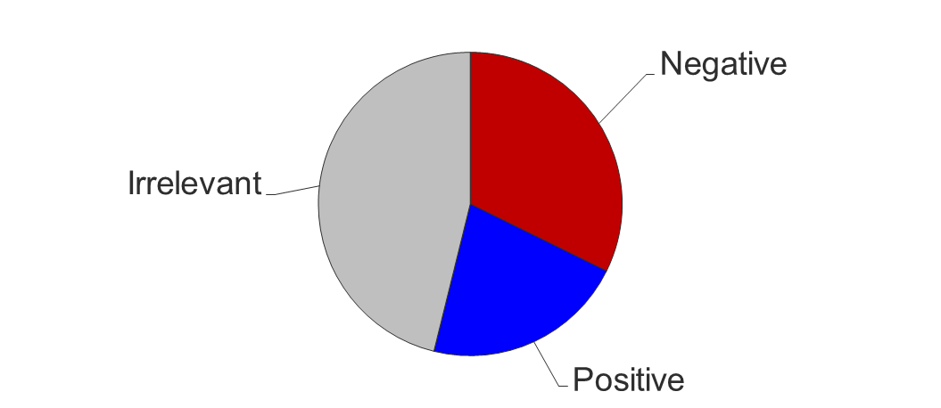
Data Collection
Final Test-Set
Consisted of 1753 Tweets 944 Relevant tweets Of those: 378 Positive 566 Negative This is the set of tweets that our models were trained on

Slide 7
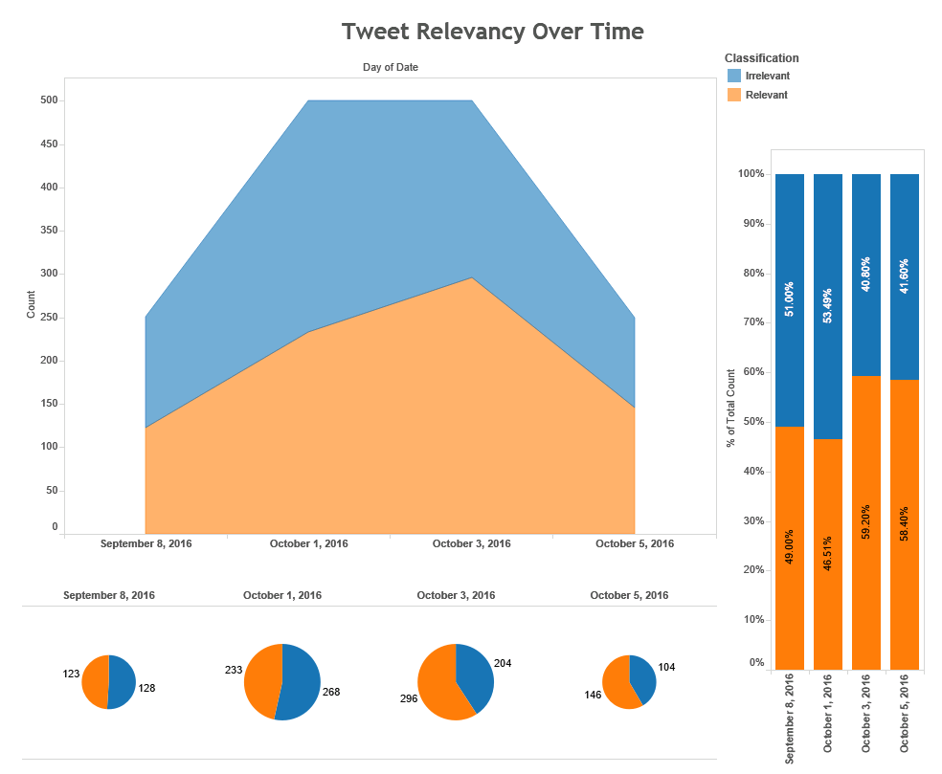
Notes:
Relevancy after certain events
Relevancy changing post-events, relatively even split among relevancy, no bias

Slide 8
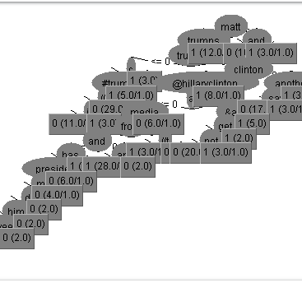
Creating a Predictive Model
Our first Decision Tree Model was very complex, with 55 elements and 28 leaves. The reasoning behind the complexity is the nature of political language, and the widespread use of sarcasm and humor. It managed to correctly classify 86% of the training set tweets.
Notes:
Difference in sets
Training set, predictably, slightly better

Slide 9
Creating a Predictive Model
Our results were so good mainly because of a lack of Cross-Validation
The most important aspects of our models moving forwards were:
  Recall: In a democratic political system its especially important that every voice is accounted for
  False Positives: Because we were looking at the election from a Trump-centric perspective, it was important to prevent as much positive bias as possible

Slide 10
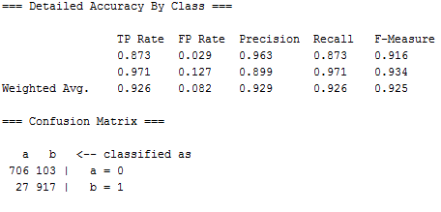
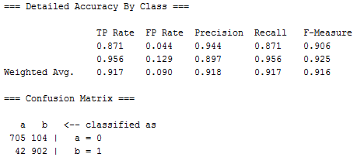
Creating a Predictive Model
Training Set
Cross Validation
Notes:
Difference in sets
Training set, predictably, slightly better

Slide 11
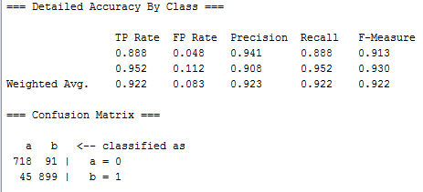
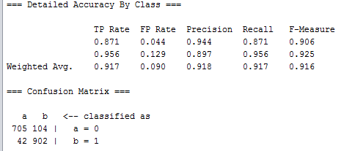
Creating a Predictive Model
Decision Tree
Naïve Bayes
Notes:
Difference in sets
Training set, predictably, slightly better

Slide 12
Conclusions
Word Features
Sentiment
Volume
  Certain features were more likely to be associated with positive or negative sentiment
  There was a clear difference in overall sentiment towards each candidate
  The two candidates were mentioned in vastly different amounts

Slide 13
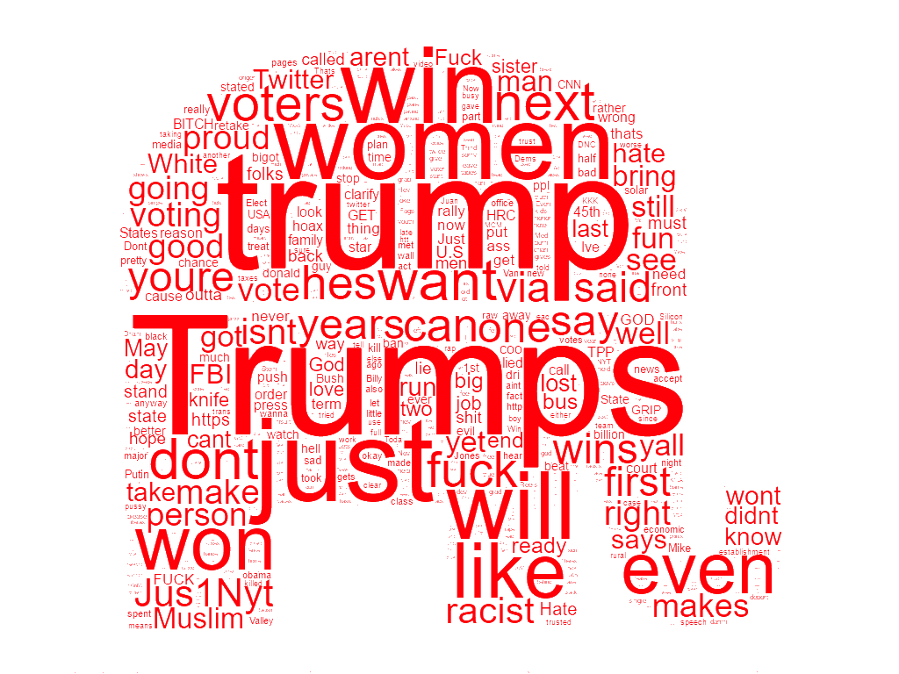
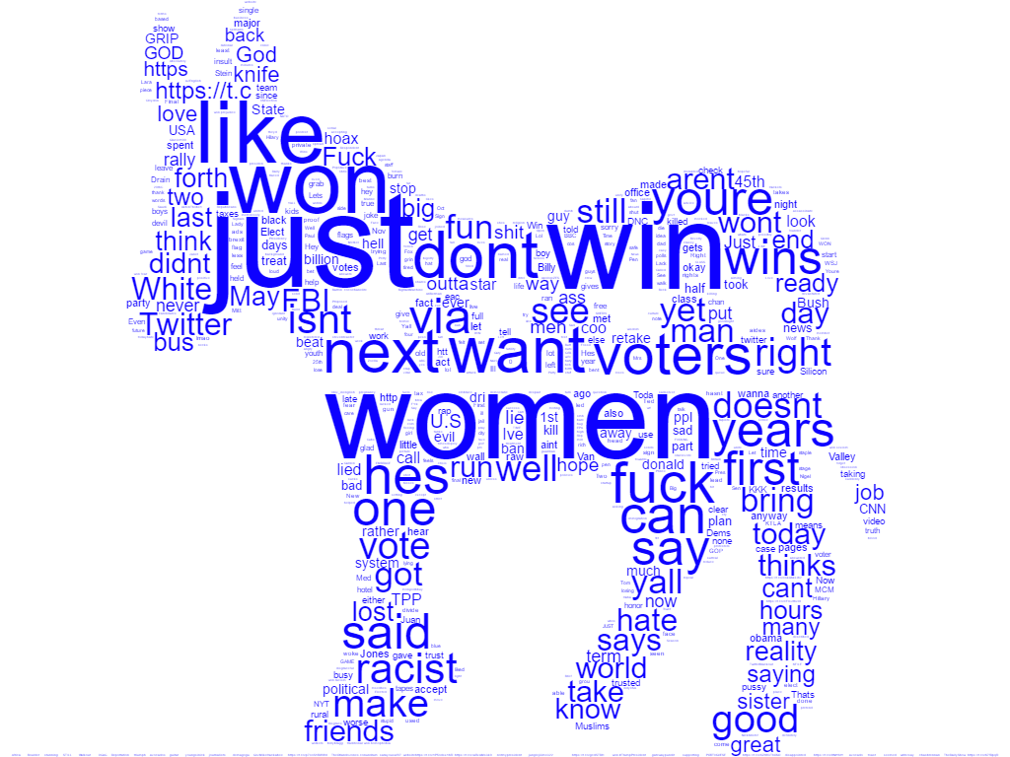
Word Cloud Visualization

Slide 14
Positive Sentiment Word Cloud
The word cloud generated for tweets that were classified positively is dominated by the features “trump” and “Trumps”. This suggests that tweets designed to promote trump demonstrated the active voice, focusing on Trump as the doer of actions, not the receiver.

Slide 15
Negative Sentiment Word Cloud
The word cloud generated for tweets that were classified negatively shows the prominence of the feature “women” in anti-Trump tweets. This highlights one of the demographics that Trump possible lost out on in the election, women.

Slide 16
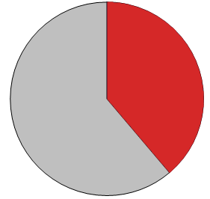
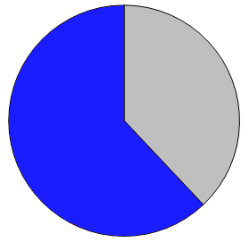
Word Feature Visualization: “trump”
39%
61%

Slide 17
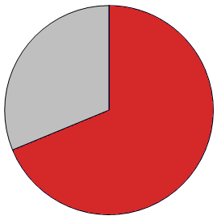
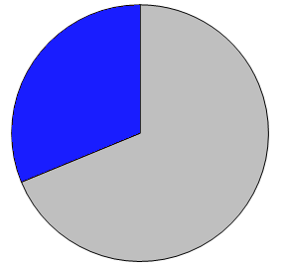
Word Feature Visualization: “hillary” or “clinton”
69%
31%

Slide 18
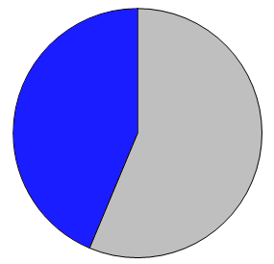
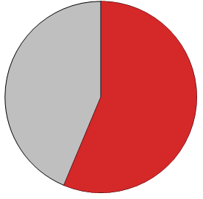
Word Feature Visualization: “vote”
56%
44%

Slide 19
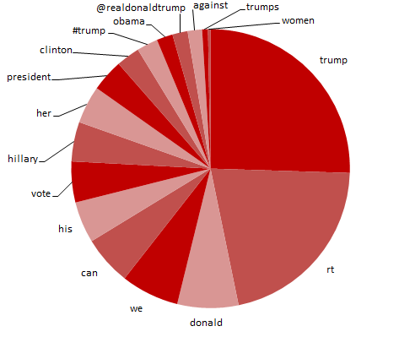
Positive Sentiment Tweets: Key Features
The first few dominant features are fairly self-explanatory, but features such as “we” show that Trump tweeters often identify collectively when describing taking action. The prominence of the feature “vote” is also still apparent in this particular visualization.

Slide 20
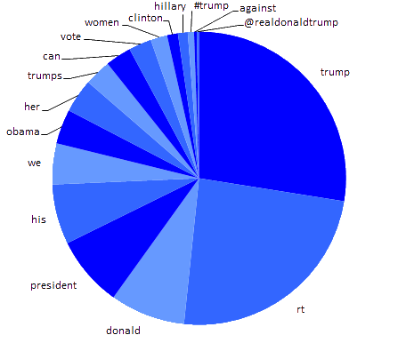
Negative Sentiment Tweets: Key Features
This distribution shows that the feature “president” is much more prominent in anti-Trump tweets, possible commenting on Trump being unfit for presidency. The “obama” feature is also much greater, showing that many tweeters cited the current president in their tweets.

Slide 21
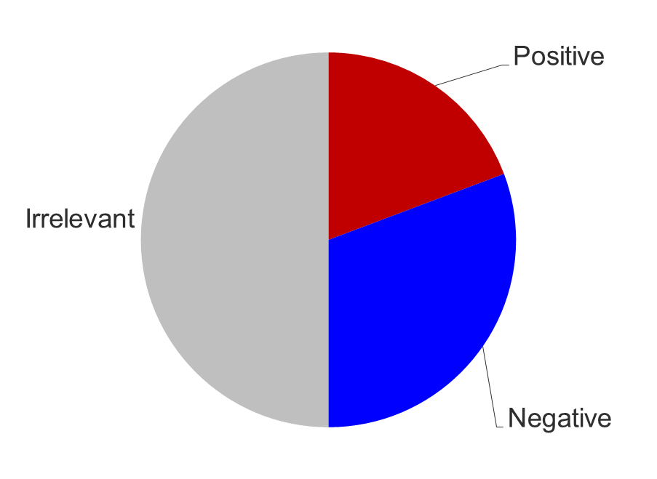
Overall Sentiment
The overall sentiment was largely negative towards Trump
About half of the tweets that contained the keywords were irrelevant

Slide 22
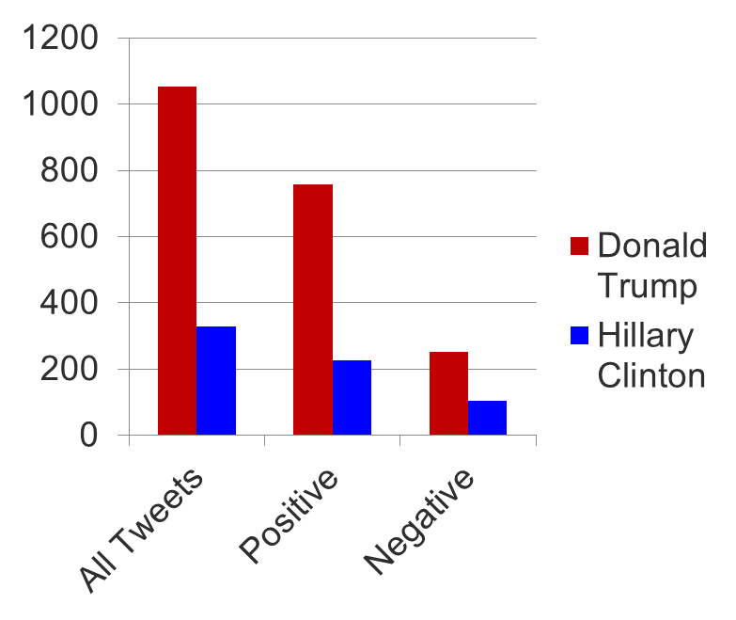
Overall Volume
The totals are lazily summed (not accounting for doubles) and then multiplied by an correcting factor
Even in the negative tweets Trump was more prevalently tweeted about

Slide 23
Closing Thoughts
An interesting second step with this project would be to analyze retweeting, and evaluate the word-of-mouth spread of sentiment on Twitter.
Certain biases towards our data were introduced from a very early point in project design, such as the exclusive use of Trump-related keywords. A different way of doing it would be to included equal keywords from both candidates and analyze the differences in the data collected with each.

