Slide 1

QuantFin
Zach Boehnlein
05/04/2021
Notes:
Hi folks, we are QuantFin and today, we’d like to start our presentation off by asking you guys to just take a quick mental guess of what percent of American adults are invested in the stock market.

Slide 2
Our Project
Creating a trading algorithm and financial API
Increase access to financial markets
Make it accessible for tech illiterate people
Documentation and testing for those who are interested
Notes:
Nathan
“Normal people” (e.g. no finance background) who can’t afford premium data sources
People who want to trade but don’t want to learn
Get more people invested
Promoting sound investing principles and early starts will help people compound their wealth and secure financial security and prosperity
Why is this a challenge for people?
Many feel that they do not have enough capital to invest and make significant gains
Disparities in knowledge and access to resources of all kinds discourages new and/or small investors and maintains the endless cycle of generational wealth inequality

Slide 3


Goals
Learn a new skill
Learning trading strategies and API building
Make some money
Looking for above average returns
Hands- off financial solutions
Easily testable and shareable
Multiple algorithms/strategies for user choice
Notes:
Nathan
We viewed this as a unique opportunity to apply our AIMS background using
Algorithms
To automate investing activity which reduces costs and simplifies the processes of trading stocks
Cloud Infrastructure
To create an environment which host and updates our data daily while leveraging variable costs benefits
API Creation
To improve ease of access and usability to higher level financial data

Slide 4
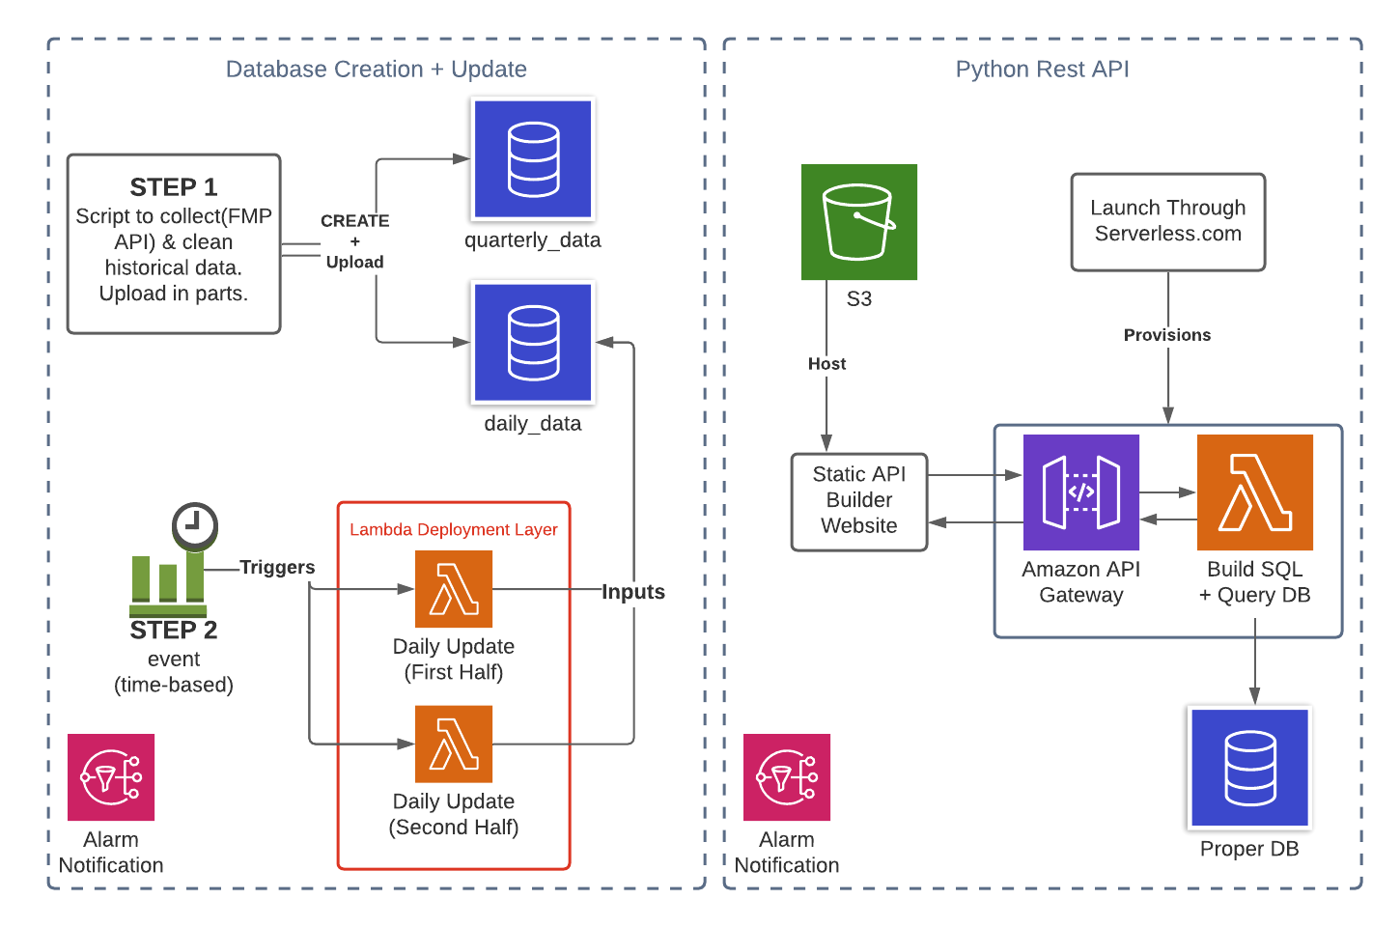
Project Description
Algorithms
Breakout
Looking for key points above certain resistance levels
Stop loss to prevent loss
Mean reversion
Prices will revert to mean or average
Example is to buy a stock after it falls unusually low
Earnings reaction
Method to buy stocks based on negative reactions to earnings releases
Bet on corrections

Slide 5
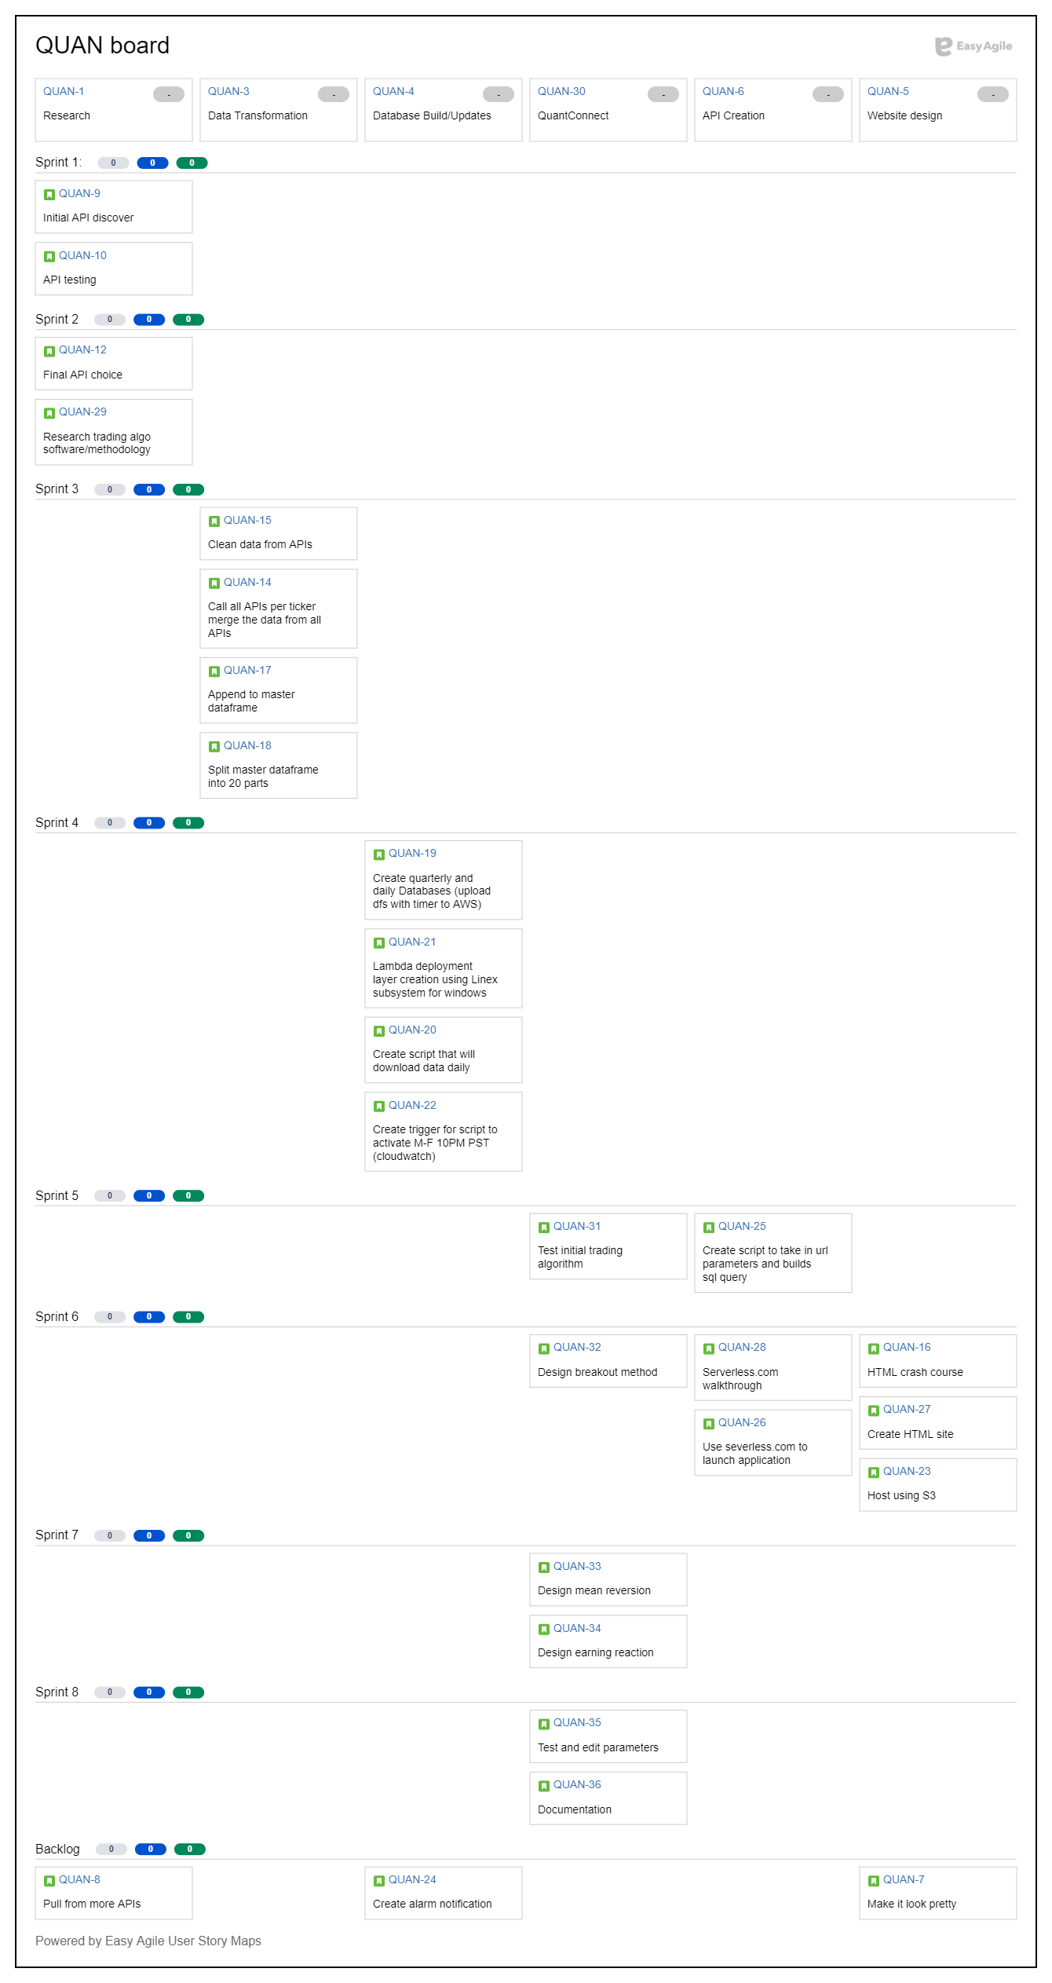
Planning
Project Management Tools
Atlas → Confluence and Jira
Project Planning:
User Story maps through Jira
Notes:
Jordan (API) /Zach (QuantConnect)

Slide 6
Agile Methods
Method: Scrum
Easy
Understandable
Advantages/Drawbacks
Simple and solid UI
Paid
Notes:
Jordan

Slide 7
Demonstrations
LIVE DEMO
Notes:
Zach

Slide 8

In Retrospect
Challenges
Challenges
Problem: Data collection
Go through all the data sources and format correct
Solution: Hard coding
Problem: Testing Code
Back test
Solution:
Pushing through
Notes:
Jordan

Slide 9
Thank You
Notes:
Zach

