Slide 1
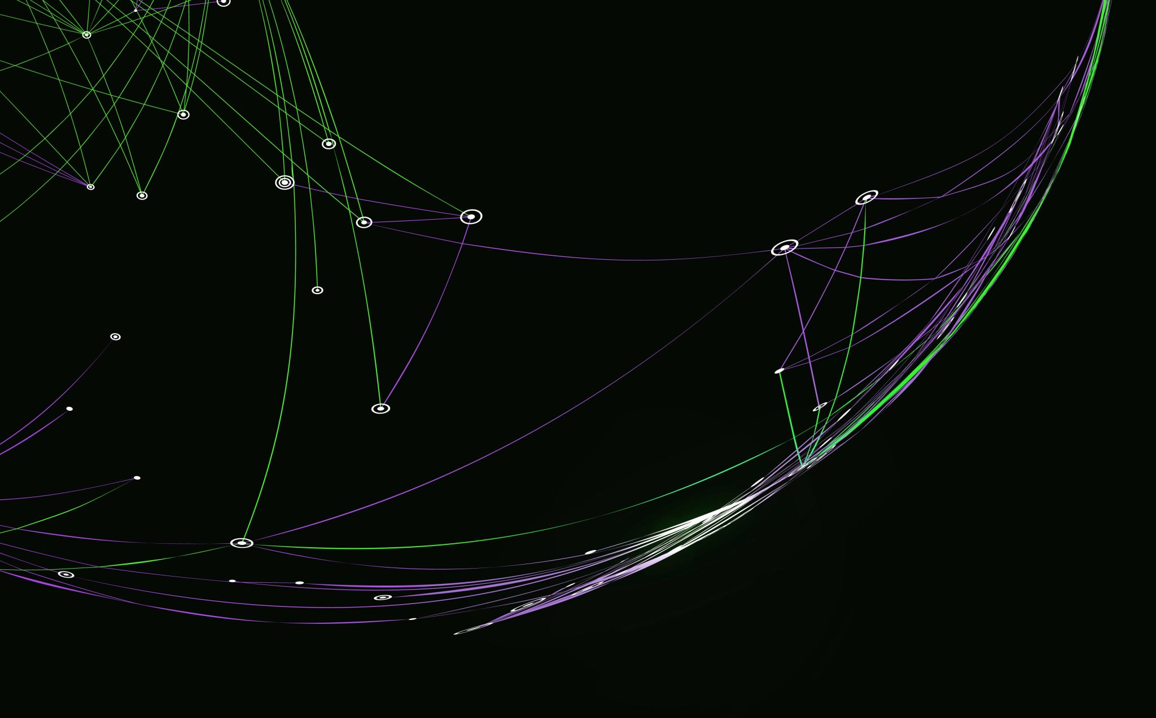
Scrum-Agile
Z.Davis
CS 250
Professor Maryann Krupa
Feb 21, 2025

Slide 2
Agile Roles
Product Owner | Set Goals Ensure backlog is stocked and clearly defined Order the backlog/Prioritize Update and refine backlog Collect feedback from stakeholders, users, and customers on product increments
Scrum Master | Facilitate meetings, conversations, and improvements Communicate clearly the goals and scope of the project Facilitate scrum events Help remove impediments to the team’s progress Coach the team when the needed Lead the team with a servant leader mentality
Developer | Manage the sprint backlog Inspect and adapt through daily scrum Contribute to the sprint goal
Tester | Ensure the product is matching the goals of the client Ensure quality code Develop test points and automatic testing to help the flow and development of the program Create clear pass/fail requirements
The Scrum Team | Scrum Alliance. (n.d.). https://resources.scrumalliance.org/Article/scrum-team

Slide 3
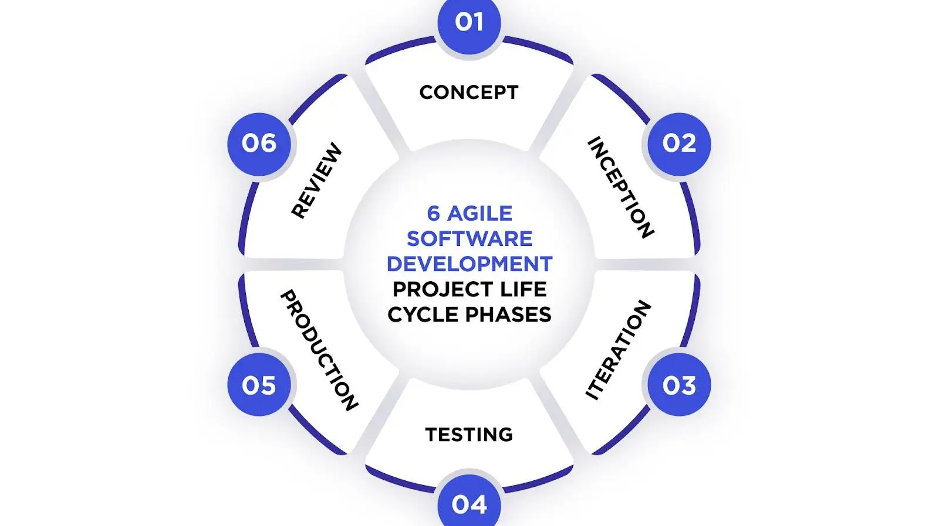
Agile Life Cycle
Dziuba, A., & Dziuba, A. (2024, October 3). Navigating the agile software development life cycle: phases, tools, roadmap. Relevant Software. https://relevant.software/blog/agile-software-development-lifecycle-phases-explained/

Slide 4
Phases
Definition
1. Concept | Stake holders and product owners meet to outline projects scope and priorities Discuss costs, completion time, and requirements to determine projects feasibility
2. Inception | Team selection and tool gathering Create a mock-up of the user interface analyze competitor’s strength and weakness Architecture discussion where the team discusses best framework and tools needed for completion of the project
3. Iteration | The programming phase Iteratively create the program
4. Testing | Test the features of the program Ensure all features behave as intended
5. Production | This is the release phase Show users the progress being made
6. Review | Listen to customer feedback React to request for new features

Slide 5

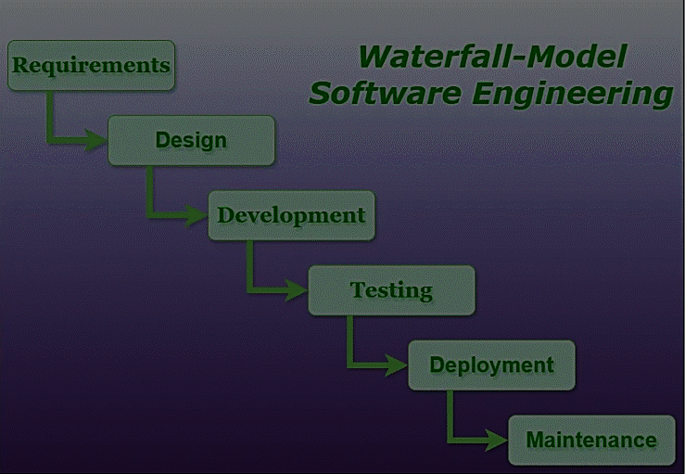
The Waterfall Method
GeeksforGeeks. (2024c, October 18). Waterfall Model Software Engineering. GeeksforGeeks. https://www.geeksforgeeks.org/waterfall-model/

Slide 6
Waterfall pros/cons
Advantages
Disadvantages
Easy to Understand
Individual Processing
Clearly Defined
Clear Milestones
Works well for smaller project where requirements are well understood
No Feedback path
Difficult to accommodate changes
No overlapping of phases
Limited flexibility
Stakeholder involvement is limited
Late testing phase
Potentially longer development time

Slide 7

Waterfall
Change of Requirements
Agile
Requirement phase
New requirement would have to be documented and approved
Design Phase
Design documents would have to be updated to reflect the changes
Implementation Phase
Developers would have to adjust code
Could involved significant reworking to the existing codebase
Testing Phase
The new feature would have to be thoroughly tested
Could uncover new or existing issues which would cause further delays
Deployment Phase
All delays would cause deployment date to fall back impacting overall project timeline
Re-prioritize the backlog
Hold a meeting to make the team aware of the changes
Implementation
Developers make the required changes
Testing
The feature is thoroughly tested
Deployment
Gather feedback from end users

Slide 8
Agile VS Waterfall
Agile
Waterfall
Flexible
Potential for future changes
Better for complex projects
Continuous Risk management
Incremental development provides value to stakeholders
Continuously receives stakeholder involvement
Well, suited for well-defined/stable requirements
Limited stakeholder involvement
Suitable for smaller/less complex projects
Rigid structure
Risks are identified early but unforeseen issues pose significant problems
Linear timeline with a single delivery

Slide 9
References
Kneafsey, S. (2023, March 31). Agile Principles - Effective communication. Scrum.org. https://www.scrum.org/resources/blog/agile-principles-effective-communication
Cobb, C. (2021, January 5). What is an agile developer? How is the role different? Agile Project Management. https://managedagile.com/what-does-it-mean-to-be-an-agile-developer/
Dziuba, A., & Dziuba, A. (2024, October 3). Navigating the agile software development life cycle: phases, tools, roadmap. Relevant Software. https://relevant.software/blog/agile-software-development-lifecycle-phases-explained/
The Scrum Team | Scrum Alliance. (n.d.). https://resources.scrumalliance.org/Article/scrum-team

