Slide 1
Housing prices in ames, Ia: building and evaluating a linear regression model
By: Zach Green
8/23/2018

Slide 2
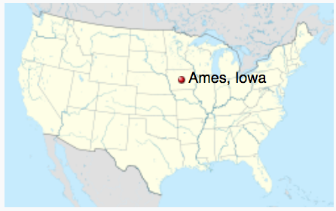
Ames is cool…right?
"One of the Greatest Places You've Never Heard Of"
-Mother Earth News
The Caldwell family from Ames survived the Titanic.
"How little did that happy group, who with reverent thoughts, were worshiping God, realize that within a few hours the majority of them would meet him,”
–Albert Caldwell on the church service before the Titanic sank.

Slide 3
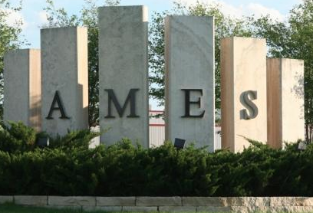
What are we looking for?
Take a look at all factors that could influence housing prices and determine which factors are important
Develop and evaluate a model that predicts sale price
The data we have:
78 features with info about the house
2051 data points from 2006 – 2010

Slide 4

Its munge time
Dropped all unbalanced features
Null values filled with 0 or ”None”
Filled Nans in columns about Basement, garage, and lot frontage.
Transformations
Sale date- changed to months since 1/1/2006
Age - Calculate from Year built
Total baths- 2 full baths and 1 half bath = 2.5 total baths

Slide 5
Feature engineering
Drop unbalanced features.
Make interaction terms on all continuous features and 3 discrete features.
interactions added after making dummies:
'Neighborhood', 'Overall Quality', 'Overall Condition’
Make dummies on all remaining discrete features.

Slide 6
Build the model
Standardizing and regularization
Standard scaled
Ridge regularization
Alpha = 0.1
Recursive Feature Elimination
2009 features, dummy variables, and interaction terms to check
2²⁰⁰⁹ = 5.88 x 10⁶⁰⁵ possible combinations
This model is limited to 35 features

Slide 7
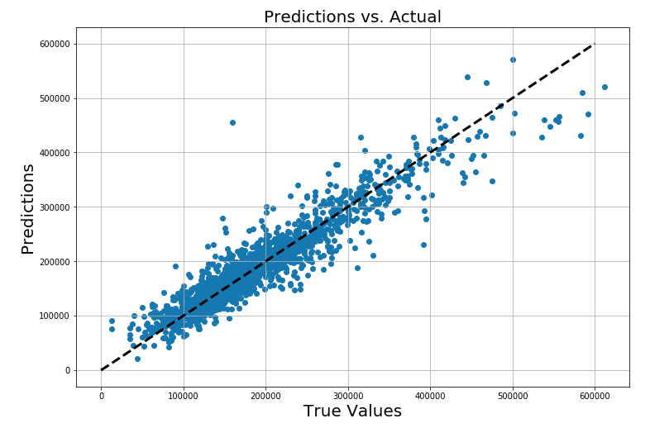
Evaluating this model
R² score: 89.2%
CV score: 85.2%
Things to note:
Strong relationship
Potential overfit
Outlier to investigate

Slide 8
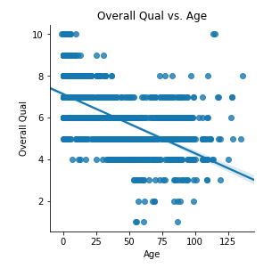
Assessing multicollinearity
Some of the predictors correlate strongly with each other
Such as overall quality and age.
This can interfere with how we interpret the coefficients in the model.
This can also affect the precision of our predictions.

Slide 9
Ways to further improve the model
Cutting out invalid predictor combinations
Models with interaction terms, but not the features they were derived from
Hypothesis testing R²
Perform a general linear F-test.
Consider more than 35 features
Hyperparameter tuning
Alpha for ridge regularization

Slide 10
What can we learn?
Features that are important:
Neighborhood
Overall quality
Basement quality
Kitchen quality
Lot frontage
Age
Building type and style

