Slide 1

Judging a post by its title:
Predicting a Subreddit Using NLP
By: Zach Green

Slide 2
Science vs. History Subreddits
Goal: Predict the subreddit of a post from only the text in the title.
Gather and explore the data
Prepare the text
Apply various models
Compare results

Slide 3
Scraping
Use requests library to gather posts from Reddit.
1000 History Posts
650 Science Posts
Scraped several other subreddits test model consistency.
r/Jokes vs. r/Research
Extract relevant data from JSON save to csv.

Slide 4
Text Processing
Tokenized with regex ‘w/+’
Stemming vs Lemmatization vs Vectorizer Default
Stemming tended to perform the best
Vectorizers (n-grams: 1-3)
TFI-DF (Max features: 1500)
Count Vectorizer
Hash Vectorizer

Slide 5
Models
8 Models tested with hyperparameter tuning
Naïve Bayes
K-Nearest Neighbors
Logistic Regression
Support Vector Machine
Random Forest
Extra Trees
Gradient Boost
AdaBoost

Slide 6

Results
Logistic Regression and SVM (linear) consistently performed the best
Naïve Bayes also stood out across different tests
Decision Tree ensemble models and KNN also did well.

Slide 7
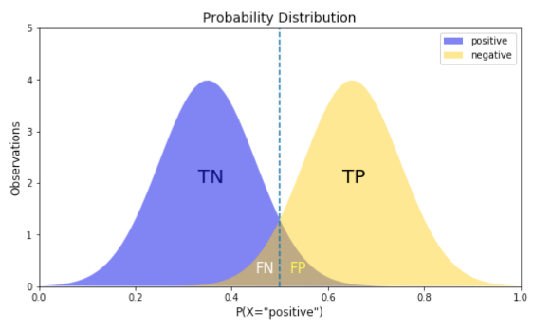
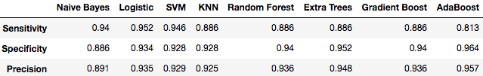
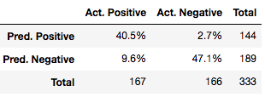
Sensitivity vs. Specificity
Some models showed imbalanced sensitivity vs. specificity.
This could suggest a skewed decision threshold.
Low Sensitivity:
Overpredicting negative class
Low Specificity
Overpredicting positive class
AdaBoost:

Slide 8
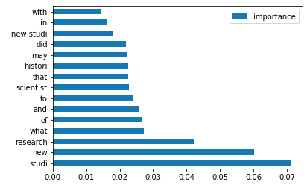
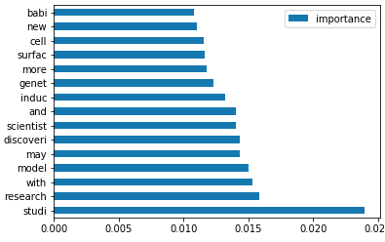
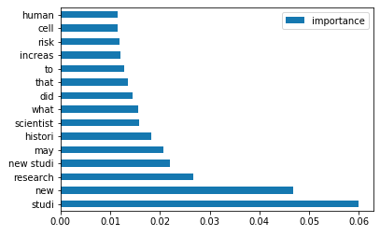
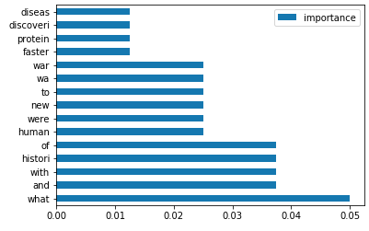
Important Features
“Forest” Models
Boosting Models
Random
Forest:
Gradient
Boost:
Many are stop words
Extra
Trees:
AdaBoost:

Slide 9
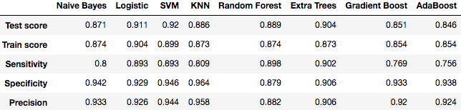
Generalizing to Other Subreddits
Tested r/Research vs r/Jokes
Kept the hyperparameter settings tuned from previous tests.

