Slide 1
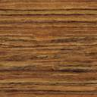

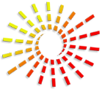


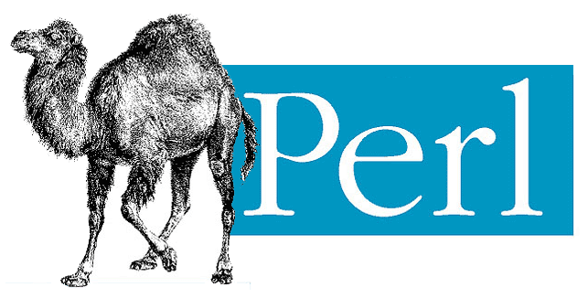
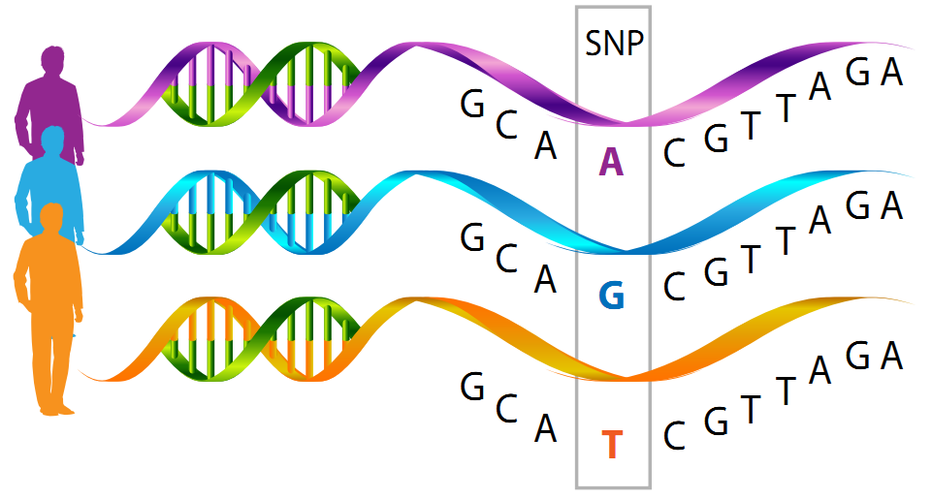
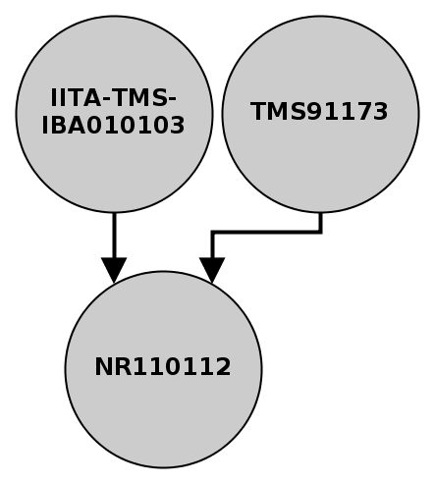
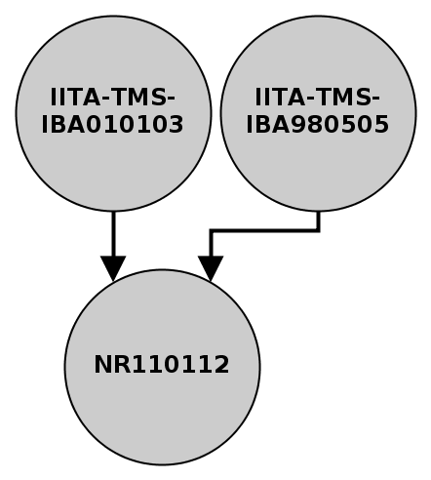
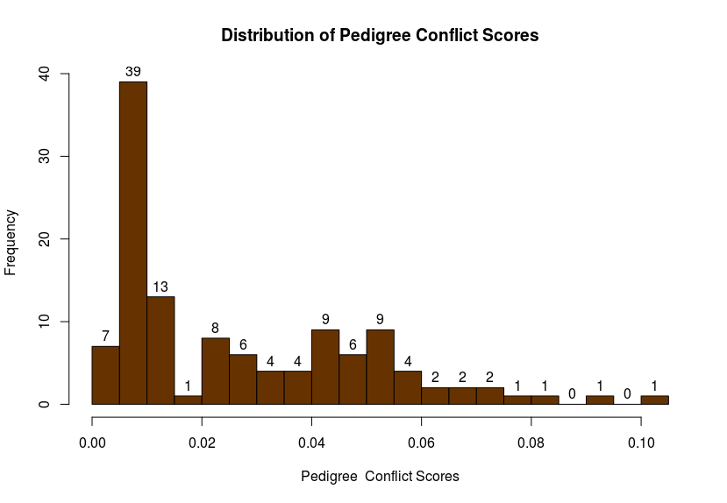
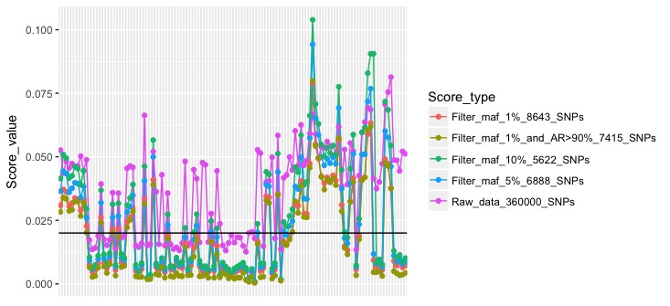
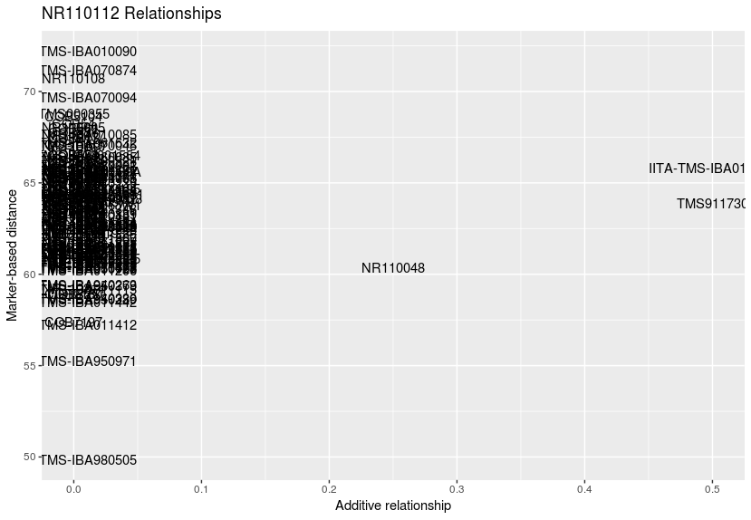
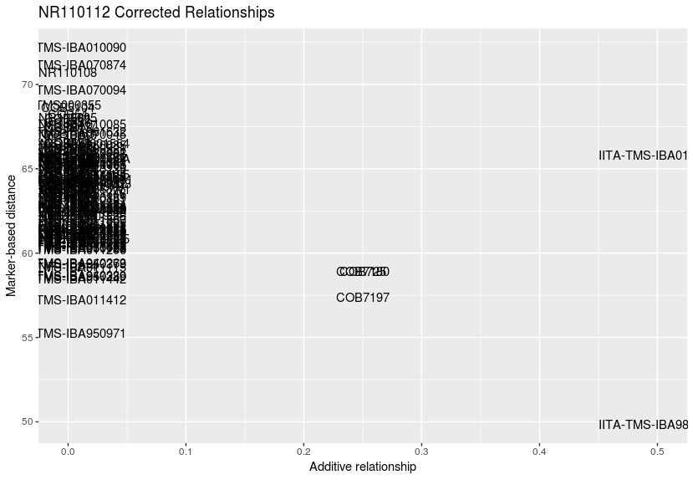
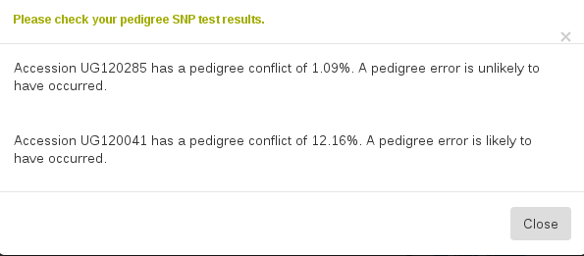
Pedigree Verification in Cassava through Analysis of Single Nucleotide Polymorphisms
Kyndra Zacherl, Bryan Ellerbrock, Guillaume Bauchet, and Lukas A. Mueller
Boyce Thompson Institute, 533 Tower Road, Ithaca, NY 14853
Introduction
Research Methods
Cassava, also known as yuca, is a tropical root crop in Africa and South America. Cassava is the primary food source of 500 million people around the globe, including 40% of Africa. Cassavabase.org is the open access public database for next generation cassava breeding (nextgencassava.org) that allows cassava breeders to deposit their data, including genotypes and pedigree information [1]. As the breeder performs crosses at each breeding cycle to improve the crop, recordkeeping of this information is essential. Pedigrees are then uploaded by breeders, but may not always be complete due to polycrosses (Figure 2, where many potential fathers are possible) or mistakes due to human input error.
Genetic data, including genotypes with single nucleotide polymorphisms (SNP) dosage scores, are also stored in CassavaBase. SNP marker segregation occurs from parent to child, allowing them to be used for the assessment of kinship or genetic similarity and thus assess original pedigree information validity, as can be seen in Figure 1. SNPs can be assigned as a quantitative dosage score based on how many copies of a polymorphism (homozygous, heterozygous) are present that can then be used for mathematical genetic analysis, as seen in Figure 3.
A pedigree validation tool based on the work of Endelman et al. [2] preliminarily written in R and finalized in Perl, was developed in order to compare the SNP dosage values of the child and parents in each pedigree, with genotypes and pedigrees for 120 accessions being retrieved from Cassavabase.
Set of scores were analyzed and assigned a value of possible or impossible based on expected inheritance patterns, as shown in Figure 4. If the combination of dosage scores was deemed impossible, it was marked as such and added to the total of impossible SNP combinations.
At the end of the analysis, the amount of score sets identified as impossible were divided by the amount of total score sets, providing a pedigree conflict score.
1 2 3 4 5 6 7 8 9
7 8 9 1 2 3 4 5 6
4 5 6 7 8 9 1 2 3
AA = 2
Aa = 1
aa = 0
Impossible Genotypes
(Mother, Father, Child)
Possible Genotypes
(Mother, Father, Child)
[2][2][0]
[0][0][2]
[0][1][2]
[1][1][1]
[2][1][2]
[2][0][1]
[2][1][0]
[0][0][1]
[1][0][0]
[1][1][0]
Figure 1: An illustration of a SNP where A is the expected base (purple)
and G (blue) and T (orange) are the variant bases.
Figure 2: A polycross is a common planting scheme used by cassava breeders. Many viable lines have equal opportunity to mate with each
other but are kept distant from identical lines.
Figure 3: An explanation of how mathematical values are assigned to SNPs. Each non-reference
allele is assigned a value of 1.
Figure 4: A comparison of possible and impossible scores, formatted as mother dosage score, father dosage score, and child dosage score respectively. SNPs are inherited and thus impossibilities
occur when they do not travel from parent to child.
SNP Marker Discovery & Filtering
Post-Filter Data Analysis
Results
Genotyping data was generated through Genotyping-By-Sequencing using the Tassel pipeline [3] (GBS ApeKI v6) producing a 359,792 SNP marker set for each accession. As GBS is a low depth sequencing technique, SNPs were filtered to ensure quality using several parameters including:
Marker missing data (<0.5)
Depth (>10x)
Minor allele frequency (maf) (>1%,5%,10%)
Linkage disequilibrium (<0.5)
Allelic correlation (>0.9)
Resulting in 4 filters, as can be seen in Figure 6:
Filter 1: MAF1% (8643 SNPs)
Filter 2: MAF5% (6888 SNPs)
Filter 3: MAF10% (5622 SNPs)
Filter 4: MAF1% and allelic correlation AR>0.9 (7415 SNPs)
The final selected filter, Filter 3, can be seen below in Figure 5.
A high pedigree conflict score represents a large amount of genetic conflict between the parents and child while a low score indicates that the pedigree is likely accurate.
A pedigree conflict score cutoff of .02 was set based on the visual bimodal distribution as was done in Endelman et al. [2] and any accessions with scores above this (60 total) were sent for further data analysis in R.
An additive matrix, a table of relationship scores from 0 to 1 based on the pedigree, was calculated along with the Euclidean genetic marker distance, a measure of the allelic divergence of the genotypes.
The additive matrix and genetic marker distance were graphed against one another in order to visually identify incorrect parents and locate correct ones – potential correct parents have both low additive relationship scores and marker-based genetic distance. As can be seen below, in Figure 7 a potentially correct father for line NR110112 has been identified and the breeder that uploaded this line can then be contacted to confirm if the suggested father could potentially be correct.
Figure 7: A visual representation of line NR110112 with its existing pedigree (left) and corrected pedigree (right). The plot on the right visualizes the much lower marker based
distance between the existed father and the corrected father.
Figure 5: A histogram of pedigree conflict scores with the final filter. Figure 6: A representation of the changing scores between filters.
References/Acknowledgements
Conclusions/Project Future
This tool successfully located accessions in the databases that are highly likely to be inaccurate, along with other lines that had no outward appearance of being incorrect, and enabled the identification of possible correct parents. The tool was successfully integrated into CassavaBase utilizing Perl, JavaScript, and HTML to create both an independent version for breeders to examine existing pedigrees (Figure 8) and an automatic version that runs during pedigree upload.
The correction of inaccurate pedigrees in the database supports efficient, effective, next generation cassava breeding, as shown in other plants in Munoz et al. [4]. In the future, this tool could be further developed in order to provide pedigree visualization or aid in the construction of unknown pedigrees.
[1] NEXTGENCassava. (2017) Why cassava? Retrieved from http://www.nextgencassava.org/about.html
[2] Endelman, J.B., Schmitz Carley, C.A., Douches, D.S. et al. (2017, April). Pedigree reconstruction with genome-wide markers in potato. American Journal of Potato Research, 94(2), 184-190. Retrieved from https://link.springer.com/article/10.1007%2Fs12230-016-9556-y
[3] Glaubitz, J.C., Casstevens, T.M., Lu, F, et al. (2014, February). TASSEL-GBS: A high capacity genotyping by sequencing analysis pipeline. Retrieved from http://journals.plos.org/plosone/article?id=10.1371/journal.pone.0090346.
[4] Munoz, P.R., Resende, M.F.R., Huber, D.A. et al. (2014, March) Genomic relationship matrix for correcting pedigree errors in breeding populations: impact on genetic parameters and genomic selection accuracy.
I would like to thank the NSF and the Bill & Melinda Gates Foundation for their generous funding of this project. I would also like to thank the co-authors of this project, especially my mentor Bryan Ellerbrock for the guidance he provided. Finally, I would like to thank Delanie Sickler for her excellent coordination and organization of this internship.
Figure 8: A screenshot of the result screen from the independent tool on CassavaBase. The user selects a lists of existing accessions with pedigree to test and
these accessions are then analyzed.

