Slide 1
Inception Project
Zach Gentry, Tousar Mohammed, Giannina Pachas, Courtney Howland

Slide 2
edU
Interactive educational app

Slide 3
Project Vision
We are creating a multi-platform mobile app which focuses on image recognition capabilities in an educational environment. Our app focuses both on text and drawn image recognition and being cross-platform for both iOS and Android. Our app's main feature is recognizing text and images from a drawn source. The app allows for users to go through exercises where they draw or write out a given word or shape and is then checked against our image recognition APIs to see if the user is correct.

Slide 4
Top-3 Risk List
Beginners to app development
Short duration to develop the full vision of the application
We want to use openCVL but we are not sure how well it will work cross-platforms

Slide 5
Competitors
PocketPhonics
Is a learning app, that encourages the child to explore the alphabet by tracing the image of the letter. They also have an option of choosing the letter after hearing the corresponding audio.
Scribble Cards
Scribble Cards is similar to PocketPhonics, but also incorporates numbers, as well as, the alphabet. Scribble Cards, on the other hand, does not include an audio learning feature.
Trace it, Try it
Is a handwriting app that teaches children to trace over pre-drawn alphabets, numbers (0-20), and simple three letter words.

Slide 6
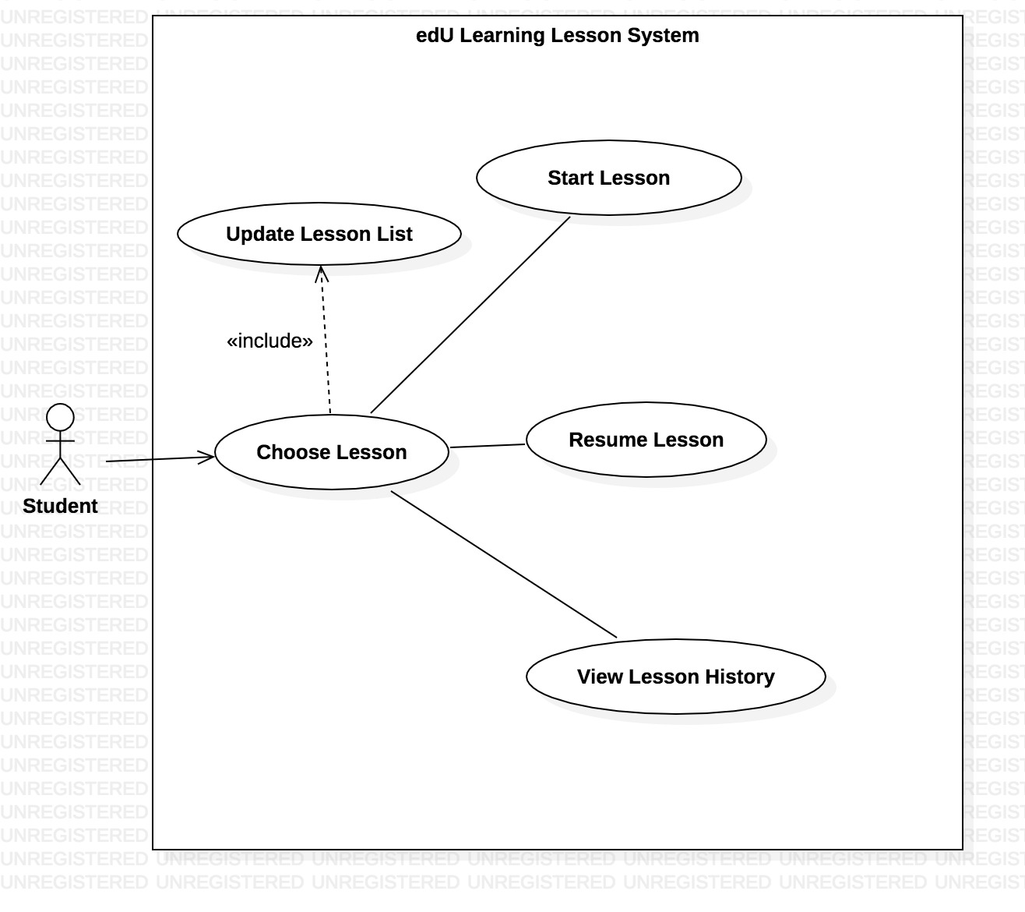
Use Case

Slide 7
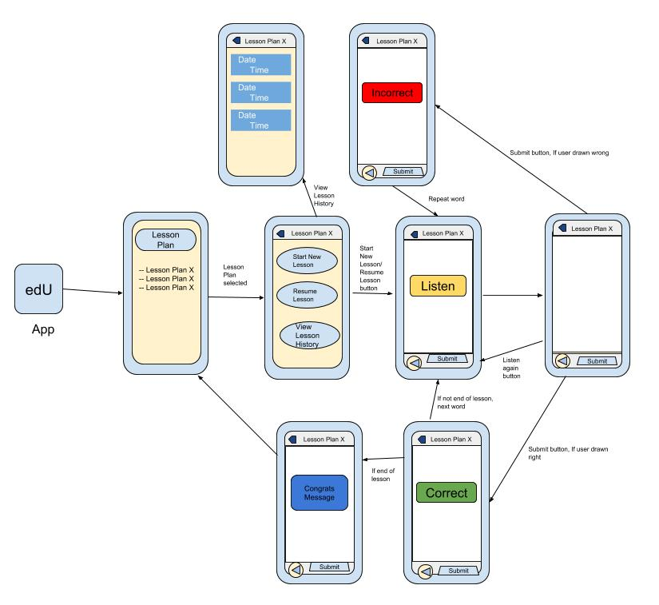
UI Layout

Slide 8
edU Software Development Plan

Slide 9
Iteration Plans
Iteration 1
Testing tools (single word test)
Able to draw images
Audio works
Successfully validate drawn words
Iteration 2
Create UI
Setup database
Populate database
Iteration 3
Create lessons based on data from database
Test 5 lessons in app
Final Deliverable
Final product
Future plans
Polish application

Slide 10
Tools
React Native
Node.js
SQLite
openCVL

Slide 11
People
Target audience
Kids ages 2+
Develop app
Us, Team 5

Slide 12
Education
Beginners with app development
Upperclassmen software engineering students from UTA

Slide 13
Requirements
5 lesson plans
Letters (a-z)
Number (1-100)
Shapes
Words (school words)
Math (add, subtract)
SQLite database
Android and iOS
Produces audio
Capture screen images
Validates images for correctness

