Slide 1
Function;Chaos P3
Paul Trapp, Zach Goodenow, Martin Hu,
Shun Lin, Alber Moied

Slide 2
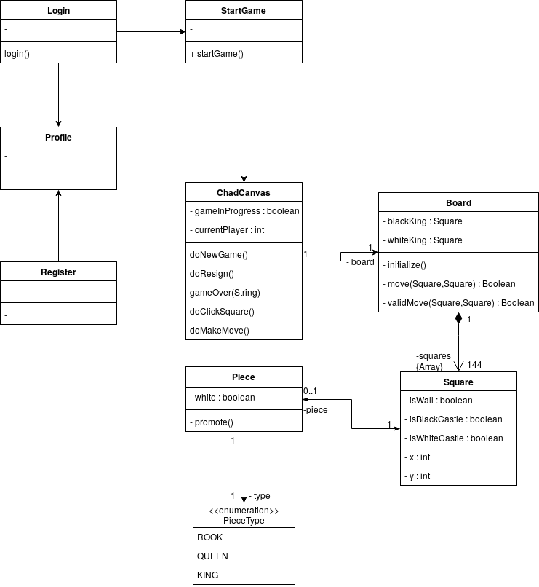
Design Class Diagram

Slide 3
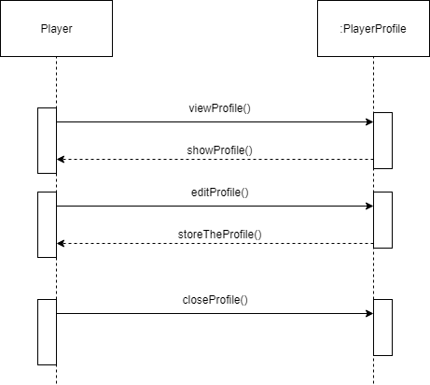
System Sequence Diagram 1

Slide 4
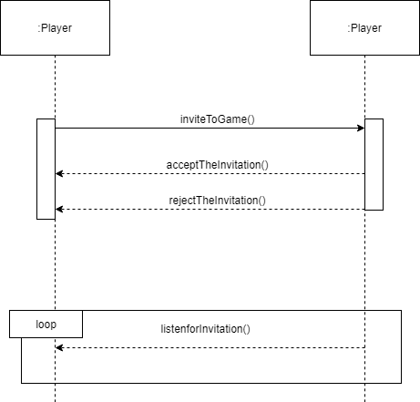
System Sequence Diagram 2

Slide 5
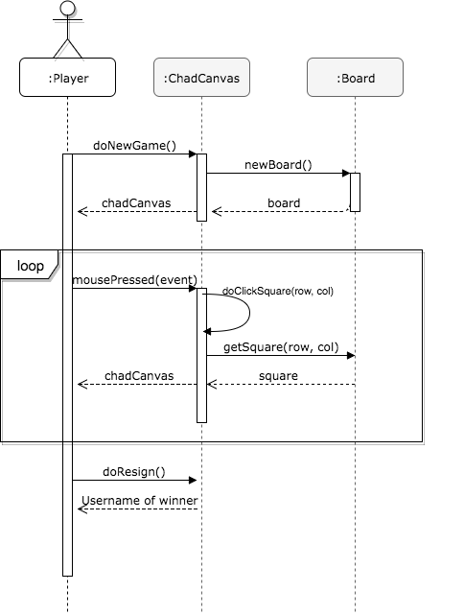
System Sequence Diagram 3

Slide 6
Chad Demo

Slide 7
Questions?

