Slide 1
Hockey pong
By: Zach M.

Slide 2
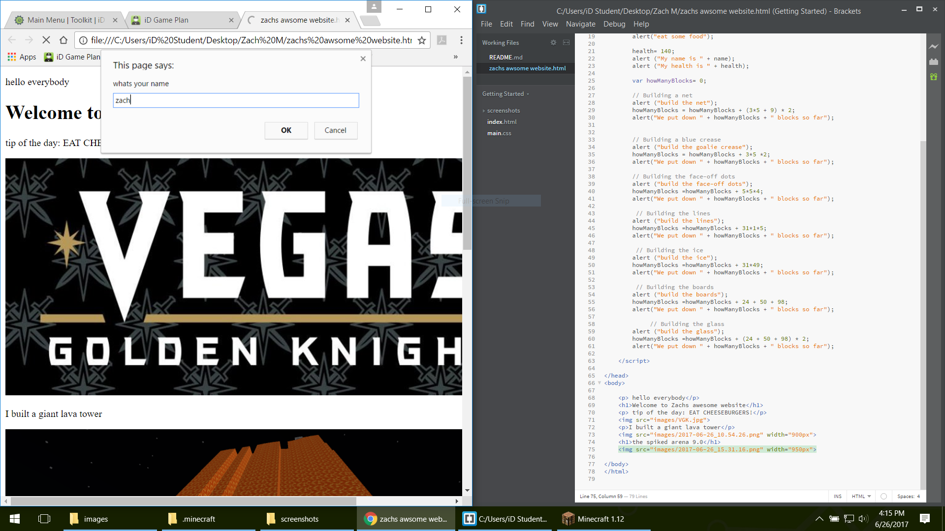
Louisville Shelby Campus
This is what I did on Monday

Slide 3
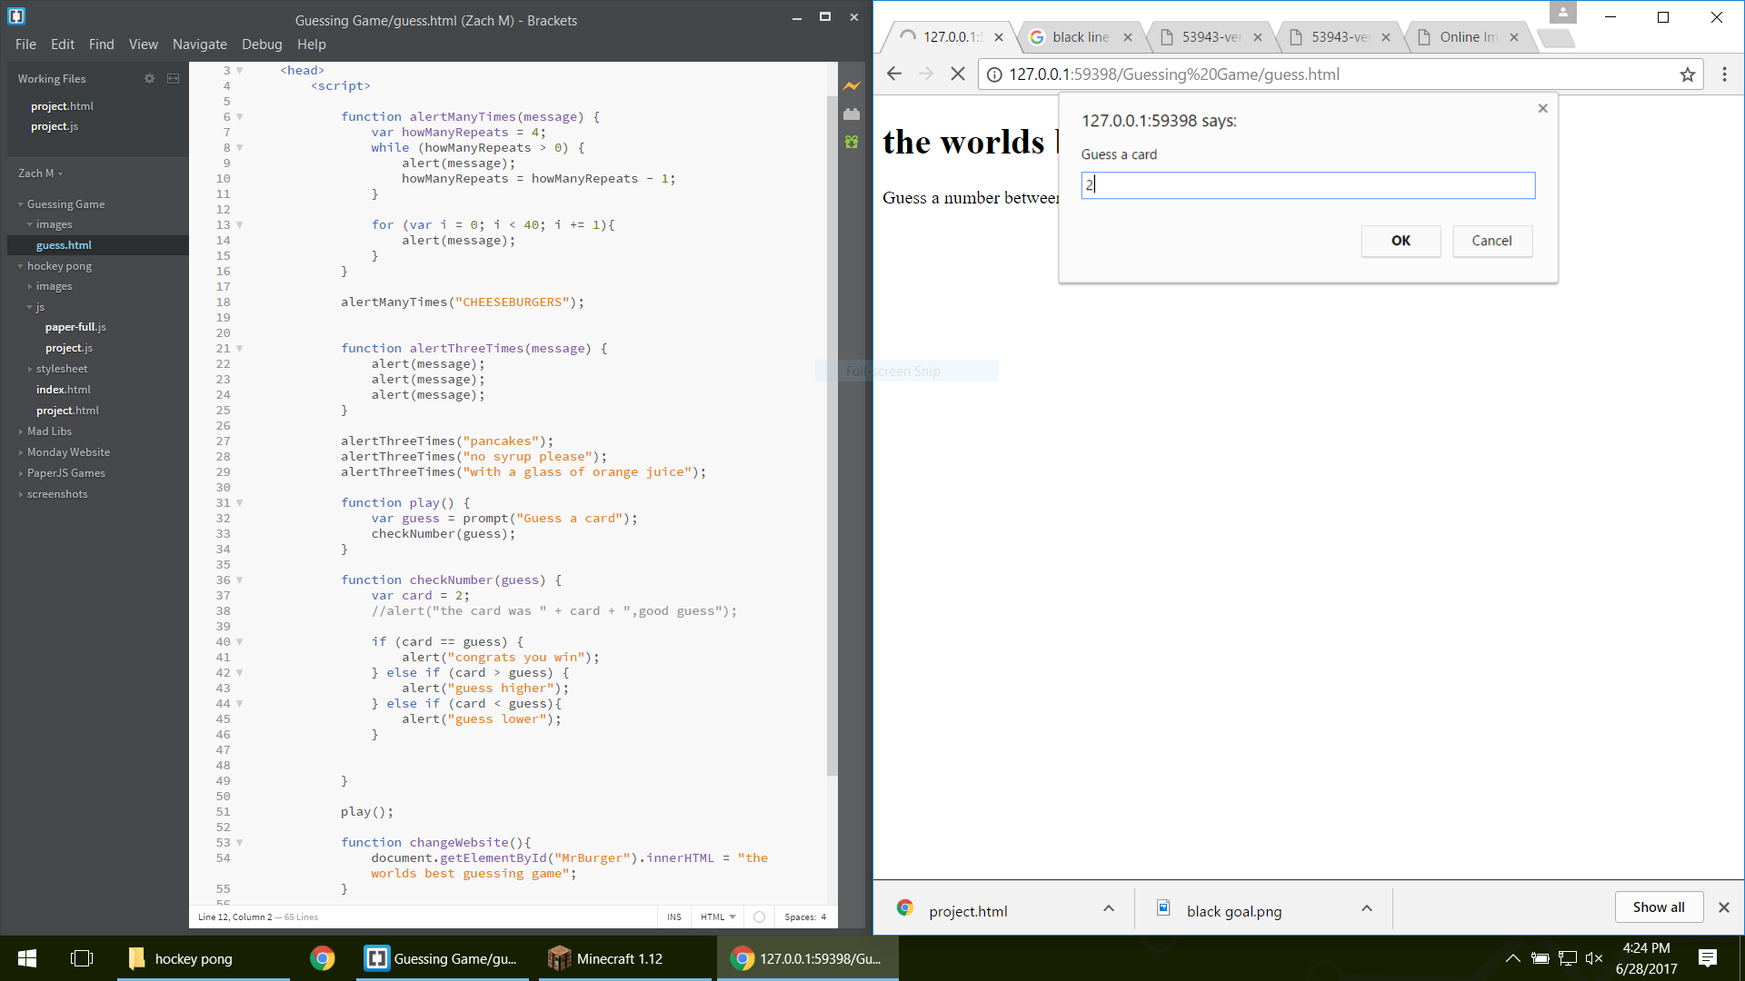
This is what I did on Tuesday

Slide 4
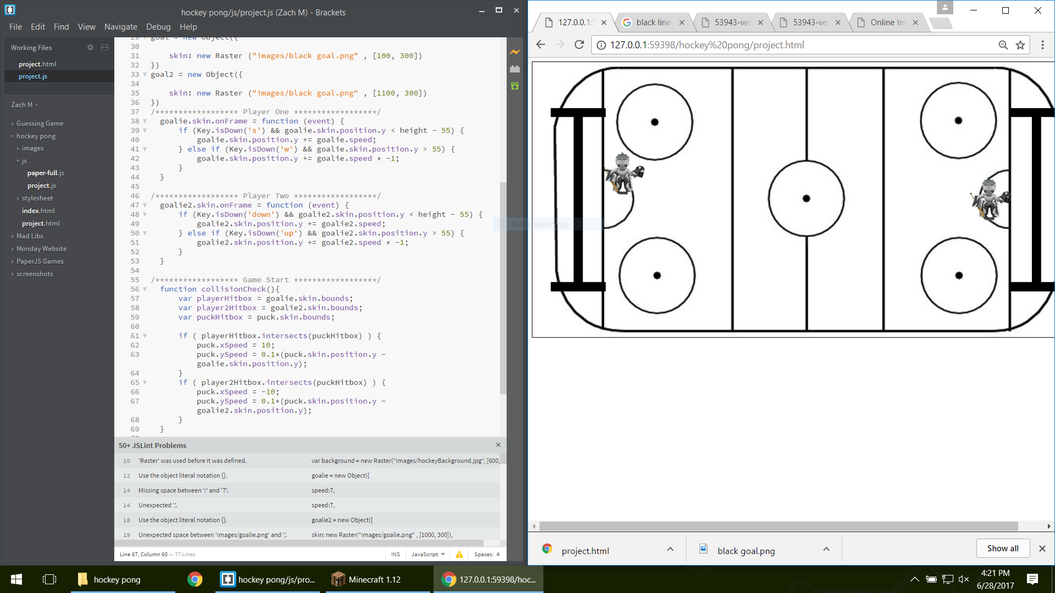
This is what I did on Wednesday

Slide 5
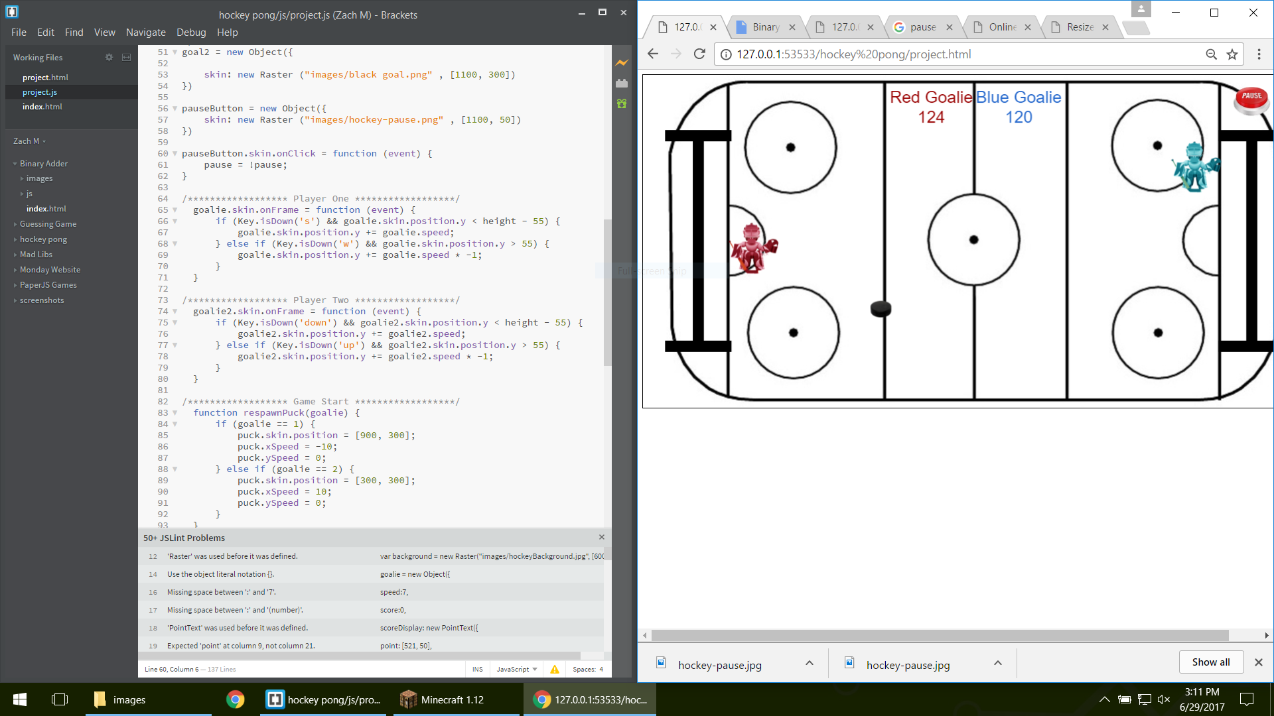
This is what I did on Thursday

Slide 6
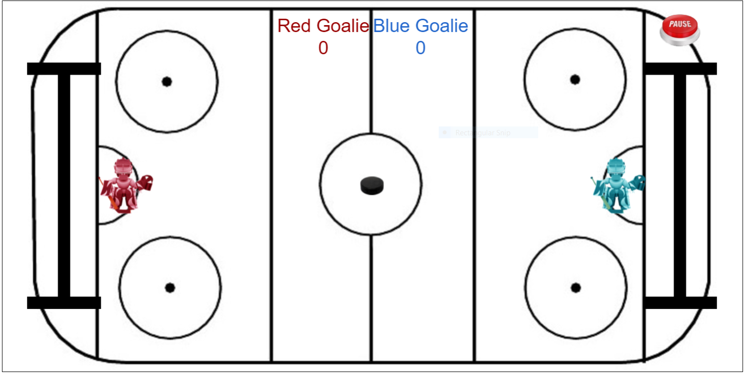
Hockey Pong
Controls: You use the up and down arrows and 'w' and 's'
Object of the game: to get the puck past the goalie and the goal line and then you get a point. Then first to however wins
Puck: the little black thing running across the ice
Goalies: the red and blue things hitting the puck

Slide 7
Questions?

